Slide 1
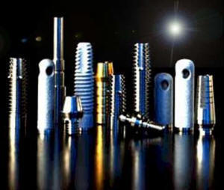
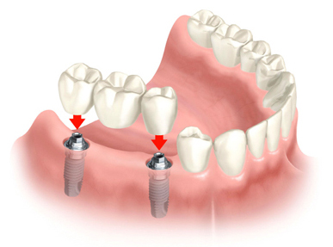
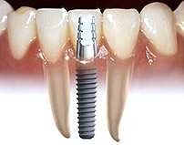
IMPLANT biomaterials

Slide 2
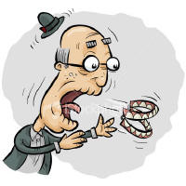
INTRODUCTION
IMPLANT DENTISTRY is a boon for restoration of missing teeth .
It overcomes many disadvantages of other conventional methods of restorations
i.e.,
with removable prosthesis
with fixed prosthesis .

Slide 3
WHAT IS IMPLANTATION?
IMPLANTATION – is defined as insertion of any object or a material , which is alloplastic in nature, either partially or completely into the body for therapeutic , experimental , diagnostic or prosthetic purpose .
- ANUSAVICE
Biomaterial :- Any substance other than a drug that can be used for any period of time as part of a system that treats, augments or replaces, any tissue,organ or function of the body. (GPT8)

Slide 4
FATHER OF IMPLANT DENTISTRY Per Ingvar Branemark

Slide 5
ADVANTAGES OF IMPLANT
to overcome the drawbacks of removable prostheses
Bone maintenance of height and width
Ideal esthetic tooth positioning
Improved psychological health
Increased stability in chewing
Increased retention
Eliminates need to involve adjacent teeth

Slide 6
Parts of Implant

Slide 7
Implant supported restoration

Slide 8
CLASSIFICATION OF DENTAL IMPLANTS

Slide 9
5 Types of classification
1.Based on implant design
2.Based on attachment mechanism
3.Based on macroscopic body design
4.Based on the surface of the implant
5.Based on the type of the material

Slide 10
CLASSIFICATION BASED ON IMPLANT DESIGN

Slide 11
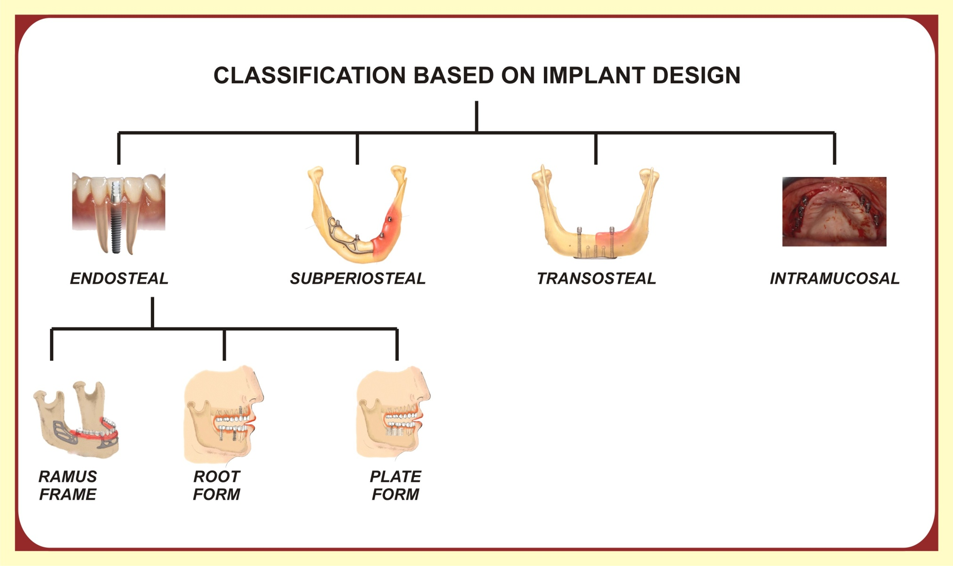

Slide 12
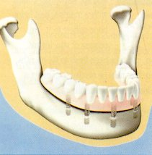
1.ENDOSTEAL IMPLANT
A device which is placed into the alveolar bone and/or basal bone of the mandible or maxilla
Transect only one cortical plate

Slide 13
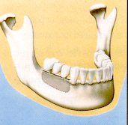
a) BLADE IMPLANT
It consist of thin plates in the form of blade embedded into the bone

Slide 14
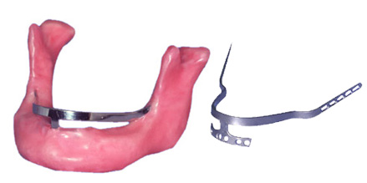
b) RAMUS FRAME IMPLANT
Horse shoe shaped stainless steel device
Inserted into the mandible from one retromolar pad to the other
It passes through the anterior symphysis area

Slide 15
c) ROOT FORM IMPLANT
Designed to mimic the shape of the tooth
For directional load distribution

Slide 16
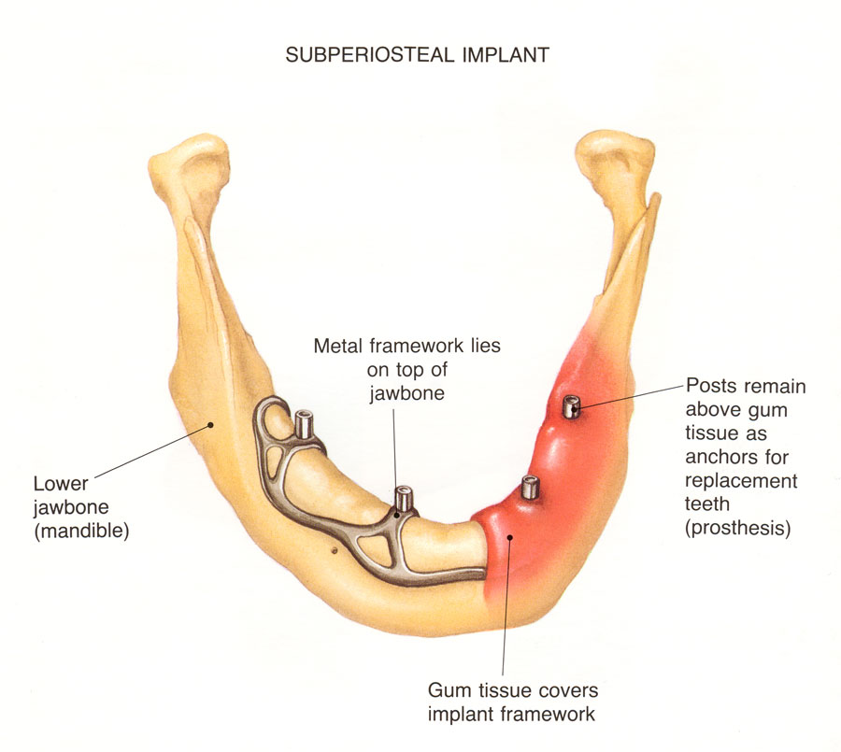
2. SUBPERIOSTEAL IMPLANT
Placed directly beneath the periosteum overlying the bony cortex

Slide 17
3. TRANSOSTEAL IMPLANT
Other names- staple bone implant
mandibular staple implant
transmandibular implant
combines the subperiosteal and endosteal components
Penetrates both cortical plates

Slide 18
3. TRANSOSTEAL IMPLANT

Slide 19
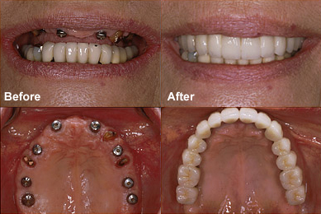
4.INTRAMUCOSAL IMPLANTS
Inserted into the oral mucosa
Mucosa is used as attachment site for the metal inserts

Slide 20
CLASSIFICATION BASED ON ATTACHMENT MECHANISM OF THE IMPLANT

Slide 22
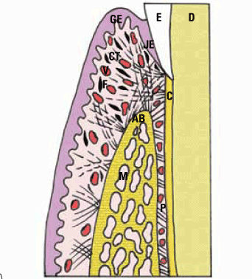
FIBROINTEGRATION
Proposed by Dr.Charles Wiess
Complete encapsulation of the implant with soft tissues
Soft tissue interface could resemble the highly vascular periodontal fibers of natural dentition

Slide 23
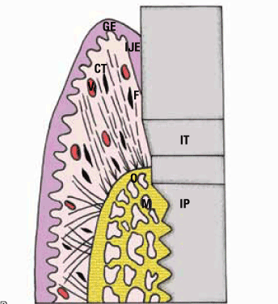
OSSEO-INTEGRATION
Direct contact between the bone and the surface of the loaded implant
Described by BRANEMARK
Bio active material that stimulate the formation of bone can also be used

Slide 24
CLASSIFICATION BASED ON MACROSCOPIC BODY DESIGN OF THE IMPLANT

Slide 26
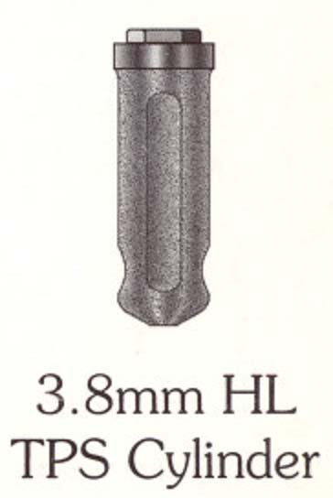
CYLINDRICAL DENTAL IMPLANTS
in the form of cylinder
Depends on coating or surface condition to provide microscopic retention and bonding to the bone
Pushed or tapped into a prepared bone site
Straight, tapered or conical

Slide 27
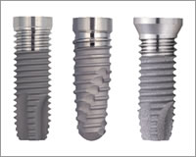
THREADED DENTAL IMPLANTS
The surface of the implant is threaded, to increase the surface area of the implant
This results in distribution of forces over a greater peri-implant bone volume

Slide 28
PLATEAU- DENTAL IMPLANTS
Plateau shaped implant with sloping shoulder

Slide 29
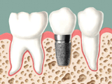
PERFORATED DENTAL IMPLANTS
The implants of inert micro porous membrane material (mixture of cellulose acetate ) in intimate contact with and supported by the layer of perforated metallic sheet material (pure titanium)

Slide 30
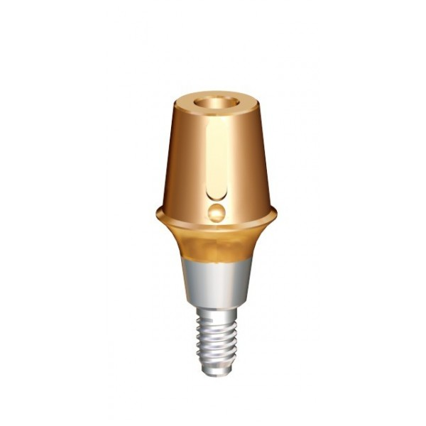
SOLID DENTAL IMPLANTS
They are of circular cross section without vent or hollow in the body

Slide 31
VENTED DENTAL IMPLANTS
It is hydroxy apetite coated cylinder implant patented vertical groove connecting to the apical vents were designed to facilitate seating and allow bone ingrowth to prevent rotation

Slide 32
HOLLOW DENTAL IMPLANTS
Hollow design in the apical portion
Systematically arranged perforations on the sides of the implant
Increased anchoring surface

Slide 33
CLASSIFICATION BASED ON THE SURFACE OF THE IMPLANT

Slide 35
SMOOTH SURFACE IMPLANT
It has a very smooth surface
To prevent microbial plaque retention, smooth surface is essential

Slide 36
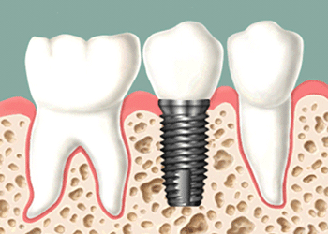
MACHINED SURFACE IMPLANTS
For the purpose of better anchorage of implant to the bone, the surface of the implant is machined

Slide 37
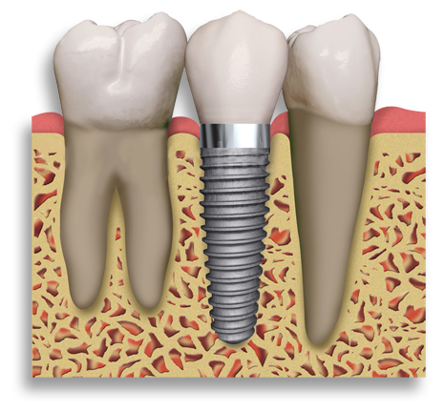
TEXTURED SURFACE IMPLANT
The implants of increasing surface roughness of the area to which bone can bond

Slide 38
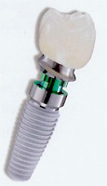
COATED SURFACE IMPLANT
The implant surface is covered with a porous coating
The materials used for coating are
titanium
hydroxy apatite

Slide 39
CLASSIFICATION BASED ON THE IMPLANT MATERIAL

Slide 40
Based on composition

Slide 41
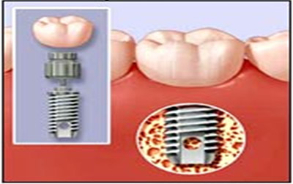
METALLIC IMPLANT
Most popular material in use today is TITANIUM
Other metallic implants are
stainless steel
cobalt chromium molybdenum alloy
vitallium

Slide 42
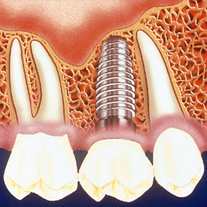
CERAMIC & CERAMIC COATED IMPLANTS
These materials are also used to coat metallic implants
These ceramics can either be plasma sprayed or coated to produce bio active surface.
Non reactive ceramic materials are also present

Slide 43
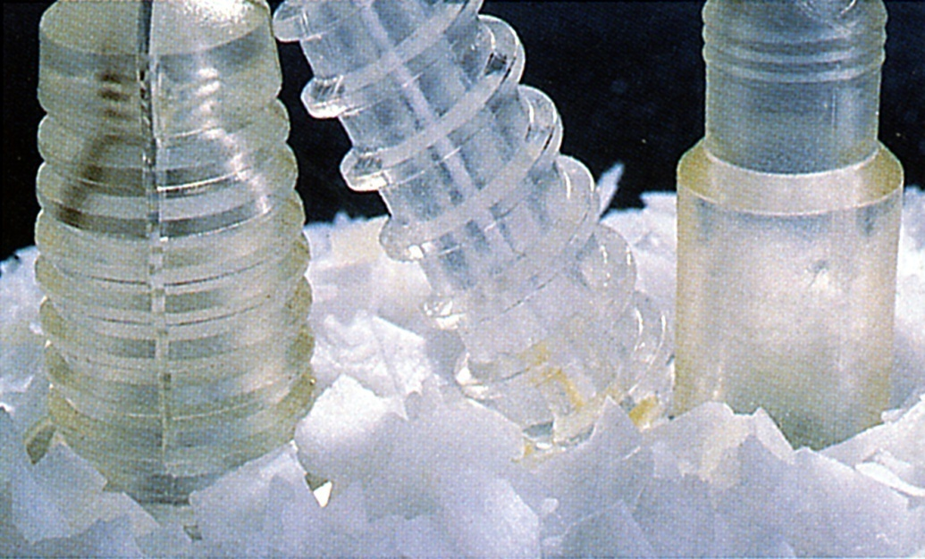
POLYMERIC IMPLANT
In the form of polymethylmethacrylate & polytetrafluoroethylene
Have only been used as adjuncts stress distribution along with implants rather than used as implants by themselves

Slide 44
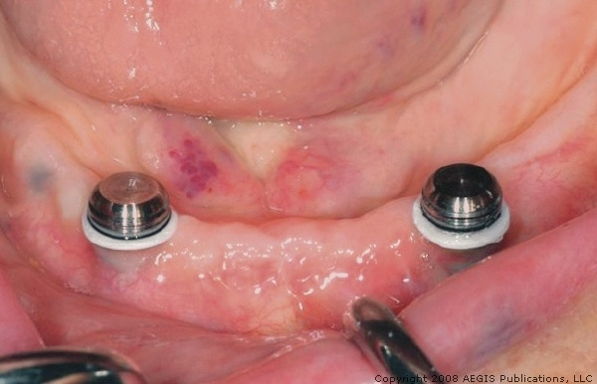
CARBON IMPLANTS
Made up of carbon with stainless steel
Modulus of elasticity equivalent to bone and dentine
Brittleness leads to fracture

Slide 45
Based on biocompatibilty and chemical composition

Slide 46
Bioinert
Minimal interaction
Stainless steel , Ti, Al, partially stabilized Zirconia and ultra hmwt Polyethylene
Bioactive
Interacts with surrounding bone
Synthetic hydroxy apetite, glass ceramic, Bioglass
Biotolerant
Resorbs and incorported into surrounding tissues
Tri Calcium phosphate
Bioresorbable
> Forms a layer of fibrous tissue around
> Gold, Co-Cr, polymers

Slide 47
Biological biocompatibility | Chemical composition
 | Metals | Ceramics | Polymers
BIOTOLERANT | Gold |  | Polyethylene
 | Cobalt-chromium alloys |  | Polyamide
 | Stainless steel |  | Polymethylmethacrylate
 | Zirconium |  | Polytetrafluoroethylene
 | Niobium |  | Polyurethane
 | Tantalum
BIOINERT | Commercially pure titanium | Aluminum oxide
 | Titanium alloy (Ti-6Al-4V) | Zirconium oxide
BIOACTIVE |  | Hydroxyapatite
 |  | Tricalcium phosphate
 |  | Calcium pyrophosphate
 |  | Fluorapatite
 |  | Carbon:vitreous, pyrolytic
 |  | Bioglass

Slide 48
Implant Biomaterials
Most of the materials used for implants are constructed from metals and their alloys. These includes Titanium, Tantalum, Aluminum, Vanadium, Cobalt, Chromium, Nickel and Molybdenum.
These are selected on the basis of their over all strength.
Less frequently used are precious metals as Gold and Platinum.
Most popular Ti and Ti alloys and calcium phosphate coated materials

Slide 49
Requirements of implant biomaterials
BULK PROPRTIES:-
Modulus of elasticity comparable to bone.
High tesile, comprssive and shear strength to prevent fractures and improve functional stability.
High yield strength and fatigue strength to prevent brittle fractures under cyclic loading.
Minimum 8% ductility
Increased hardness and toughness.
Minimum electrical and thermal conductivity to prevent thermal expansion contraction and galvanism

Slide 50
Requirements of implant biomaterials
SURFACE PROPERTIES:-
Surface tension and surface energy of 40dynee or more for adequate wettability and cleanliness of implant.
Biocompatibility
Corrosion resistence

Slide 51
Surface treatments to improve oxide layer :-
Passivation – immersion in 40% nitric acid
Anodization – electric current is passed thru implant
Ion implantation – bombarding the surface with high energy ions
Texturing -
Plasma spraying with Ti
Acid etching
Sand blasting with Aluminium oxide or ceramic

Slide 52
Titanium and alloys
Most popular implant biomaterial
It is available as
Commercially pure Ti - available in four grades
(- based on the incorporation of small amounts of oxygen, nitrogen, hydrogen, iron, and carbon during purification procedure) and
Two Ti alloys
Cp Grade I
Cp Grade II
Cp Grade III
Cp Grade IV
Ti-6Al-4V
Ti-6Al-4V (ELI Alloy)

Slide 53
COMPOSITION OF Cp Ti
Titanium 99.75%
Iron 0.05%
Oxygen 0.1%
Nitrogen 0.03%
Hydrogen 0.012%
Carbon 0.05%
2phases α and β
Manufactured by machining

Slide 54
Physical properties
Light wt & Low density 4.5g/cm³
High flexural strength
Modulus of elasticity 5times compact bone (104GPa)
Very resistant to corrosion
Exhibit passivation
Ability to form oxide layer within millisecond
Melting point – 1668⁰C

Slide 55
Cobalt Chromium Molybdenum Alloy
High modulus (stiffness) and Low ductility.
Outstanding resistance to corrosion
Excellent biocompatibility
Commonly used for fabrication of custom design (e.g. : subperiosteal frames) by casting.

Slide 56
IRON - CHROMIUM - NICKEL BASED ALLOYS
Surface is passivated to increase biocorrosion resistance.
High strength and ductility.
Used in wrought and heat treated condition.

Slide 57
Other Metals and Alloys
Gold, Platinum, Iridium and alloys of these metals are being used.
Have low strength that limits the implant design.
High cost and High density.
Due to its nobility and availability, gold is continued to be used as surgical Implant materials.

Slide 58
Ceramics and Carbon as implant Materials
CERAMICS
These are non organic, non metallic, non polymeric materials manufactured by compacting and sintering at elevated temperatures.

Slide 59
These are bio compatible high strength insulators.
Have low ductility and inherent brittleness are their limitations.
Classified into :
Bio active -Ca₃(PO₄), Hydroxyapatite
Bio non-reactive - Oxides of Aluminum, Titanium, Zirconium

Slide 60
ALUMINUM, TITANIUM, ZIRCONIUM OXIDES
Used for Endosteal root form, plate form implants
Have clear white cream or light grey color so used for anterior root form
Minimal biodegradation
High modulus of elasticity
Low fracture resistance
Exhibit direct interface with bone

Slide 61
POLYMERS AND COMPOSITES
These can be designed to match tissue properties and can be fabricated at relatively low cost.
These include polytetraflouroethylene (PTFE), polyethyleneterephthalate (PET), polymethylmethacrylate (PMMA),
polypropylene (PP),
polysulfone (PSF),
silicon rubber (SR)

Slide 62
PROPERTIES
Polymers have low strengths and elastic moduli and higher elongation to fracture compared with other class of biomaterials.
Relatively resistant to biodegradation compared to bone.

Slide 63
Conclusion
Most commonly used dental implant design is endosteal root form implants
Most popular implant biomaterial is Titanium
Used for fixed and fixed removable prostheses

