Slide 1
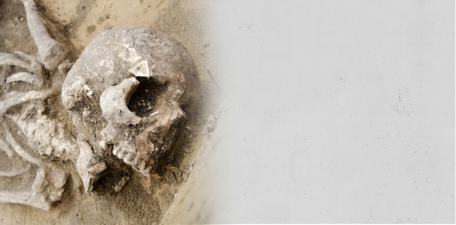
FORENSIC ODONTOLOGY

Slide 2
Contents
Introduction
Historical evidences
Scope and purpose
Personal identification
Basis of dental identification
Technique of identification
Identification in mass disaster
Sex differentiation
Dental age estimation
BITE MARK ANALYSIS
LIP PRINTS
AMELOGLYPHICS
FINGER PRINTS
ROLE OF RADIOGRAPHS
DENTIST AS AN EXPERT WITNESS
CONCLUSION

Slide 4
INTRODUCTION:
Forensic means legal: A word that comes from Latin, meaning “to the forum”.
The forum was the basis of Roman law and was a place of public discussion and debate pertinent to the law.
FDI defined it as “that branch of forensic medicine which in the interest of justice, deals with the proper handling and examination of dental evidence and also with proper evaluation and presentation of the dental findings”.

Slide 5
Forensic odontology involves the management, examination, evaluation and presentation of dental evidence in criminal or civil proceedings, all in the interest of justice.
The subject can be divided roughly into three major fields of activity: Civil or noncriminal, criminal and research

Slide 6
Civil class - malpractice and other aspects of fraud and neglect, in which compensation is sought. Identification of the dead and living also comes under this category.
Criminal sector – identification from bite marks that may be present on the victim, or on some inanimate objects such as food items.
Research field encompasses academic courses for undergraduate and postgraduate training, teaching Forensic dentistry to police and new research works.

Slide 7
Historical evidences
Dr. Oscar Amoedo, Paris, is considered as "Father of Forensic Odontology".
Dental evidence played a vital role in historical case of identification of Adolf Hitler. His dental findings were compared with antemortem dental records and radiographs .
Dentition was an important lead in the identification of remains of various leaders, who were killed, like Zia Ul Haq, former Pakistani President and Rajiv Gandhi, former Indian Prime Minister.

Slide 8
Mass disaster- World Trade Centre in September 11, 2001.
Recently in Nirbaya case suspects are confirmed , By Dr. Ashith Acharya using forensic odontology.
Federation Dentair International in 1968 has recommended to include forensic odontology in the curriculum of teaching institutions.
First formal instructional programme in forensic dentistry was given in United States at the Armed Forces Institute of Pathology

Slide 9
SCOPE AND PURPOSE :
Identifying Unknown Human Remains Through Comparison Of Postmortem Dental Evidence With Dental Records Of The Presumed Deceased.
Assisting At The Scene Of A Mass Disaster And In The Victims’ Identification.
Eliciting The Ethnicity/Population Affinity And Assisting In Building Up A Picture Of Lifestyle And Diet Of Skeletal Remains At Forensic And Archaeological Sites.

Slide 10
Assessing The Sex Of Skeletonized Remains.
Age Estimation Of Both The Living And Deceased.
Analysis And Identification Of Bite Marks Found On Human Tissue, Animal Tissue, And Inanimate Objects/Foodstuffs.
Presenting Evidence In Court As Expert Witnesses.

Slide 11
SCOPE AND PURPOSE :
Management and maintenance of dental records that comply with legal requirements
Identification of human remains by comparing antemortem and postmortem dental information.
Collection and analysis of patterned marks (bite marks) on inanimate material or injured tissue.
Recognition of the signs and symptoms of human abuse.
Assessment of the age of the person
Determination of sex of a person

Slide 12
REASONS FOR IDENTIFICATION OF HUMAN REMAINS
Criminal: Typically an investigation to a crime death cannot begin until the victim has been positively identified.
Marriage: Individuals from many religious backgrounds cannot remarry unless their partners are confirmed deceased.
Monetary: The payment of pension, life insurance and other benefits relies upon positive confirmation of death.
Burial: Many religions require that a positive identification be made prior to burial in geographical sites

Slide 13
Social: Society's duty to preserve human rights and dignity beyond life begins with identity.
Closure: The identification of individuals missing for prolonged periods can bring sorrowful relief to family members.

Slide 14
Personal identification
Identification is the establishment of a person’s individuality
Defined as ‘the characteristics by which a person may be recognized’.
Methods
Traditional methods
-visually recognizing body
-personal property such as clothing ,jewels etc
Burned or decomposed can be very difficult for friends and relatives

Slide 15
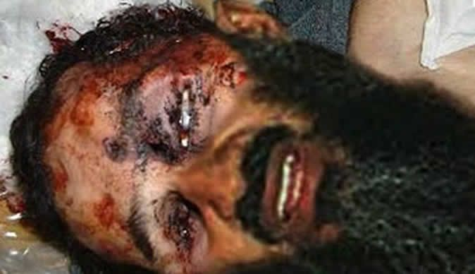
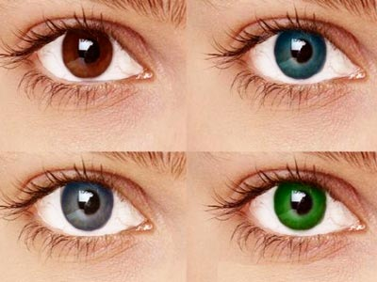
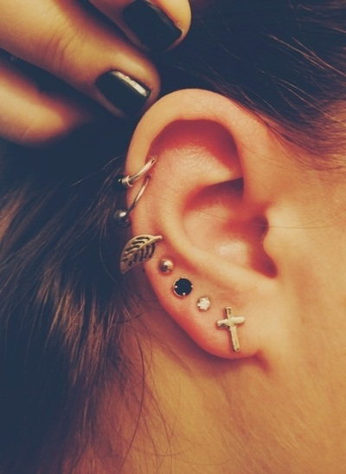
tattoo
jewels
Eye color

Slide 16
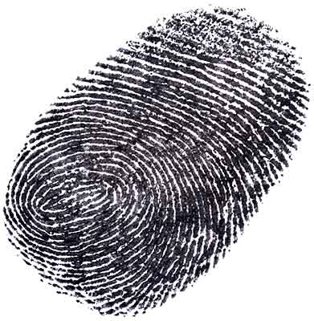
Analyze physical features:
Physical features- inherited and acquired
Inherited feature include ethnic characteristics
Acquired features- surgical scars, previous fractures, dental restorations.
Physical features –prone to change over time
Finger prints - undergo postmortem change

Slide 17
Dental hard tissues and Dental materials - resistant to post mortem decomposition
Dental evidence is the method of choice in establishing identity of badly burned, decomposed and skeletal remains

Slide 18
BASIS FOR DENTAL IDENTIFICATION:
Human Dentition is never same in any two Individuals
The morphology and arrangement of teeth vary from person to person
Dental identity -″total of all characteristics of the teeth and their associated structures which, while not individually unique, when considered together provide a unique totality”
Teeth are relatively resistant to environmental insults after death

Slide 19
TECHNIQUES OF IDENTIFICATION:
1)COMPARATIVE DENTAL IDENTIFICATION: attempts conclusive identification by comparing the dead individuals teeth with presumed dental records of the individual.
ORAL AUTOPSY
OBTAINING DENTAL RECORDS
COMPARING POST AND ANTEMORTEM DENTAL DATA
WRITING A REPORT AND DRAWING CONCLUSIONS
2) RECONSTRUCTIVE GROUPS:
Attempts are made to elicit age, sex, race, occupation etc leading to a probable identification.

Slide 20
3) DNA PROFILING: This method is used when dental record is not available for comparison. The technique uses modern forensic DNA profiling methods to oral tissues to establish identity

Slide 21
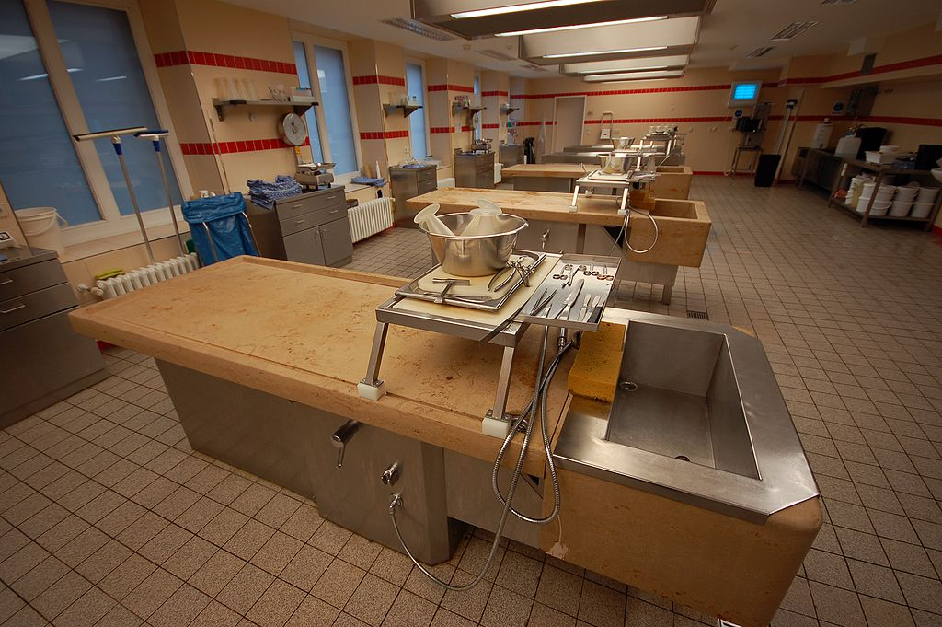
ORAL AUTOPSY
Autopsy is a highly specialized surgical procedure that consists of a thorough examination of a corpse to determine the cause and manner of death and to evaluate any disease or injury that may be present.
Performed for either legal or medical purposes
TYPES:
Forensic
Clinical or pathological
Anatomical
virtual

Slide 22
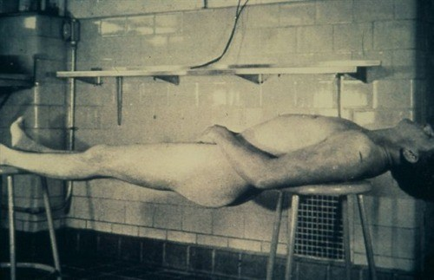
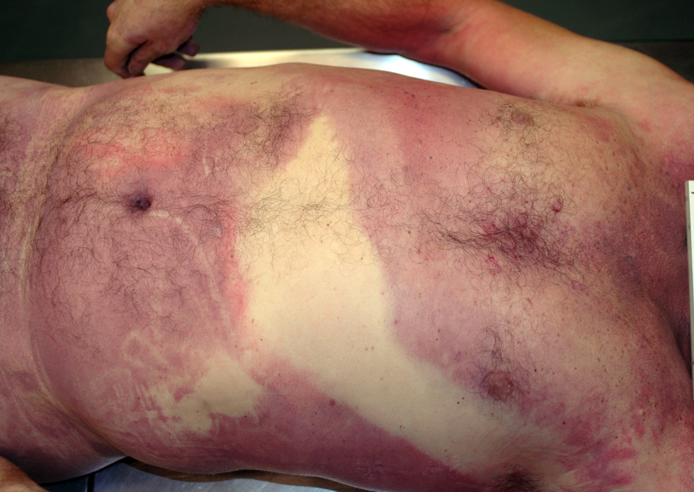
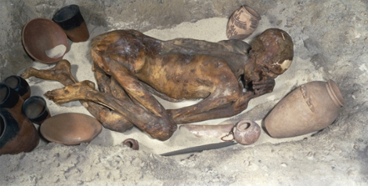
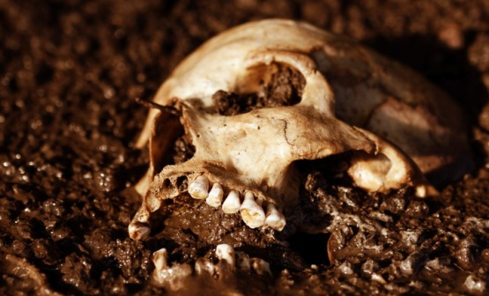
RIGOR MORTIS
LIVOR MORTIS
DECOMPOSED BODY

Slide 23
Critical examination –gender, ethnicity, build, wounds, scars, tatoos
Photographs, radiographs, fingerprints, finger nail scraping and hair sample may be obtained according to the requirements.
Oral examination is an essential part of post mortem procedures
Rigor mortis - use of mouth gags or intra oral myotomy is essential for jaw seperation.
Thorough examination of soft tissues injuries, fractures, each tooth (carious, restored, missing) should be noticed.

Slide 24
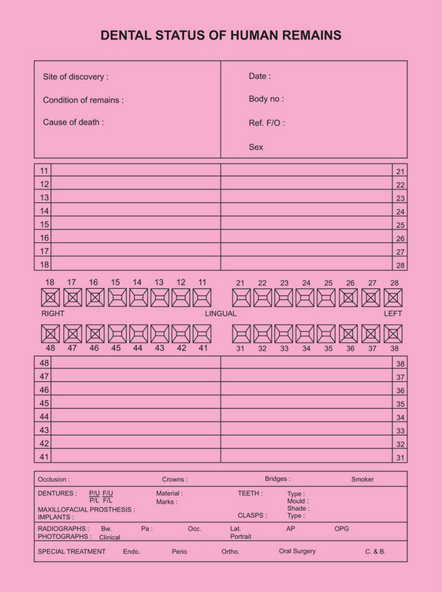
MODIFIED INTERPOL POSTMORTEM ODONTOGRAPH

Slide 25
Obtaining dental records
Dental records contain information of treatment undergone and dental status of a person during his/her life time and constitute the antemortem dental data.
Content of all available records should be transcribed on to the standard ‘interpol antemortem form’ which is colour coded in yellow

Slide 26
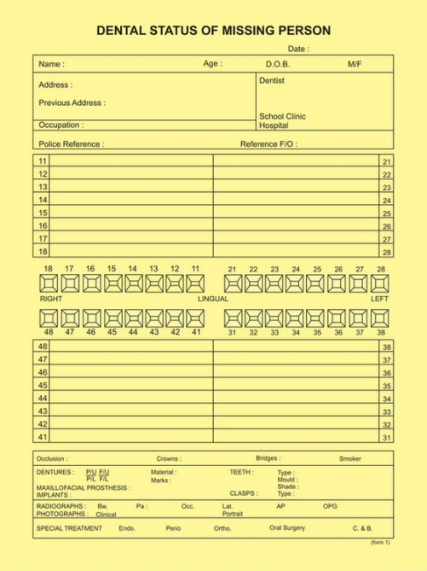

Slide 27
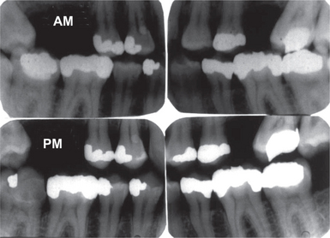
Comparing post mortem and ante mortem dental records
Features compared include tooth morphology and associated bony structures, pathology and restorations
An individual with multiple dental treatment and unusual features has a better likelihood of being identified than someone with no extraordinary dental characteristics

Slide 28
RESULTS/ CONCLUSION:
Positive identification: sufficient uniqueness among the comparable items.
Probable identification: high level of concordance among datas, may lack radiograph support.
Presumptive (possible) identification: enough information may be missing from either source.
Insufficient identification: insufficient supportive evidence.
Exclusion of identification: clearly inconsistent.

Slide 29
Problems with dental identification
1) Absence of antemortem records.
2) Absence of acquired dental tracts for identification.
3) Limitations for storing dental records for certain period.
4) Poor quality dental records.
5) In post mortem situation, all of the teeth may not be recovered as a result of post mortem trauma or loss of Pdl.
6) Fire can result in irreversible changes to restorations and teeth which can reduce the amount of information available for comparison.

Slide 30

Identification in mass disaster
The term "mass disaster" evokes images of a chaotic event.
The process of dental identification is same except the magnitude of event is far greater.
Mass disasters can be classified in one of three ways:
I . Natural
2. Accidental
3. Criminal
Large number of human remains
Fragmented and
incinerated or commingled
Tsunami in 2004

Slide 31

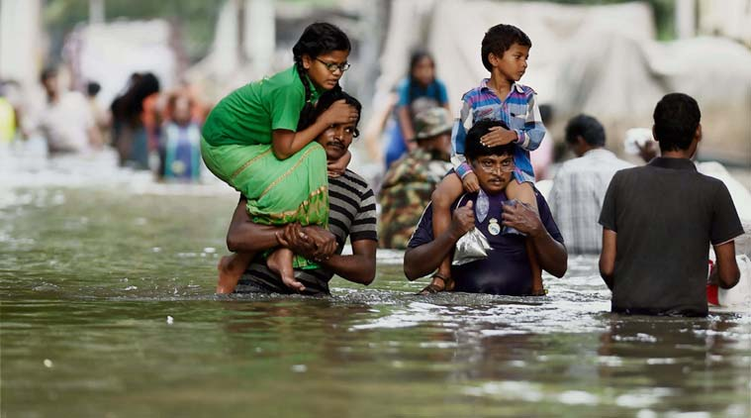
Natural mass disasters include earthquakes, tornadoes, volcanic eruptions, fire storms and floods.
Principal problem for the dental identification team → environmental infrastructure is often compromised. Dental offices containing antemortem records may be destroyed

Slide 32

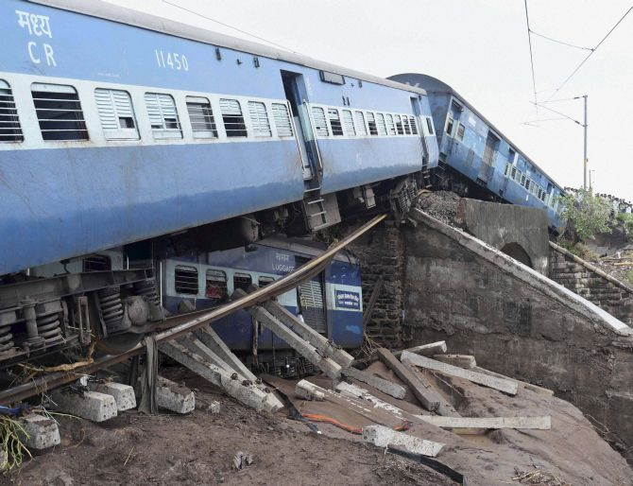
Accidental mass disasters are most often associated with transportation accidents, fires, industrial and mining accidents, and military accidents.
Occur over short periods, closed populations

Slide 33
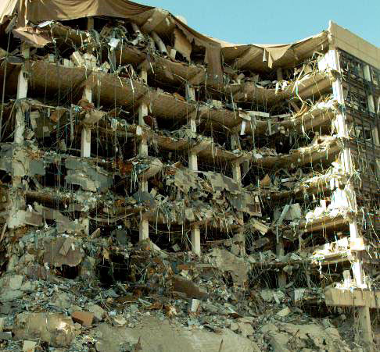
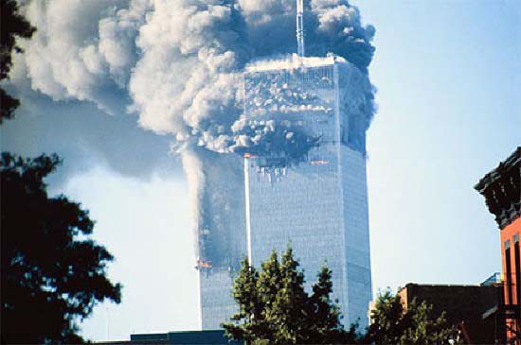
INTENTIONAL MASS DISASTERS
Bombing of buildings
World trade center attack in 2001

Slide 34
According to clark, 50% of identification are from dental evidence. So odontology is a part of team.
Clarke states- ‘dental examination is usually done after most other procedures such as photography, fingerprinting, and autopsy’.
Postmortem unit is responsible for processing the radiograph and also need to arrange photography of teeth.
Antemortem unit is most difficult. Dentist need to collect as mush information as possible in the shortest period of time.
Comparison by- IDENTIFY, ODONTID, CAPMI, IDIS softwares.

Slide 35
Reconstructive post mortem (dental profiling)
Dental profiling includes extracting a triad of information- race, gender, occupation & age.
According to Sweet and pretty- “The information from this process will enable a more focused search for ante mortem records”.

Slide 36
IDENTIFYING ETHNIC ORIGIN FROM TEETH
Traditionally, the human species has been categorized into three ‘races’ – Caucasoid, Mongoloid, Negroid.
Many of the best traits of estimation of race are found in the mid facial skeleton, including the area of nose, mouth and cheek bones.
Landmarks – a)shape of the cranium,
b)lateral projection of zygomatic arches,
c)shape and contour of the orbits and
d)nasal aperture.

Slide 37
GENETIC AND ENVIRONMENTAL INFLUENCES ON TEETH:
Scott and turner suggest - dental features have evolved over time as a result of genetic and environmental forces that have influenced different population groups.
complex mode of inheritance
combination of hereditary factors and environmental effects to which a person is exposed.
Dental features that have a stronger genetic and weak environmental influence are useful.
Dental features – metric (tooth size) and
non metric (tooth shape).

Slide 38
Metric features are based on measurements - considerably influenced by local environmental factors
Non metric in terms of presence or absence of a particular feature - are more inheritable.
Shovelling,
Carabelli’s cusp,
3 cusped maxillary 2nd molar
4 cusped mandibular molars
Odontome
Two rooted upper premolar
Two rooted upper molar
Two rooted lower canine

Slide 39
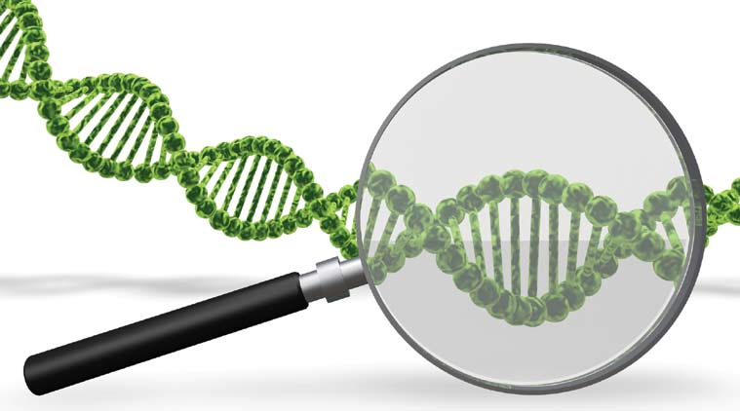
IDENTIFICATION FROM DENTAL DNA:
Teeth can resist extreme condition.
Pretty and Sweet state that teeth are an excellent source of DNA
Applied technique → polymerase chain reaction- allows amplification of highly degraded DNA.
This facilitates comparison with a known biological antemortem sample of the decedent such as hair from a comb, epithelial cells from a toothbrush or biopsy specimen.
Advantage: - DNA pattern can be compared to the parents or siblings, thus facilitating positive identification

Slide 40
Types of DNA:
Pretty and Sweet pointed out 2 types of DNA:
Genomic or Nuclear DNA: located in the nucleus of a cell and commonly used in nuclear studies.
Mitochondrial DNA: present in the mitochondria of cells.

Slide 41
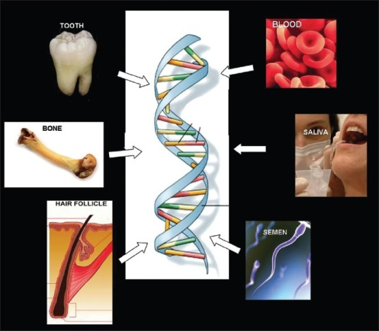
Extraction of dental DNA:
Tooth pulp is considered as the best source of dental DNA.
Ajayprakash and co-workers isolated DNA from dental pulp and accurately determined personal identity using HLA-DQ amplification.

Slide 42
Cytogenic grinding:
Advocated by Sweet and Hildebrand.
Technique:
cooling the whole tooth to extremely low temperatures using liquid nitrogen
mechanically grinding it to fine powder.
sufficient amount of DNA
(intact, carious as well root-filled teeth).
Disadvantage: - tooth needs to be completely crushed.

Slide 43
According to Trivedi and coworkers
less destruction method for DNA isolation.
opening of the root canals,
scraping the pulp area with a notched medical needle
subsequently flushing of the tissue debris.
This authors claim, ‘retains the morphology and physiology of the tooth’.

Slide 44
PALATAL RUGAE IN IDENTIFICATION:
Palatal rugae are ridges on the anterior part of the palatal mucosa on each side of the mid-palatal raphe behind the incisive papilla
A useful method of identification in edentate individuals.
The rugae pattern on the deceased’s maxilla or maxillary denture may be compared to old dentures
well protected by lips, check, tongue, buccal pad of fat and teeth in incident of fire and high impact trauma.

Slide 45
Can resist decomposition to an extent
Unique to an individual.
Seldom change shape with age and reappear after trauma or surgical procedures.
Classification of palatal rugae:
Acc to lysell,
Primary rugae (>5mm)
Secondary rugae (3-5 mm)
Fragmentary rugae (2<3 mm)
(Rugae <2 mm is not taken into consideration).

Slide 46
Analysis of rugae pattern
Thomas and Van Wyk traced rugae patterns from dentures on to clear acetate and then superimposed these tracings on photographs of plaster models.
Limson and Julian analyzed rugae pattern by a computer software and obtained 97% accuracy.
Ohtani and coworkers suggests - high accuracy can be obtained using straight forward visual comparison from dentures.

Slide 47
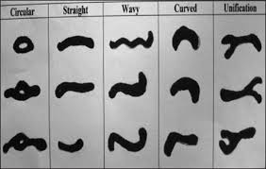
Patterns of palatal rugae: (a) curved, (b) wavy, (c) straight, (d) undetermined

Slide 48
Sex differentiation
Sex can be determined based on :
data from morphology of skull and mandible,
metric features
DNA analyses of teeth

Slide 49
Sexing from craniofacial morphology and dimension:
Acc. to Botha and Chandra- these features are not reliable until well after puberty.
Use of multiple features tend to be more accurate.
Williams and Rogers predicted sex using 6 more traits –
mastoid,
supraorbital ridge,
size and architecture of skull,
zygometic extension,
nasal aperture and
mandibular gonial angle- the accuracy was 94%.

Slide 50
Sex differences in tooth size
Sex differentiated - measuring mesiodistal and buccolingual dimensions of tooth.
Lund and Mornstad state that “This is of special importance in young individuals where skeletal secondary sexual characters have not yet developed”.
Canines - maximum sex difference,
Premolars, first and second molars as well as maxillary incisors are also have significant differences.

Slide 51
DENTAL INDEX:
Mandibular canines are found to exhibit the greatest sexual dimorphism amongst all teeth.
Mandibular canines - exposed to less plaque, calculus, abrasion from brushing, or heavy occlusal loading & less severely affected by periodontal disease and so they are the last teeth to be extracted with respect to age.
Mandibular canines - the key teeth for personal identification.

Slide 52
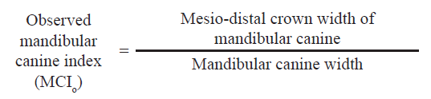

Slide 53
The cut-off point, or standard MCI value, obtained by Rao and associates was 0.274.
MCI value less than or equal to the standard MCI, the individual is female;
Value more than the standard MCI would group the person as male.
The success rate of determining sex using the standard MCI was almost 86%.

Slide 54
Measurement of mandibular canine width
Measurement of mandibular inter canine width

Slide 55
SEX DETERMINATION BY DNA ANALYSIS
Amelogenin (AMEL) –Major matrix proteins secreted by the ameloblasts of the enamel
AMEL gene coding → located on the X chromosome and the Y chromosomes in humans.
Females (XX) have two identical AMEL genes but the males (XY) have two non identical genes.
Preparing DNA from teeth authors obtained 100% success in determining sex of the individual.

Slide 56
Dental age estimation
Dental age is one of the few measures of physiologic development that is uniformly applicable from infancy to late adolescence
Age estimation using the dentition may be grouped into 3 phases.
1. Aging in prenatal, neonatal and early post natal
2. Age estimation in children and adolescents and
3. Age estimation in adults

Slide 57
Age estimation in prenatal,neonatal and early post natal children
Primary tooth germ forms→7th week in utero (IU)
Enamel formation of deciduous teeth →1st year.
Permanent first molar → germ formation →3.5 - 4 months IU.
Age estimation in this group - very accurate.
It makes use of histological techniques, which enable observation of tooth mineralization up to 12 weeks before it is actually apparent on radiographs.
The neonatal line - indicator of birth.

Slide 58
Age estimation in children and adolescents
Two events – A) tooth emergence or eruption and B) tooth calcification.
Deciduous teeth: emergence →genetic control→6M- 2.5 years.
Permanent teeth: under the influence of the intra oral environment, being affected by infection, arch space and premature tooth loss.
Methods: 1) tooth calcification
2) Demirjian’s method
3) value of 3rd molars

Slide 59
Evaluation of radiographs to assess tooth calcification is a much better alternative, since:
1) Calcification can be observed from radiographs for a period of several years.
2) It is not altered by local factors
3) The study of tooth calcification also let us assess age at periods when no emergence takes place (2.5-6 years and > 12 yrs).
Advantage- a)simple, b)easy to master
Age estimation - accurate.
Dental calcification - better indicator of age in first two decades of life

Slide 60
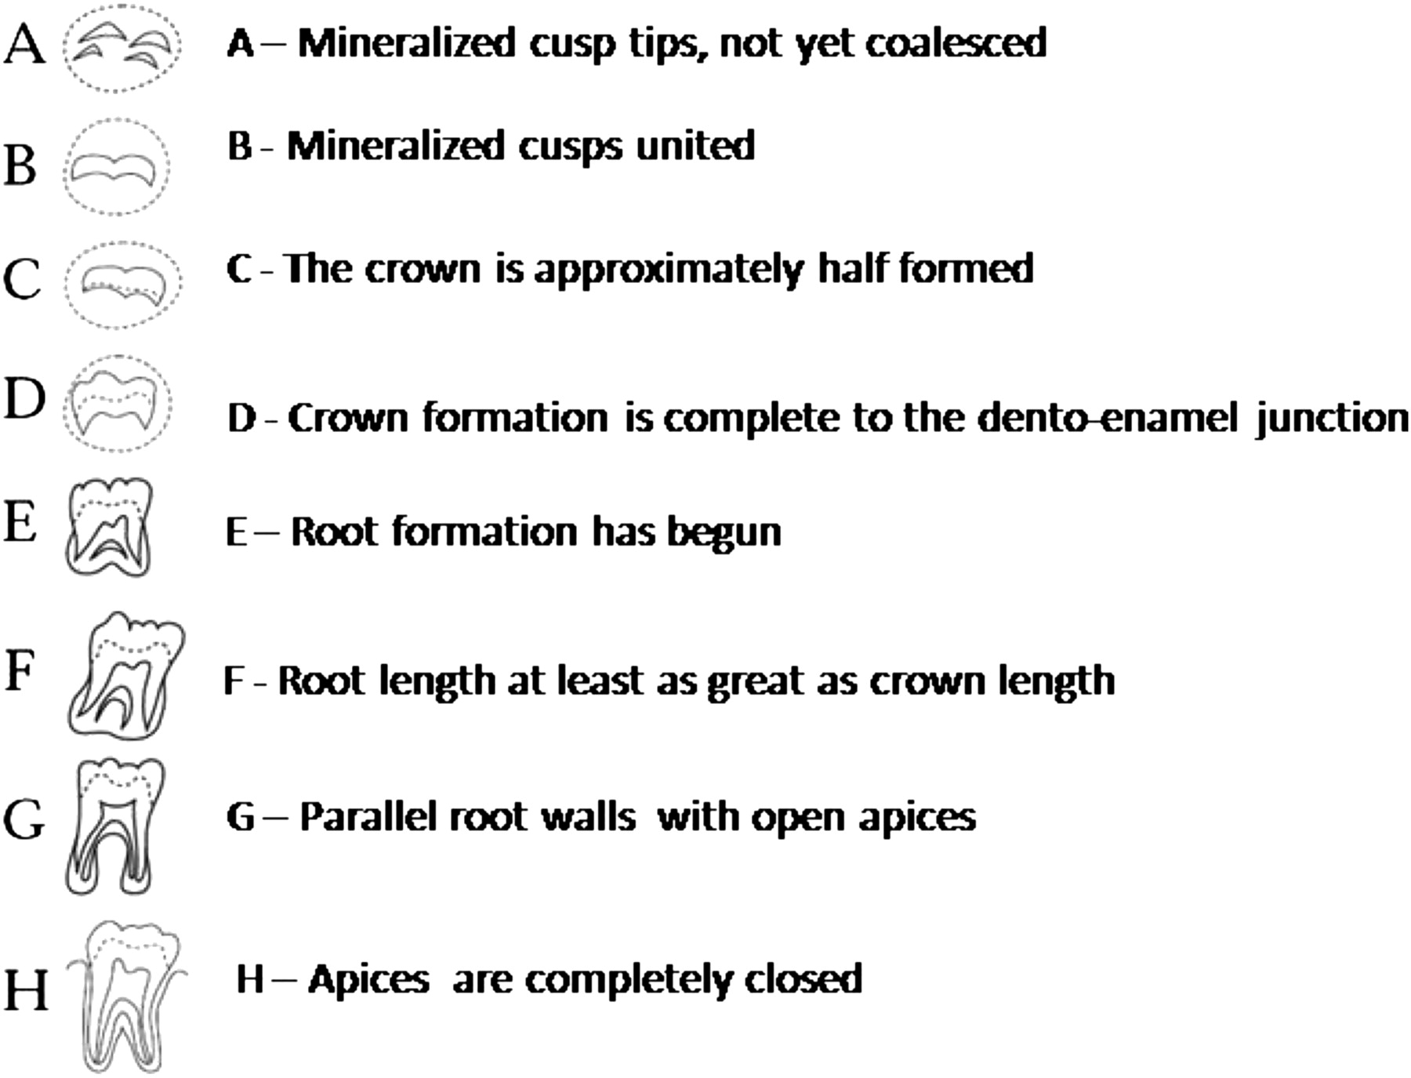
DEMIRJIAN’S METHOD
The development of seven mandibular teeth on the left side was divided into eight stages each.
These stages were named ‘A’ to ‘H’,

Slide 61
THIRD MOLARS IN AGE ESTIMATION
Valuable indicator of age in the age group of 16-23 yrs.
When all 4 third molars have completely calcified, the chances of the individual being 18 yrs old is 96.3% and 95.1% for males and females respectively.
When only one or two third molars present, the lower third molars are the best predictors of whether an individual is 18 yr old.

Slide 62
AGE ESTIMATION IN ADULTS
Age estimation in adults is challenging when compared to younger age groups - “are influenced not only by the age of the individual, but also by numerous endogenous and exogenous factors, such as disease, nutrition and physical strain”.
Methods:
Gustafson’s method
Dentin translucency
Incremental line of cementum
Amino acid racemization
Radiographic method of Kvaal

Slide 63
GUSTAFSONS METHOD
In 1950, Gosta Gustafson developed a method for age estimation based on morphological and histological changes of the teeth
Assessed regressive changes such as:
Amount of occlusal attrition (A)
Coronal secondary dentin deposition (S)
Loss of periodontal attachment (P)
Cementum apposition at the root apex (C)
Root resorption at the apex (R)
Dentine translucency (T)
Age was estimated using the formula 11.43+4.56X

Slide 64
Maples and Rice - Age=13.45+4.26X
Johanson made improvements in this and suggested another formula which is widely accepted
Age=11.02+5.14A+2.3S+4.14P+3.71C+5.57R+8.98T

Slide 65
DENTIN TRANSLUCENCY:
Root dentin → translucent → 3rd decade of life
Begins at the apex and advance coronally.
↓ Diameter of dentinal tubules - ↑ intratubular calcification - ↑ translucency.
Johnson- recognized it as best to age estimation.
Bang and Ramm- root translucency increases with age.

Slide 66
Age estimation from incremental lines of cementum
Kagerer and Grupe-- Acellular cementum incremental lines are used in estimation.
Mineralized unstained cross sections of teeth, preferably mandibular central incisors and third molars are used.
Author Claims accuracy to within 2-3 years of actual age.
Hypomineralized bands in the incremental line — indicates pregnancy, skeletal trauma and renal disorders which can be related to persons life-history → facilitating identification.

Slide 67
Radiographic method of Kvaal
Kvaal and associates developed a method that used pulp size measurements of six teeth.
Maxillary- central & lateral incisor, second premolar and
Mandibular- lateral incisor, canine and first premolar

Slide 68
The measurements included
pulp-root length(P)
pulp-tooth length(R)
tooth-root length(T)
pulp-root width at CEJ(A)
Pulp-root width at the mid root level(C)
Pulp-root width at mid point btw level C and A(B)
M- Mean values of all ratios excluding T
w- Mean values of width ratios B and C
L- Mean values of length ratios P and R
AGE=129.8 - 316.4 (M) - 66.8 (W - L)

Slide 69
Amino acid racemisation
All humans use amino acids exclusively in protein synthesis.
Aspartic acid is an amino acid that has a rapid rate of racemisation i.e., it gets spontaneously converted from one type (L-Aspartic acid) to another (D-Aspartic acid) with increasing age.
Constant change in the ratio of L and D aspartic acid at different ages and this ratio may be used for age estimation.
Racemisation rate of aspartic acid is high in root dentin
Age estimates within ± 3 years of actual age.

Slide 70
Key to optimal dental estimation
( Williems and associates):
Investigator should be sufficiently experienced
Second opinion is important
Use of multiple age estimation methods
Use of multiple teeth
Careful adherence to suggested protocol

Slide 71


Slide 72
Introduction:
Bitemarks have been defined by MacDonald as a” mark caused by the teeth either alone or in combination with other mouth parts”
ABFO defines bite-marks as “a pattern left in an object or tissue by the dental structures of an animal or human,”
During sexual attacks including sexual homicide, rape and child sexual abuse, bite marks are clustered around parts of body associated with sexuality

Slide 73
Sweet and pretty- “The size, shape and pattern of the biting edges of the anterior teeth in the upper and lower dental arches are considered to be specific to an individual”.
Rawson and associates have mathematically calculated that biting edges (incisal edges) of the twelve anterior teeth can be arranged in 1.36 X 10²⁶ different combinations

Slide 74

Classification of Bite Marks:
A. Cameron And SIMS Classification:
This is based on the type of agent producing the bite mark and material exhibiting it.
1. Agents:
a) Human
b) Animal
2. Materials:
a) Skin, body tissue
b) Food stuff
c) Other materials

Slide 75
B. Mac Donald’s Classification:
a) Tooth Pressure Marks: Marks produced on tissues as a result of direct application of pressure by teeth. These are generally produced by the incisal or occlusal surfaces of teeth.
b) Tongue Pressure Marks: When sufficient amount of tissue is taken into mouth, the tongue presses it against rigid areas.
c) Tooth Scrape Marks: These are caused due to scraping of teeth across the bitten material. They are usually caused by anterior teeth and present as scratches or superficial abrasions.

Slide 76
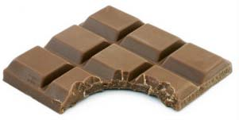
Webster’s–foodstuff- theft/robbery
Type 1- food item fractures readily-limited tooth penetration eg- hard chocolate
Type 2- considerable food penetration eg- apple & other firm fruits
Type 3- complete penetration of food item with slide marks-eg cheese

Slide 77
Description of some types of bite marks:
Sexually Oriented bites- inflicted slowly and deliberately with suction applied to the tissue by tongue and lips.
exhibits central or peripheral "suck marks" and marks of- anterior teeth with good definition.
Child abuse cases: In the child abuse cases either aggressive (anger bite marks) or sexually oriented type of bite marks are seen.

Slide 78
Self inflicted bite marks: Mostly found on the forearms of children caused by themselves.
Mentally retarded and psychologically disturbed people may also inflict bite on themselves.
Lesch-Nyhan syndrome, a X-linked, recessively transmitted disease with insensitivity to pain.

Slide 79
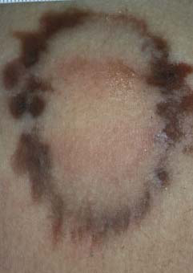
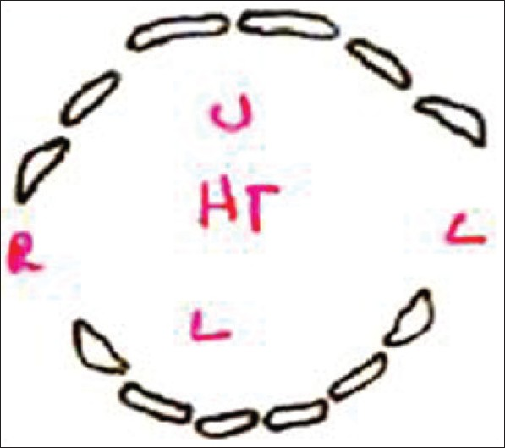
Identifying injury as a bite mark
Gross features:
-circular/elliptical mark - upper & lower arch
-central area ecchymosis - sucking action
Class features: differentiate b/n tooth type
-incisors - rectangular
-canines - triangular
-premolars + molars – spherical/point shaped
- Depends on attrition
Individual features: fractures/rotations/spacing

Slide 80
Sites of bite marks
Females are usually bitten - breasts, abdomen, thighs, buttocks and pubis, while
Men are usually bitten - back, arms, shoulders, chest and penis.
In cases of self-defense the victim can bite on the hands and arms of an assailant.

Slide 81
Factors influencing the bite marks:
Type of tissue:
loose or with excessive fat - bruising leading to poor definition.
Fibrous tissue or with high muscle content - bruise less, definition is good.
Age: Infants and old individuals bruise more than other age groups.
Sex: Females tend to bruise more than males. Once produced bitemarks will be evident for longer period of time in females compared to males.

Slide 82
Medical status- bleeding disturbances, under anticoagulant therapy, skin diseases → bruise more.
Time: Depression produced in the skin due to bitemarks will recover within 10-20 minutes leaving swelling and discoloration.
After death skin tends to contract, harden and decompose

Slide 83

Bite mark cases have to be dealt step by step in the following way:
Description of bite marks.
Collection of evidence from the victim.
Collection of evidence from the suspect.
Bite marks comparison.

Slide 84
Description of bite marks:
Both in the living and deceased victims the following vital information should be recorded.
Demographics:
Name, age, sex, race, case number, date of examination, and name of the examiners should be recorded.
Location of the bite mark:
Anatomic location, contour - flat, curved or irregular and state the tissue characters
Skin - fixed or mobile.
Underlying tissue - bone, cartilage, muscle or fat.

Slide 85
Shape of the bite marks:
round, ovoid, crescent or irregular in shape.
Color of the mark:
Size of the mark:
Both vertical and horizontal dimensions should be recorded in metric system.
Type of injury:
Petechial hemorrhage, Contusion, Abrasion, Laceration, Incision, Avulsion.

Slide 86

II. Data collection from the victim:
Steps in the examination of the victim:
A. Visual Examination- Type of injury, Contour & texture, Physical appearance (color and size), location
If the victim is dead, visual examination must be done before an autopsy.
B. Photographs of the bite marks should be made immediately.
Orientation photographs
Close-up photographs

Slide 87

C. Salivary swabbing:
Saliva deposited on skin may have WBCs and sloughed epithelial cells which may be a source of DNA, enabling direct link to the suspect
D. Impression of bite marks

Slide 88
III. Examination of the suspect:
History of dental treatments after or just before the bite mark has to be noted.
Photographs:
Full face, frontal, occlusal and lateral views of the dental arches should be taken.
Examination:
TMJ status, facial asymmetry, muscle tone, maximum opening of mouth, deviation while opening and closing movements, Tongue movements, periodontal status should be noted. Special attention should be given to the arrangement of dentition.
Saliva swabbing should be performed
Upper and lower dental models should be prepared.

Slide 89
IV. Evaluation of evidence
While evaluating the bite mark first the cause of the mark has to be determined, since bite marks may be caused by nonhumans or humans.

Slide 90
HISTOPATHOLOGICAL CHANGES IN BITE MARKS
•Stage 1 –0 to 18 hrs – Scab formation
•Stage 2 –30 to 70 hrs‐ Epithelial regeneration
•Stage 3 –5 to 12 days ‐ Subepidermal granulation
•Stage 4 –after 12 days – Regression

Slide 91
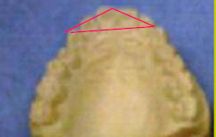
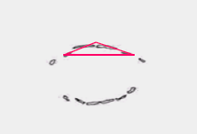
METHODS OF BITE MARKS ANALYSIS:
Odontometric triangle method:
A triangle is made on the tracing of bite marks and teeth models by marking three points, two on the outer most convex point of canines and one in the centre of the upper central incisors.
Three angles measured and compared

Slide 92
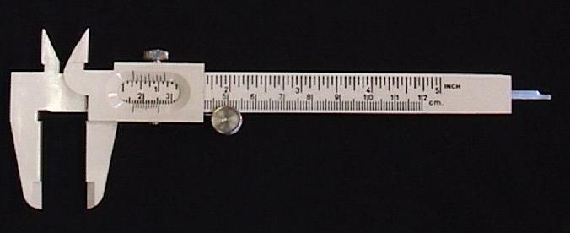
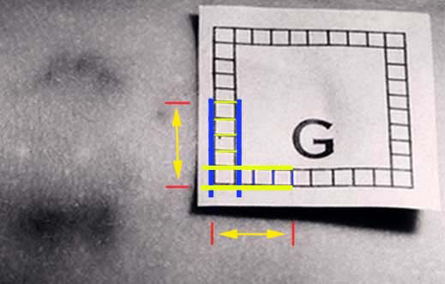
Metric analysis
Vernier Calipers
Computer digitization method

Slide 93
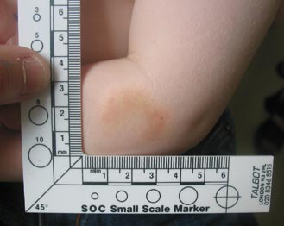
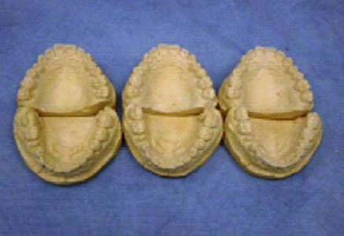
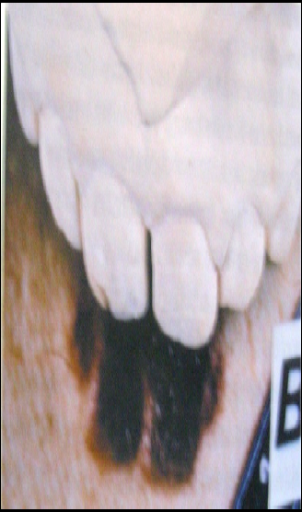
Pattern Association
Bite mark photograph from victim
Models from suspect
Comparison
Direct method- suspects model are placed directly over the bite mark photograph
Indirect method- incisal and occlusal edge of the suspect’s teeth may be traced on to clear acetate and superimposed on life-size bite mark photographs.

Slide 94
CONCLUSIONS OF BITE MARK ANALYSIS
By Levie
Positive identification: characteristic matches between the bite mark pattern and the pattern of the suspect's teeth.
Possible identification:
This implies that although the suspect's teeth could have made the bite mark, there are no characteristic matches to be absolutely certain.
Excludes identification:
When features on the bitemark indicate that the suspect's teeth could definitely not have caused them, it represents a Negative or exclusion.

Slide 95
Cheiloscopy
Cheiloscopy is a forensic investigation technique that deals with identification of humans based on lips traces.
Lip prints have to be obtained within 24 hours of time of death to prevent erroneous data that would result from post mortem alterations of lip.
Pattern depends on whether mouth is opened or closed.
Closed mouth position - well defined grooves
Open position - ill defined and difficult to interpret

Slide 96
Classification of lip prints
By Santos in 1967
Simple wrinkles
• Straight line
• Curved line
• Angled line
• Sine-shaped curve
Compound wrinkles
• Bifurcated
• Trifurcated
• Anomalous

Slide 97
Suzuki and Tsuchihashi (1970)
Type I - Clear-cut vertical grooves that run across the entire lip
Type I' - Similar to Type I, but do not cover the entire lip
Type II - Branched grooves
Type III- Intersected grooves
Type IV - Reticular grooves
Type V - Grooves that cannot be morphologically differentiated.

Slide 98
A combination of these grooves may be found on any given set of lips.
To simplify recording, the lips are divided into quadrants similar to the dentition - a horizontal line dividing the upper and lower lip and a vertical line dividing right and left sides.
By noting the type of groove in each quadrant, the individual's lip print pattern may be recorded

Slide 99
Lip prints are usually left at crime scenes and can provide a direct link to the suspect.
Traditionally, the use of lipsticks was essential to leave behind colour traces of lip prints.
In recent years, however, lipsticks have been developed that do not leave any visible trace after contact with surfaces such as glass, clothing, or cigarette butts.

Slide 100
Disadvantage of Lip Print Investigation:
Major trauma to the lips can result in scarring.
Surgical treatment rendered to correct any abnormality also affects the size and shape of the lips, thereby altering the pattern and morphology of the grooves.
The prints produced may differ in appearance depending on the pressure applied and its direction.

Slide 101
Use of Ameloglyphics in Personal Identification
Tooth prints are the pattern formed by the enamel rod ends at the crown surface of the tooth.
they have categorized tooth prints into eight different pattern
no two teeth have similar pattern
doubts regarding its forensic value since enamel undergoes regressive changes and the course taken by the enamel rods vary at different levels of the enamel.

Slide 102
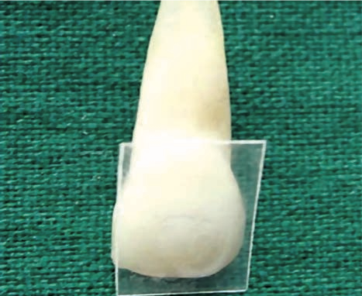


Slide 103
AMELOGLYPHICS
The study of the enamel rod end patterns is known as Ameloglyphics (amelo-enamel; glyphics-carvings)
The basic structural unit of enamel is the enamel rods (enamel prisms).
The uniqueness of these tooth prints may be utilized as a successful identification tool in forensic science.
Teeth - most indestructible components of the human body → highest resistance to most environmental effects like fire, desiccation and decomposition → possible tool for personal identification of an otherwise unrecognizable body

Slide 104
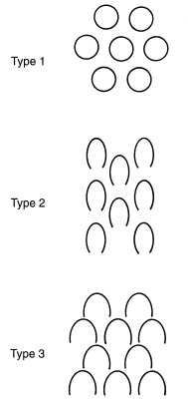
The shape of the enamel prisms approximates to one of the three main patterns
Pattern I: Prisms are circular.
Pattern II: Prisms are aligned in parallel rows.
Pattern III: key hole appearance.

Slide 105
ORIENTATION OF ENAMEL RODS
The general orientation of the enamel rods is perpendicular to the dentin surface.
In deciduous teeth, the enamel rods lie in a horizontal plane in the cervical and middle third. They gradually become more oblique in the incisal and occlusal third and are almost vertical in the incisal edge or the cusp tip.
In permanent teeth, the arrangement is similar to deciduous teeth in the occlusal and middle third; in the cervical third, the enamel rods show a rootward inclination or pass outward.

Slide 106
ACID ETCHING
The acid etching on the surface enamel results in the removal of the surface mineral component in the rod and rod sheath.
The effect of acid etching on enamel depends on:
Kind of acid used.
Acid concentration.
Etching time.
Form of etchant
Rinse time
About 10% orthophosphoric acid in gel form is the most commonly used acid to condition the enamel for in vivo studies.

Slide 107
Peel technique
A peel is a replica of an acid-etched mineral surface, made on acetate film.
Simple,
Inexpensive, and
Rapid way of making replicas of dental hard tissue surfaces.
The peel can be examined under microscope

Slide 108


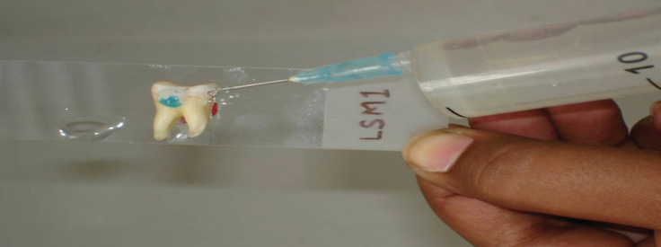
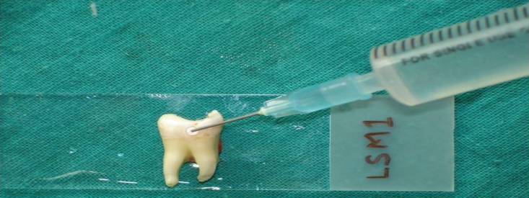
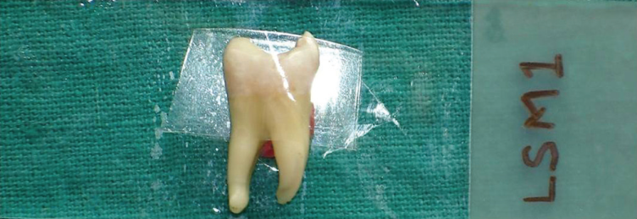
METHOD TO BE FOLLOWED
Teeth should to be scaled and polished.
Central region of the buccal/lingual surface chosen as the representative area.
Chosen area etched with 37% orthophosphoric acid for 30 s.
Rinse with water and dry the conditioned surface.
A drop of acetone to be applied on to the tooth surface and covered by cellulose acetate film and left undisturbed for 20 min

Slide 109
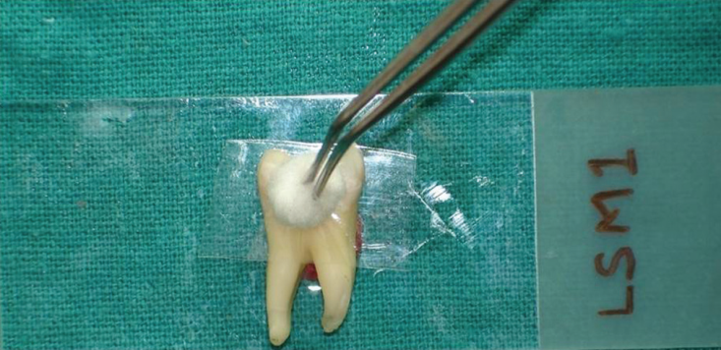
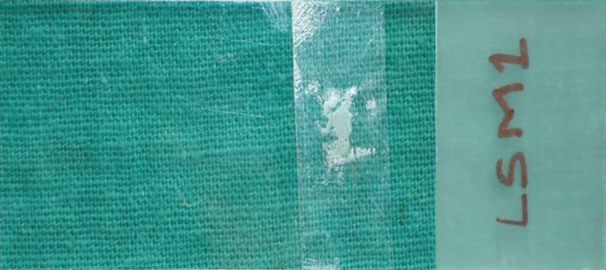
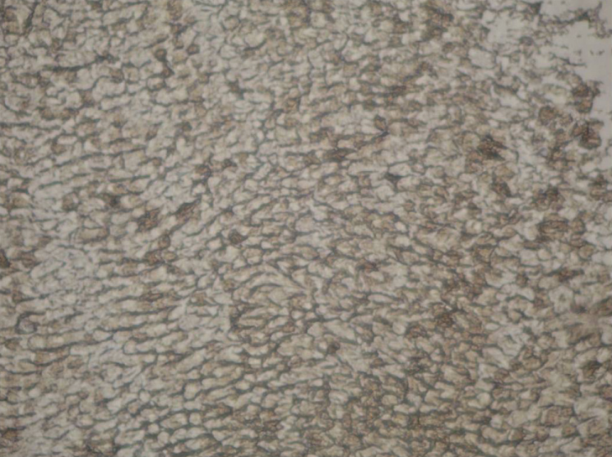
The tape was then pulled away gently and transferred onto a clean glass slide for microscopy
Slides observed under light microscope attached with a digital camera. The area of interest was viewed under different magnifications.
The digital image was then subjected to biometric conversion using fingerprint analysis software. The software used recognizes and compares prints for similarities and dissimilarities.

Slide 110
USES
used as an adjunct with other methods for personal identification.
simple, inexpensive, and rapid method which can be performed by even a dental auxiliary staff.
Can be included as adjunct ante-mortem dental records of fire fighters, soldiers, jet pilots, divers, and people who live or travel to politically unstable areas.

Slide 111
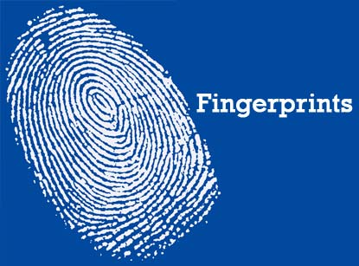

Slide 112
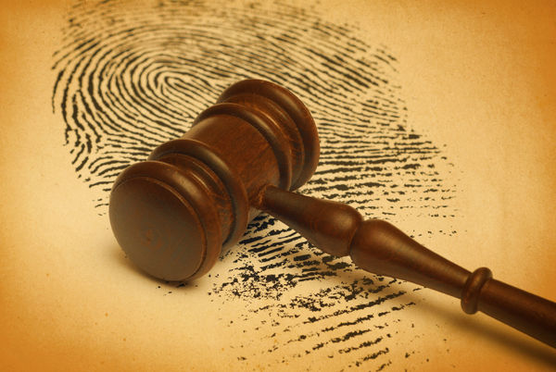
FINGERPRINTS
The analysis of finger prints as a form of identification has been used since time immemorial.
No two finger prints even in a given individual have been found to have the same ridge pattern and this remains unchanged throughout life.
This uniqueness in its presentation is the very fact that the analysis of finger print offers an excellent means of forensic investigations

Slide 113
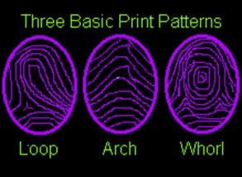
The broad Classification patterns or Ridge formation classes of prints used are:
arch,
loop &
whorl.

Slide 114
Human fingerprints are detailed, presumed to be nearly unique, difficult to alter, and durable over the life of an individual, making them suitable as long-term markers of human identity.
They may be employed by police or other authorities to identify individuals who wish to conceal their identity, or to identify people who are incapacitated or deceased and thus unable to identify themselves, as in the aftermath of a natural disaster.
used by police agencies around the world to identify suspected criminals as well as the victims of crime

Slide 115
LOSS OF FINGER PRINT
Adermatoglyphia is characterized by the absence of fingerprints. Affected persons have completely smooth fingertips, palms, toes and soles, but no other medical signs or symptoms
Ectodermal dysplasia, also have no fingerprints
Anti-cancer medication capecitabine may cause the loss of fingerprints
DISADVANTAGE
Finger prints - undergo postmortem change

Slide 116


Slide 117

Child abuse
Child abuse may be defined as any act of commission that endangers or impairs a child's physical or emotional health and development.
Such acts include physical, sexual, or emotional abuse, as well as physical neglect, inadequate supervision, and emotional deprivation.
Most of the abusers (offenders) are the family members or relatives of the children.

Slide 118
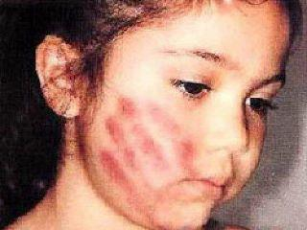
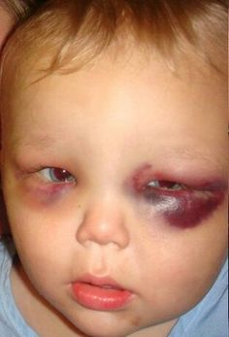
Oral findings in Physical abuse:
Craniofacial, head, face, and neck injuries occur in more than half of the cases of child abuse.
A careful and thorough intraoral and perioral examination is necessary in all cases of suspected abuse and neglect.
Oral cavity may be a central focus for physical abuse because of its significance in communication and nutrition.
The abuse may result in: contusions, burns, or lacerations of the oral cavity; or facial bone and jaw fractures.

Slide 119
BITE MARKS IN CHILD ABUSE
Acute or healed bite marks may indicate abuse.
Bite marks should be suspected when ecchymoses, abrasions, or lacerations are found in an elliptical or ovoid pattern
Bite marks may have a central area of ecchymoses
The pattern, size, contour, and color of the bite mark should be evaluated by a forensic odontologist or a forensic pathologist

Slide 120
DOCUMENTING AND REPORTING CHILD ABUSE
When one suspects child abuse, it is important to document the findings thoroughly.
This record of the evidence is crucial for whatever legal proceeding may follow.
Documentation may involve written notes, photographs, and radiographs. Videotapes or audiotapes may be helpful.
The report can be made to the local police agency or welfare department or to a local agency for other supportive information.

Slide 121
Use of Radiology in Forensic Dentistry
Radiographs being non destructive method play a vital role in forensic dentistry to uncover the hidden facts which can't be seen by means of physical examination.
Helped to solve difficult cases in the forensic science.
Uses:
1) Identification of Victims:
Determine age of an individual by assessing the stage of eruption of teeth.
Skull radiographs can be used in identification by superimposing on antemortem radiographs or photographs.

Slide 122
2)Evidence in the identification of suspect:
Identifying fractured tooth parts of victims in the body of the suspects.
3)To determine the cause of death:
provide evidence of bullets or foreign bodies
4)To find faulty charting of teeth:
Sometimes while charting postmortem data teeth may be wrongly numbered especially in cases where adjacent tooth migrate into the extraction space.

Slide 123
General considerations:
Radiographs should be taken before and after head and neck autopsy
Whenever possible radiographs should be made at the scene of accident or crime.
They should be properly labelled with identification number, site and date of examination for future reference.
All intra and extra oral projections including panoramic radiographs have to be taken as and when it is needed depending on the case and type of remains.

Slide 124
Dentist as an Expert Witness:
Expert witness is an advisor to the court and may give opinions, draw inferences or interpret facts about which the judge has special knowledge.
A dentist may be required to testify in malpractice cases, other criminal and civil cases. In principle he should act only as an advisor to the court and not an advocate of either side. All the court exhibits should be simple and straight forward which can be understood by the judges.
Always simple and clear language should be used.

Slide 125
CONCLUSION
The roles of any forensic scientist are to collect, preserve and interpret trace evidence, then to relay the results to the judicial authority in a form of a report.
Forensic Odontology is the forensic science that is concerned with dental evidence.
Dental records that are used to provide patients with optimal dental service could also be very beneficial to legal authorities during an identification process.
Therefore, all forms of dental treatments should be recorded and kept properly.

Slide 126
REFERENCES
R Rajendran, B Sivapathasundaram. Shafers textbook of oral pathology 6th ed
Neville ,Damm, Allen, Bouquot. oral and maxillofacial pathology 2nd ed
Girish HC, Murgod S, Manasa Ravath CJ, Hegde RB. Ameloglyphics and predilection of dental caries. J Oral MaxillofacPathol 2013;17:181-4.
Nidhi Yadav, Prem Chandra Srivastava, Bite Marks: An Indispensible Forensic Odontological Evidence in Rape Cases, J Indian Acad Forensic Med. July-September 2014, Vol. 36, No. 3 .
Venkatesh R, David MP. Cheiloscopy : An aid for personal identification. J Forensic Dent Sci 2011;3:67-70.
Juneja M, Juneja S, Rakesh N, Bhoomareddy Kantharaj YD. Ameloglyphics: A possible forensic tool for person identification following high temperature and acid exposure. J Forensic Dent Sci 2016;8:28-31.
Mutalik VS, Menon A, Jayalakshmi N, Kamath A, Raghu AR. Utility of cheiloscopy, rugoscopy, and dactyloscopy for human identification in a defined cohort. JForensic Dent Sci 2013;5:2-6.

Slide 127
Thank you

