Slide 1
Furcation involvement

Slide 2
definition
“Invasion of bifurcation and trifurcation
of multi-rooted teeth by periodontal
disease”

Slide 3
Etiology
Bacterial plaque and the inflammatory consequences that result from its long-term presence
Local factors : affects plaque deposition
Age : increases with age
Dental caries
Pulpal death
Trauma from occlusion
Presence of enamel projections
invasion
Trauma from o

Slide 4
Diagnosis
Thorough clinical examination
Careful probing (Nabors probe)
Transgingival sounding
A probe of small cross-sectional dimension is required if the clinician is to detect early furcation involvement.

Slide 5
Local Anatomic Factors
Root Trunk Length - Teeth may have very short root trunks, moderate root trunk length, or roots that may be fused to a point near the apex
Root Length
Root Form
Interradicular Dimension
Anatomy of Furcation
Cervical Enamel Projections

Slide 6
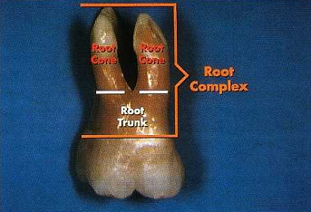
Root Trunk Length
The shorter the root trunk, the less attachment needs to be lost before the furcation is involved.
Once the furcation is exposed, teeth with short root trunks may be more accessible to maintenance procedures, and the short root trunks may facilitate some surgical procedures.

Slide 7
Root Length
Teeth with long root trunks and short roots may have lost a majority of their support by the time that the furcation becomes affected

Slide 8
Root Form
Curvature and fluting of roots may increase the potential for root perforation during endodontic therapy
These anatomic features may also result in an increased incidence of vertical root fracture

Slide 9
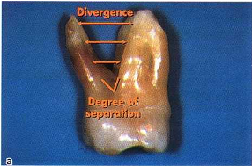
Interradicular Dimension
Closely approximated or fused roots can preclude adequate instrumentation during scaling, root planing, and surgery.
Teeth with widely separated roots present more treatment options

Slide 10
Anatomy of Furcation
Bifurcational ridges, a concavity in the dome, accessory canals complicates not only scaling, root planing, and surgical therapy, but also periodontal maintenance.

Slide 11
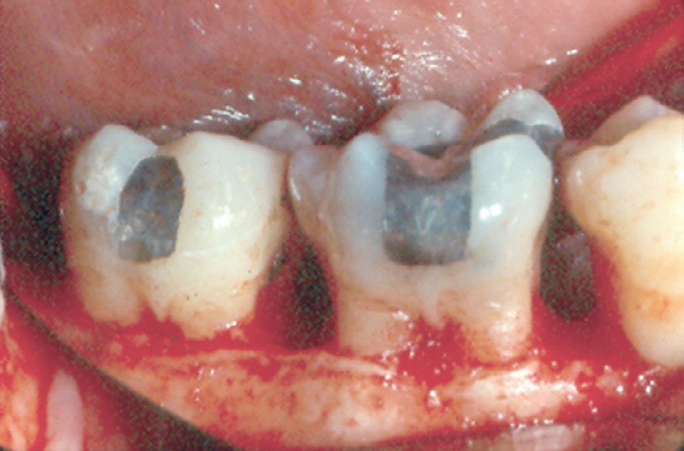
Cervical Enamel Projections
Occur on 8.6% to 28.6% of molars.
The prevalence is highest for mandibular and maxillary second molars.
Can affect plaque removal, can complicate scaling and root planing

Slide 12
Glickman’s classification
Grade I
Incipient or early stage of furcation involvement
Early bone loss may have occurred with an increase in probing depth
Radiographic changes are not usually found.
Grade II
Cul-de-sac with a definite horizontal component
Partial bone loss
Radiographs may or may not depict the furcation involvement

Slide 13
Grade III
Complete loss of interradicular bone
Bone not attached to dome of furcation
Radiolucency seen in the furcation area
Grade IV
Interdental bone destroyed, and soft tissues have receded apically so that the furcation opening is clinically visible.
A tunnel exists between the roots of
such an affected tooth

Slide 14
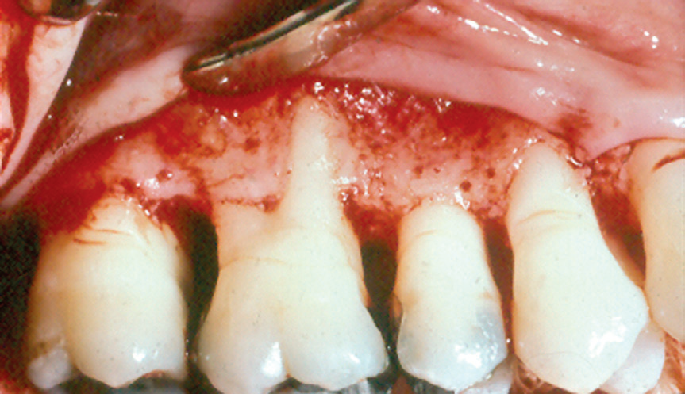
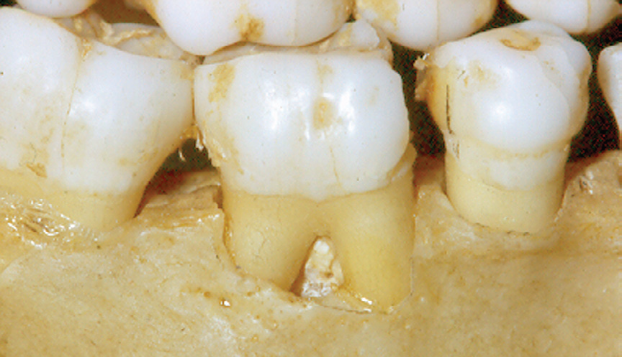
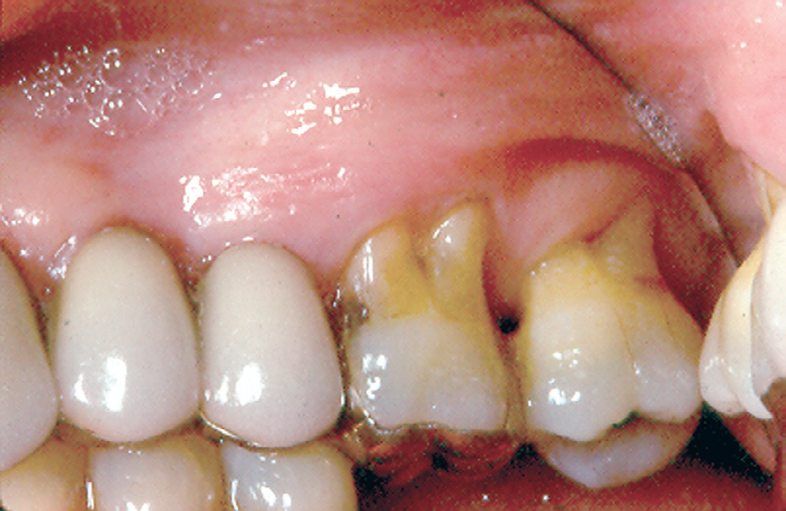
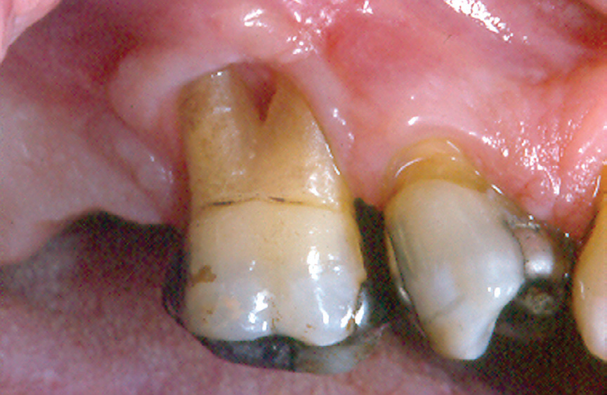

Slide 15
Treatment
The objectives of furcation therapy are to
(a) facilitate maintenance,
(b) prevent further attachment loss,
(c) obliterate the furcation defects as a periodontal maintenance problem.

Slide 16
Grade I
Amenable to conservative periodontal therapy - oral hygiene, scaling, and root planing
Odontoplasty and osteoplasty
Any thick overhanging margins of restorations, facial grooves, or CEPs should be eliminated by odontoplasty, recontouring, or replacement.

Slide 17
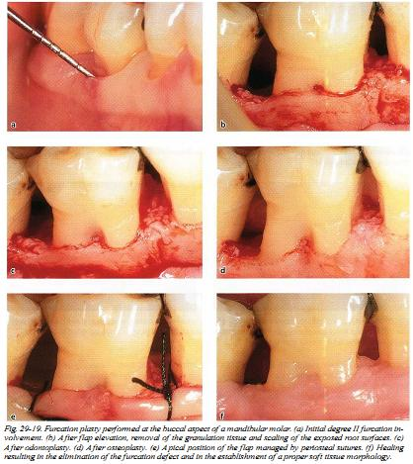
Furcation plasty (odontoplasty & osteoplasty)

Slide 18
Grade ii
Shallow horizontal involvement - localized flap procedures with odontoplasty, osteoplasty, and ostectomy.
Deep Class II furcations – regenerative periodontal surgery

Slide 19
Grade iii & grade iv
Tunelling
Root resection
Hemisection
Extraction

Slide 20
Tunnel preparation
Hard and soft tissue resection - enough space has been established
Flaps are apically positioned
Exposed root surfaces should be treated by topical application of chlorhexidine digluconate and fluoride varnish

Slide 21
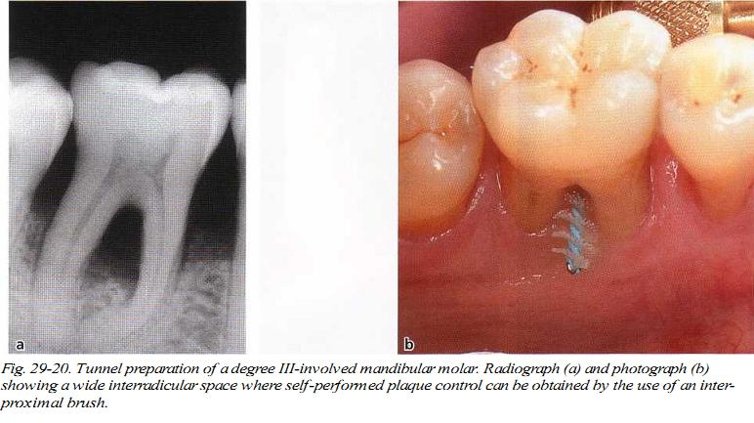

Slide 22
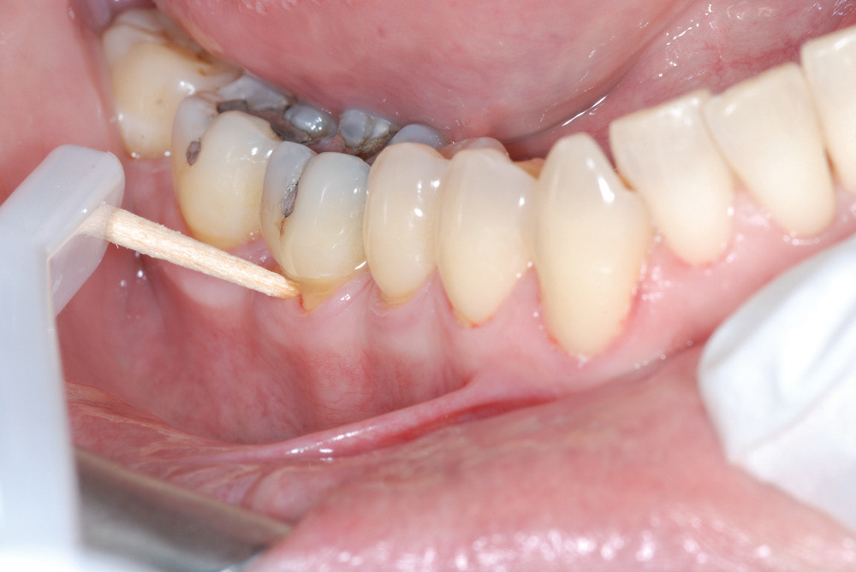

Slide 23
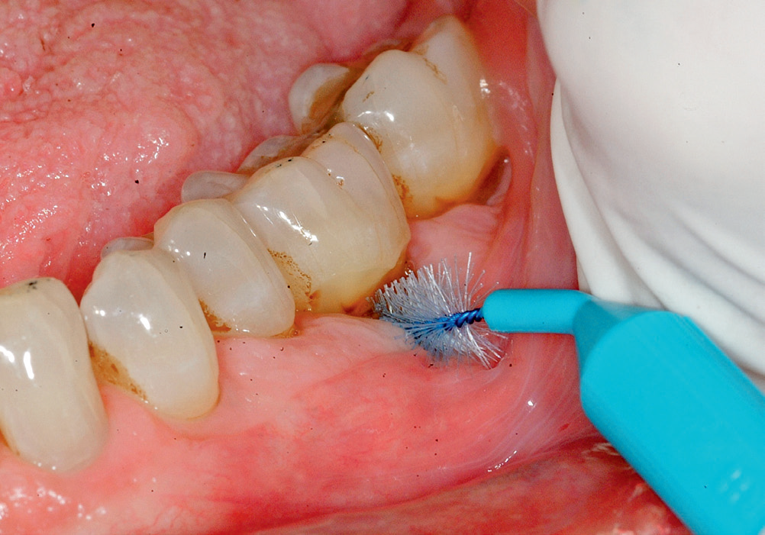

Slide 24
Root resection - indications
Teeth that are critically important to the overall dental treatment plan.
Teeth that have sufficient attachment remaining for function
Teeth for which a more predictable or cost-effective method of therapy is not available.
Teeth in patients with good oral hygiene and low activity for caries are suitable for root resection

Slide 25
Hemisection
Splitting of a two-rooted tooth into two separate portions.
Bicuspidization - changes the molar into two separate roots
Performed in mandibular molar with grade II and grade III furcation lesions
Wide interradicular space essential

Slide 26
Root resection - procedure
Distobuccal or mesiobuccal root of the maxillary first molar
Local anesthesia, a full-thickness mucoperiosteal flap is elevated.
Debridement
Resection of the root begins with the exposure of the furcation on the root to be removed
Cut is made with a high-speed, surgical-length fissure or crosscut fissure carbide bur
After sectioning, the root is elevated from its socket

Slide 27
The flaps are then approximated to cover any grafted tissues or slightly cover the bony margins around the tooth.
Sutures are then placed to maintain the position of the flaps.
The area may or may not be covered with a surgical dressing adjust the occlusion

Slide 28
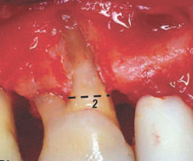
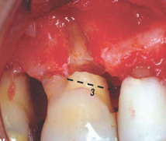
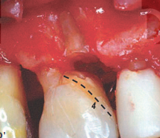
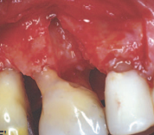
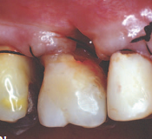
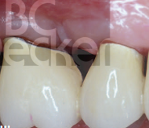

Slide 29
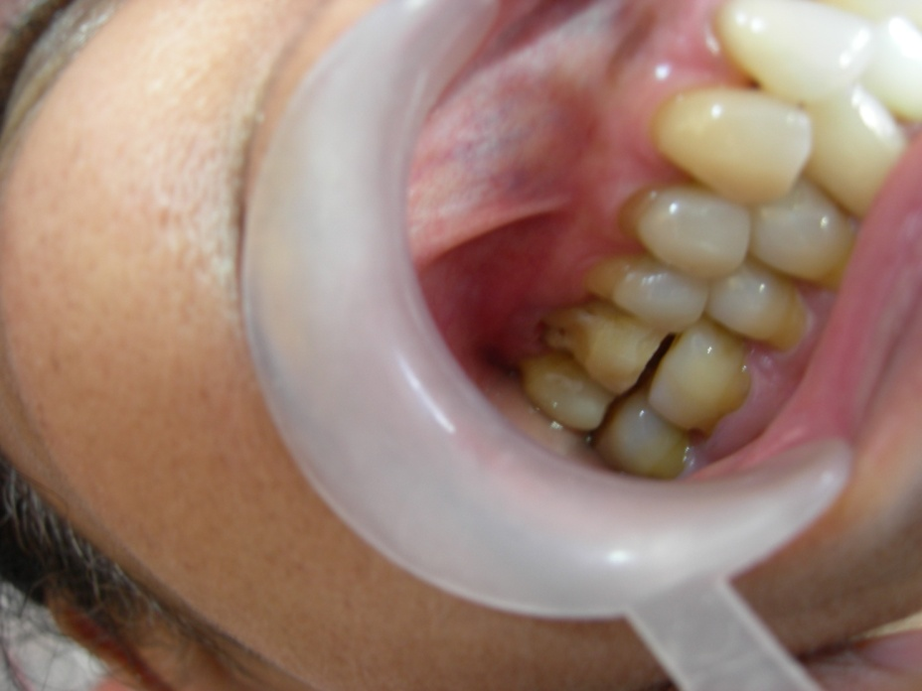
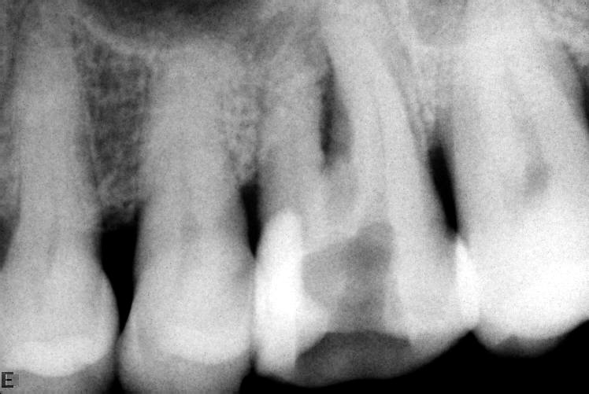
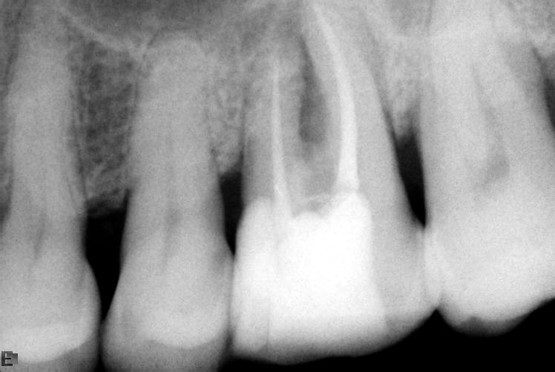

Slide 30
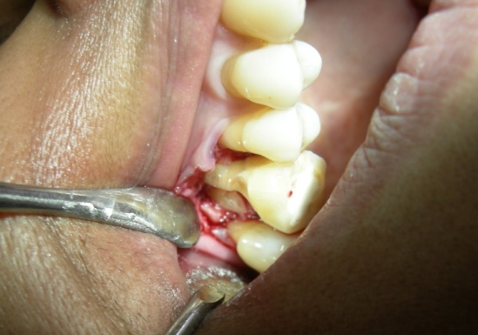
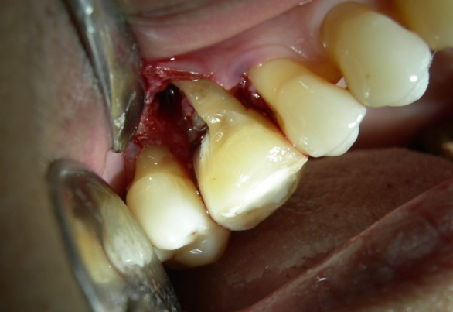
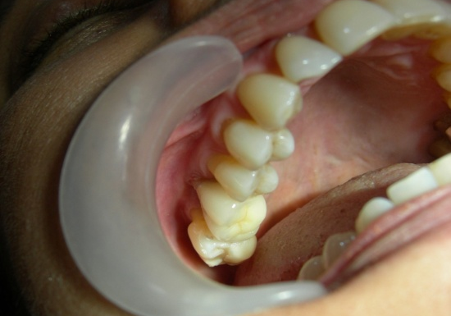

Slide 31
hemisection
Done in mandibular molars
Anestheisa, flap elevation
A vertically oriented cut is made faciolingually through the buccal and lingual developmental grooves of the tooth, through the pulp chamber, and through the furcation
If the tooth maintained as two premolars – bicuspidization
Or the diseased half of the tooth removed
Flap closure and suturing

Slide 32
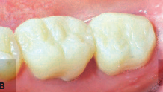
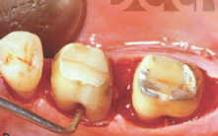
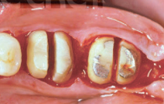
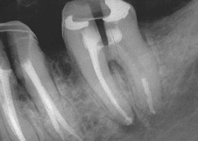
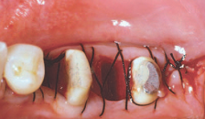
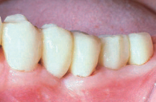
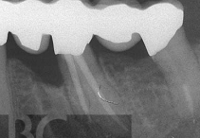
HEMISECTION

Slide 33
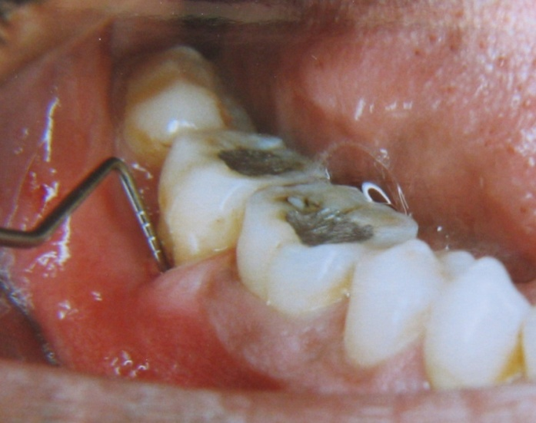
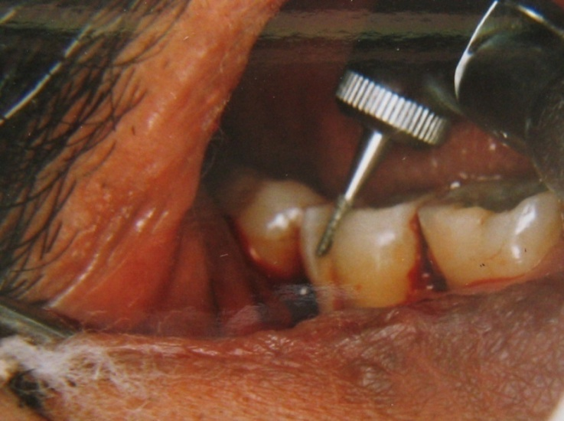
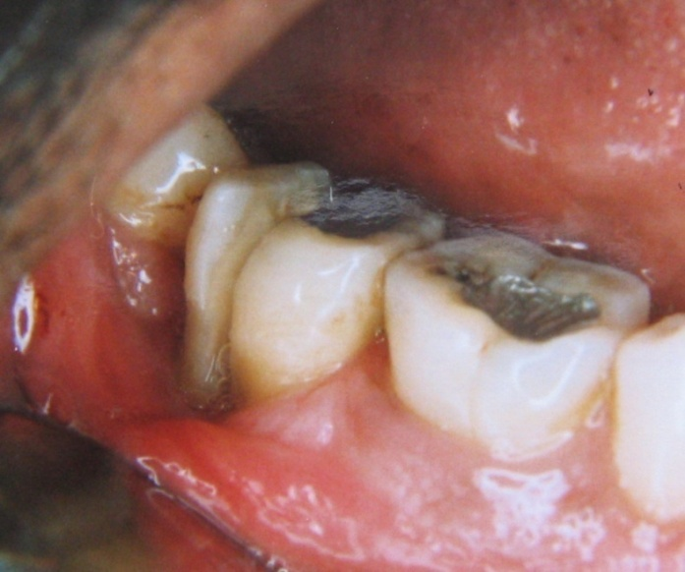
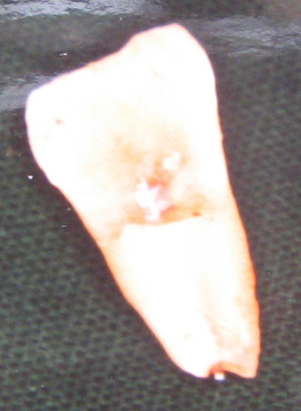
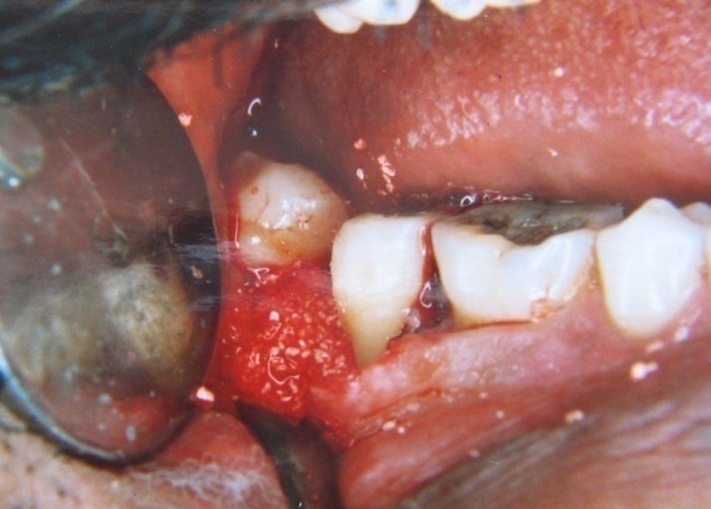

Slide 34
