Slide 1
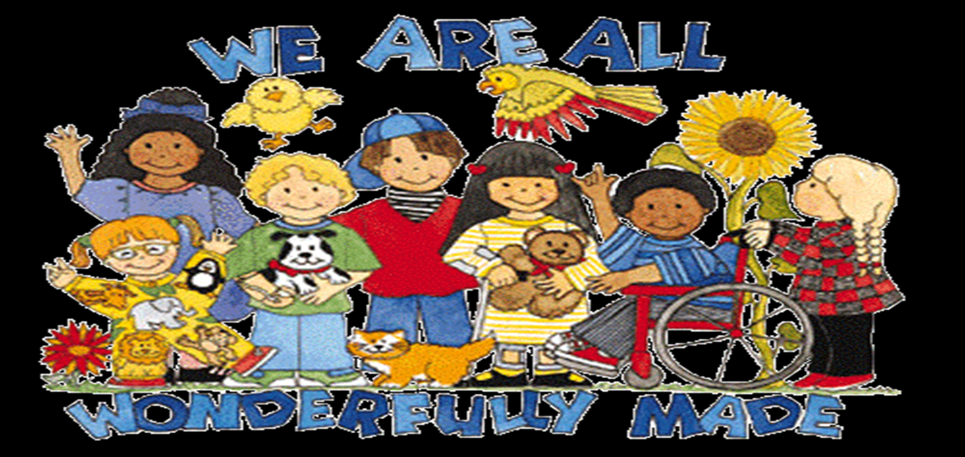
AUTISM

Slide 2
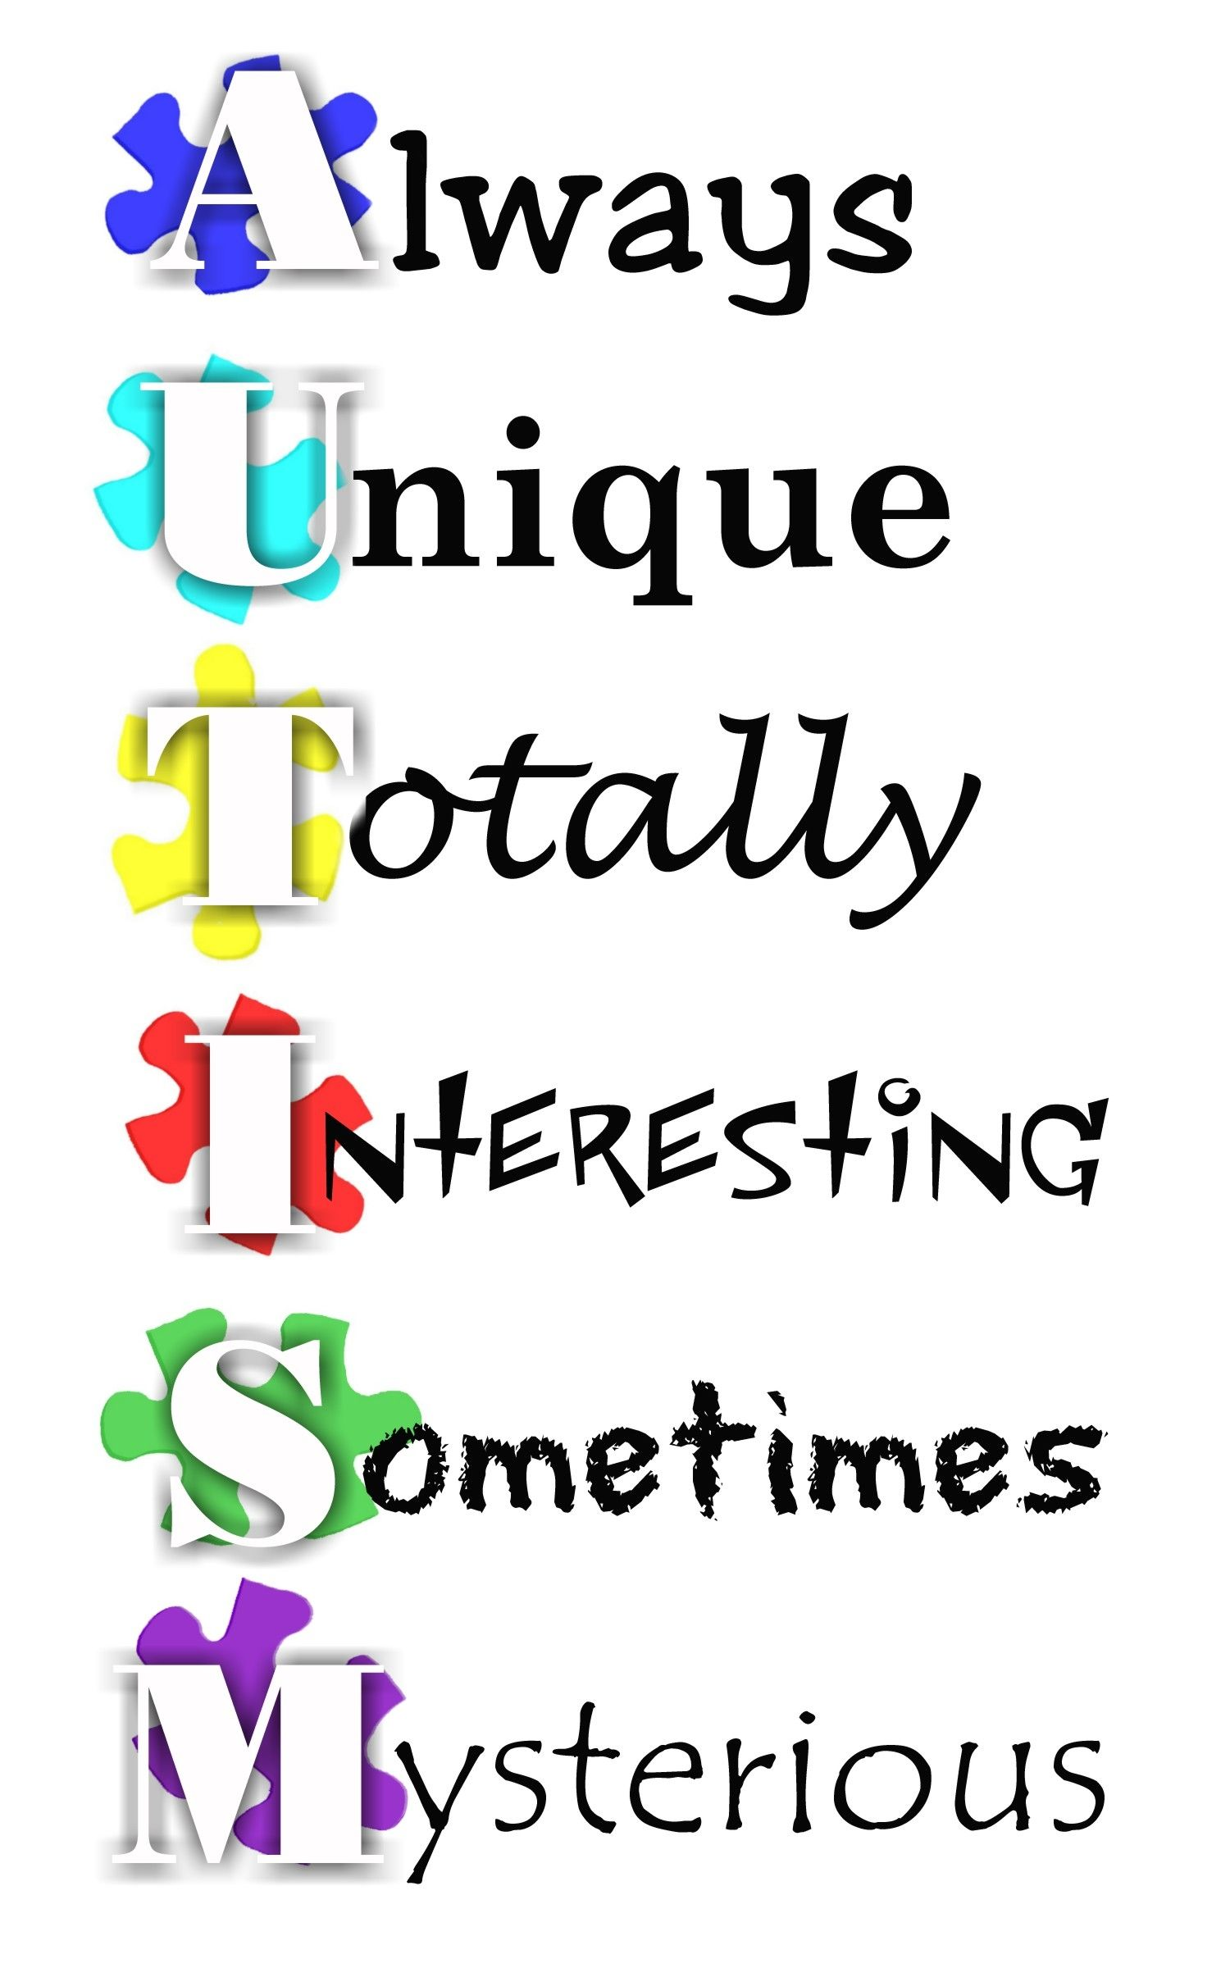
Autism – a different operating system
‘autos’ - meaning self
Notes:
. The term ‘autism’ is derived from the Greek word ‘autos’, meaning ‘self .as the word suggest they are self absorbed people,lost in their own world.t is a range of complex neurodevelopment disorders that includes Impairments in social interaction Difficulty in developmental language and communication skills combined with rigid repetitive behaviours.

Slide 3
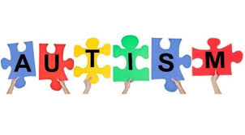
The Timeline of "Autism":
1911- Eugen Bleuler ‘autos’ - meaning self
1943- Leo Kanner ” Kanner's syndrome- Early Infantile Autism
1980- DSM-III "infantile autism".
1987- "Autistic Disorder"
2013- Autism Spectrum Disorder (ASD).
Notes:
described autism as “neurodevelopmental disorder presenting within the first 3 yrs of life” Kanner's syndrome- Early Infantile Autism

Slide 4
What is autistic spectrum disorder?
pervasive developmental disorder defined behaviorally as a syndrome consisting of abnormal development of social skills, limitations in the use of interactive language and sensorimotor deficits
Notes:
Because of the range of symptoms - Autism Spectrum Disorder (ASD). that each individual develops their own particular symptoms or carries the disease to a different degreeAutism is known as a “spectrum” disorder because there is wide variation in the type and severity of symptoms people experience

Slide 5
DSM - 5
Notes:
This category is used to refer to children who have significant problems with communication and play, and some difficulty interacting with others, but are too social to be considered autistic.

Slide 6
Asperger’s disorder
Higher-functioning end of the autism spectrum.
Possess relatively normal language skills intelligence display poor social skills
Decreased ability to show empathy
Unusual interests that are pursued with great intensity

Slide 7
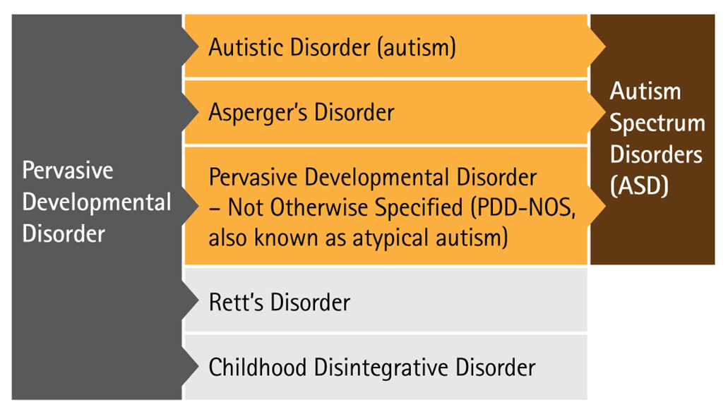
Pervasive developmental disorder - Not otherwise specified (PDDNOS)
Children with more
Social activity
Higher empathy
greater interaction
Notes:
This category is used to refer to children who have significant problems with communication and play, and some difficulty interacting with others, but are too social to be considered autistic.
The pervasive developmental disorders are:^{[1]}
Asperger syndrome (9% of autism diagnoses);
Rett syndrome; and
Childhood disintegrative disorder (CDD).
The first three of these disorders are commonly called the autism spectrum disorders; the last two disorders are much rarer, and are sometimes placed in the autism spectrum and sometimes not.^{[2][3]}
In May 2013, the Diagnostic and Statistical Manual-Fifth Edition (DSM-5) was released, updating the classification for pervasive developmental disorders. The grouping of disorders, including PDD-NOS, Autism, Asperger Syndrome, Rett Syndrome, and CDD, has been removed and replaced with the general term of Autism Spectrum Disorders. The American Psychiatric Association has concluded that using the general diagnosis of ASD supports more accurate diagnoses. The combination of these disorders was also fueled by the standpoint that Autism is characterized by common symptoms and should therefore bear a single diagnostic term. In order to distinguish between the different disorders, the DSM-5 employs severity levels. The severity levels take into account required support, restricted interests and repetitive behaviors, and deficits in social communication.^{[8]}

Slide 8
Childhood disintegrated disorder
Heller's syndrome, dementia infantilis, disintegrative psychosis
Notes:
1908 described thomas hellerthat resembles autism . It is characterized by at least two years of normal development, followed by loss of language, social skills, and motor skills before age ten.
-also hellers syndrome – loss of social nd language skil.
Complex dev disorder –affects complex dev disorder
Loss of bladder nd bowel control
Inability to move
2 yrs normal dev – regress

Slide 9
Epidemiology.
Prevalence of 10 to 20 cases of classic autism per 10,000 births
30 to 50 per 10,000 if the entire spectrum of autism is included
male:female ratio is 3:1
Epilepsy: . The prevalence varies from around 8% to as high as 46%.
Notes:
When the disorder appears in a female- often associated with a more severe degree of MR.

Slide 10
Etiology
.
Prenatal environment
Valproic acid ; or intrauterine rubella, cytomegalovirus infection in the mother.
Pesticides-Dicofol and Endosulfan.
Folic acid
Fetal testosterone
Fetal alcohol syndrome
Notes:
While scientists don’t know the exact causes of ASD, thesemay affect a pregnancy during the critical first eight weeks of conception.
Fhe cause of ASD is not clear yet. Based on the available research, one can say that the disorder may be multi-factorial, involving genetics, environmental poisons, neuropsychopathy.olic Acid - An untested hypothesis proposes that Folic Acid might play a role in autism due to its modulation of gene expression through epigenetic mechanism.
Ultrasound - A study conducted in 2006 showed that sustained exposure of mouse embryos to ultrasound waves caused a small but statistically significant number of neurons to fail to acquire their proper position during neuronal migration. Research findings also indicate that mild forms of
autismlike symptomology may occur in one or
both parents and siblings of people with autism.

Slide 11
Perinatal
Low birth weight
gestation duration
Hypoxia during childbirth.

Slide 12
Postnatal
Viral infections- herpes simplex ,untreated phenylketonuria, encephalitis, infantile spasm
Reduced intake in Omega 3 fatty acids - in impaired cell membranes and Neurodevelopmental disorders
Deficiencies in Key Nutrients in our modern diet
Irritable bowel syndrome
Leaky gut
Notes:
Zinc, Selenium, Vit B12, Vit B6 Vit D, and Folate - affect neural development & result in weaknesses in cellular membranes and internal processes of cells. MMR Vaccine - One of the most controversial hypothesized causes of autism. A “study” conducted by Andrew Wakefield and 12 others linked use of the vaccine Penetration of Opioid Stimulants; the Opioid Excess Theory:
Panksepp in 1979 proposed an “opioid excess” theory of autism.
MMR Vaccine - One of the most controversial hypothesized causes of autism. A “study” conducted by Andrew Wakefield and 12 others linked use of the vaccine in infants with ASD. The entire study was later discovered to have been fraudulently altered by Wakefield in order to support his claims. Recent studies have verified this theory as a fallacy and that there is no connection between MMR vaccine and ASD. Oxidative stress- damaging Purkinje cells in cerebellum
Leaky Gut Syndrome - The controversial Wakefield et al. vaccine paper also suggested that some bowel disorders may allow antigens to pass from food into the bloodstream and then to contribute to brain dysfunction.
Viral Infection - Viruses have long been suspected as triggers for immune-mediated diseases such as multiple sclerosis but showing a direct role for viral causation is difficult in those diseases, and mechanisms whereby viral infections could lead to autism are speculative.
Oxidative Stress - This theory hypothesizes that toxicity and oxidative stress may cause autism in some cases by damaging Purkinje cells in the cerebellum after birth. It has been suggested that glutathione is involved.

Slide 13
Penetration of Opioid Stimulants; the Opioid Excess Theory:
Panksepp in 1979 proposed an “opioid excess” theory of autism. Many parents of children with autism report significant improvements on a dairy and gluten free diet. The opioid excess theory is a theory which postulates that autism is the result of a metabolic disorder in which opioid peptidesproduced through metabolism of gluten and casein pass through an abnormally permeable intestinal membrane and then proceed to exert an effect on neurotransmission through binding with opioid receptors.^{[1]} It is believed by advocates of this hypothesis that autistic children are unusually sensitive to gluten,
They found that "exorphin opioids" derived from casein (dairy protein) and gluten (from grains) crossed the blood-brain-barrier and caused “social indifference”symptoms in experimental animals, as well as inability to differentiate essential from nonessential stimuli.
Peptide in urine from autistics that increased platelet
Kidd, P. M. (2002). "Autism, an extreme challenge to integrative medicine. Part: 1: The knowledge base." Altern Med Rev 7(4): 292-316.
Notes:
Many parents of children with autism report significant improvements on a dairy and gluten free diet. The opioid excess theory is a theory which postulates that autism is the result of a metabolic disorder in which opioid peptidesproduced through metabolism of gluten and casein pass through an abnormally permeable intestinal membrane and then proceed to exert an effect on neurotransmission through binding with opioid receptors.^{[1]} It is believed by advocates of this hypothesis that autistic children are unusually sensitive to gluten,
They found that "exorphin opioids" derived from casein (dairy protein) and gluten (from grains) crossed the blood-brain-barrier and caused “social indifference”symptoms in experimental animals, as well as inability to differentiate essential from nonessential stimuli.
Peptide in urine from autistics that increased platelet content of serotonin, which is also a common finding in autism.

Slide 14
Genetic susceptibility:
3 to 8 percent recurrence risk if a family already has one autistic child
studies suggests - is an inherited disorder involving up to 20 interacting genes.
Genes located on chromosomes 2, 7, 15, 16 and 19 have been suggested.
X-linked disorder
Notes:
Male are affected moreResearch findings also indicate that mild forms of
autismlike symptomology may occur in one or both parents and siblings of people with autism.31

Slide 15
Paternal age
Children whose fathers were 40 years or older at the time of their births are 5.75 times more likely to have autism
Notes:
father’s age at the time of an offspring’s birth influences the child’s risk of developing autism.30 than are children whose fathers were younger than 30 years at the time of their births

Slide 16
Social Interaction Difficulties
Repetitive Speech & Behaviour
Communication Challenges
Notes:
Verbal and nonverbal communication skills - delayed an inability to integrate words with gaze, facial expression and gestures

Slide 17
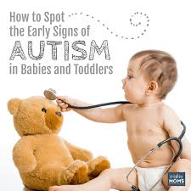

Slide 18
Reduced social interaction, absence of social smile, lack of facial expression
Abnormal muscle tone, posture and movement patterns
Failure to orient to name, lack of pointing, decreased orienting to faces
Lack of spontaneous imitation
Early symptoms
A baby who
does not babble or gesture by the age of 12 months
lacks eye contact with its mother by the age of 12 months
resists being held or cuddled by its mother
does not respond when its mother says its name
appears to be deaf
An infant who does not say single words by 16 months of age
A toddler who does not say 2-word phrases by 24 months of ag
Notes:
raise arms in anticipation of being picked up engage in imitation games (for example, peekaboo), point to or show an object such as a toy to the parent (sharing experience with others/joint attention) or respond to smiles or a mother’s voice

Slide 19
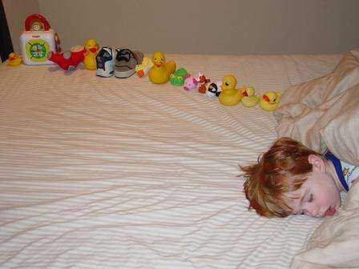
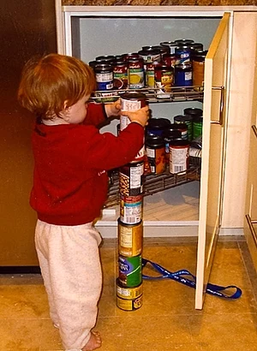
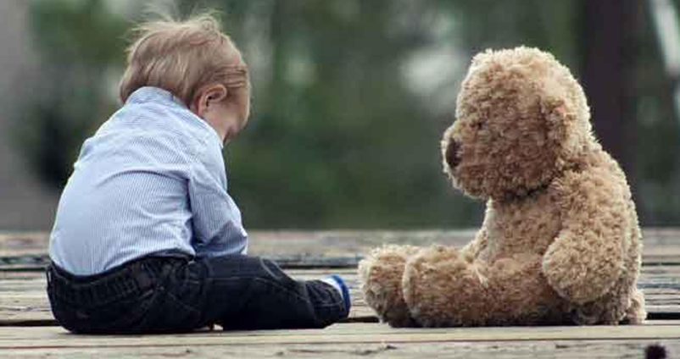
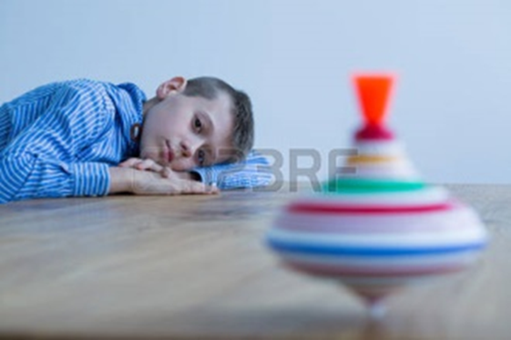
Young children
Notes:
Repetitive stereotypical behaviour,restrictive interest,social interaction .lacks creativity and imagination,repeated rigid behaviours

Slide 20
Young children
Do not engage themselves in group activity and seems to be in their own world
Unable to share in another child’s interest in an activity
Inability to interpret the behavior of others
Failure to use facial expression and body language to interact with others those results in social conflictLacks creativity and imagination.
persistently occupied by the sensory features of objects
older children – obsessional interest in systems that operate according to immutable rules
Repetitive behaviors including opening and closing doors and flipping light switches. Instead of building
with blocks, children with autism may compulsively
line them up in rows, or they may become persistently occupied by the sensory features of objects such as buttons on
Notes:
Unable to recognize intentions, desires, feelings and beliefs of other people that can be different from their own

Slide 21
Persistent questioning, confusion and reference to self as “you,” “she” or “he,”
Use of made-up words (neologisms)
Abnormal use of words and phrases with idiosyncratic meaning.
Immediate echolalia (the involuntary repetition of what has just been heard),
Delayed echolalia (repetition of things heard in the past such as radio and television dialogue)
Abnormal variation in stress, pitch and rhythm of speech (prosody) Finger flicking, hand flapping, body rocking, self spinning ,running in circles.
Stress, excitement or certain stimuli (noise) - trigger repetitive actions.
Demand rigid routines
Extreme reactions to invasion of personal space
Notes:
Phenomena such as immediate echolalia rhythm of speech (prosody) further tend
to obscure the meaning of speech.6

Slide 22
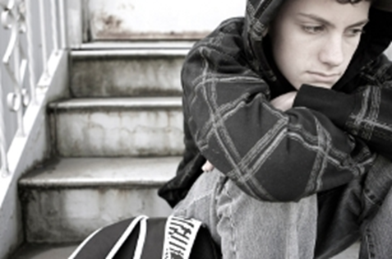
Teenagers & young adults
Notes:
Adolescence - psychiatric illnesses such as anxiety disorders, mood disorders, attention deficit hyperactivity disorder, obsessive-compulsive disorder & schizophreniaBehavioral symptoms of autism

Slide 23
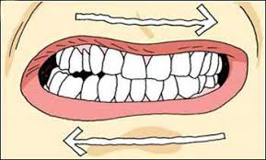
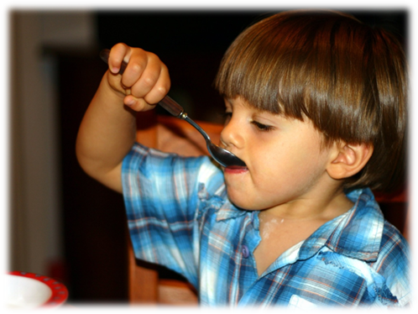
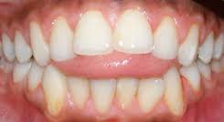
Oral manifestations
Bruxism
Traumatic injuries
Damaging oral habits
Dental erosion
Dental Caries
Gingivitis
Tooth eruption delayed –phenytoin
Notes:
Traumatic ulcerated lesions usually brought on by self-injury from head banging, picking or face tapping. Such as tongue thrusting, picking at the gingiva, lip biting, and pica.

Slide 24
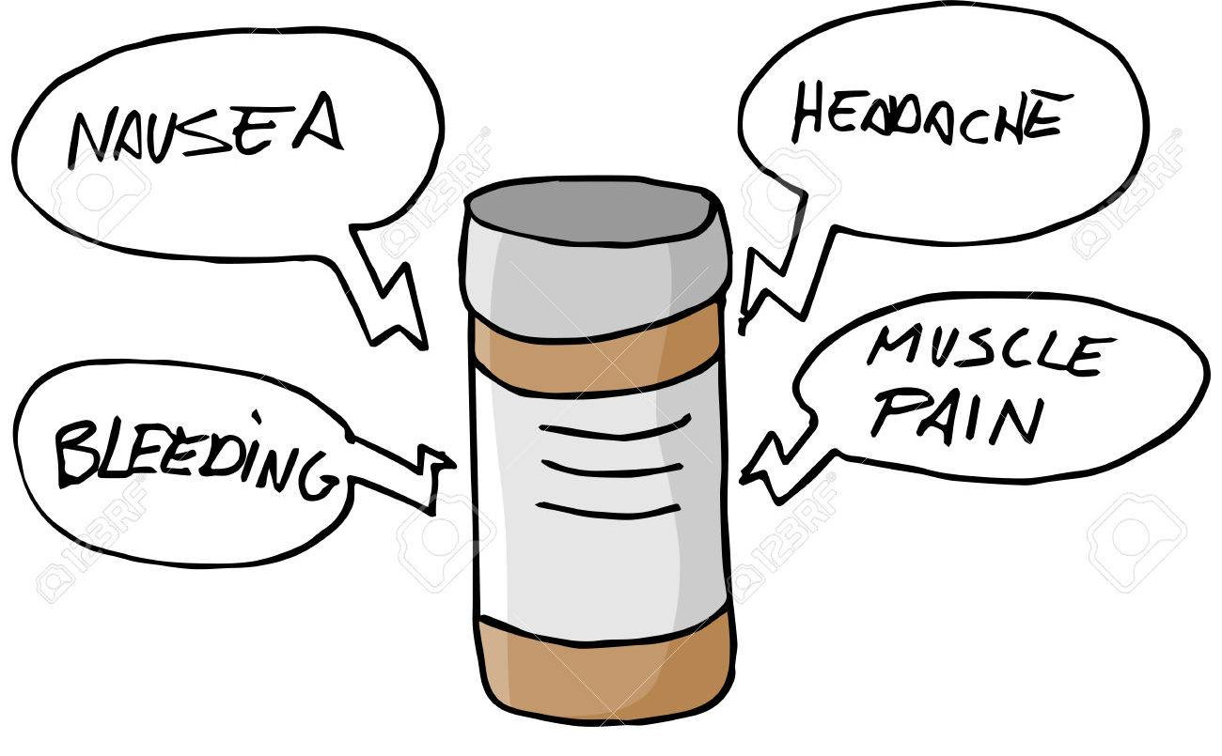
Side effects: Xerostomia
Dysphagia
Sialadenitis
Gingivitis
Stomatitis
Glossitis
Notes:
A methylphenidate (CNS stimulant)
Clonidine ( antihypertensive )
Fluoxetidine and sertraline (Antidepressants)
Carbamazepine , Sodium Valproate (anticonvulsants)
Otarizapine and Risperidone (antipsychotics)

Slide 25
Dental Management
Previsit parent consultation
Childs home preparation
Familarization with the dental environment using audiovisual education materials
Notes:
Recording of childs medical history and past dental history with professionals,identification of the triggering points in the childs behaviour and favourite toy,assignment of patient education tools. A prominent symptom of infantile autism is an intense desire to maintain consistency in the environmenSolicit suggestions from the parent or caregiver on how best to deal with the child as the minor changes in he environment may elicit extreme anxiety in autistic childrentThey often exhibit an extreme resistance on being held and show an inappropriate reaction to fearful situations. Autistic children are hypersensitive to loud noises, sudden movement, and things that are felt. Schedule the appt – they do not like crowd

Slide 26
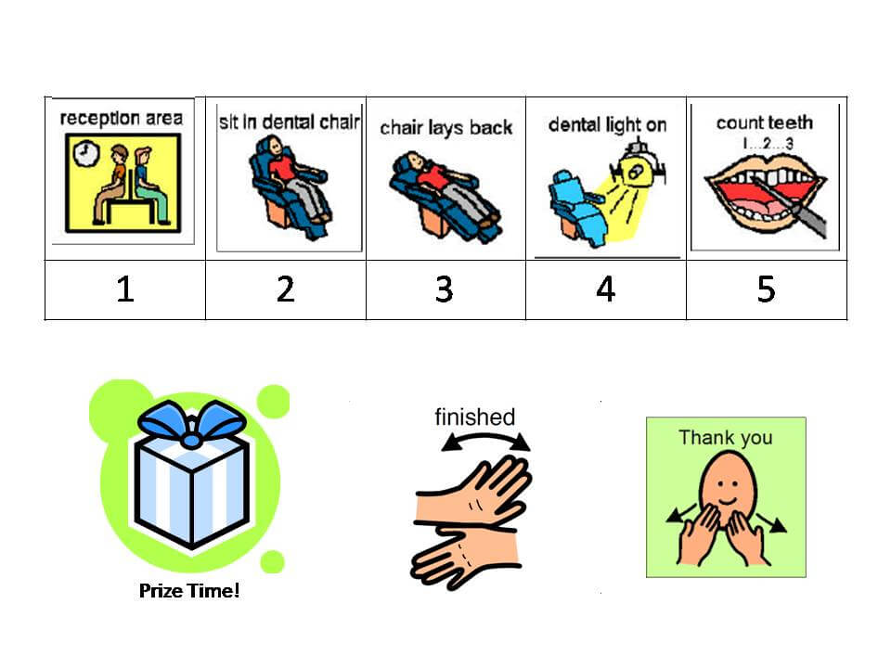
Visual pedagogy
The dentist can organize the home-centered preparation that includes familiarization with dental instruments, teaching of skills required for the dental examination using phrases such as ‘open your mouth’,
Notes:
. Patients with ASD react more favourably to structured, as opposed to unstructured, situations pecs- picture xchange
The dentist can organize the home-centered preparation that includes familiarization with dental instruments, teaching of skills required for the dental examination using phrases such as ‘open your mouth’,
Structuring is carried out through drawings (pictograms, photos, etc.) To assist the child to get acquainted with the dental operatory room
rough series of coloured photographs describing step-by-step dental visit and toothbrushing to introduce dentistry and oral hygiene to autistic children Through visual pedagogy, what to do, where, when, and how are explained, as well as what to do afterOne of the basic principles of TEACCH is the structuring of time and space, given that

Slide 27
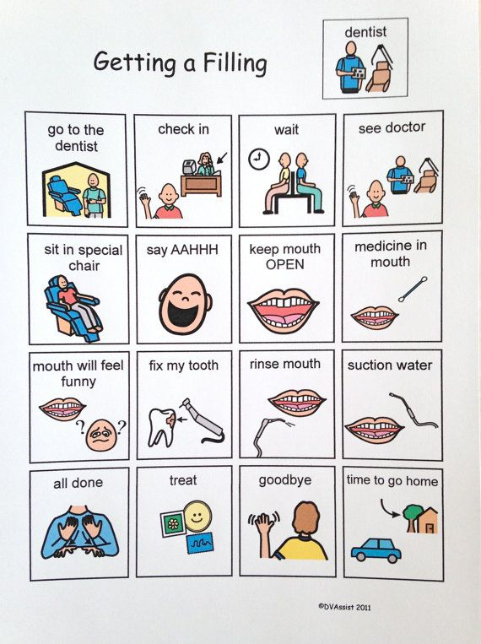

Slide 28
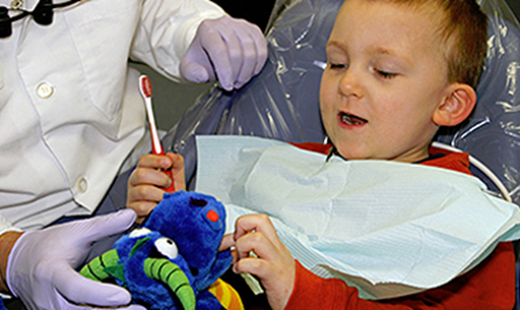
On the day of appointment

Slide 29
Sensory adapted environment
behavioural difficulties may be invoked by loud, unexpected, nearby noises.
persist to cover their eyes or squint under light exposure,
present hypersensitivity in intraoral and perioral regions.
Oral defensiveness - approximately 50 percent of children with ASD
DeMattei R, Cuvo A, Maurizio S. Oral assessment of children with an autism spectrum disorder. J Dent Hyg. 2007;81:65
Notes:
, and therefore experience frustration by a light touch or even fall back during dental examinationThus, physical and verbal aggression, withdrawal or attempt to fight back might be expected from a young autistic patient in the milieu of dental practice as a consequence of aggravated sensory processing (

Slide 30
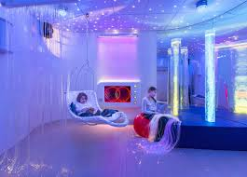
Introduction of relaxing light conditions, rhythmic music
A single operating room may be also reserved to accommodate the treatment of the autistic child.
snoezelen room
Notes:
sensory adapted dental environment (SADE) to reduce distress, sensory discomfort, and perception of pain during oral prophylaxis for children with autism spectrum disorder (ASD). and deep pressure in the dental setting diminished adverse patient reactions and enhanced positive participation in dental prophylactic cleaning Duration of the dental visit, and sensory sensitization should be kept to a minimum (1). Towards this end,

Slide 31
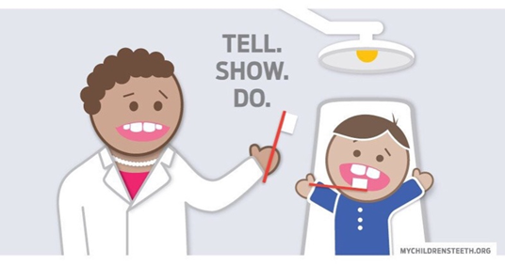
. Use TSD, Reinforcements and Rewards
In the early, stages of the program, sweet foods can serve as desirable rewards.
latter stages - oral rewards should be changed to social rewards, such as a pat on the back or a hug.

Slide 32
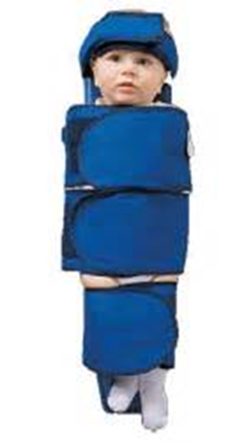
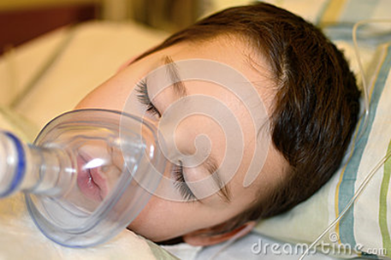
Advanced behaviour guidance methods
Antipsychotic medications - to alleviate symptoms of irritability, distress, self-injurious behaviour, aggression and delusions .
Protective stabilization
Conscious sedation and nitrous oxide inhalation - proven less popular practices
General anesthesia in approximately 40 percent of cases
.
Loo CY, Graham RM, Hughes CV. The caries experience and behavior of dental patients with autism spectrum disorder. J Am Dent Assoc. 2008;139:1518–24
Notes:
Under certain circumstances, dental management of these patients may be performed in combination with advanced behaviour guidance techniquesSome autistic children can be calmed by moderate pressure, such as by using a papoose board to wrap the child.
The dental specialists should be aware of the oral adverse reactions of the aforementioned drugs, which can be summarized as xerostomia, sialorrhea, sialadenitis, stomatitis, gingival enlargement, edema and discoloration of the tongue

Slide 33
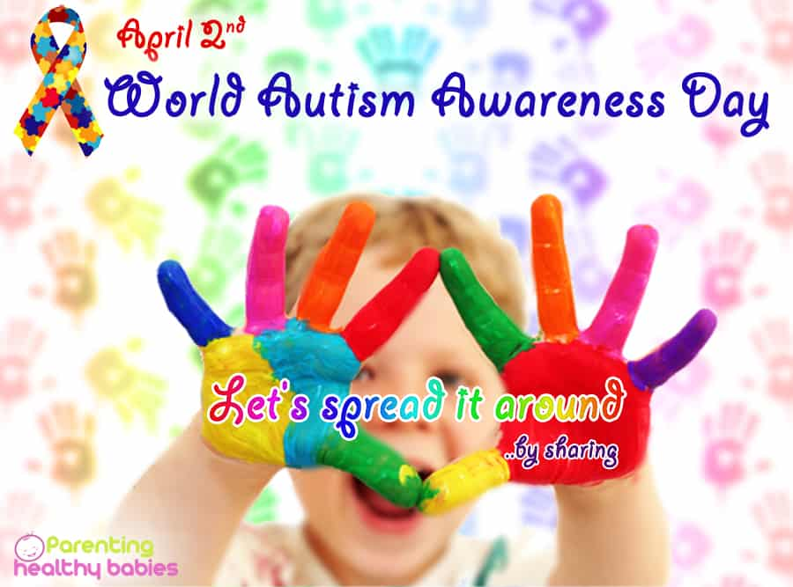
Notes:
The aim of this month is educate the public about autism. Increasing Awareness About The Common Characteristics Of Autism. The dental management of a child with ASD requires in-depth understanding of the autistic behavioural profile. Based on well-established behavioural guidance techniques, the therapeutic approach should be individualized for each patient.

