Slide 1
Tympanic membrane
Tympanic membrane is a thin, translucent partition between the external ear and middle ear
It is oval in shape, measuring 9mm long and 10 mm width
It is placed obliquely at an angle of 55 degree with the floor of the meatus
It faces downwards, forwards and laterally
The membrane has outer and inner surfaces
Outer surface is concave lined by skin
The inner surface is convex
The maximum point of convexity is called umbo
The inner surface provides attachment to the handle of the malleus
The tip of the handle of the malleus lies at the umbo
The membrane is thickened at its circumference which is fixed to the tympanic sulcus of the temporal bone
Superiorly the sulcus is deficient. Here the membrane is attached to the tympanic notch
The membrane has two folds, anterior and posterior malleolar folds

Slide 2
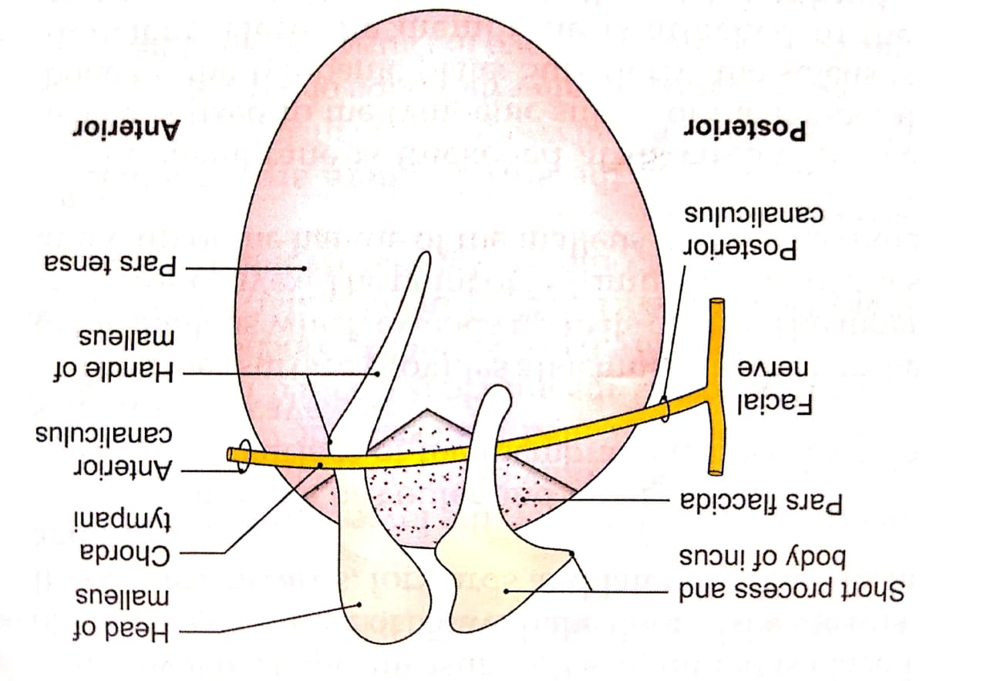

Slide 3
The greater part of the tympanic membrane is tightly stretched called pars tensa
The part between the two malleolar fold is loose and is called the pars flaccida
The pars flaccida is crossed internally by the chorda tympani
The membrane is held by the inward pull of tensor tympani muscle which is inserted into the upper end of handle of malleus
Structure
Tympanic membrane is composed of three layers:
The outer circular layer: made up of skin
The middle fibrous layer: made up of superficial radiating fibres and deep circular fibres. Circular fibres are minimal at the centre and maximal at the periphery. In pars flaccida the fibrous tissue is replaced by loose areolar tissue
The Inner mucous layer: lined by a ciliated columnar epithelium

Slide 4
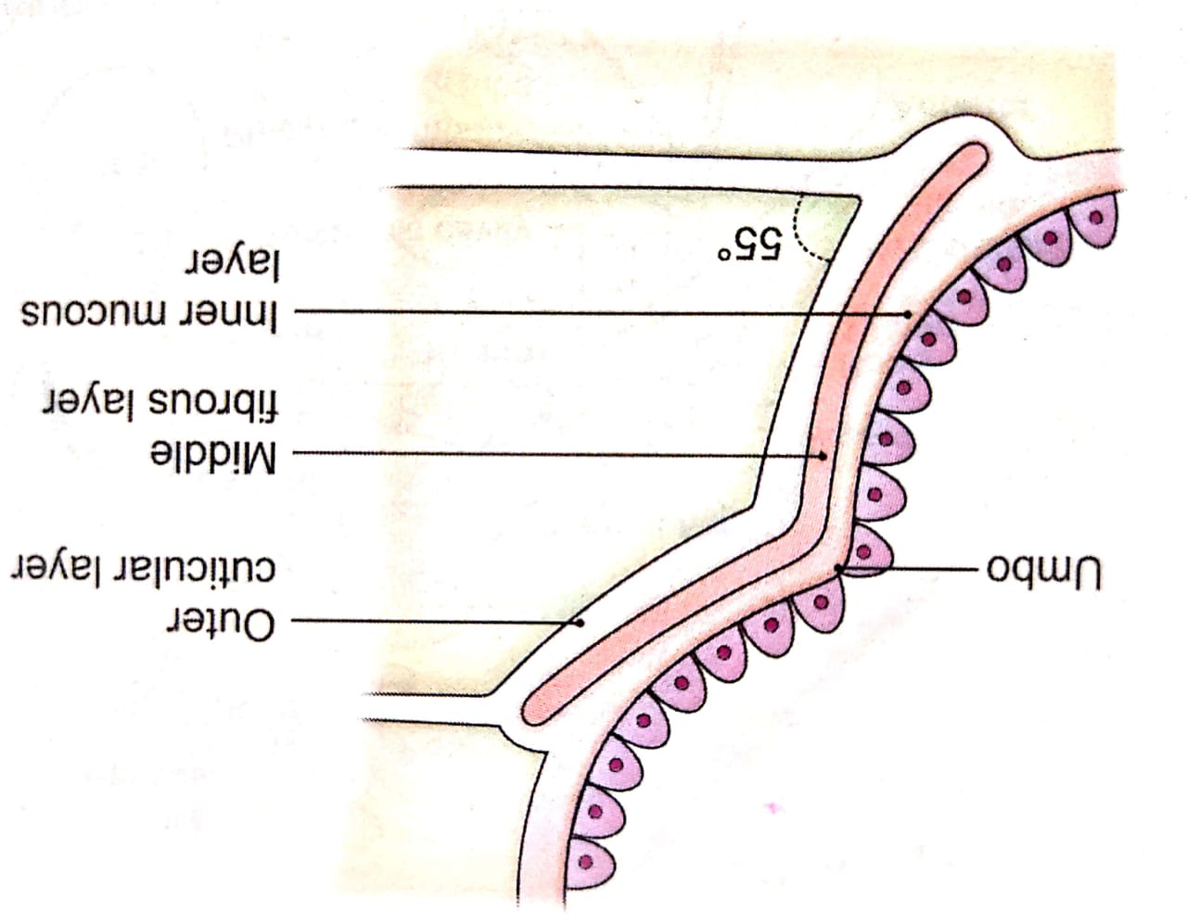
Structure

Slide 5
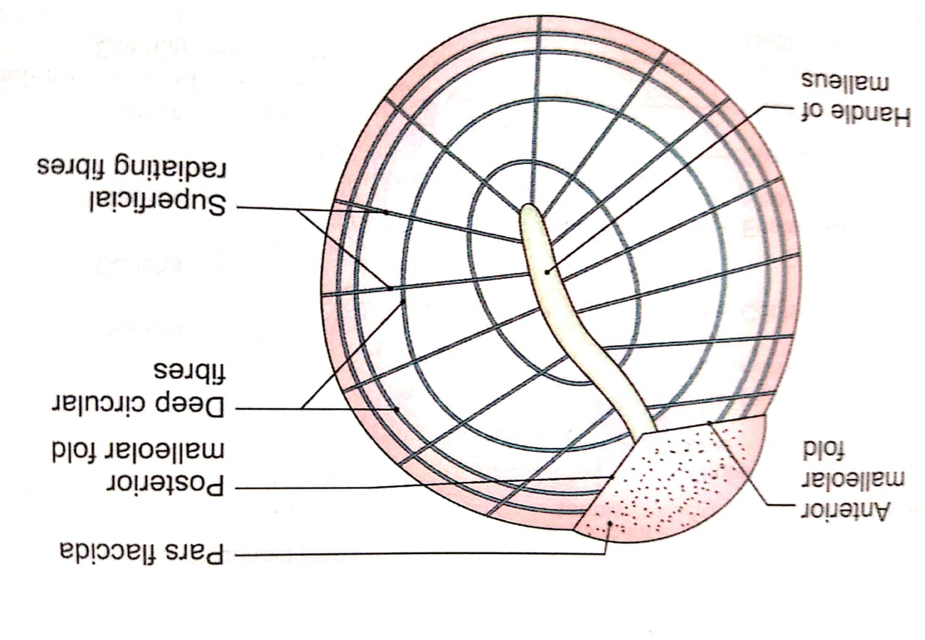

Slide 6
Blood supply
The outer surface is supplied by deep auricular branch of maxillary artery
The inner surface is supplied by anterior tympanic branch of maxillary artery and posterior tympanic branch of stylomastoid artery
Venous drainage
Veins from the outer surface drains into external jugular vein
Veins from the inner surface drains into transverse sinus and venous plexus around the auditory tube
Lymphatic drainage
Preauricular and retropharyngeal lymph nodes
Nerve supply
The outer surface is supplied by auriculotemporal nerve and auricular branch of vagus nerve
Inner surface is supplied by the tympanic branch of glossopharyngeal nerve

Slide 7
Clinical aspects
For the examination of the tympanic membrane the auricle should be drawn upwards, backwards and slightly laterally. In infants the auricle is drawn downwards and backwards because the auditory canal is cartilaginous and the outer surface of the tympanic membrane is directed downwards
When the tympanic membrane is illuminated for the examination the concavity of the membrane produces a cone of light through the membrane the under lying handle of malleus and long process of incus can see
The tympanic membrane is sometimes incised to drain pus present in the middle ear. The procedure is called myringotomy.

