Slide 1
General Anesthesia
By Dr. Alka Mariam Mathew

Slide 2
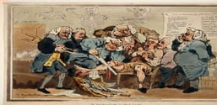
What was done before an operation

Slide 3
History of ANESTHESIA
■ 1824 –Sir Humphry Davy recognized anesthetic property of nitrous oxide
■ March 30, 1842-Dr Crawford W long used ether as surgical anesthesia
■ First used Nitrous oxide for dental extraction of by dentist Horrace Wells
■ October 16 1846 William Morton, pupil of Wells explained (public demonstration) the use of ether to facilitate surgical anesthesia

Slide 4
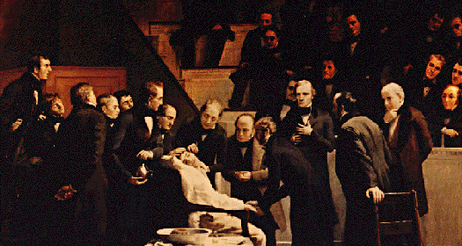

Slide 5
general anaesthetics (GAs) are drugs which produce reversible loss of all senations and consciousness.
General anaesthetics (GAs) are a class of drugs used to depress the CNS to a sufficient degree to permit the performance of surgery and other noxious or unpleasant procedures.

Slide 6
DEFINATION
General anesthesia is a drug-induced reversible loss of consciousness during which patients are not arousable, even by painful stimulation.

Slide 7
BASIC PRINCIPLES OF ANAESTHESIA
Anesthesia defined as the abolition of sensation
Analgesia defined as the abolition of pain
“Triad of General Anesthesia”
need for unconsciousness
need for analgesia
need for muscle relaxation

Slide 8
PURPOSE
General anaesthesia has many purposes including:
• Analgesia — loss of response to pain
• Amnesia — loss of memory
• Immobility — loss of motor reflexes
• Hypnosis — loss of consciousness
• Skeletal muscle relaxation.

Slide 9
Pre- Anesthestic Evaluation
“Never treat a stranger”
 Never do anesthesia on a patient you have not previously evaluated.
 Never sedate or aesthesis on first patient visit
 Always have a consultation first!

Slide 10
PRE-ANESTHETIC EXAMINATION
Physical examination
Evaluation of anxiety level
Review of medical history
Review medications and drug allergies
Assign ASA classification
Review prior sedation / anesthetic history
Obtain informed consent
Give pre‐sedation/ anesthesia instructions

Slide 11
MEDICAL HISTORY
Diseases to evaluate: HTN;, asthma, COPD, URI, DM
Pregnancy; psychiatric renal; hepatic problems
Obesity; sleep apnea; etc
Medications
Prior anesthetic experience
Allergies
Hospitalizations

Slide 12
PHYSICAL EXAMINATION
Vital signs
Appearance
Height, Weight, & BMI (Body Mass Index)
Mental & psychological status
Cardiac & pulmonary level
Exercise tolerance (“if they can walk up 2 flights of stairs to your office, they’re probably ok for anesthesia”)
Airway evaluation

Slide 13
AIRWAY EVALUATION
BMI (Body Mass Index)
History of obstructive sleep apnea, snoring
Mallampati score
Protrusive (ask: “bite your upper lip with your lower teeth”)
TMJ range of motion (oral opening)
Neck circumference
Sternomental distance (patit’s test)
Thyomental distance (Savva’s test)
Interincisal gap

Slide 14
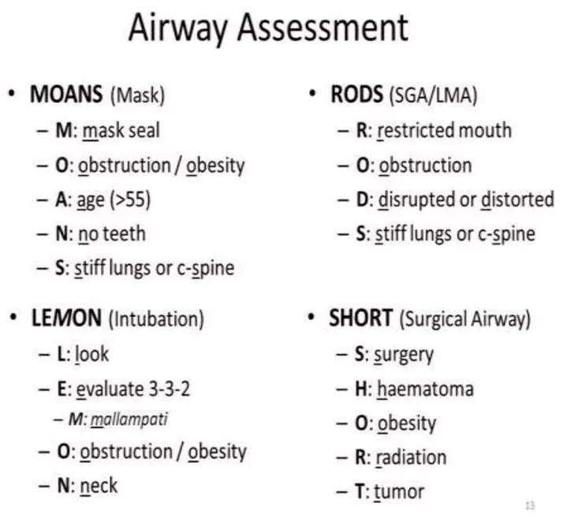

Slide 15
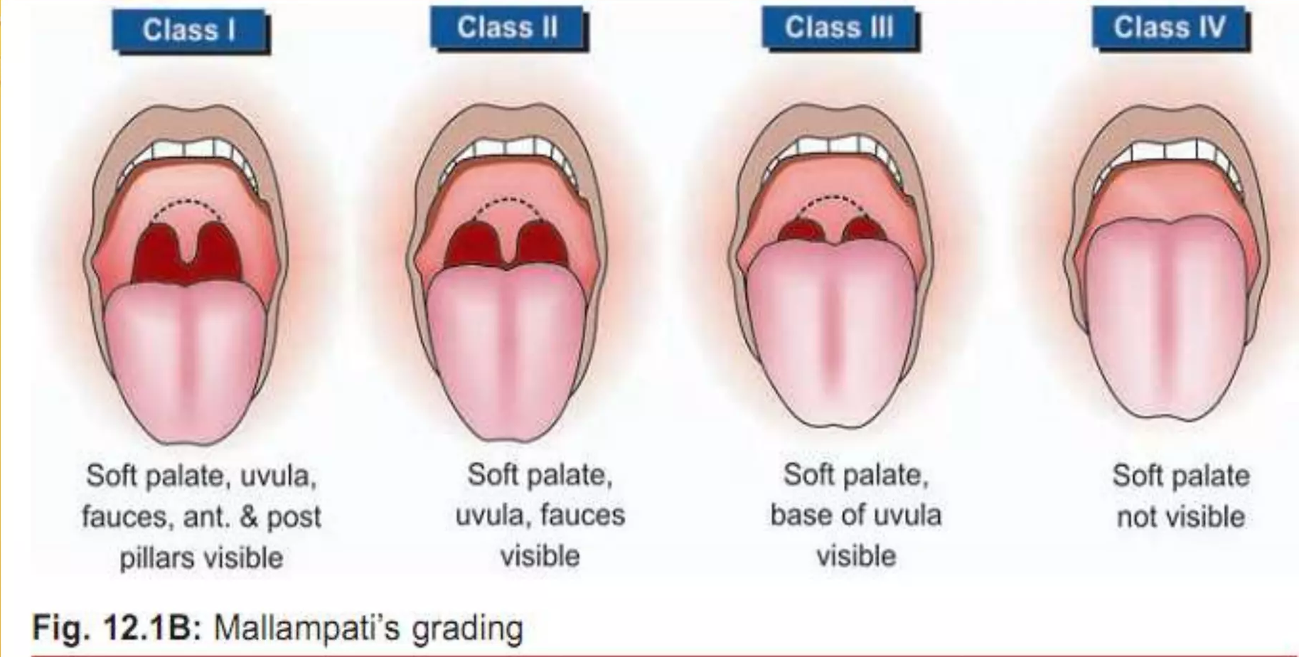

Slide 16
ASA PHSICAL CLASSIFICATION
IA normal healthy patient
II A patient with mild systemic disease
III A patient with severe systemic
IVA patient with severe systemic disease that is a constant threat to life
VA moribund patient who is not expected to survive without the operation

Slide 17
PRE-PROCEDURE PATIENT ASSESSMENT
Investigations:
ECG, echo
Chest – x-ray
CBC
BT,CT ,PT T, PT ,INR
Na , k
R.B.S or F.B.S
LFT
KFT
HBs-Ag HIV

Slide 18
MEDICAL CONSULTATIONS
After doing the medical and physical examination with the full investigations; the patient should be evaluated by a medical doctor or anesthetist to do a medical fitness for him to receive the anesthesia.

Slide 19
INFORMED CONSENT
It’s a process, not a piece of paper.
Verbal and written informed consent must be given at the pre‐op consultation appointment, not the day of surgery Cannot be obtained once medications are administered.
New written consent must be obtained for each procedure or sedation. Consent to surgery does not imply consent for sedation; sedation needs to be specified.
Consent must be obtained by the doctor in face‐to‐face meeting, not a staff member.

Slide 20
PRE-SEDATION/ANESTHETIC INSTRUCTIONS
Give both verbally and in writing
Fasting (“NPO”) instructions (if needed)
“Vested” escort to accompany patient Patient’s other medications

Slide 21
PRE-PROCEDURE FASTING (NPO)
The patient must be fasted minimum 2-3 hours for clear liquids and 6 hours for solid food to prevent vomiting causing Suffocation and aspiration pneumonia.

Slide 22
PSYCHOLOGICAL PREPARETION
Psychological preparation of the patient for the sedation or GA is paramount.
Explain the different types of sedation available and GA techniques
Tell them they will be “relaxed, drowsy, comfortable,” and “aware and in control.”
Give realistic expectations to patient and explain that every patient reacts differently, and they may need more / less medication or different technique at future appointments.

Slide 23
PREANAESTHETIC MEDICATION
Preanaesthetic medication refers to the use of drugs before anaesthesia to make it more pleasant and safe.

Slide 24
1.Opioids : Morphine (10 mg) or pethidine (50-100 mg).
2. Antianxiety drugs: Benzodiazepines like diazepam (5-10mg oral) or lorazepam (2 mg i.m.) have become populardrugs for preanaesthetic medication
3.Sedative-hypnotics : Barbiturates like pentobarbitone,secobarbitone or butabarbitone (100 mg oral) have been used night before (to ensure sleep) and in the morning to calm the patient.

Slide 25
4. Anticholinergics: Atropine or hyoscine (0.6 mg i.mJi.v.) have been used, primarily to reduce salivary, bronchial secretions and to prevent vagal bradycardia and hypotension.
5.Antiemetics: Metoclopramide 10-20 mg i.m.
6. Ondansetron (4-8 mg i.v.) and Granisetron (0.1 mg) has been found to be highly effective in reducing the incidence of post anaesthetic nausea and vomiting.

Slide 26
INTRAOPERATIVE RESPONSIBILITIES
◦ Informed consent signed prior to sedation
◦ Name, dose, route and time of all medications documented
◦ Procedure begin and end times
◦ Prior adverse reactions
◦ Pre-medication time and effect
◦ Vital Signs
BP
Heart Rate
Respiratory Rate
Oxygen Saturation
Level of Consciousness

Slide 27
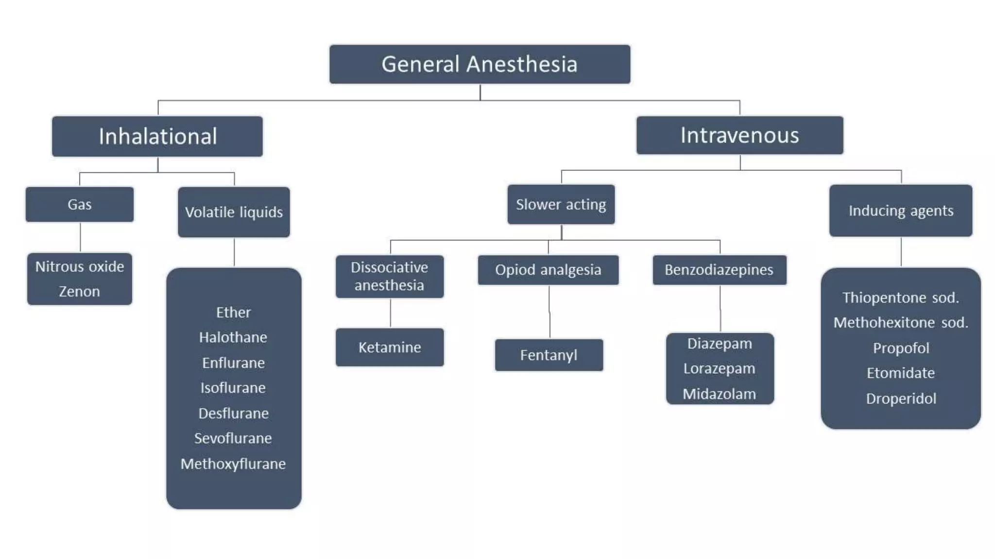

Slide 28
STAGES OF ANAESTHESIA
Stage 1: Analgesia
Lasts until consciousness is lost (then Stage 2)
Pain is supressed to an extent
In a dream-like state
Does not last long
Used for women in labour, incisions, and minor operations

Slide 29
STAGES OF ANAESTHESIA
Stage 2: Delirium
Begins at loss of consciousness and ends at the return of regular respiration
Irregular breathing, heart rate, blood pressure
Vomiting, nausea, and defecation may occur
Patients may hold their breath
No operative procedures are carried out during this stage

Slide 30
STAGES OF ANAESTHESIA
Stage 3: Surgical Anaesthesia (4 planes)
Begins once regular respiration returns, ends at cessation of breathing
Plane 1 – roving eye balls
Plane 2 - loss of corneal and laryngeal reflexes
Plane 3 – pupils are dilated, light reflex is lost
Plane 4 - intercostal paralysis, small breathes as a result

Slide 31
STAGES OF ANAESTHESIA
Stage 4: Medullary and Respiratory Paralysis
Cessation of breathing Leads to death

Slide 32
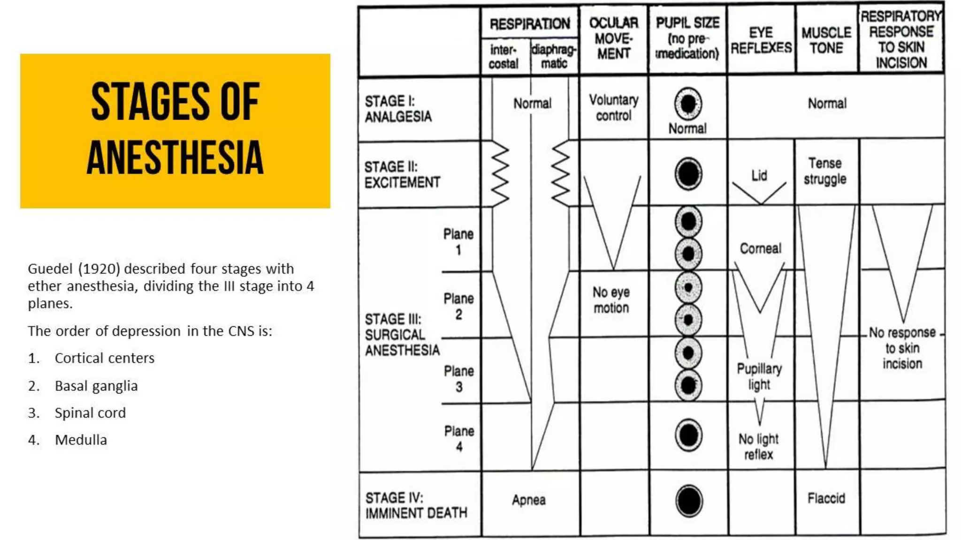

Slide 33
HALOTHANE
potent anaesthetic, rapid induction & recovery
Neither flammable nor explosive, sweet smell, non irritant
Does not augment bronchial and salivary secretions.
Low incidence of post operative nausea and vomiting.
Relaxes both skeletal and uterine muscle, and can be used in obstetrics when uterine relaxation is indicated.
Combined with its pleasant odor, this makes it suitable in children for inhalation induction.

Slide 34
DISADVANTAGES
Weak analgesic(thus is usually coadministerd with N2O, opioids)
Is a strong respiratory depressant
Is a strong cardiovascular depressant; halothane is vagomimetic and cause atropine-sensitive bradycardia.
Hepatotoxic: is oxidatively metabolized in the liver to tissue- toxic hydrocarbons (e.g., trifluroethanol and bromide ion).
Malignant hyperthermia

Slide 35
ENFLURANE
Less potent than halothane, but produces rapid induction and recovery
~2% metabolized to fluoride ion, which is excreted by the kidney
Has some analgesic activity
Disadvantages:
CNS excitation at twice the MAC
Can induce seizure

Slide 36
DESFLURANE
Rapidity of induction and recovery: outpatient surgery
Less volatility (must be delivered using a special vaporizer)
It decreases vascular resistance and perfuse all major tissues very well.
Irritating cause apnea, laryngospasm, coughing, and excessive secretions

Slide 37
SEVOFLURANE
Has low pungency, not irritating the airway during induction; making it suitable for induction in children
Rapid onset and recovery:
Metabolized by liver, releasing fluoride ions; thus, like enflurane, it may prove to be nephrotoxic.

Slide 38
METHOXYFLURANE
The most potent and the best analgesic anesthetic available for clinical use.
Nephrotoxic and thus seldom used.

Slide 39
NITROUS OXIDE
It is a potent analgesic but a weak general anesthetic.
Rapid onset and recovery:
Does not depress respiration, and no muscle relaxation.
Clinical use: dental surgery, obstetrics, postoperative physiotherapy, refractory pain in terminal illness, and maintenance of anesthesia.
The least hepatotoxic, Teratogenic, bone marrow depression.

Slide 40
INTRAVENOUS ANESTHETICS BARBITURATES
thiopental, methohexital
Potent anesthetic but a weak analgesic
High lipid solubility; quickly enter the CNS and depress function, often in less than one minute, and redistribution occur very rapidly as well to other body tissues, including skeletal muscle and ultimately adipose tissue (serve as a reservoir).
All barbiturates can cause apnea, coughing, chest wall spasm, laryngospasm, and bronchospasm

Slide 41
INTRAVENOUS ANESTHETICS PROPOFOL
Phenol derivative, It is an IV sedative-hypnotic used in the induction and or maintenance of anesthesia.
Onset is smooth and rapid (40 seconds)
Decrease BP without depressing the myocardium, it also reduce intracranial pressure.
It is widely used and has replaced thiopental as the first choice for anesthesia induction and sedation, because it produces a euphoric feeling in the patient and does not cause post anesthetic nausea and vomiting.
Poor analgesia.

Slide 42
INTRAVENOUS ANESTHETICS KETAMINE
Ketamine (phencyclidine derivative) a short-acting, anesthetic, induces a dissociated state in which the patient is unconscious (but may appear to be awake) and does not feel pain.
This dissociative anesthesia provides sedation, amnesia, and immobility. ➢Ketamine is also a potent bronchodilator.

Slide 43
Therefore, it is beneficial in patients in asthmatics. Conversely, it is contraindicated in hypertensive or stroke patients.
Ketamine is used mainly in children and elderly adults for short procedures.
It is not widely used, because it increases cerebral blood flow and may induce hallucinations, particularly in young adults.

Slide 44
DEXMEDETOMIDINE
It is a sedative used in intensive care settings and surgery.
It is relatively unique in its ability to provide sedation without respiratory depression.
Like clonidine, it is an α2 receptor agonist in certain parts of the brain.
Dexmedetomidine has sedative, analgesic, sympatholytic, and anxiolytic effects.
It reduces volatile anesthetic, sedative, and analgesic requirements without causing significant respiratory depression.

Slide 45
BENZODIAZEPINE
Benzodiazepine (midazolam, lorazepam and diazepam)
Are used in conjunction with anesthetics to sedate the patient.

Slide 46
OPIOIDS
Opioids (fentanyl, sufentanil)
Analgesic, not good amnesic, used together with anesthetics.
They are administered either I.V, epidurally, or intrathecally

Slide 47
During surgery
Induction – thiopentone, etomidate or propofol,
Maintanance usually with nitrous oxide and oxygen + vollatile agent (halotane or isoflurane) i.v. less often with nitrous oxide and oxygen + analgesic (fentanyl, morphine, pethidine) + competitive neuromuscular blocking agent if muscular relaxation is needed (for abdominal surgery),

Slide 48
After surgery
Relief of pain (morphine and its derivates are commonly used and other analgesics NSAIDs).
Postoperative vomiting – antiemetics (metoclopramide, ondansetron, prochlorperazine).

Slide 49
COMPLICATION OF GENERAL ANAESTHESIA
A. During anaesthesia
1.Respiratory depression.
2. Salivation, respiratory secretions -less now as non-irritant anaesthetics are mostly used.
3. Cardiac arrhythmias.
4. Fall in BP
5. Aspiration of gastric contents: acid pneumonitis.
6. Fire and explosion - rare now due to use of non-inflammable agents.

Slide 50
B. After anaesthesia
1.Nausea and vomiting.
2. Persisting sedation: impaired psychomotor function.
3. Penumonia.
4. Organ toxicities: liver, kidney damage.
5. Nerve palsies - due to faulty positioning
6. Emergence delirium.

Slide 51
DEFINATION
Cardiopulmonary resuscitation (CPR) is the manual application of chest compressions and ventilations to patients in cardiac arrest, done with an effort to maintain viability

Slide 52
INDICATION:
Road Traffic Accident
Drowning
Electric Shock
Airway Obstruction
Cardiac Arrest
CONTRAINDICATION :
Do-not-resuscitate (DNR)

Slide 53

CHAIN OF SURVIVAL

Slide 54
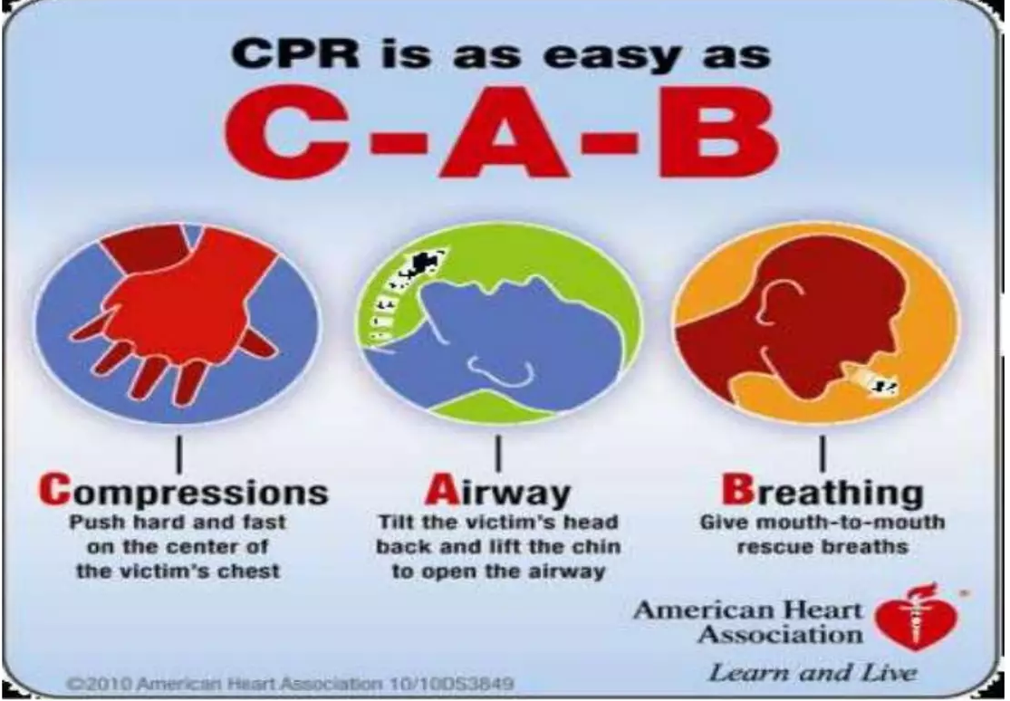

Slide 55
POSITIONING
Positioning for CPR:
CPR is most easily and effectively performed by laying the patient supine on a relatively hard surface, which allows effective compression of the sternum.
Delivery of CPR on a mattress or other soft material is generally less effective.
The person giving compressions should be positioned high enough above the patient to achieve sufficient leverage, so that he or she can use body weight to adequately compress the chest.

Slide 56
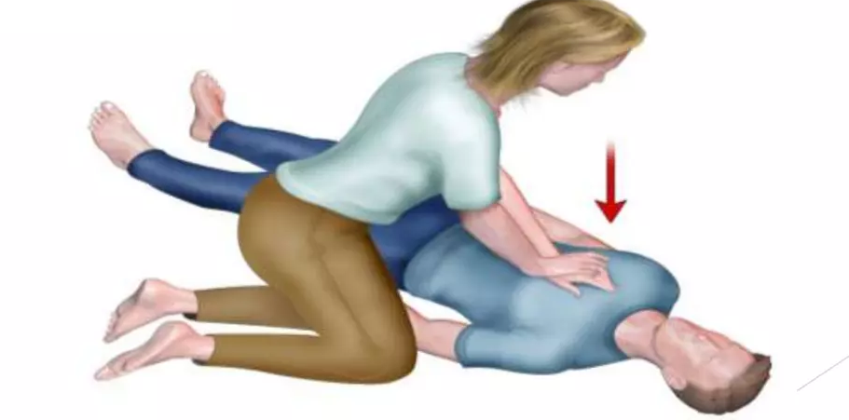
REMEMBER TO SPELL C-A-B
C-A-B Compressions: Restore blood circulation
Place the heel of one hand over the center of the person's chest, between the nipples. Place other hand on top of the first hand. Keep elbows straight and position shoulders directly above hands.
2. Use upper body weight (not just arms) as pushing straight down on (compress) the chest

Slide 57
Compression rate:
In adult victims of cardiac arrest, it is reasonable for rescuers to perform chest compressions at a rate of 100 to 120/min.
Compression depth:
During manual CPR, rescuers should perform chest compressions to a depth of at least 2 inches (5 cm) for an average adult, while avoiding excessive chest compression depths (greater than 2.4 inches [6 cm])
Chest recoil:
It is reasonable for rescuers to avoid leaning on the chest between compressions, to allow full chest wall recoil for adults in cardiac arrest.
If not trained in CPR, continue chest compressions until there are signs of movement or until emergency medical personnel take over.

Slide 58
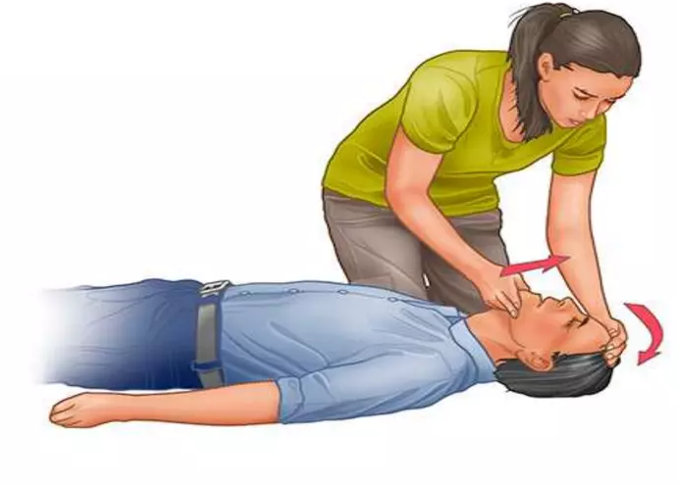
AIRWAY
Open the airway
Some signs of obstructed airway include poor air exchange, high pitch noise while breathing and inability to speak.
If rescuer trained in CPR and performed 30 chest compressions, open the person's airway using the head-tilt, chin-lift maneuver.
Put palm on the person's forehead and gently tilt the head back. Then with the other hand, gently lift the chin forward to open the airway.

Slide 59
Breathing
Breathe for the person
Rescue breathing can be mouth-to-mouth breathing or mouth-to-nose breathing if the mouth is seriously injured or can't be opened.
With the airway open (using the head-tilt, chin-lift maneuver), pinch the nostrils shut for mouth-to-mouth breathing and cover the person's mouth with yours, making a seal.
Prepare to give two rescue breaths. Give the first rescue breath lasting one

Slide 60
It may be reasonable for the provider to deliver 1 breath every 6 seconds (10 breaths per minute) while continuous chest compressions are being performed (ie, during CPR with an advanced airway).
The adequacy of breath given can be determined by observing for rise in victims chest.
Continue CPR until there are signs of movement or emergency medical personnel take over

Slide 61
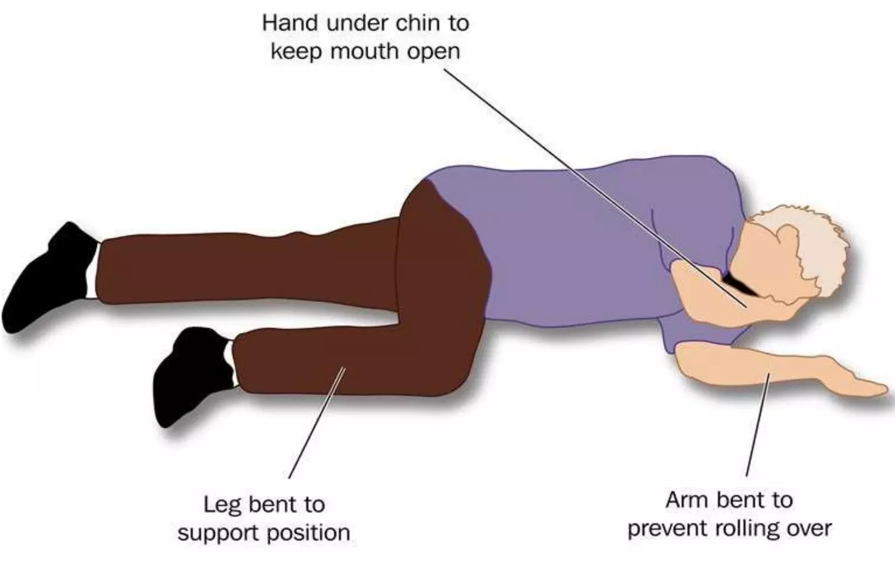
RECOVERY POSITION
The recovery position refers to one of a series of variations on a lateral recumbent or three-quarters prone position of the body.
If a person is unconscious but is breathing and has no other life- threatening conditions, they should be placed in the recovery position.
Putting someone in the recovery position will keep their airway clear and open.
It also ensures that any vomit or fluid won't cause them to choke.

Slide 62
STEPS BEFORE YOU BEGIN
Immediately upon seeing the victim and Before starting CPR, check:
Is the environment safe for the person?
Is the person conscious or unconscious?
If the person appears unconscious, tap or shake his or her shoulder and ask loudly, "Are you OK?“
Check carotid pulse for 10 seconds.

Slide 63
If the person doesn't respond and two people are available, have one person call 108 or the local emergency number and have the other person begin CPR.
If alone and have immediate access to a telephone, call 108 or local emergency number before beginning CPR. Get the AED, if one is available.
As soon as an AED is available, deliver one shock if instructed by the device, then begin CPR.
Put the person on his or her back on a firm surface.
Kneel next to the person's neck and shoulders.

Slide 64
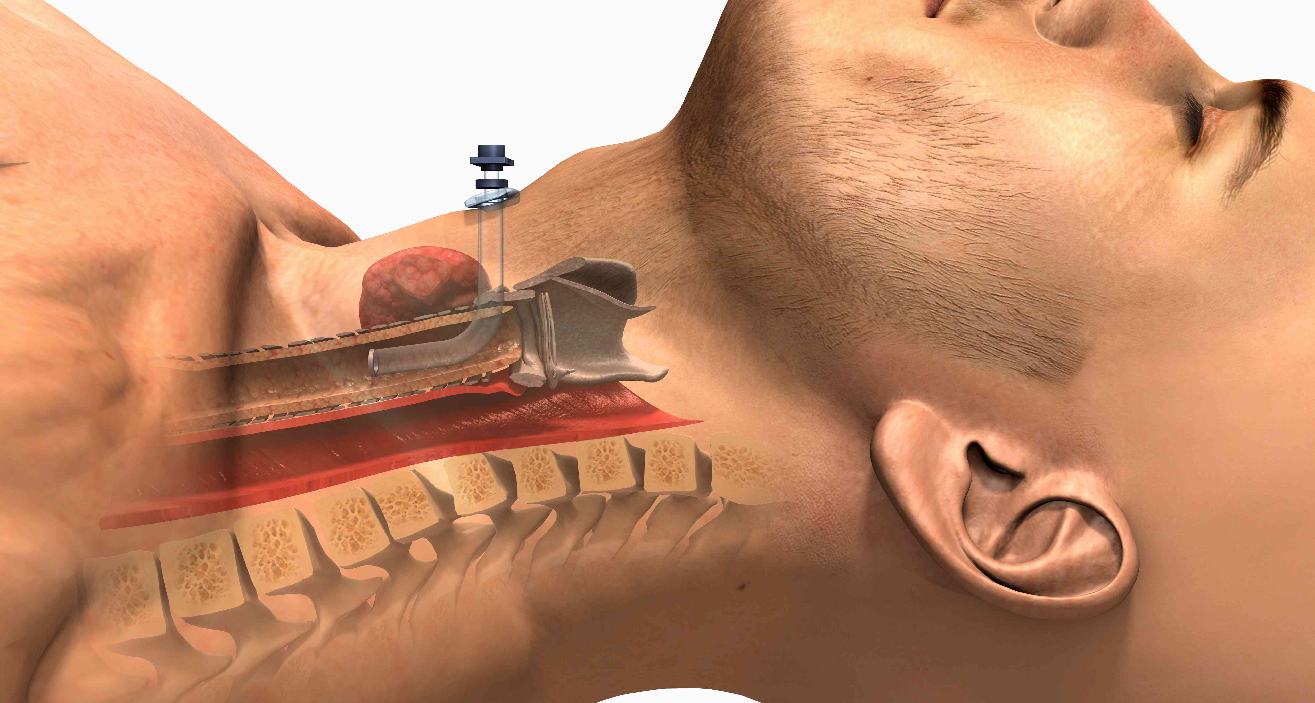
TRACHEOSTOMY
A tracheostomy, also known as a tracheotomy, is a medical procedure that involves creating an opening in the neck in order to place a tube into a person’s trachea to facilate breathing.
The tube may be temporary or permanent.

Slide 65
Anatomic landmarks such as the thyroid notch, cricoid cartilage, and sternal notch are palpated and marked
A skin incision is then marked in the midline anterior neck 1 to 2 cm inferior to the carotid cartilage. A horizontal or vertical incision may be utilized.
The incision is extended through the platysma muscle to expose the strap muscles (sternohyoid and sternothyroid), identifying the median raphe.
The strap muscles are then retracted laterally, exposing the cricoid cartilage and thyroid gland.

Slide 66
The thyroid isthmus is identified and ligated, if necessary
A cricoid hook is then placed under the cricoid cartilage to elevate the larynx and trachea into the operative field.
The second and third tracheal rings are identified.
An incision is made between the second and third rings, and tracheostomy tube placed.

Slide 67
COMPLICATIONS
Infection
Tube displacement
Scarring of the trachea
Abnormal thinning of the trachea (tracheomalacia)
Fistula

Slide 68
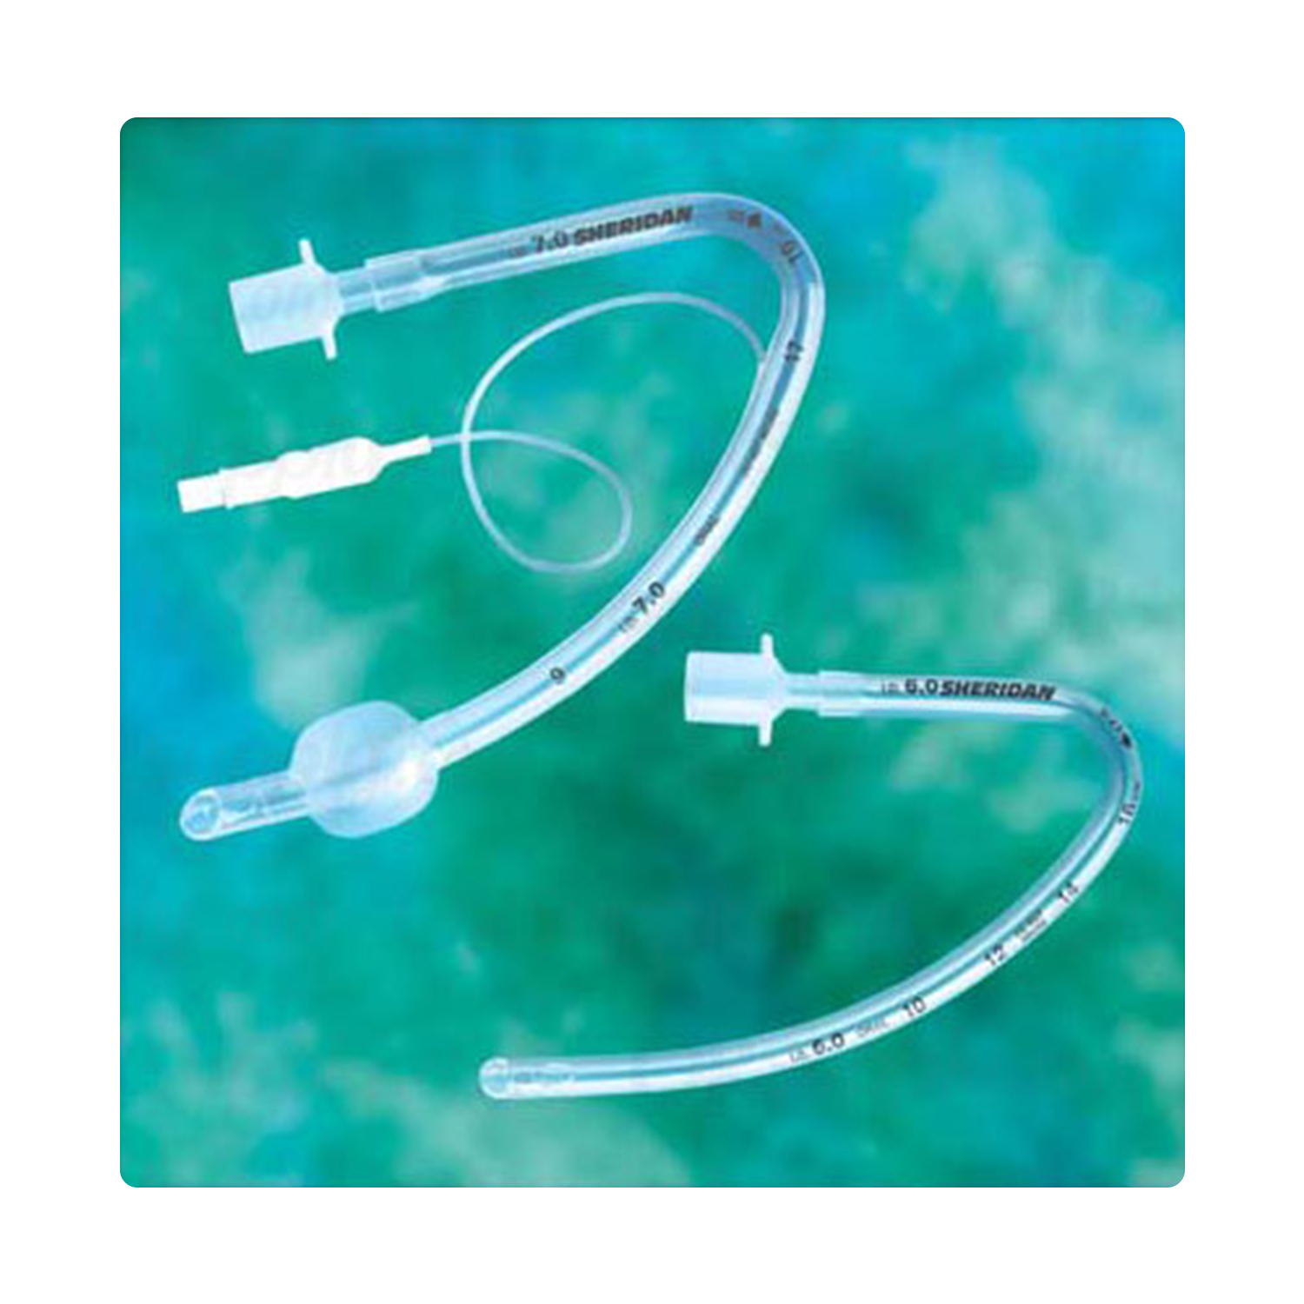
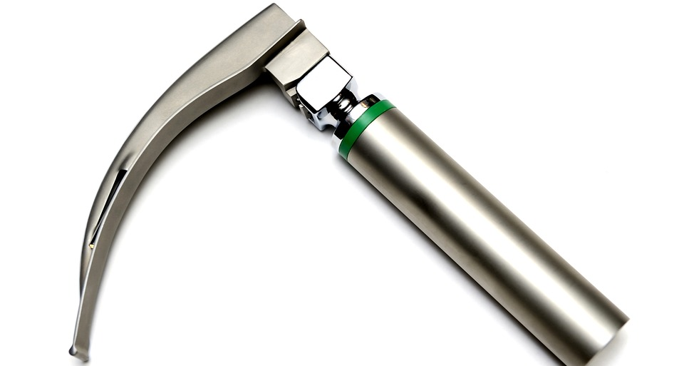
Endotracheal tube laryngoscope

Slide 69
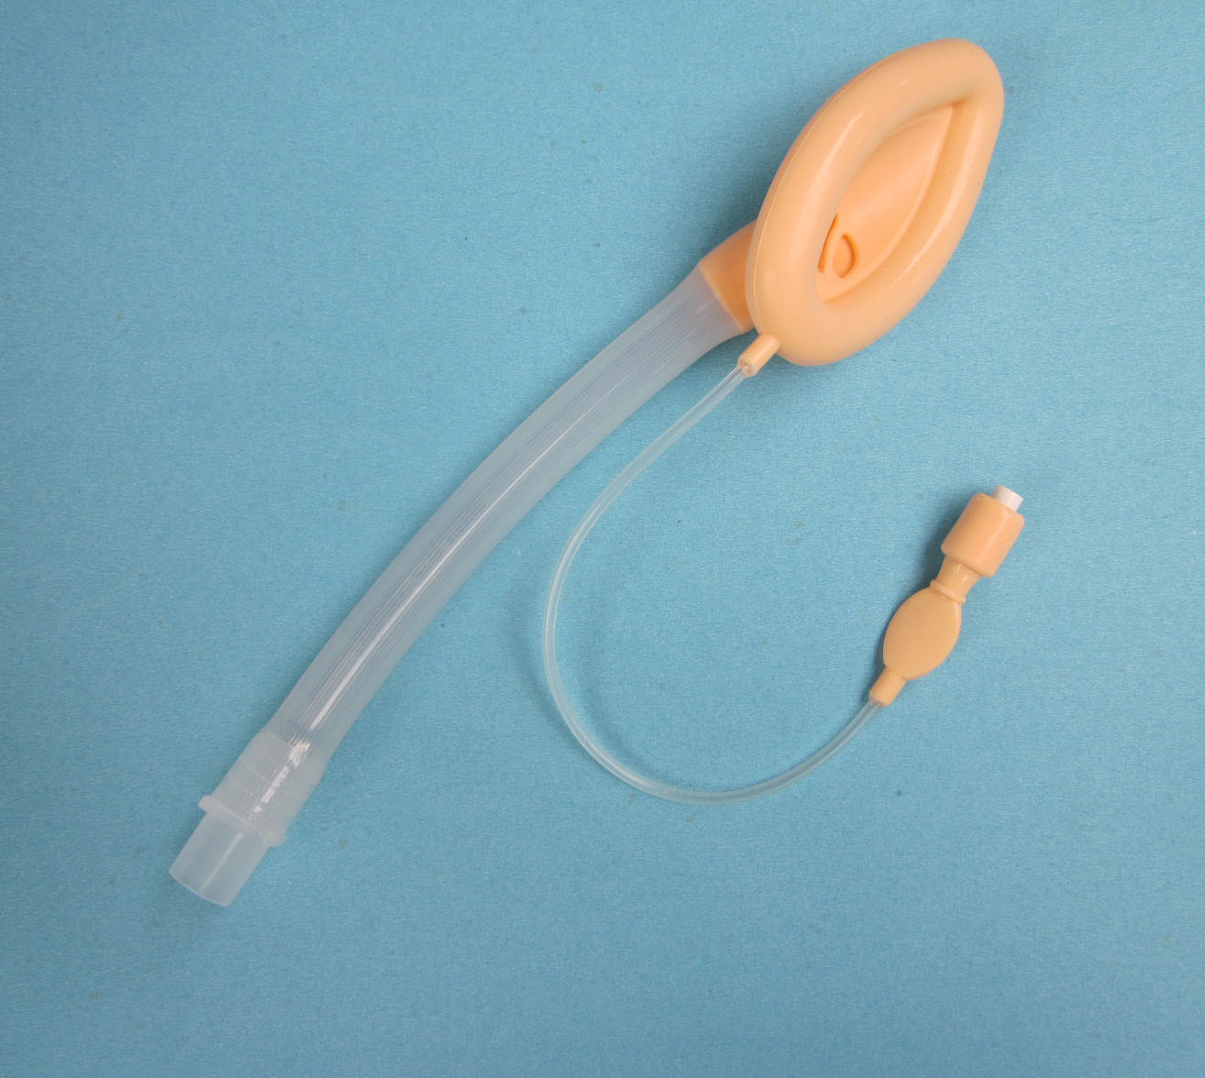
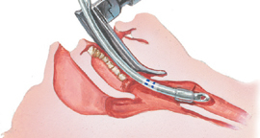

Slide 70
