Slide 1
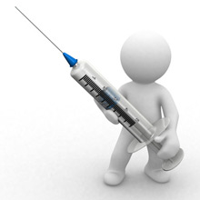
Local anesthesia

Slide 2
INTRODUCTION
Derived from the word
“an-without Aisthetos-sensation “ Oliver Bendel in 1846.
Local anesthesia is a state of controllable, reversible insensibility in which sensory perception and motor responses are both markedly depressed.
Analgesia is the temporary abolition or diminution of pain reception

Slide 3
DEFINITION
Local anesthesia has been defined as loss of sensation in circumscribed area of body caused by depression of excitation in nerve endings or an inhibition of conduction process in peripheral nerves.(Stanley F. Malamed)
Local anesthetic are the drugs have a little or no irritating effects when injected into the tissues and that will temporarily interrupt conduction when absorbed into the nerves(Monheims)
Local anesthesia has been defined as direct administration of anesthetic agent to tissue to include the absence of sensation in small area of body (Mosby’s dictionary)

Slide 4
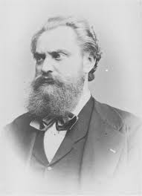
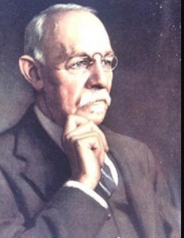
HISTORY
1859 - cocaine was isolated by “Niemann”.
1884 - The ophthalmologist Koller used cocaine for topical anesthesia in ophthalmological surgery.
1884 - Regional anesthesia in the oral cavity was first performed by surgeon Halsted.

Slide 5
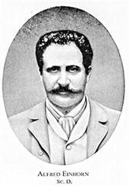
In 1905, Einhorn reported the synthesis of procaine - first ester type LA
In 1943, Lofgren synthesized lidocaine, which was first “modern” local anesthetic agent.
Lidocaine - marketed in 1948
commonly used local anesthetic in dentistry worldwide.

Slide 6
Mepivacaine 1957,
Prilocaine 1960,
Bupivacaine 1963.
Articaine 1969 chemist “Muschaweek” and was approved in 1975

Slide 7
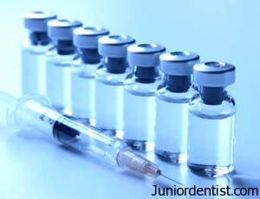
IDEAL PROPERTIES
Reversible action.
Non-irritant.
No allergic reaction.
No systemic toxicity.
Rapid onset of action.
Sufficient duration of action.
Potent.
Stable in solutions.
Not interfere with healing of tissue.
Vasoconstrictor action or compatible with VC.
Not expensive

Slide 8
ELECTROPHYSIOLOGY OF NERVE CONDUCTION
Notes:
resting potential which is negative electrical potential of -70mV because of differing in concentration of ions on either side of membrane.
Internal to the membrane is negative in respect to the outer part.
Stimulation excites the nerve cells.
Initial phase of slow depolarization, the electrical potential becomes slightly less negative.
Falling electrical potential reaches a critical level. Extremely rapid phase of depolarisation results reaches to a threshold potential or firing potential where reversal of electrical potential across nerve membrane.
Internal to the membrane becomes positive in respect to the outside (+40mV)
This is a phase of Repolarisation.
Electrical potential gradually becomes more negative in respect to the outside until -70mv is achieved.
DEPOLARIZATION- 0.3msec
REPOLARIZTION- 0.7msec

Slide 9
IMPULSE PROPAGATION AND SPREAD
The propagated impulse travels along the nerve membrane towards CNS
UNMYELINATED NERVES:
High resistance cell membrane and extra cellular media
Slow forward-creeping process.
Conduction rate is 1.2m/sec

Slide 10
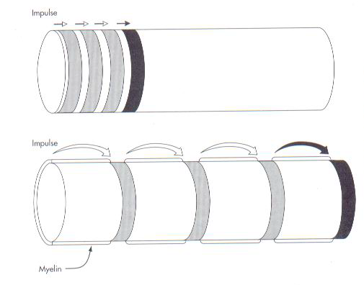
MYELINATED NERVES :
By means of current leaps from nodes to node, this process is called as SALTATORY CONDUCTION.
More rapid in thicker nerves
Thickness of myelin sheath
distance between adjacent nodes of ranvier.
Conduction rate of myelinated fibers is 120m/sec.

Slide 11
MODE AND SITE OF ACTION OF LA
Local anaesthetic agent interferes with excitation process in a nerve membrane in one of the following ways:
Altering the basic resting potential of nerve membrane
Altering the threshold potential
Decreasing the rate of depolarization
Prolonging the rate of repolarization

Slide 12
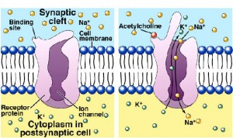
THEORIES OF LA
ACETYL CHOLINE THEORY
Stated that acetylcholine was involved in nerve conduction in addition to its role as a neurotransmitter at nerve synapses.
Notes:
: Stated that acetylcholine was involved in nerve conduction in addition to its role as a neurotransmitter at nerve synapses. There is no evidence that acetylcholine is involved in neural transmission.

Slide 13
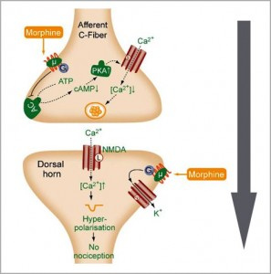
CALCIUM DISPLACEMENT THEORY
States that local anesthetic nerve block was produced by displacement of calcium from some membrane site that controlled permeability of sodium.

Slide 14
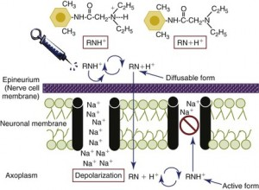
SURFACE CHARGE THEORY
Proposed that local anaesthetic acted by binding to nerve membrane and changing the electrical potential at the membrane surface.
Notes:
Cationic drug molecule were aligned at the membrane water interface, and since some of the local anesthetic molecule carried a net positive charge, they made the electrical potential at the membrane surface more positive, thus decreasing the excitability of nerve by increasing the threshold potential. Current evidence indicate that resting potential of nerve membrane is unaltered by local anesthetic.

Slide 15
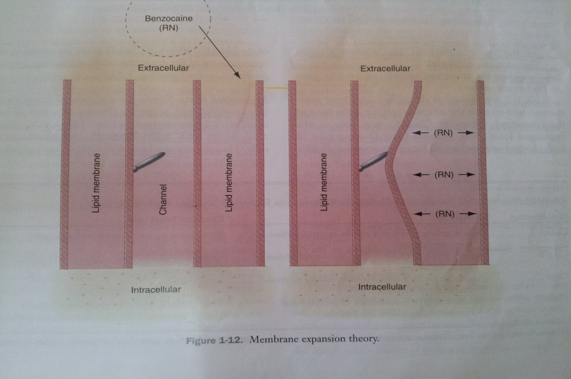
MEMBRANE EXPNSION THEORY
Local anesthetic molecule diffuse to hydrophobic regions of excitable membranes, producing a general disturbance of bulk membrane structure, expanding membrane, and thus preventing an increase in permeability to sodium ions.

Slide 16
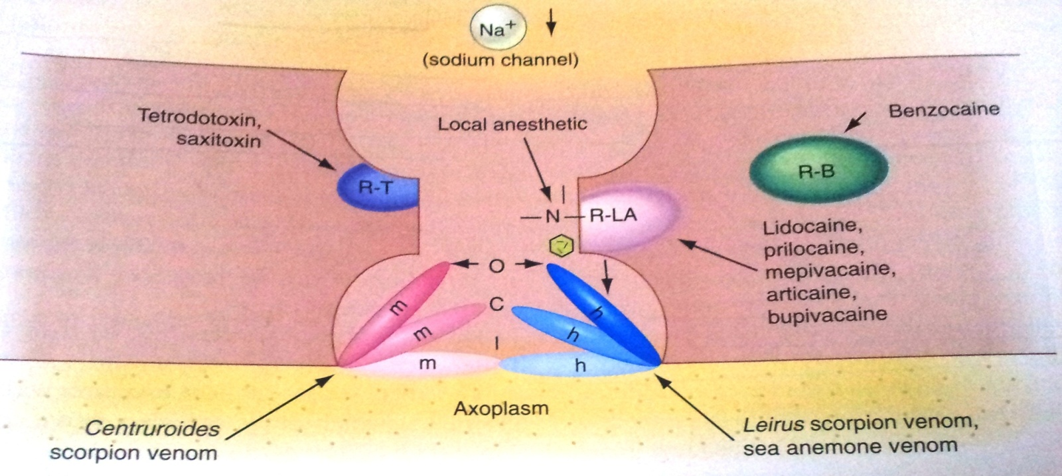
SPECIFIC RECEPTOR THEORY
The most favoured today, proposed that local anesthetics act by binding to specific receptors on sodium channel
Permeability to sodium ion is decreased or eliminated and nerve conduction is interrupted.

Slide 17
HOW LOCAL ANESTHETIC WORKS ?

Slide 18
CLASSIFICATION OF LA
I. Based on bioavailability
Natural – eg. cocaine.
Synthetic nitrogenous compound – eg. procaine, benzocaine, lignocaine & bupivacane
Non Nitrogenous compounds – benzyl alcohol
Miscellaneous – clove oil , phenol.

Slide 19
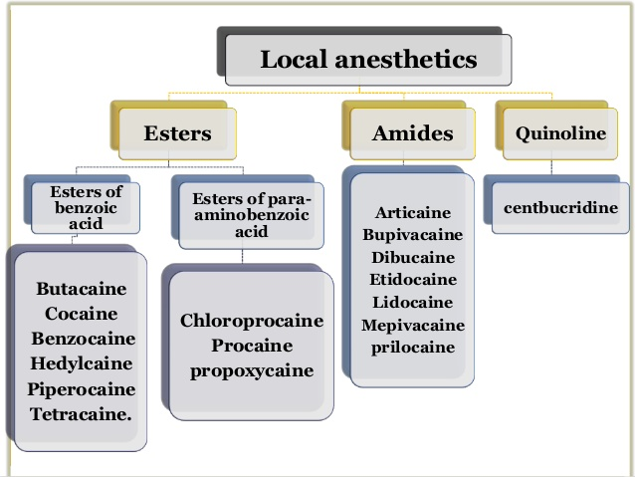
II. According to structure:

Slide 20
III. According to duration of action :
1) Ultra Short acting anesthetic – less than 30 min
Procaine without a vasoconstrictor
2 chloroprocaine without vasoconstrictor
2% lidocaine without a vasoconstrictor
2) Shot acting local anesthetic – 45 to 75 min
2% lidocaine with 1:100000 epinephreine
2% mepivacaine with 1: 20000 lavonordefrin
4% prilocaine when used to nerve block

Slide 21
3) Medium acting anesthetics 90 – 150min
4% prilocaine with 1:200000 epinephrive
2% lidocaine and 2% mepivacaine with a vasoconstrictor
May produce pulpal anesthesia of this duration
4) Longer acting anesthestic – 180 min or longer
0.5% bupivacaine with 1: 200000 epinephrine
0.5% or 1.5% etidocaine with 1:200000 epinephrine

Slide 22
IV. According to mechanism of action
Class A : Agents acting at receptor site on external surface of nerve membrane
eg: Biotoxins
Class B : Agents acting at receptor sites on internal surface of nerve membrane
eg: scorpion venom
Class C : Agents acting by receptor independent physio-chemical mechanism
eg: Benzocaine
Class D :Agents acting in combination of receptor dependent-independent mechanism
eg: Lidocaine, Mepivacaine, Prilocaine

Slide 23
DISSOCIATION OF LOCAL ANESTHETICS
Local anesthetics are available as salts (usually hydrochlorides)
The salts, both water soluble and stable, is dissolved in sterile water or saline.
In this solution it exists simultaneously as unchanged molecule (RN), also called base and positively charged molecules (RNH+) called cations.
RNH⁺ ⬅====➔ RN+ H⁺

Slide 24
The relative concentration of each ionic form in the solution varies with the pH of the solution or surrounding tissue.
In the presence of high concentration of hydrogen ion (low pH) the equilibrium shifts to left and most of the anesthetic solution exists in cationic form.
RNH+ > RN+ + H+
As hydrogen ion concentration decreases (higher pH) the equilibrium shifts towards the free base form.
RNH+ < RN + H+

Slide 25
The relative proportion of ionic form also depends on pKa or DISSOCIATION CONSTANT, of the specific local anesthetic.
The pKa is a measure of molecules affinity for H+ ions.
When the pH = pKa of the local anesthetic, exactly half the drug will exists in the RNH+ form and exactly half in RN form.
The percentage of drug existing in either form can be determined by Henderson Hasselbalch equation
Log base/acid = pH - pKa

Slide 26
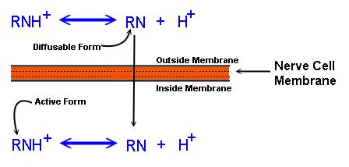
Injectable local anesthetics are weak bases (pka=7.5-9.5) When a local anesthetic is injected into tissue it is neutralized and part of the ionized form is converted to non-ionized
The non-ionized base diffuses into the nerve.

Slide 27
pH INFLUENCE
If the tissue is infected, the pH is lower (more acidic) and according to the HH equation; there will be less of the non-ionized form of the drug to cross into the nerve

Slide 28
INDUCTION TIME
Is defined on the period from deposition of the anaesthetic solution to complete condition blockade
Factors :
Concentration of drug
pH of solution
Diffusion constant of drug
Anatomical barriers for diffusion

Slide 29
KINETICS OF LOCAL ANESTHETICS
UPTAKE:
When injected into soft tissue most local anaesthetics produce dilation of vascular bed.
Vasodilation is due to increase in the rate of absorption of the local anesthetic into the blood, thus decreasing the duration of pain control, while increasing the anesthetic blood level and potential for over dose.
Cocaine produces vasoconstriction

Slide 30
ORAL ROUTE:
Except cocaine, local anesthetics are poorly absorbed from GIT
Most local anesthetics undergo hepatic first-pass effect following oral administration.
72% of dose is biotransformed into inactive metabolites
TOCAINIDE HYDROCHLORIDE an analogue of lidocaine is effective orally

Slide 31
TOPICAL ROUTE:
Local anesthetics are absorbed at different rates after application to mucous membranes: In the tracheal mucosa uptake is as rapid as with intravenous administration.
In pharyngeal mucosa uptake is slow
In bladder mucosa uptake is even slower
Eutectic mixture of local anesthesia (EMLA) has been developed to provide surface anesthesia for intact skin.

Slide 32
INJECTION:
The rate of uptake of local anaesthetics after injection is related to both the vascularity of the injection site and the vasoactivity of the drug.
IV administration of local anaesthetics provide the most rapid elevation of blood levels and is used for primary treatment of ventricular dysrhythmias.

Slide 33
TIME TO ACHIEVE PEAK BLOOD LEVEL
ROUTE | TIME (min)
INTRAVENOUS | 1
TOPICAL | 5
INTRAMUSCULAR | 5 – 10
SUBCUTANEOUS | 30 – 90

Slide 34
DISTRIBUTION
Highly perfused organs have higher blood levels of anesthetic than less highly perfused organs.
Skeletal muscles contains greatest percentage of local anesthetics as constitute biggest mass of tissue in body.
All LA’s can cross blood brain barrier and placenta.
Plasma concentration of local anesthetic in target organs depends on :-
Rate at which drug is absorbed into CVS
Rate of drug distribution from blood to tissues
Drug elimination through metabolic or excretory pathways.
Elimination Half life of lidocaine is 1.6 hours.

Slide 35
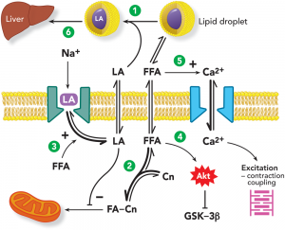
METABOLISM (BIOTRANSFORMATION)
Ester local Anesthetics
Pseudocholinesterase
Site – Plasma.
Chloroprocaine the most rapidly hydrolyzed, is the least toxic.
Tertracaine hydrolyzed 16 times more slowly than Chloroprocaine ,hence it has the greatest potential toxicity.

Slide 36
AMIDE LOCAL ANESTHETICS
Primary site – liver
Rate of biotransformation – influenced by liver function and hepatic perfusion.
Poor liver function – unable to biotransform amide local anesthetics at a normal rate.
Action of biotransformation products
Methemoglobinemia – in patients receiving large doses of prilocaine, Produced not by prilocaine but by its primary metabolite orthotoluidine.
Sedative effect – Produced by metabolites of lidocaine.

Slide 37
EXCRETION
Primary site – kidneys
Esters – small concentration in urine since hydrolyzed completely in plasma.
Amides – Present in urine as parent compound in a greater percentage because of their more complex process of biotransformation.
Procaine appears in the urine as PABA (90%) and 2% unchanged.
Renal disease – Relative contraindication to local anesthetic administration.

Slide 38
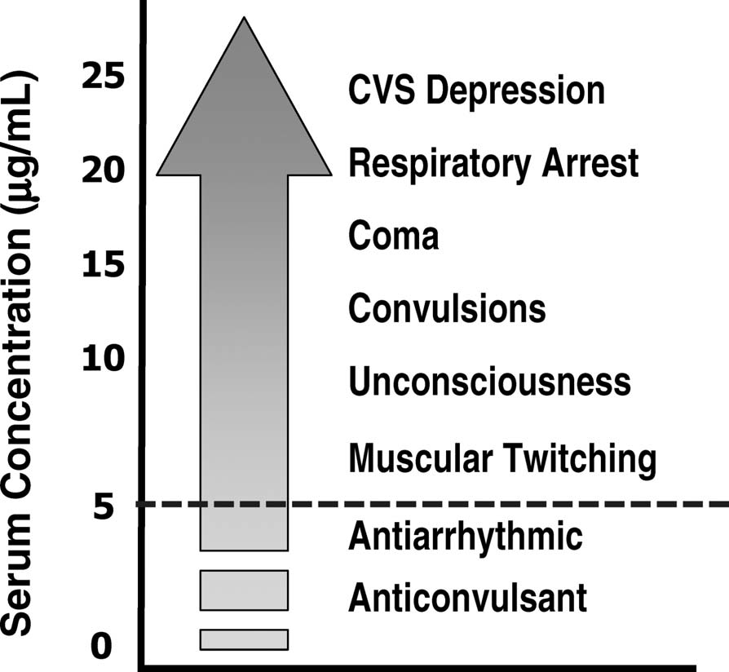
SYSTEMIC ACTIONS OF LA
CNS Stimulation:
(More sensitive than cardiac)
Dose-related spectrum of effects and all effects are due to depression of neurons.
First an apparent CNS stimulation (convulsions most serious)
Premonitory signs include: ringing in ears, metallic taste, numbness around lips
Followed by CNS depression (death due to respiratory depression)

Slide 39
Cardiovascular System:
Decrease cardiac excitability and contractility
Decreased conduction rate
Increased refractory rate (bupivicaine)
Hypotension: Arteriolar dilation is a result of:
Direct effect (procaine and lidocaine have most effect)
Block of postganglionic sympathetic fiber function
CNS depression
Allergic reactions: allergic dermatitis to anaphylaxis (rare, but occur most often by ester-type drugs).

Slide 40
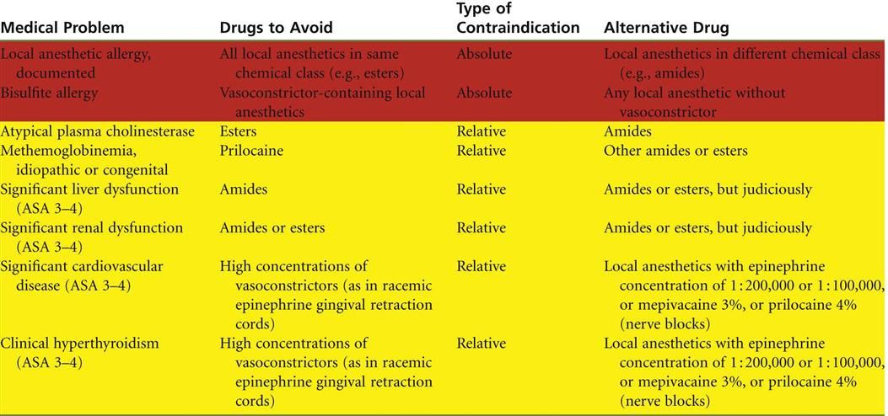
CONTRAINDICATIONS

Slide 41
VASOCONSTRICTORS
Vasoconstrictors are the drugs that constricts the blood vessels and thereby control tissue perfusion.
They are added to local anaesthesia to oppose the vasodilatory action of local anesthetic agent.

Slide 42
ACTIONS
1) Constrict blood vessels → decrease blood flow to the surgical site
2) Cardiovascular absorption is slowed → lower anesthetic blood levels
3) Local anesthetic blood levels are lowered → lower risk of toxicity
4) Local anesthetic remains around the nerve for longer periods → increased duration of anesthesia
5) Decreases bleeding

Slide 43
CLASSIFICATION
Catecholamines Noncatecholamines
Epinephrine Amphetamine
Norepinephrine Methamphetamine
Levonordefrin Ephedrine
Isoproterenol Mephentermine
Dopamine Hydroxyamphetamine
Metaraminol
Methoxamine Phenylephrine

Slide 44
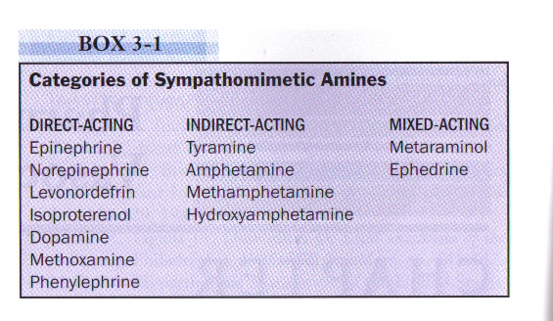
MODES OF ACTION
3 Classes of Sympathomimetic Amines:
1) Direct Acting → directly on adrenergic receptors
2) Indirect Acting → use norepinephrine release
3) Mixed Acting → both direct and indirect actions

Slide 45
Concentrations of Vasoconstrictor in Local Anesthetics - 1:50,000 ,1:100,000, 1:200,000 - 0.020mg/ml ,0.010mg/ml, 0.005 mg/ml
Calculation 1:50,000= 1gram/50,000ml= 1000mg/50,000ml= 1mg/50ml= 0.02mg/ml
Max dose of vasoconstrictors
Healthy patient approximately 0.2mg
Patient with significant cardiovascular history: 0.04mg

Slide 46
Max Dose for Vasoconstrictors (CV patient) 1 capsule = 1.8ml 1:100,000=.01mg/ml
0.01 X 1.8ml = 0.018mg 0.04/0.018=2.22 capsules
In a healthy adult patient 0.2/0.018=11.1 capsules

Slide 47
COMPOSITION
Lidocaine hydrochloride – Local anesthetic agent
Adrenaline bitarterate (epinephrine) – vasoconstrictor
Methylparaben – Preservative
Thymol – Fungicide
Sodium metabisulphate – Reducing agent
Sodium chloride – Isotonic solution
Ringer’s lactate solution : Vehicle
Distilled water : Diluting agent
Sodium hydroxide : ph adjuster

Slide 48
LIDOCAINE
Most widely used Amide linked LA and most versatile anaesthesia.
When used locally action starts within 3 min., more profound anaesthesia, has longer duration of action and greater potency.
Overdose causes muscle twitching, convulsions, cardiac arrhythmias, fall in BP, coma, respiratory arrest.
Most popular anti arrhythmic drug

Slide 49
Without Vasoconstrictor :
4.4 mg / kg of body wt = 300 mg in a 70 kg individual
= 15 ml of solution
With Vasoconstrictor :
7.2 mg / kg of body wt = 500 mg in a 70 kg individual
= 25 ml of solution

Slide 50
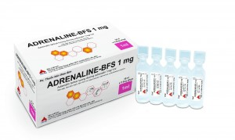
ADRENALINE BITARTERATE (EPINEPHRINE)
Adrenaline bitarterate is a hormone neurotransmitter.
It increases the heart rate constrict the blood vessels, dilates air passage and participate in fight of flight response of the sympathetic nervous system.

Slide 51
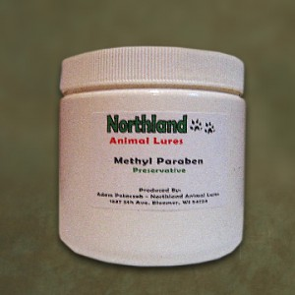
METHYL PARABEN - PRESERVATIVE
Bacteriostatic, fungistatic and antioxidant properties
Commonly used as preservatives in oinments, creams, lotions and dentrifices.
0.1 % concentration
FDA mandated removal of methyl paraben from dental local anesthetic catridges manufactured after january 1, 1984
- repeated exposure to paraben has led to increased allergic reactions.

Slide 52
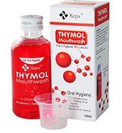
THYMOL
In the past some solutions tended to become cloudy due to the proliferation of minute fungi.
Small quantity of thymol is added to serve as fungicide and prevent this occurrence.

Slide 53
REDUCING AGENT – SODIUM META BISULFITE
Vasoconstrictors are unstable in solution and may oxidize especially on prolong exposure to sunlight, turning solution brown and must be discarded.
sodium metabisulphite - competes for the available oxygen.
shelf life increses

Slide 54
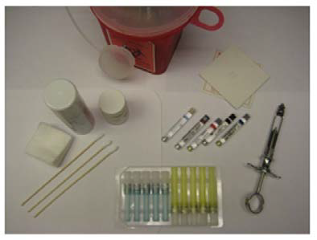
ARMAMENTARIUM
1.) The Syringe
2.) The Needle
3.) The Cartridge
4.) Other Armamentarium
Topical Anesthetic -ointments, gels, pastes, sprays
Applicator sticks
Cotton gauze

Slide 55
THE SYRINGE
TYPES
1.Non disposable syringes
a.Breech loading, metallic, catridge – type, aspirating
b. Breech loading, plastic, catridge – type, aspirating
c. Breech loading, metallic, catridge – type, self aspirating
d. Pressure syringe for periodontal ligament injection
e. Jet injector (needle less)
2.Disposable syringes
3.Safety syringes
4.Computer controlled LA delivery systems
Notes:
BREECH LOADING – catridge inserted into the syringe from sideof barrel of syringe
ASPIRATING SYRINGE – has a device sharp hook end called harpoon attached to the piston

Slide 56
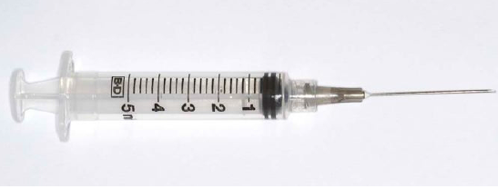
PLASTIC DISPOSABLE SYRINGE
Advantages | Disadvantages
Disposable , single use Sterile until opened lightweight | Does not accept prefilled dental cartridges Aspiration is difficult

Slide 57
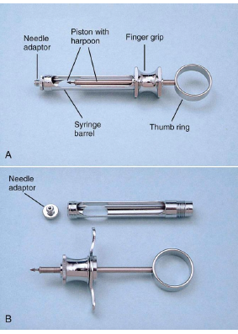
Syringe Components
1.) Needle adapter
2.) Piston with harpoon
3.) Syringe barrel
4.) Finger grip
5.) Thumb ring

Slide 58
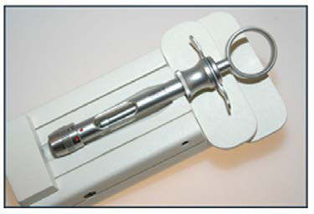
SAFETY SYRINGES

Slide 59
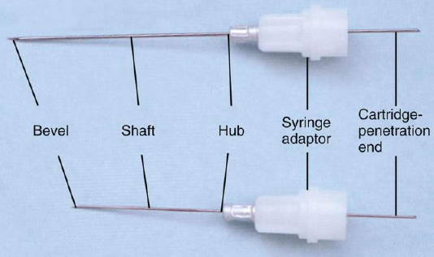
THE NEEDLE
The Needle Gauge:
The larger the gauge the smaller the internal diameter of the needle Usual dental needle gauges are 25,27, & 30 Length:
1-Long(approximately 40 mm "32-40 mm")
2-Short(20-25 mm).
3-Extra-short(approximately 15 mm), for PDL.
COMPONENTS OF NEEDLE

Slide 60
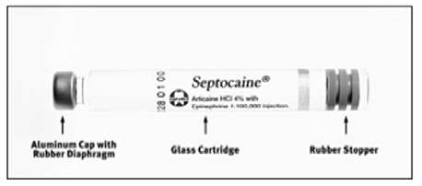
THE CATRIDGE
The Cartridge Components:
- Cylinder, plunger, diaphragm
- Types: Standard – Self aspirating, plastic, Glass
- Contents: LA, VC, Vehicle, preservative.
- Volume: 1.8, 2.0 & 2.2 ML.

Slide 61
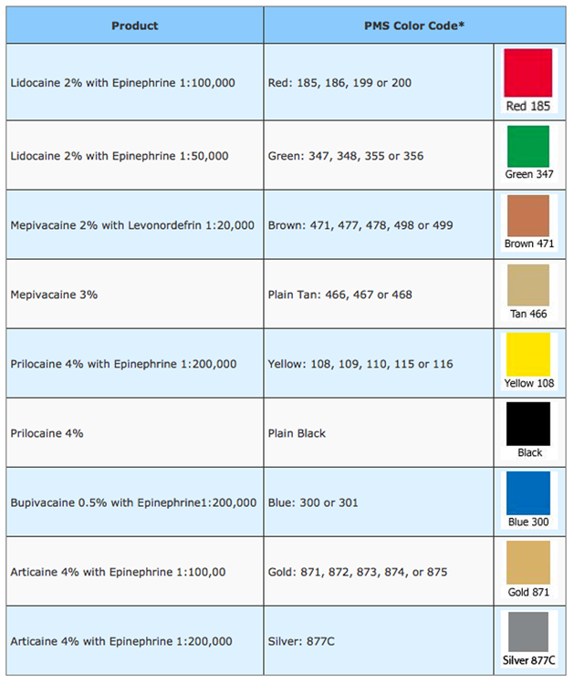
AMERICAN DENTAL ASSOCIATION COLOR CODE FORMAT FOR ANESTHETIC CARTRIDGE BANDING.

Slide 62
TECHNIQUES OF LA

Slide 63
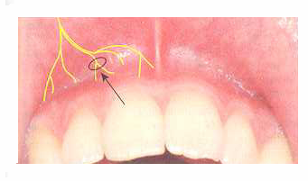
TECHNIQUES OF LOCAL ANESTHESIA
INFILTRATION
Small terminal nerve endings in the area of dental treatment are flooded with local anesthetic.
The treatment is done in the same place where anesthetic is deposited.

Slide 64
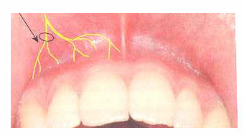
FIELD BLOCK
Local anesthetic solution is deposited near the larger terminal branches so the anesthetized area is well circumscribed.
Incision or treatment is done at an area away from the site of injection of local anesthetic.

Slide 65
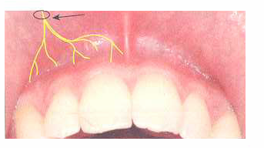
NERVE BLOCK
Local anesthetic solution is deposited close to the main nerve trunk, usually at a distance from the site of operative intervention

Slide 66
MAXILLARY INJECTION TECHNIQUES
Supraperiosteal injection
Periodontal injection
Intraseptal injection
Intraosseous injection
Posterior Superior Alveolar nerve block
Middle superior Alveolar nerve block
Anterior Superior Alveolar nerve block
Maxillary nerve block
Nasopalatine nerve block
Greater palatine nerve block

Slide 67
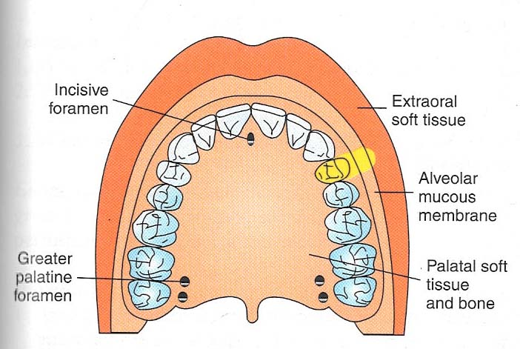
SUPRAPERIOSTEAL INJECTION
LOCAL INFILTRATION
Notes:
Nerve anesthetized
Large terminal branches of dental plexus
Area anesthetized
Entire region innervated by large terminal branches of dental plexus
Pulp & root area of tooth
Connective tissue mucous membrane; buccal periosteum.
Indications
Pulpal anesthesia of maxillary teeth when treatment is limited to one or two teeth
Soft tissue anesthesia when indicated for surgical procedures in circumscribed area
Area of insertion
Height of mucobuccal fold above apex of tooth to be anesthetized
Target area
Apical region of the tooth to be anesthetized
Landmarks
Mucobuccal fold
Crown of tooth
Root contour of tooth
Orientation of bevel
Towards bone

Slide 68
INTRALIGAMENTORY TECHNIQUE
Anaesthetic solution deposited forcefully into PDL of the tooth which has to be anaesthetized.
Technique useful for procedures involving only one tooth
Nerves anaesthetized - Terminal nerve endings at site of injection.
Areas anaesthetized - Bone, soft tissue, apical & pulpal tissue in the area of injection.
Indication - Pulpal anaesthesia of one or two teeth in a quadrant.
Notes:
Regional block anaesthesia is contraindicated.
As an adjunct to nerve block.
Contraindication
Infection at site
Primary teeth, when permanent tooth bud is present.
Advantages
Prevents anaesthesia of lip, tongue & other soft tissue
Minimum dose of l.A solution.
Rapid onset
Less traumatic
Disadvantages
Proper needle placement difficult
Leakage of L.A solution
Postinjection discomfort

Slide 69
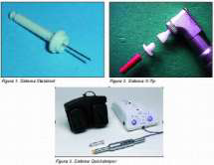
INTRAOSSEOUS TECHNIQUE
L.A solution is deposited in to the cancellous bone adjecent the tooth to be anaesthetized. Used when other methods have failed.
Notes:
Technique:
Used when other methods have failed. The soft tissues are anaesthetized using local infiltration. A small incision is made in the apical region of the tooth to be anaesthetized and a dense hole is drilled through the dense cortical plate to reach cancellous bone. A 25 gauge needle is inserted to this hole,and approximately 1ml of solution is deposited under pressure.

Slide 70
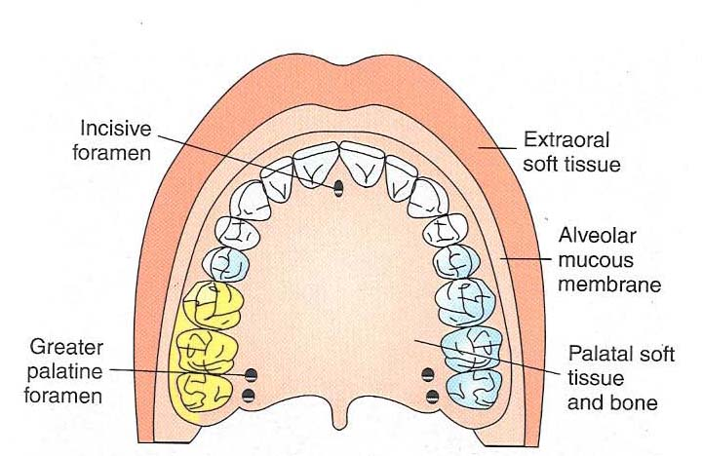
POSTERIOR SUPERIOR ALVEOLAR NERVE BLOCK
TUBEROSITY BLOCK
ZYGOMATIC BLOCK
Notes:
Nerves anesthetized
Posterior superior alveolar nerve and branches
Area anesthetized
Pulps of maxillary third, second and first molars
Buccal periodontium and bone overlying these teeth
Indications
Treatment involving 2 or more maxillary molars
When supraperiosteal injection is contraindicated
When supra periosteal injection has proved ineffective
Anatomic land marks
Mucobuccal fold
Maxillary tuberosity
Zygomatic process of maxilla

Slide 71
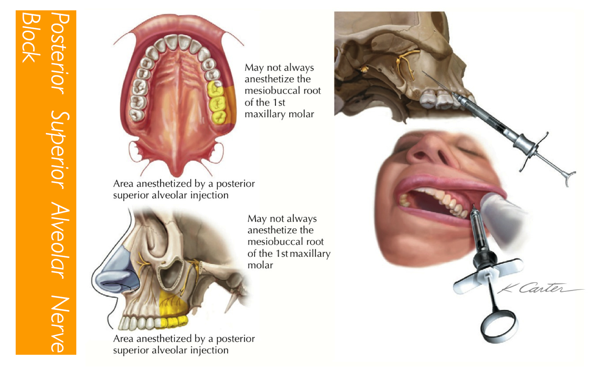
TECHNIQUE
Notes:
Technique
Assume the correct position
For a left PSA nerve block, and a right handed administer, sit at the 10 o’clock position facing the patient
For a right PSA block and a right handed administer, sit at the 8 o’clock position facing the patient
Retract the patient’s cheek with your finger
. Insert the needle into the height of mucobuccal fold over the second molar
6. Advance it slowly in an upward, inward and backward direction in one movement
Slowly advance it through soft tissue into mucobuccal fold pterygoplalatine area
Penetrate the needle to 16 mm
9. Aspirate and then inject
Complications
Risk of hemorrhage is too great, resulting in hematoma.
Mandibular anesthesia
The mandibular division of fifth cranial nerve is located lateral to PSA nerves

Slide 72
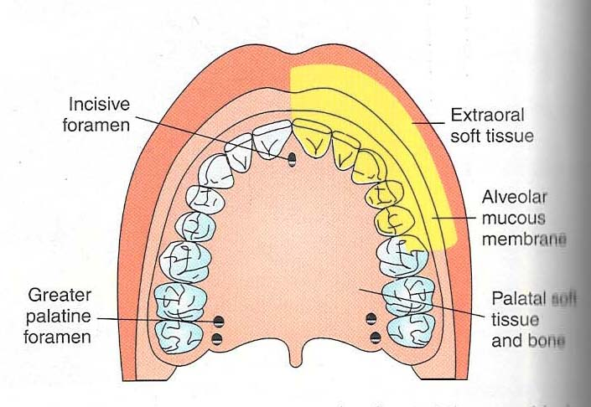
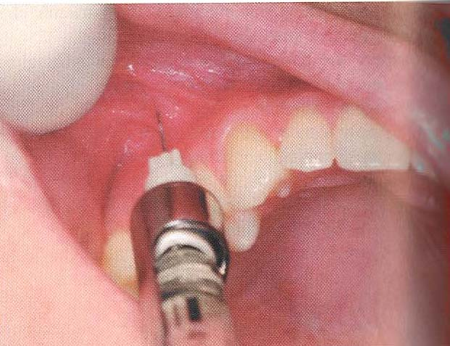
ANTERIOR SUPERIOR ALVEOLAR NERVE BLOCK (INFRA ORBITAL)
Notes:
Nerves anaesthetized
Anterior superior alveolar nerve
Middle superior alveolar nerve
Infra orbital nerve ( Inferior palpebral, Lateral nasal, Superior labial )
Areas anaesthetized
Pulps of maxillary central incisor to canine on the injected side
In about 72% of patients, pulps of maxillary premolars and mesio buccal root of first molar
Buccal periodontium and bone of these same teeth. Lower eyelid, lateral aspect of nose, upper lip
Indications
More than 2 maxillary teeth and their overlying buccal tissues
Inflammation or infection
if cellulitis is present
When supra periosteal injection have been infective because of dense cortical bone

Slide 73
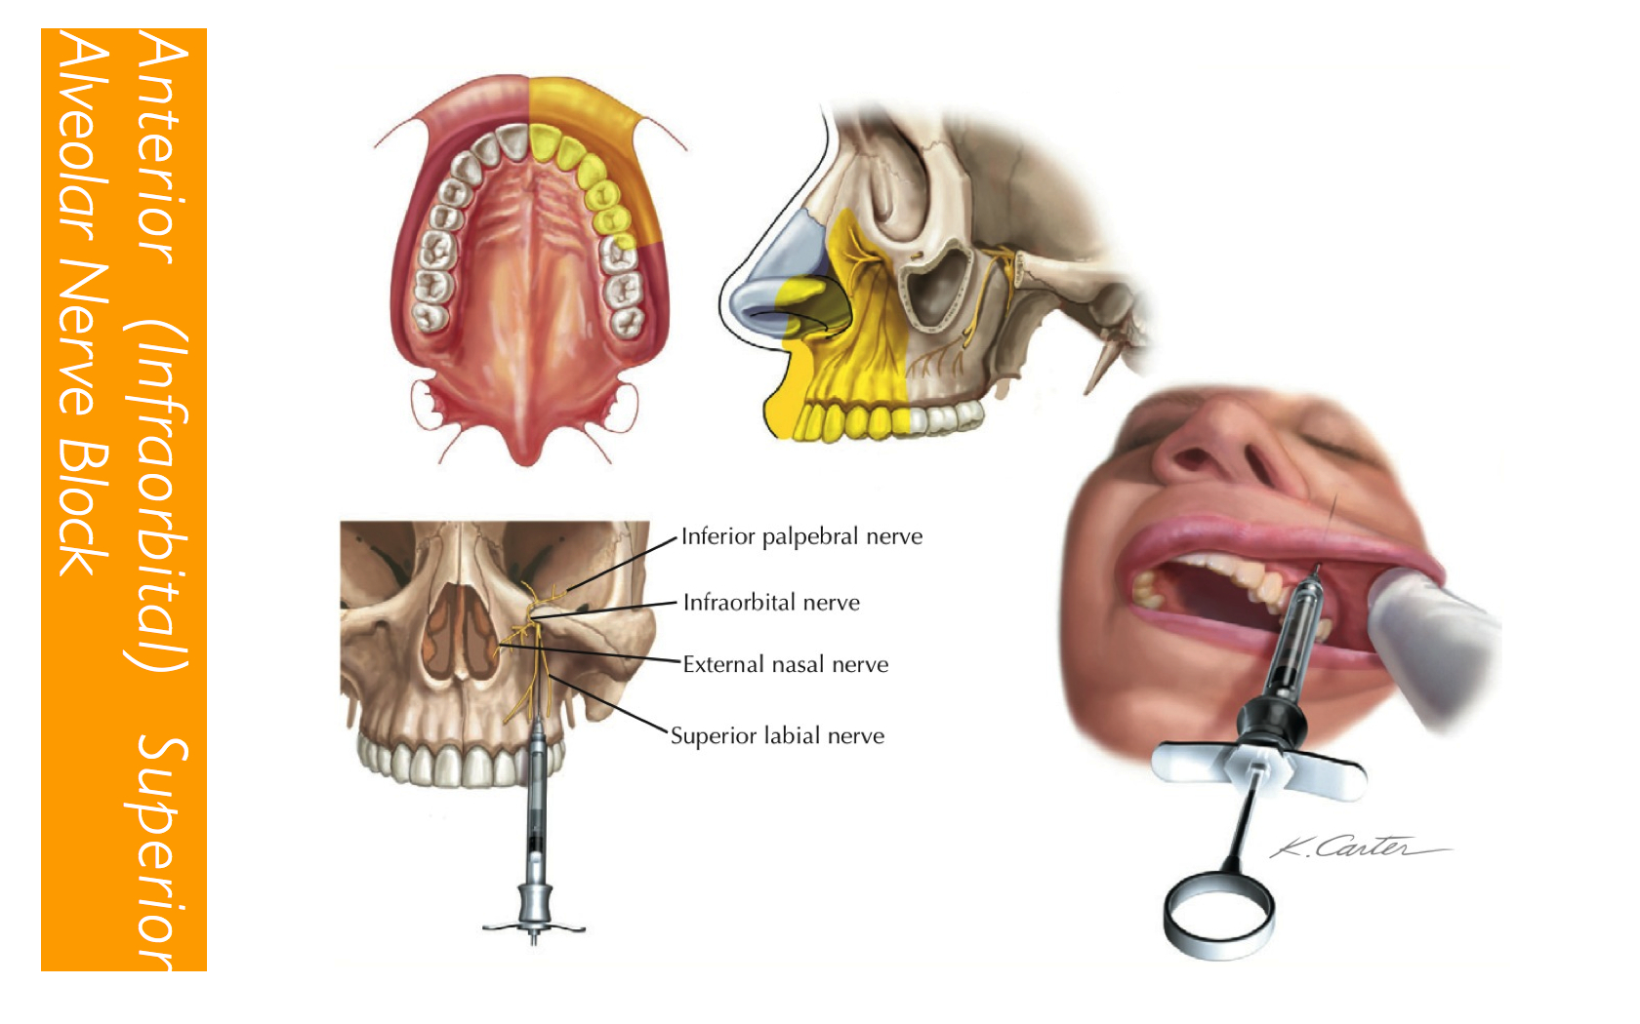
TECHNIQUE
Notes:
Techniques
A 25 gauge needle is recommended
Area of insertion
Height of mucobuccal fold directly over first premolar
Target area
Infraorbital foramen
Landmarks
Mucobuccal fold
Infraorbital notch
Infraorbital foramen
Procedure
Bicuspid approach
Assume the correct position
Position the patient supine or semi supine with neck extended slightly
Prepare the tissues at injection site
Locate the infraorbital foramen
Feel infraorbital foramen
Move downwards from notch applying gentle pressure to tissues
The bone immediately inferior to the notch will be convex
This represents the lower border of orbit & roof of infraorbital foramen
As your finger advances inferiorly a concavity will be felt, infraorbital foramen
Maintain your finger on the infraorbital foramen
Retract the lip, pulling the tissues in the mucobuccal fold taut & increasing visibility
Insert the needle into the height of mucobuccal fold over the first premolar with bevel facing the bone. Orient the syringe towards infraorbital foramen
Advance the needle slowly until bone is gently contacted
Aspirate
Slowly deposit 0.9 – 1.2ml little or no swelling should be visible as the solution is deposited
Maintain firm pressure with your finger over injection site both during & at least 1 minute after injection
Withdraw the syringe slowly
Wait 3-5 minute before commencing the dental procedure

Slide 74
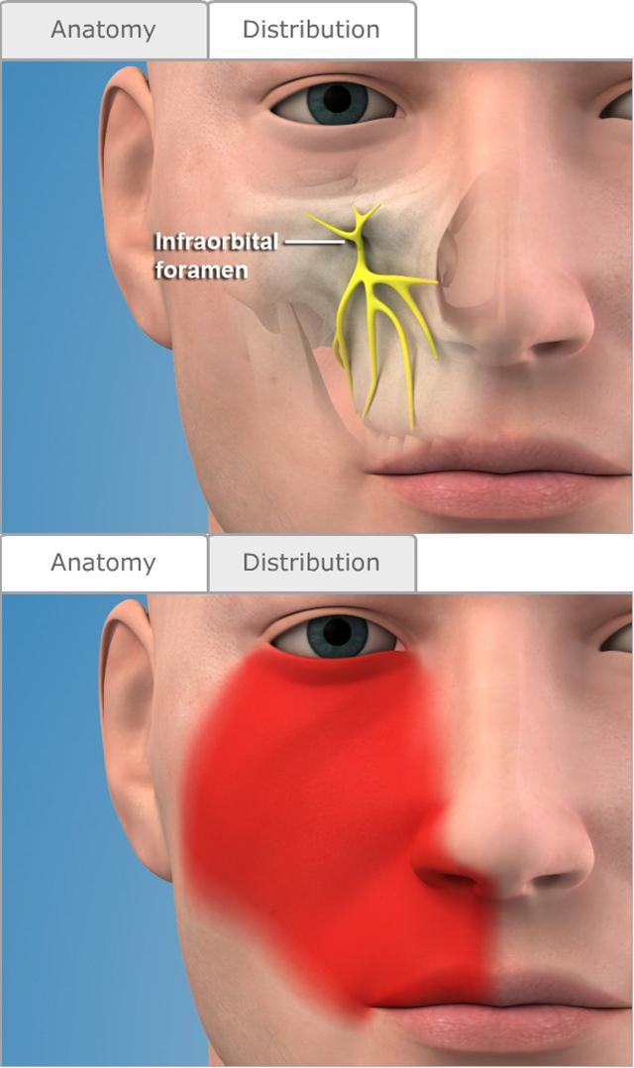
Notes:
Signs & symptoms
Tingling or numbness of the lower eyelid, side of nose & upper lip indicate the anesthesia of the infraorbital nerve
Numbness of teeth & soft tissues along the distribution of anterior superior alveolar nerve & middle superior alveolar nerves
No pain during dental therapy
Safety features
Needle contact with bone at root of infraorbital foramen prevents inadvertent over insertion & possible puncture of the orbit
Finger over the infraorbital foramen helps direct the needle towards foramen
Precautions
For the pain on insertion of the needle move in a more lateral position & deposit solution as needle advances through soft tissue
For over insertion of the needle, estimate the depth of penetration before injection before injection & exert the finger pressure over foramen

Slide 75
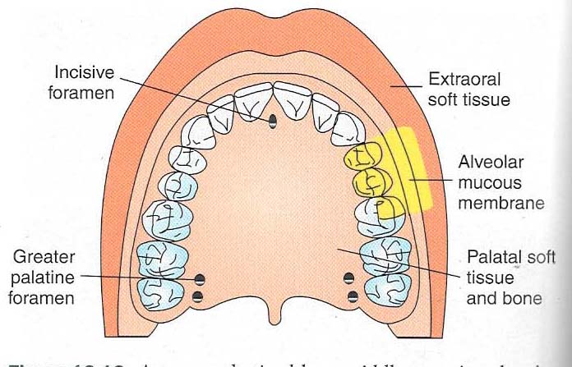
MIDDLE SUPERIOR ALVEOLAR NERVE BLOCK
Notes:
Nerves anesthetized
Middle superior alveolar nerve and terminal branches
Areas anaesthetized
Pulps of maxillary first and second premolars.
Mesiobuccal roots of first molar
Buccal periodontal tissue
Indications
Any surgical procedures, Endodontic procedures, periodontal procedure
When infra orbital nerve block fails to provide pulpal anesthesia distal to the maxillary canine
Dental procedures involving both maxillary premolars only
Technique
Insert the needle into the height of mucobuccal fold above the second premolar
Penetrate the mucous membrane and slowly advance the needle until its tip is located well above the apex of second premolars
Aspirate and inject 0.9-1.2ml

Slide 76
PALATAL ANESTHESIA
The steps in the atraumatic administration of palatal anesthesia
Provide adequate topical anesthesia at site of needle penetration
Use pressure anesthesia at the site both before and during needle insertion and the deposition of solution
Maintain control over the needle
Deposit the anesthetic solution slowly

Slide 77
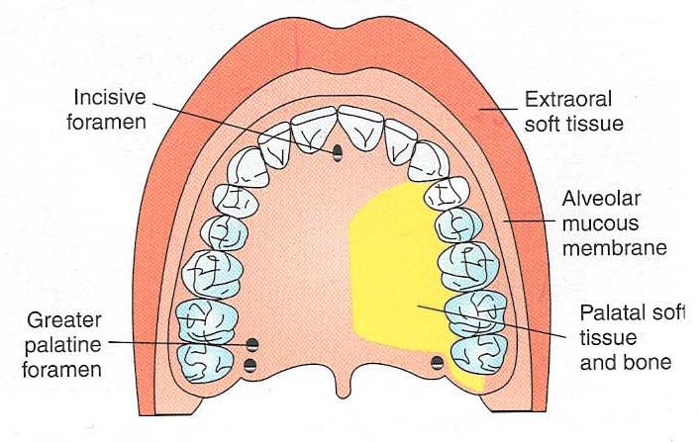
GREATER PALATINE NERVE BLOCK
ANTERIOR PALATINE NERVE BLOCK
Notes:
Synonym
Anterior palatine nerve block
Nerves anesthetized
Greater palatine nerve
Areas anesthetized
Posterior portion of hard palate, some portion of soft palate up to palatine raphae
Anatomical land marks
Second and third maxillary molars palatal gingival margin of molars, midline of palate
Technique
Assume the correct position
Locate the greater palatine foramen
Direct the syringe into the mouth from opposite side with the needle approaching the injection site at right angle
Aspirate and inject

Slide 78
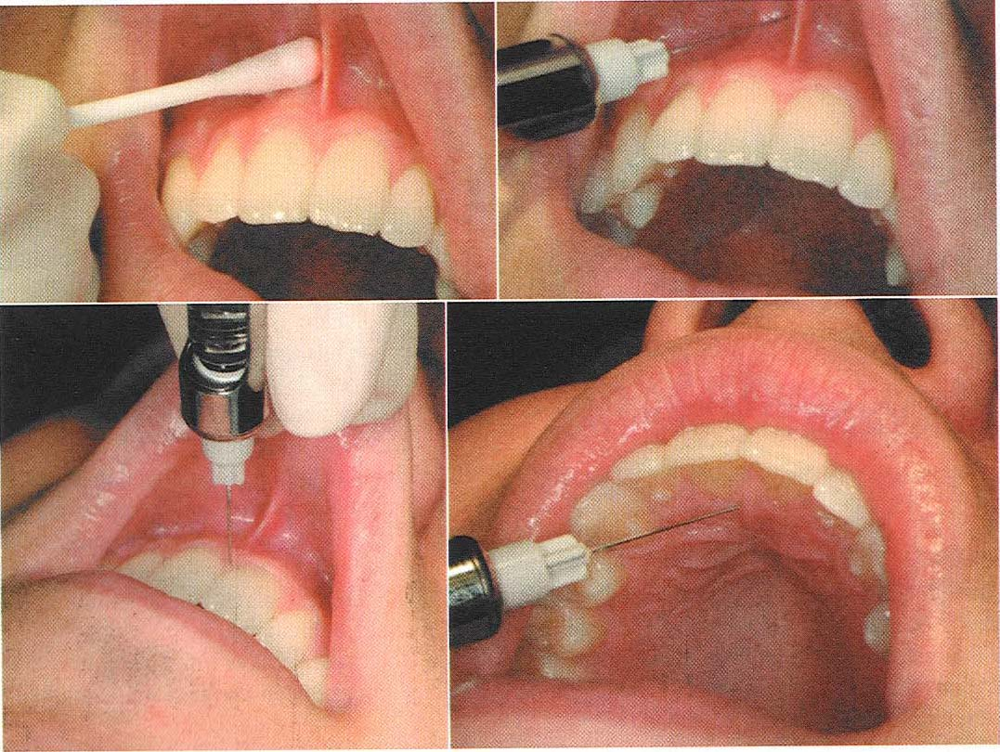
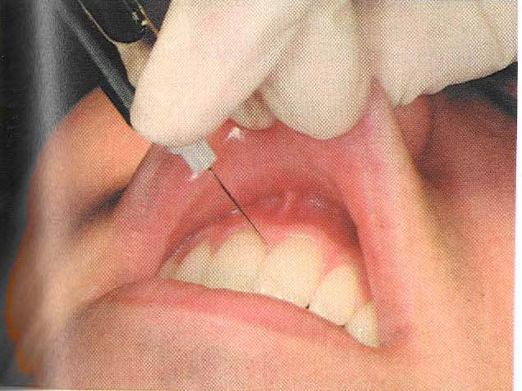
NASOPALATINE NERVE BLOCK
INCISIVE NERVE BLOCK
SPHENOPALATINE NERVE BLOCK
Notes:
Synonym
Incisive nerve block, sphenopalatine nerve block
Nerves anesthetized
Anterior portion of hard palate from mesial of first premolars to opposite side
Indications
Any surgical procedures involving anterior maxillary region
In case where local anesthesia not possible
Anatomical Land marks
Central incisor teeth
Incisive papilla
Technique
Area of insertion
Palatal Mucosa just lateral to the incisive papilla
Target area
Incisive foramen, beneath the incisive papilla
Needle is inserted in incisive papilla

Slide 79
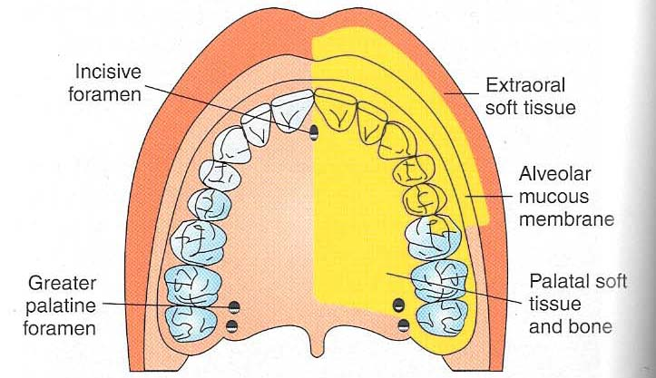
MAXILLARY NERVE BLOCK
Effective method of achieving profound anesthesia of hemi maxilla
It is useful in procedures involving quadrate dentistry or in the extensive surgical procedures
2 approaches
Nerves anesthetized
Maxillary division of trigeminal nerve
Notes:
Areas anesthetized
Pulpal anesthesia of maxillary teeth on the side of block
Buccal periodontium & bone overlying these teeth
Soft tissues and bone of hard palate medially to midline
Skin of lower eyelid
Side of nose, cheek & upper lip

Slide 80
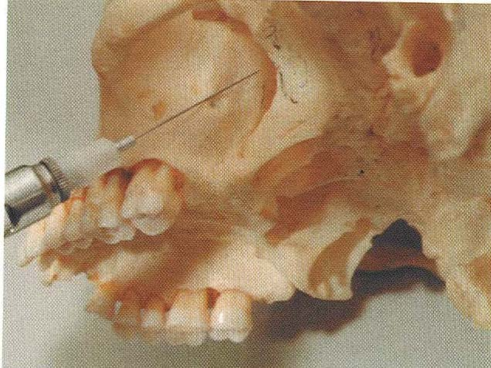
HIGH TUBEROSITY APPROACH
Notes:
Techniques
High Tuberosity Approach
27 gauge needle is used
Area of insertion
Height of mucobuccal fold above the distal aspect of maxillary second molar
Target area
Maxillary nerve as it passes through pterygopalatine fossa, superior and medial to target area of PSA nerve block
Landmarks
Mucobuccal fold at distal aspect of max II molar
Maxillary tuberosity
Zygomatic process of maxilla
Orientation of bevel
Towards bone
Procedure
Place the needle into height of mucobuccal fold over the maxillary II molar
Advance the needle slowly in the upwards, inwards & backward direction
Advance the needle to needle to the depth of 30 mm. No resistance to needle penetration should be felt
Aspirate
If negative, slowly deposit 1.8 ml
Withdraw the syringe
Make the needle safe
Wait 3-5 min before commencing dental procedure

Slide 81
GREATER PALATINE CANAL APPROACH
Notes:
Greater Palatine Canal Approach
25 gauge long needle used
Area of insertion
Palatal soft tissue directly over the greater palatine foramen
Target area
Maxillary nerve as it passes through the pterygopalatine fossa
Needle passes through greater palatine canal to reach pterygopalatine fossa
Orientation of bevel
Towards palatine soft tissues
Procedure
Measure the length of needle from tip to hub
Assume the correct position
Patient in supine
Locate greater palatine foramen
Prepare the tissues directly over greater palatine foramen
After 1 minute the topical anesthetic application move the swab posteriorly so it lies just posterior to greater palatine foramen
Direct syringe into the mouth from opposite side with the needle approaching the injection site at right angle
Place the bevel against the ischemic soft tissue at injection site
With the bevel lying against the tissue, deposit a small volume of LA
Straighten the needle & permit the bevel to penetrate mucosa
Continue to deposit small volume of anesthetic throughout the procedure
Continue to apply pressure with he cotton applicator stick during this part of procedure
Probe gently for the greater palatine foramen. The needle must usually be held at 45 degree angle to facilitate entry into grater palatine foramen
After locating the foramen, slowly advance the needle into greater palatine canal to a depth of 30mm
Aspirate, if negative, slowly deposit 1.8 ml of solution over a minimum of 1 minute

Slide 82
COMPLICATIONS
Hematoma
Penetration of orbit
Penetration of nasal cavity
Notes:
Complications
Hematoma if maxillary artery is punctured via high tuberosity approach
Penetration of the orbit during greater palatine approach
The complications produced by injecting the LA into orbit include
producing periorbital swelling & proptosis
Regional block of sixth cranial nerve producing diplopia
Classic retrobulbar block, producing mydriasis, corneal anesthesia & ophthalmoplegia
Possible optic nerve block with transient loss of vision
Possible retrobulbar hemorrhage
Penetration of nasal cavity
If needle deviates medially during insertion through greater palatine canal, the paper thin medial wall of pterygopalatine fossa will be penetrated & needle will enter into nasal cavity
On aspiration, large amount of air appear in cartridge
On injection, the patient complaints that LA solution in running down the throat

Slide 83
MANDIBULAR INJECTION TECHNIQUES
Inferior alveolar nerve block
Lingual nerve block
Buccal nerve block
Mental nerve block
Incisive nerve block
Vazirani Akinosi closed mouth mandibular block
Gow Gates technique

Slide 84
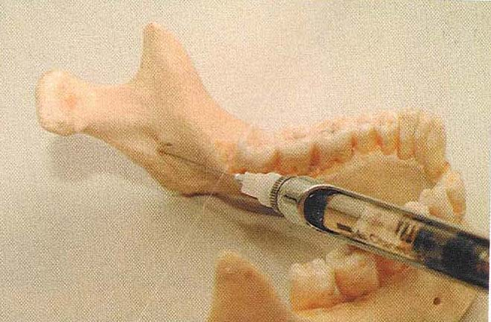
INFERIOR ALVEOLAR NERVE BLOCK
MANDIBULAR BLOCK OR PTERYGOMANDIBULAR BLOCK
Nerves anesthetized
Inferior alveolar nerve
Incisive nerve
Mental branch
Lingual nerve
Areas anesthetized
Mandibular teeth to midline
Body of mandible
Inferior portion of the ramus
Buccal mucoperiosteum
Mucous membrane anterior to mand 1 molar
Anterior 2/3 of tongue
Floor of oral cavity
Lingual soft tissue & periosteum
Notes:
Mandibular block/Pterygomandibular block)
Most commonly used & possibly the most important technique in dentistry
An especially useful technique for quadrant dentistry

Slide 85
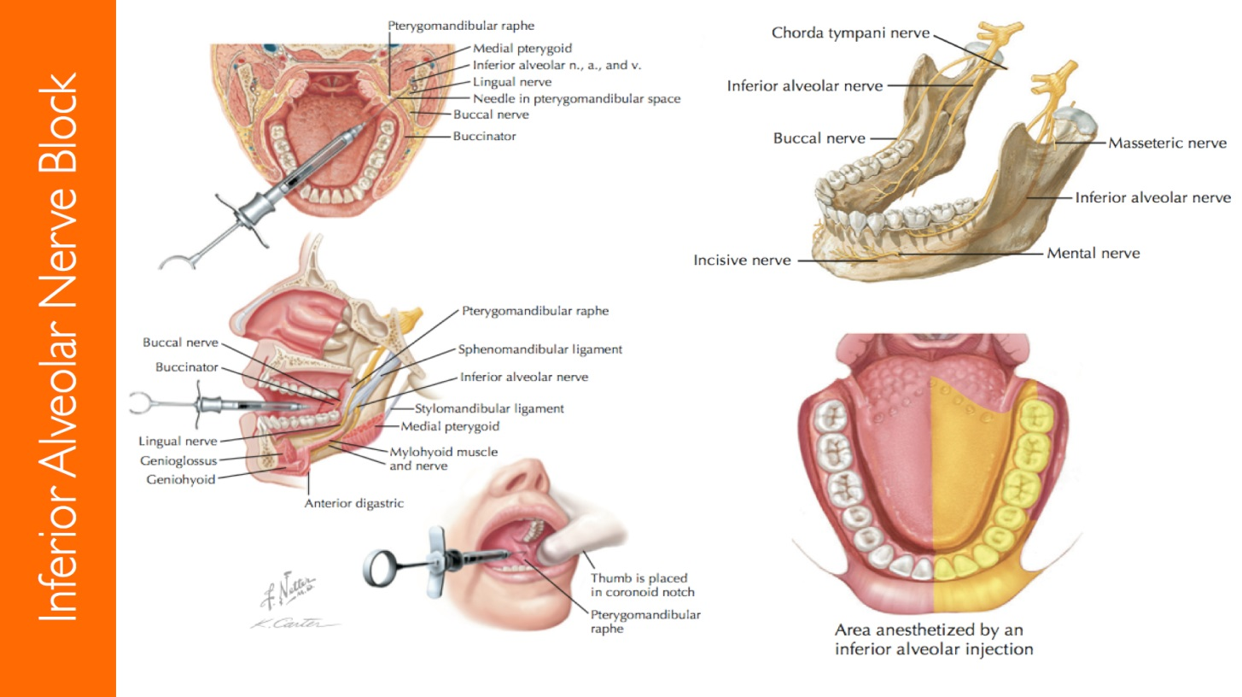
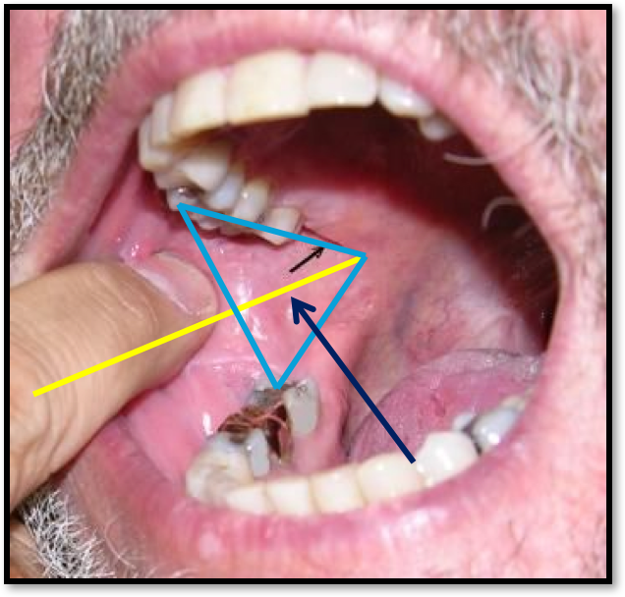
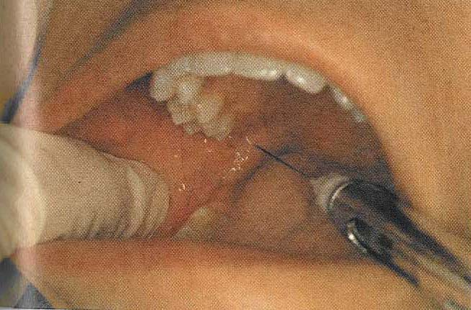
DIRECT TECHNIQUE
Notes:
Target area
Inferior alveolar nerve as it passes downward through sulcus mandibulris towards mandibular foramen before it enters into foramen
Position of the patient
Semi supine with mouth open & occlusal plane of the madibular molars parallel to the floor
Landmarks
External oblique ridge
Internal oblique ridge
Coronoid notch
Pterygomandibular raphae
Occlusal plane of the mandibular posterior teeth
Height of injection
6-10 mm above the occlusal plane of mandibular molars
Procedure
Place the index finger on the external oblique ridge or anterior border of ramus of mandible
When the finger contact the ramus it is moved up& down until the greatest depth of anterior border of ramus is indentified, the coronoid notch
Height of injection is parallel and 6-10 mm above the occlusal plane of mandibular molars
Palpating finger is moved lingual across the retromolar triangle and onto the internal oblique ridge
The finger still in the line with coronoid notch and in contact with internal oblique ridge is moved to buccal side, taking with it the buccal pad of fat
6. This gives better exposure to internal oblique ridge, the pterygomandibular raphae & pterygotemporal depression
7. When palpating the intraoral landmarks with thumb, the operator may place the index finger extra orally behind the ramus of mandible, thus holding mandible between thumb & index finger to assess anteroposterior width of ramus
8. Depth of needle penetration can be determined by estimating anteroposterior width of ramus of mandible when the needle tip has been advanced half the distance between the palpating thumb & index finger
The syringe & needle is then inserted at previously described height of insertion from opposite mandibular premolars at the level bisecting finger & penetrating the tissues of the pterygomandibular space
During insertion, the patient is asked to keep the mouth wide open. The needle is penetrated into the tissues until gently contacting the bone on the medial surface of the ramus of mandible
The needle is then withdrawn about 1 mm & 0.8 - 1ml of the solution is deposited slowly
The needle is moved to the same side, then withdrawn slowly and when about one-half of its inserted depth has been withdrawn, 0.5ml of solution is injected in this area to anesthetize lingual nerve
Long buccal nerve is anesthetized with a separate insertion
5. Wait for 3-5 min & commence with surgical or dental procedure

Slide 86
SINGS AND SYMPTOMS
Tingling & numbness of lower lip
Tingling & numbness of one half of the tongue
Absence of pain during dental therapy
COMPLICATIONS
Hematoma
Trismus
Transient facial paralysis
Notes:
Signs & Symptoms
Tingling & numbness of lower lip
Tingling & numbness of one half of the tongue
Absence of pain during dental therapy
Complications
Hematoma
Trismus
Transient facial paralysis by the deposition of local anesthesia into body of parotid gland

Slide 87
INDIRECT TECHNIQUE
FISCHER 123 TECHNIQUE
Notes:
Three positional Nerve Block Technique/Fischer1-2-3 technique
Position
Directed from same side to inject between external & internal oblique ridge for long buccal nerve
Directed from same side for lingual nerve
Directed from opposite side for inferior alveolar nerve

Slide 88
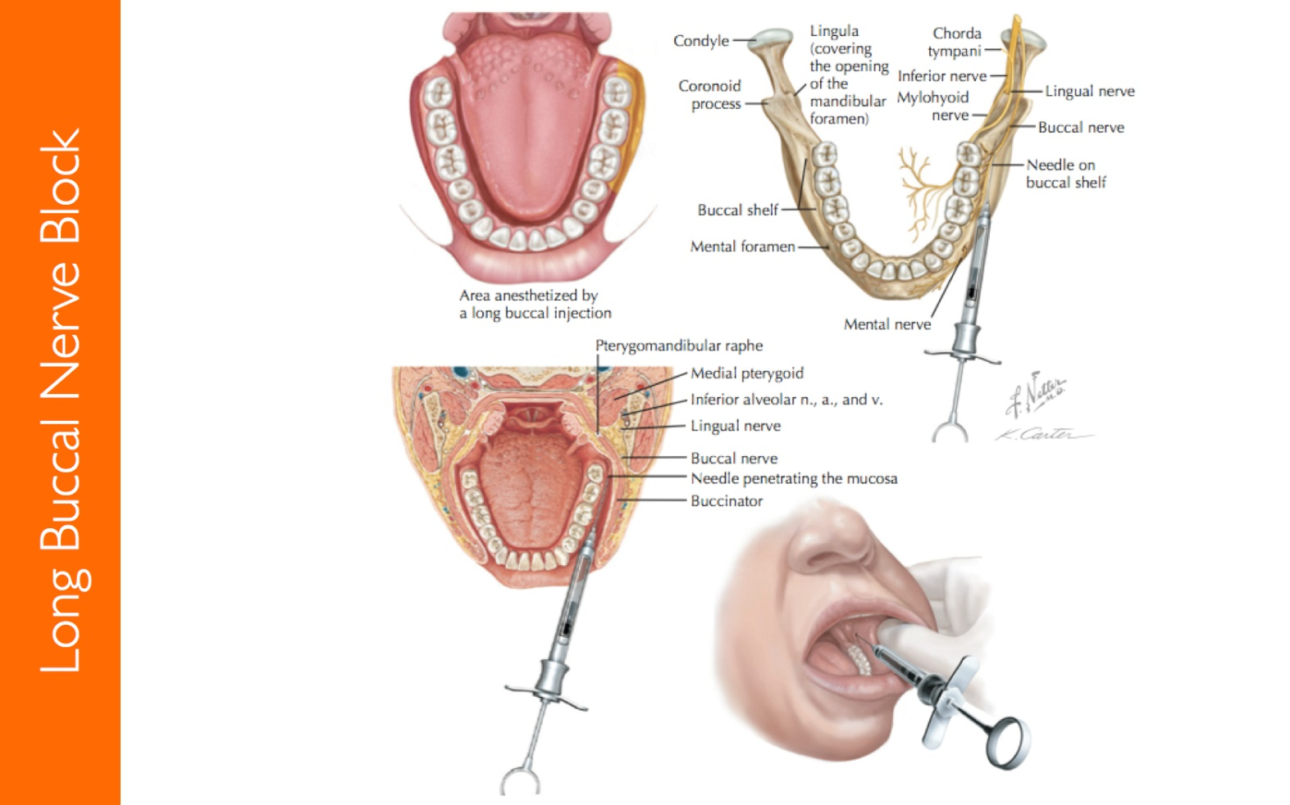
BUCCAL NERVE BLOCK
LONG BUCCAL
BUCCINATOR NERVE BLOCK
Notes:
Target area
Buccal nerve as it passes over anterior border of ramus
Areas anesthetized
Soft tissues & periosteum buccal to mandibular molar teeth
Landmarks
Mandibular molars & mucobuccal fold

Slide 89
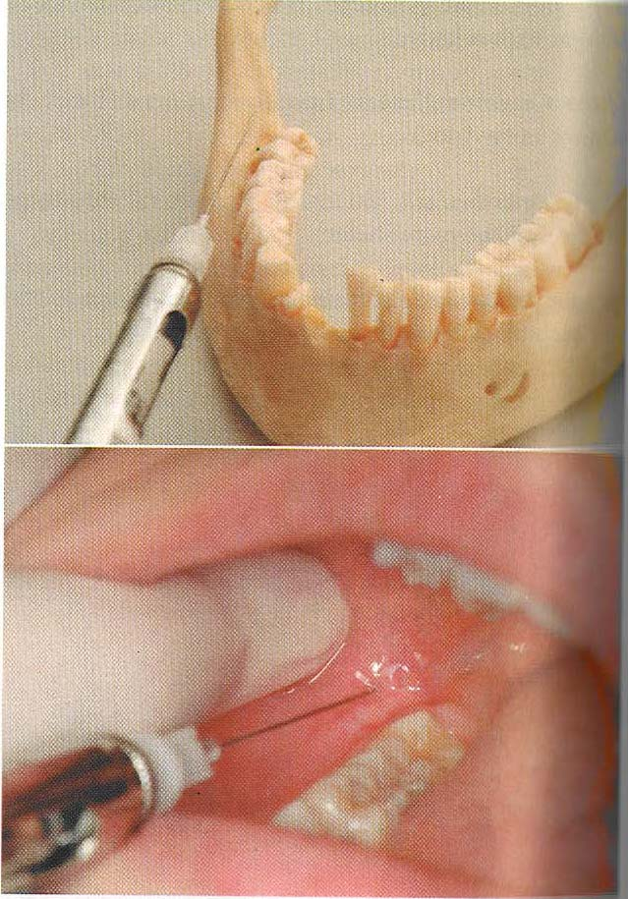
TECHNIQUE
Notes:
Procedure
Assume correct position
Position the patient supine/semi supine
Buccal soft tissue is retracted with the index finger of left hand
Syringe is directed towards injection site parallel to the occlusal plane on the side of the injection
Penetrate needle distal & buccal to last molar
With negative aspiration deposit 0.2 – 0.5 ml of solution
Withdraw the needle & make it safe
Wait approximately 1 min before commencement of procedure

Slide 90
LINGUAL NERVE BLOCK
Nerves anesthetized
Lingual nerve, a branch of the mandibular nerve
Areas anesthetized
Anterior two thirds of the tongue and the floor of the oral cavity
Mucosa and mucoperiosteum on the lingual side of the mandible
Notes:
Nerves anesthetized
Lingual nerve, a branch of the mandibular nerve
Areas anesthetized
Anterior two thirds of the tongue and the floor of the oral cavity
Mucosa and mucoperiosteum on the lingual side of the mandible
Anatomical landmarks
The landmarks are the same as those for the inferior alveolar nerve
Indication
For surgical procedures of the anterior two thirds of the tongue, floor of the oral cavity, and mucous membrane on the lingual side of the mandible
Technique
The technique is the same as that for the inferior alveolar nerve, as previously described

Slide 91
MENTAL NERVE BLOCK
Notes:
Nerves anesthetized
Mental nerve
Areas anesthetized
Buccal mucous membrane anterior to mental foramen to midline and skin of lower lip
Technique
25 or 27 gauge short needle is used
Area of insertion
Mucobuccal fold at or just anterior to mental foramen
Landmarks
Mandibular premolar & mucobuccal fold
Orientation of bevel
Towards bone

Slide 92
TECHNIQUE
Notes:
Procedure
Assume the correct position
Patient in supine position
Locate the mental foramen
Place the index finger in the mucobuccal fold &press against the body or mandible in the 1 molar area
Move finger slowly anteriorly until the bone beneath finger feels irregular & some what concave
Prepare the tissue at the site of the injection
With your index finger pull lower lip & buccal soft tissues laterally
Orient the syringe with bevel directed towards bone
Penetrate the mucous membrane at the injection site, at the canine or 1st premolar, directing syringe towards the mental foramen
Advance the needle until the foramen is reached
Aspirate
If negative, slowly deposit 0.6ml over 20 sec
Withdraw the syringe & immediately make the needle safe
Wait 2-3 min before commencing the procedure

Slide 93
GOW GATES TECHNIQUE
Nerves anesthetized
Inferior alveolar
Mental
Incisive
Lingual
Mylohyoid
Auriculotemporal
Buccal ( 75% patients )
Notes:
Areas anesthetized
Mandibular teeth to midline
Buccal mucoperosteum & mucous membrane
Anterior 2/3rd of tongue & floor of mouth
Lingual soft tissues & periosteum
Body, inferior ramus
Skin over zygoma, cheeck & temporal regions

Slide 94
Notes:
Technique
25 gauge long needle recommended
Area of insertion
Mucous membrane on the mesial of mandibular ramus, on a line from inertragic notch to corner of the mouth just distal to maxillary second molar
Target area
Lateral side of condylar neck, just below the insertion of lateral pterygoid muscle
Landmarks
Extra oral
Lower border of tragus
Corner of mouth
Intraoral
Mesiolingual cusp of maxillary second molar
Technique
Assume correct position
Postion the patient supine/semi supine
Locate extra oral landmarks
Visualize intraoral landmarks
Direct the syringe towards towards the site of injection from the corner of the mouth from opposite side
Insert the needle gently into tissues just distal to maxillary second molar at the height of mesiopalatal cusp
Align the needle with the plane extending from corner of the mouth to inter trajic notch on the side of injection
Direct the syringe towards the target area
Slowly advance the needle until bone is contacted.
If not contacted, withdraw the needle slightly & redirect.
Do not deposit LA if bone not contacted
Withdraw the needle1 mm
Aspirate & if negative slowly deposit 1.8 ml over 60 – 90 seconds
Withdraw syringe & make the needle safe
Complications
Hematoma
Trismus
Temporary parylis of cranial nerves III, IV, VI

Slide 95
VAZIRANI AKINOSI NERVE BLOCK
CLOSED MOUTH
Nerves anesthetized
Inferior alveolar and mental and incisive nerves
Lingual nerve
Buccinator
Notes:
Areas anesthetized
All hard and soft tissues to the midline, including floor of the mouth and anterior 2/3nd of tongue
Anatomical Landmarks
Occlusal plane of occluding teeth
Mucogingival junction of the max. molar
Anterior border of ramus

Slide 96
Notes:
Indications
Limited mandibular opening
Multiple procedures on mandibular teeth
Inability to visualize landmarks for IANB
Technique
Operator position : patient’s right side slightly to the front
The patient is instructed to occlude the teeth
The syringe is aligned to the occlusal and sagital planes but positioned at the level of mucogingival junction of max. molars
The needle penetrates the mucosa just medial to the ramus and inverted 1½ inches
Following negative aspiration slowly deposit the solution (1.5to 1.8ml)

Slide 97
EXTRA ORAL TECHNIQUES
MAXILLARY NERVE BLOCK
MANDIBULAR NERVE BLOCK

Slide 98
MAXILLARY NERVE BLOCK
Nerves anesthetized
Maxillary nerve and all its subdivisions peripheral to the site of injection
Areas anesthetized
Anterior temporal and zygomatic regions
Lower eyelid
Side of the nose
Anterior cheek
Upper lip
Maxillary teeth
Maxillary alveolar bone and overlying structures
Hard and soft palate
Tonsil
Part of the pharynx
Nasal septum and floor of the nose
Posterior lateral mucosa and turbinate bones

Slide 99
Anatomical landmarks
Midpoint of the zygomatic arch
Zygomatic notch
Coronoid process of the ramus of the mandible located by opening and closing the lower jaw
Lateral pterygoid plate

Slide 100
Technique
The needle is inserted through the skin wheal, perpendicular to the median sagital plane (skin
surface) until the needlepoint gently contacts the lateral pterygoid plate
After careful aspiration, 2 or 3 ml of a suitable anesthetic solution is slowly injected
Care should be exercised to aspirate after each 0.5ml of the solution is injected
When the maxillary nerve block is being executed by means of the extra oral approach, the needle passes through the following structures
Skin, subcutaneous muscle, masseter muscle, mandibular notch, external pterygoid muscle
When the needle is in contact with the lateral pterygoid plate, the following important structures are near superiorly, the base of the skull
The internal maxillary artery that crosses inferiorly and curves up anterior to it, entering the lower part of the pterygomaxillary fissure
Temporal vessels from the internal maxillary artery that may lie on either side of it
Superficially, the transverse facial artery that may lie above or below it
Posteriorly, the foramen ovale, through which passes the mandibular nerve and posterior to that the foramen spinosum, though which passes into the middle meningeal artery

Slide 101
MANDIBULAR NERVE BLOCK
Nerves anesthetized
Mandibular nerve and subdivisions
Inferior alveolar nerve
Buccinator nerve
Lingual nerve
Mental nerve
Incisive nerve

Slide 102
Areas anesthetized
All those areas innervated by the mandibular nerve and its subdivisions
Temporal region
Auricle of the ear
External auditory meatus
Temporomandibular joint
Salivary glands
Anterior two thirds of the tongue
Floor of the mouth
Mandible
Lower teeth, gingiva, and buccal mucosa
Lower portion of the face (expect at the angle of the jaw
Notes:
Technique
The technique is essentially the same as that used for the block of the maxillary nerve, with the exception that a marker is placed on the needle at a measured distance of 5 cm
After the needle contacts the lateral pterygoid plate, it is withdrawn exactly as in the maxillary block
When reinserted, the needle is directed upward and slightly posteriorly so that the needle will pass posterior to the lateral pterygoid plate
The needle should not be introduced to a depth greater than the measured 5 cm
Symptoms of anesthesia
Subjective symptoms
Tingling and numbness of the lower lip and anterior two thirds of the tongue.
Objective symptoms
Opening the mandible and tapping the jaws shut will demonstrate a decided difference in the feeling of the lower teeth and the floor of the mouth
Instrumentation will also demonstrate the presence of anesthesia

Slide 103
LOCAL ANESTHETIC COMPLICATIONS

Slide 104
It is defined as any deviation from the expected pattern during or after the securing of regional analgesia
LOCAL COMPLICATIONS
SYSTEMIC COMPLICATIONS

Slide 105
LOCAL COMPLICATIONS
Needle Breakage
Pain or hyperalgesia
Burning on injection
Persistent anesthesia
or Paresthesia
Trismus
Hematoma
Infection
Edema
Sloughing of tissues
Soft tissue injury
Facial nerve paralysis
Postanaesthetic intraoral lesions.

Slide 106
NEEDLE BREAKAGE
Causes
Sudden unexpected movement
Movement of the patient is opposite to that of the needle
Smaller needles
An attempt to change the direction of the needle
An attempt to force the needle against resistance
Notes:
Causes
Sudden unexpected movement
movement of the patient is opposite to that of the needle
Smaller needles
An attempt to change the direction of the needle
An attempt to force the needle against resistance

Slide 107
Management
When a needle breaks
Remain calm do not panic
Instruct the patient not to move
Keep the patient’s mouth open
Place a bite block in patient’s mouth
If fragment is visible try to remove with a hemostat or Magill intubation forceps
Notes:
Prevention
Do not attempt to force the needle against resistance
Do not attempt to change the direction of the needle while it is embedded in the tissue
Use larger gauge needles
Do not use resterilisable needles
Do not insert the needle so far as it is out of sight in the tissue
At least 1/3 of the needle should be in view
The point at which the needle shaft meets the hub is the weakest part of the needle
This is the place at which needle breakage usually occurs
Do not surprise the patient with a sudden unexpected needle insertion
Management
When a needle breaks
Remain calm do not panic
Instruct the patient not to move
Keep the patient’s mouth open
Place a bite block in patient’s mouth
If fragment is visible try to remove with a hemostat or Magill intubation forceps
If the needle is lost and not visible and cannot be easily retrieved
Do not proceed with an incision or probing
Calm the patient
Note the incident on patient’s chart. Keep the remaining needle fragment
Refer the patient to an oral and maxillofacial surgeon for consultation
If the needle is superficial and easily located, through radiograph, then removal by a dental surgeon is possible
If located in deeper tissues or is hard to locate, permit to remain without an attempt to remove

Slide 108
If the needle is lost and not visible and cannot be easily retrieved
Do not proceed with an incision or probing
Calm the patient
Note the incident on patient’s chart. Keep the remaining needle fragment
Refer the patient to an oral and maxillofacial surgeon for consultation
If the needle is superficial and easily located, through radiograph, then removal by a dental surgeon is possible
If located in deeper tissues or is hard to locate, permit to remain without an attempt to remove

Slide 109
PAIN OR HYPERALGESIA
Causes
Careless injection technique
Rapid deposition of anesthesia solution may cause tissue damage
Infections from careless contaminations
Multiple injections
Notes:
Pain or hyperalgesia
Pain during or after the administration of local anesthesia is very common
Problem
Increases the anxiety of patient and may lead to sudden unexpected movement increasing the risk of needle breakage
Prevention
Use proper techniques of injection
Use sharp needles
Use sterile local anesthesia solutions
Inject LA slowly
Injected solutions should be as close to body to body temperature as possible
Multiple injections in same area should be avoided
Management
No management is required

Slide 110
BURNING ON INJECTION
Causes
PH of LA solution deposited in soft tissues
PH of an LA solution containing vasopressor is more acidic
Rapid injection of LA, especially In the denser and more adherent tissues like palate
Contamination of LA cartridges
Notes:
Problem
Usually transient
Burning sensation on injection indicates that tissue irritation is occurring
If it is caused by PH of the solution, it rapidly disappears as the anesthetic action develops
When a burning sensation occurs as a result of rapid injections, contaminated solution or overly warm solution, then there is greater chance for the tissues to get damaged with the development of other complications such as postanaesthetic trismus, edema or paresthesia
Prevention
Slowing the injection
Ideal rate is 1ml/min
Do not exceed the recommended rate of 1.8 ml
Cartridge of anesthesia should be stored at room temperature in a suitable container without alcohol or other sterilizing agents
Management
Most cases of burning sensation are transient and no treatment is usually indicated
In those situations in which post injection discomfort, edema or paresthesia becomes evident, management of the specific problem is indicted

Slide 111
PERSISTENT ANESTHESIA OR PARESTHESIA
Injection of local anesthetic solution contaminated by alcohol or sterilizing solution near a nerve
Hemorrhage into or around the neural sheath
Bleeding increases pressure leading to paresthesia
Trauma to the nerve sheath produced by the needle during injecting.
Notes:
Occasionally patient reports of a feeling of numbness many hours or days after a local anesthetic injection
When anesthesia persists for days, weeks or months there is an increased potential for the development of problems
Management
Most paresthesias resolve within 8 weeks without treatment
Only if damage to the nerve is severe, the paresthesia is permanent
Be reassuring
Determine the degree and extent of paresthesia
Explain to the patient that paresthesia normally persists for at least 2 months before resolution and that it may last up to 1 year
If the sensory defect is evident 1 year after the incident, consultation with an oral surgeon or neurologist is recommended

Slide 112
TRISMUS
Prolonged titanic spasm of the jaw muscles by which the normal
opening of the mouth is restricted
Cause
Trauma to a muscle in the infratemporal fossa during the insertion of the needle
Irritating solutions – Local anesthetic solutions into which alcohol or cold sterilizing solutions have diffused produce irritation to the tissues
Local anesthetic solutions have slight myotoxic properties on skeletal muscle
Hemorrhage
Notes:
Multiple needle penetrations
Low grade infection
Excessive volumes of local anesthetic solution deposited into a restricted area produce distention of tissues which lead to post injection trismus
Prevention
Use sharp, sterile disposable needle
Proper care and handle of LA cartridges
Use antiseptic technique
Change contaminated needles immediately
Practice atraumatic insertion and injection technique
Avoid repeat injections and multiple injections into the same area
Use regional nerve blocks instead of infiltration wherever possible
Use minimum effective volumes of local anesthetic

Slide 113
Management
Heat therapy
Warm saline rinse
Analgesic
Aspirin is usually adequate
Codeine may be required if the discomfort is more intense
Muscle relaxation
Diazepam or Benzodiazepine is used
Physiotherapy
opening and closing the mouth
Lateral extrusions of the mandible for 5 mm every 3-4 hours
Chewing gums provide lateral extrusions of the mandible
Avoid further dental treatment in the area
Notes:
Management
Onset of trismus occur 1 to 6 hours post treatment
Degree of discomfort varies but is usually mild
Heat therapy
Warm saline rinse
Analgesic
Aspirin is usually adequate
Codeine may be required if the discomfort is more intense
Muscle relaxation
Diazepam or Benzodiazepine is used
Physiotherapy
Consisting of opening and closing the mouth
Lateral extrusions of the mandible for 5 mm every 3-4 hours
Chewing gums provide lateral extrusions of the mandible
Avoid further dental treatment in the area

Slide 114
HEMATOMA
Effusion of blood into extravscular spaces as a result of a torn blood vessel
Cause
Arterial or venous puncture following posterior superior alveolar or inferior alveolar nerve block
Hematoma rarely develops after a palatal injection, because of density of tissue in the heart palate and its firm adherence to bone
Notes:
Cause
Arterial or venous puncture following posterior superior alveolar or inferior alveolar nerve block
Hematoma rarely develops after a palatal injection, because of density of tissue in the heart palate and its firm adherence to bone
Problem
Hematoma rarely produce significant problems
The possible complications include trismus and pain
Swelling and discoloration subside within 7-14 days
Prevention
Knowledge of the normal anatomy involved in the injection is important
Certain techniques have greater risk of hematoma – Posterior superior alveolar nerve block, inferior alveolar nerve block and mental nerve block
Use a short needle for posterior superior alveolar nerve block to decrease the risk of hematoma
Minimize the number of needle penetrations into tissue

Slide 115
Management
Immediate
When swelling becomes evident during or immediately following local anesthetic injection, direct pressure should be applied to the site of bleeding for 2 minutes. This will effectively stop bleeding
Inferior alveolar nerve block
Pressure is applied to the medial aspect of mandibular ramus
Infraorbital nerve block
Pressure is applied to the skin directly over infraorbital foramen.
Mental or incisive nerve block
Pressure is applied directly over mental foramen
Buccal nerve block or any palatal injection
Pressure is applied at the site of bleeding
Posterior superior alveolar nerve block
Digital pressure to the soft tissues in the mucobuccal fold
If available ice should be used extra orally to exert pressure on the site and help construct the vessel
Notes:
Management
Immediate
When swelling becomes evident during or immediately following local anesthetic injection, direct pressure should be applied to the site of bleeding for 2 minutes. This will effectively stop bleeding
Inferior alveolar nerve block
Pressure is applied to the medial aspect of mandibular ramus
Infraorbital nerve block
Pressure is applied to the skin directly over infraorbital foramen.
Mental or incisive nerve block
Pressure is applied directly over mental foramen
Buccal nerve block or any palatal injection
Pressure is applied at the site of bleeding
Posterior superior alveolar nerve block
Digital pressure to the soft tissues in the mucobuccal fold
If available ice should be used extra orally to exert pressure on the site and help construct the vessel
Subsequent
Once bleeding stops the patient may be discharged
Advise the patient about possible sourness and limitation of movement
Do not apply heat to the area at least 4-6 hours after the incident
Heat produces vasodilatation which may further increase the size of hematoma
Ice may be applied to the region immediately on recognition of a developing hematoma
It acts both as an analgesic and a vasoconstrictor and aid in minimizing the size of hematoma

Slide 116
Subsequent
Once bleeding stops the patient may be discharged
Advise the patient about possible sourness and limitation of movement
Do not apply heat to the area at least 4-6 hours after the incident
Heat produces vasodilatation which may further increase the size of hematoma
Ice may be applied to the region immediately on recognition of a developing hematoma
It acts both as an analgesic and a vasoconstrictor and aid in minimizing the size of hematoma

Slide 117
INFECTION
Rare
Cause
Contamination of needle prior to administration of LA
Improper handling of local anesthetic equipment and improper tissue preparation for injection
Injecting L.A solution into an area of infection
Notes:
Prevention
Use disposable needles
Proper care and handling of the needle
Avoid contamination of the needle through contact with nonsterile surfaces
Avoid multiple injections with the same needle
Proper care and handling of cartridges
Properly prepare tissues prior to penetration

Slide 118
Management
Treatment consists of heat therapy, analgesic, muscle relaxant
If signs and symptoms of trismus persists for more than 3 days patient is started on a 7 day course of penicillin
Erythromycin is substituted if the patient is allergic to penicillin
Notes:
Management
Treatment consists of heat therapy, analgesic, muscle relaxant
If signs and symptoms of trismus persists for more than 3 days patient is started on a 7 day course of penicillin
Erythromycin is substituted if the patient is allergic to penicillin
Patient takes 500 mg immediately + 25 mg 4 times a day

Slide 119
EDEMA
Trauma during injection
Infection
Allergy
Hemorrhage
Injection of irritating solutions
Notes:
Prevention
Proper care and handling of the local anesthetic armamentarium
Use atraumatic injection technique
Complete an adequate medical evaluation of the patient prior to drug administration
Management
When produced by traumatic solution or introduction of irritating solutions, edema is of minimal degree and resolves in several days without formal therapy
After hemorrhage edema resolves more slowly as extravasted blood elements are reabsorbed into the vascular system
If signs of hemorrhage are evident management follows as that for hematoma
Edema produced by infection will not resolve spontaneously, but becomes worse if untreated
If signs and symptoms of infection do not appear to resolve within 3 days antibiotic therapy is indicated
Allergy induced edema is life threatening
If swelling develops in buccal soft tissues and there is no airway involvement, treatment consists of intramuscular or oral antihistamine administration

Slide 120
SLOUGHING OF TISSUES
Prolonged irritation of gingival soft tissues lead to a number of unpleasant complications including epithelial desquamation and sterile abscess

Slide 121
Causes
Epithelial desquamation
Application of a topical anesthetic to gingival tissues for a prolonged period
Heightened sensitivity of the tissues to LA
Reaction in an area where a topical anesthetic has been applied
Sterile abscess
Secondary to prolonged ischemia resulting from the use of a local anesthetic with vasoconstrictor
Notes:
Prevention
Use topical anesthetic as recommended.
Allow the solutions to contact mucous membranes for 1-2 minutes to maximize its effectiveness and minimize toxicity
Do not use overly concentrated solutions
Management
Symptomatic management is indicated

Slide 122
SOFT TISSUE INJURY
Self inflicted trauma to the lips and tongue is frequently caused by the patient inadvertently biting or chewing these tissues, while still anaesthetized
Cause
Younger children and mentally or physically disabled children or adults
Soft tissue anesthesia lasting longer
Dental patients receiving longer anesthetic during their treatment are usually dismissed from the dental office with residual soft tissue numbness

Slide 123
Notes:
Prevention
A local anesthetic of appropriate duration should be selected if dental appointments are brief
A cotton roll can be placed between the lips and the teeth if they are still anaesthetized at the time of discharge
A self adherent warning sticker may be used on children
Warn the patient and guardian against heating, drinking hot fluids and biting on the lips or tongue
Management
Symptomatic management is indicated

Slide 124
FACIAL NERVE PARALYSIS
CAUSES
Introduction of local anesthetic solution into the capsule of the parotid gland, which is located at the posterior boarder of mandibular ramus
Directing the needle posteriorly or inadvertently deflecting it in a posterior direction during an inferior alveolar nerve block, may place the tip of the needle within the substance of the parotid gland

Slide 125
Notes:
Management
Within seconds to minutes following the deposition of local anesthetic into the parotid gland, patient will sense a weakening of the muscles on the affected side of the face
Reassure the patient
Explain that the situation is transient and will last for a few hours and resolve without residual effect
An eye patch should be applied t the affected eye until muscle tone returns
If not advise the patient to manually close the lower eyelid periodically to keep cornea lubricated
Contact lenses should be removed until muscular movement returns

Slide 126
POST ANESTHETIC INTRA ORAL LESIONS
Commonly ulcerations
Primary symptom is pain
Cause
Recurrent aphthous stomatitis and /or Herpes simplex can occur intraorally after a local anesthetic injection or after any trauma to intra oral tissues
Recurrent aphthous stomatitis is more frequently observed, developing on the gingival tissues that are not attached to underlying bone buccal vestibule
Herpes simplex can also develop intraorally, but more common extra orally
Trauma to tissues by a needle or instrument
Notes:
Cause
Recurrent aphthous stomatitis and /or Herpes simplex can occur intraorally after a local anesthetic injection or after any trauma to intra oral tissues
Recurrent aphthous stomatitis is more frequently observed, developing on the gingival tissues that are not attached to underlying bone buccal vestibule
Herpes simplex can also develop intraorally, but more common extra orally
Trauma to tissues by a needle, local anesthetic solution, cotton swab or any other instrument may activate the latent form of the disease process that has been present in the tissues prior to injection

Slide 127
Notes:
Management
Symptomatic management
Pain is the major initial symptom developing two days after injection
If pain is not severe, no management is required
If it is severe, keep the ulcerated areas covered or anaesthetized
Topical anesthetic solutions may be applied to painful areas
A mixture of equal amounts of diphenhydramine and milk of magnesia rinsed in the mouth will effectively coat the ulcerations and provide relief from pain

Slide 128
SYSTEMIC COMPLICATIONS
Syncope
Adverse drug reactions
Allergic reactions
Anaphylaxis
Idiosyncrasy
Overdose

Slide 129
SYNCOPE
Synonyms
Vasodepressor syncope
vasovagal syncope
Neurogenic syncope
Pshycogenic syncope
Atrial bradycardia.
Most frequent complication associated with local anesthesia in dental office

Slide 130
Definition
A transient and sudden loss of consciousness due to cerebral ischemia which occurs due to secondary to a vasodilatation or an increase in peripheral vascular bed, with a corresponding drop in blood pressure
Notes:
Precipitating factors
Psychogenic factors
Fear
Anxiety
Sight of instruments or blood
Nonpsycogenic factors
Waiting for a long time
Prolonged positioning in dental chair
Starvation

Slide 131
Features of syncope
Pupils dilated
Giddiness
Hypotension
Bradycardia
Visual disturbance
Weak pulse
Features of post syncope
Unconsciousness
Mental confusion
C/F -
Features of presyncope
Feeling of warmth
Heavy perspiration
Pallor especially in the forehead area
Increased respiratory rate
Rapid pulse

Slide 132
MANAGEMENT
Avoid precipitating factors
Avoid waiting for prolonged periods
Avoid starvation
Explain the procedure to the patient
Never go for sudden unexpected procedures
Never have sudden site of instruments
Discontinue any procedures in progress

Slide 133
Lower the chair back by 100 and the legs are slightly elevated by 30-40° , thus placing the patient in a semi reclining position
This position aids venous return from the lower body and prevents venous congestion in the upper body

Slide 134
If the patient is conscious, ask him to take a few deep breaths or smell ammonia spirit
Check the vital signs
Monitor airway, breathing, circulation
Airway
Maintain patient airway
Breathing
If the patient is unable to breathe go for artificial ventilation
Circulation
Oral fluids
IV fluids

Slide 135
ADVERSE DRUG REACTION
Allergic reactions and anaphylaxis
Drug allergy may be defined as a specific hypersensitivity to a drug or a chemical agent
Manifestations:
Itching, Erthema, Urticaria, Pruritis
Laryngeal edema, Bronchospasm
Dysphnoea, Respiratory collapse
Skin reactions
Rashes, Urticaria, Pruritis

Slide 136
Smooth muscles
Gastrointestinal muscle involvement
Nausea, vomiting, abdominal cramps
Respiration
Bronchospasm, Dyspnoes,Dysphonia
CVS
Cardiovascular collapse

Slide 137
TREATMENT
Administration of oral aantihistaminics
Avil (Chlorpheniramine meleate) 25-50 mg orally in minor cases injection if severe
Injection adrenaline 0.5 mg 1 in 1000 1M/SC followed by injection antihistamine
Injection corticosteroid
Hydrocortisone 100 mg IV
Betamethasone 8 mg IV
Hexamethasone

Slide 138
OVERDOSAGE
Over dosage
A drug overdose reaction has been defined as those clinical signs and symptoms that result from an overly high blood of a drug in various target organs and tissues
Notes:
Predisposing factors
Patient factors
Drug factors
Patient factors
Age
Individuals at either end of age spectrum experience higher incidence
Weight
The greater the body weight of a patient, the larger will be the dose of the drug that can be tolerated
Larger individuals have a greater blood volume and a lower level of drug per ml of blood
The maximum recommended dose (MRP) of local anesthetics are normally calculated on the basis of milligram of drug per kg of body weight
Ideally it is 7 mg/kg with adrenalin & 4.4 mg/kg without adrenaline

Slide 139
Predisposing factors
Patient factors
Age
Weight
Other medications
Sex
Presence of disease
Genetics
Mental attitude
Drug factors
Vasoactivity
Concentration
Dose
Route of administration
Route of injection
Presence of vasoconstrictors

Slide 141
Management
Management is based on the severity of the reaction
In most cases the reaction will be mild and transistory requiring little or no specific treatment
In other cases it may be more severe and long lasting in which cases prompt treatment is necessary
Mild over dosage
Step 1: Reassure the patient
Step 2: Administer oxygen
Step 3: Monitor vital signs

Slide 142
Step 4: Administer an anticonvulsant
Slow IV administration of Diazepam 5mg/min or Midazolam 1 mg/min until the signs and symptoms of overdose subside
Step 5: Seek medical assistance as soon as possible if IV administration of anticonvulsant is not possible
Step 6: Patient is examined by a physician to determine the possible causes of this reaction
Examination should include blood tests and hepatic and renal function tests

Slide 143
Step 7: Do not leave the patient leave the dental office alone
Step 8: Determine the cause of the reaction before proceeding with therapy requiring additional LAs
Severe overdose reaction
Rapid onset (within 1 minute)
Signs and symptoms
Unconsciousness with or without convulsions
Probable cause
IV injection

Slide 144
Management
Step 1: Remove the syringe from the mouth if still present and place the patient supine and feet elevated slightly
Step 2: If convulsions are present protect the patient’s arms, legs and head. Loosen tight clothing such as ties, collars and belts
Step 3: Seek medical assistance immediately
Step 4: Basic life support
Maintenance of an adequate airway and oxygenation
Step 5: Administer an anticonvulsant
Blood level of anesthetic will decline as the drug undergoes redistribution and if acidosis is not present seizures will cease within 2-3 minutes

Slide 145
If seizures persists for more than 4-5 minutes with no indication of stopping anticonvulsant is administered
Step 6: Postestizure CNS depression is usually present at an intensity equal to that of the excitation phase
The patient may be drowsy or unconsciousness, breathing may be shallow or absent. Basic life support is crucial
Airway, breathing and circulation must be provided as needed
Step 7: Additional management such as a vasopressor – phenyl ephrine or methoxamine IM is indicated if hypotension persists for extended periods (more than 30 minutes)

Slide 146
Management for hypotension in this situation is positioning of the patient and administration of IV fluids
Step 8 : Allow the patient to rest until recovery is sufficient to permit discharge
Slow onset (5-15 minutes)
Step 1 : Terminate dental treatment as soon as signs and symptoms of toxicity appear
Step 2 : Maintenance of adequate airway and circulation
Step 3 : Administer an anti convulsant

Slide 147
Step 4 : Seek medical assistance
Step 5 : Post seizure management
Basic life support and IM or IV administration of a vasopressor
Step 6 : Permit the patient to recover as long as necessary before discharge
Completely evaluate patient’s condition before readministering LA

Slide 148
MANAGEMENT IN SPECIAL
PATIENTS

Slide 149
Uncooperative child
The maximum safe dose of lidocaine for a child is 4.5 mg/kg per dental appointment.
Local infiltration of anesthesia is sufficient for all dental treatment procedures in 90% of cases even in the mandible.

Slide 150
Handicapped Patient or retarded patients
choose a shorter needle and/or a larger gauge needle which is less likely to be bent or broken.
better to use general anesthesia

Slide 151
PATIENTS ON ANTICOAGULANTS
Oral procedures must be done at the beginning of the day & must be performed early in the week
Local anesthetic containing a vasoconstrictor should be administered by infiltration or by intraligamentary injection
Regional nerve blocks should be avoided when possible.
Local vasoconstriction may be encouraged by infiltrating a small amount of local anesthetic containing adrenaline (epinephrine) close to the site of surgery.

Slide 152
PREGNANCY
Lidocaine + vasoconstrictor
Accidental intravascular injections of lidocaine pass through the placenta but the concentrations are too low to harm fetus.

Slide 154
LIVER DISORDERS
Advanced liver diseases include:
Liver cirrhosis - Jaundice
- Potential complications:
1 . Impaired drug detoxication e.g. sedative, analgesics, general anesthesia.
2. Bleeding disorders ( decrease clotting factors, excess fibrinolysis, impaired vitamin K absorption).
3. Transmission of viral hepatitis.
Management
Avoid LA metabolized in liver: Amides (Lidocaine, Mepicaine), esters should be used

Slide 155
RECENT ADVANCES

Slide 156
EMLA (EUTETIC MIXTURE OF LOCAL ANESTHETICS)
Notes:
EMLA (Eutectic Mixture of Local Anesthetics)
is oil in water emulsion i.e. 5% cream of 25mg/g
lidocaine, 25mg/g prilocaine in a ratio of 1:1 by
weight.

Slide 157
DENTIPATCH (LIDOCAINE TRANSORAL DELIVERY SYSTEM)
Notes:
a patch that contains 10-20% lidocaine is placed on the dried mucosa for 15 minutes.
Hersh et al (1996) studied the efficacy of this patch and recommended it for use in achieving topical anesthesia
for both maxilla and mandible.

Slide 158
PRESSURE SYRINGE
Notes:
Used in INTRA LIGAMENTARY injection techniques, especially in mandibular teeth (types: pistol-grip, pen-grip).

Slide 159
JET INJECTION ( NEEDLE LESS )
Notes:
Jet Injection: in this technique a small amount of local anesthetic is propelled as a jet into the submucosa
without the use of a hypodermic syringe/needle from a reservoir. This takes place when the knob is
pressed to release air pressure which produces a fine jet of solution which penetrates the mucosa through a small
puncture wound to produce surface anesthesia. This technique is particularly effective for palatal injections

Slide 160
COMPUTER CONTROLLED LOCAL ANESTHESIA DELIVERY SYSTEM (CCLAD)
Notes:
first CCLAD system in 1997 and was termed the “WAND” and the subsequent versions were
Renamed as “WAND PLUS” and “COMPUDENT”. In 2001,
“Wand” has 3 components: Base unit, Foot pedal and Disposable Handpiece assembly. Base unit
consists of a microprocessor and connects to the foot pedal and Handpiece assembly that accepts the LA
cartridge. LA solution from the cartridge passes through the microbore tubing in the Handpiece assembly and
Attached needle into the target tissue
“Single Tooth Anesthesia System – STA System” was introduced by Milestone Scientific in 2007. Its
advantages include „Dynamic Pressure Sensing – DPS‟ which provides continuous feedback to the user about
the pressure at the needle tip to identify the ideal needle placement for PDL injections.

Slide 161
STA – SINGLE TOOTH ANESTHESIA
Notes:
“Single Tooth Anesthesia System – STA System” was introduced by Milestone Scientific in 2007. Its
advantages include „Dynamic Pressure Sensing – DPS‟ which provides continuous feedback to the user about
the pressure at the needle tip to identify the ideal needle placement for PDL injections.

Slide 162
COMFORT CONTROL SYRINGE
Notes:
“Comfort Control Syringes” consists of two components; base unit and syringe. The most important
functions of the unit (injection and aspiration) can be controlled directly from the syringe.
Rate of injection: Five different basic injection rate settings for specific applications: block, infiltration,
PDL, IO and Palatal regions. The unit uses two stage delivery rates for every injection. It initially expresses the
LA solution at an extremely low rate and after 10 seconds the rate slowly increases to the pre-programed value
for the selected injection technique.

Slide 163
ELECTRONIC DENTAL ANESTHESIA (EDA) - TENS
Notes:
Electronic Dental Anesthesia: this technique involves the use of the principle of Transcutaneous
Electrical Nerve Stimulation (TENS) which has been used for the relief of pain. It can be used a supplement to
conventional local anesthesia. Some limitations of this technique are increased salivary flow and inability to use
metal instruments freely. It is contraindicated in several conditions such as heart disease, seizures, neurological
disorders, brain tumors, patients wearing pacemakers and cochlear implants.

Slide 164
ORAVERSE
Phentolamine
Notes:
Phentolamine: [3, 16] Drug used for Reversal of effects of local anesthetic solutions
The functional deficits resulting from local anesthetic solution containing a vaso-constrictor after the
completion of the procedure is an indication for the reversal of soft tissue anesthesia (lip & tongue numbness).
Phentolamine Mesylate[Fig. 1] is one drug which is indicated for this purpose. It is a non-selective alpha
adrenergic blocking agent and reverses the effects of epinephrine and nor-epinephrine on tissues containing the
alpha one and alpha two adrenergic receptors

Slide 165
REFERENCES
Handbook of local anesthesia – Stanley F Malamed – 6th edition
Monheim's Local Anesthesia and Pain Control in Dental Practice.
Newer Local Anaesthetic Drugs and Delivery Systems in
Dentistry – An Update
Dr. S. S. Sharma1, Dr. S. Aruna Sharma2, Dr. C. Saravanan3,
Dr. Sathyabama (ISSN: 2279-0853, ISBN: 2279-0861. Volume 1,
Issue 4 (Sep-Oct. 2012), PP 10-16)
Painless Anesthesia: A New Approach (https://www.researchgate.net/publication/236259394)
Local Anesthesia in Today's Dental Practice ( Margaret I. Scarlett, DMD )
Newer Delivery Systems for Local Anesthesia inDentistry
( Dr. M.P. Santhosh Kumar,* M.D.S,) M.P. Santhosh Kumar/J. Pharm. Sci. &
Res. Vol. 7(5), 2015, 252-255

Slide 166
THANK YOU ..

