Slide 1
ATRAUMATIC RESTORATIVE TREATMENT (ART)
DR LYNETTE BEENA
Dept of PHD

Slide 2
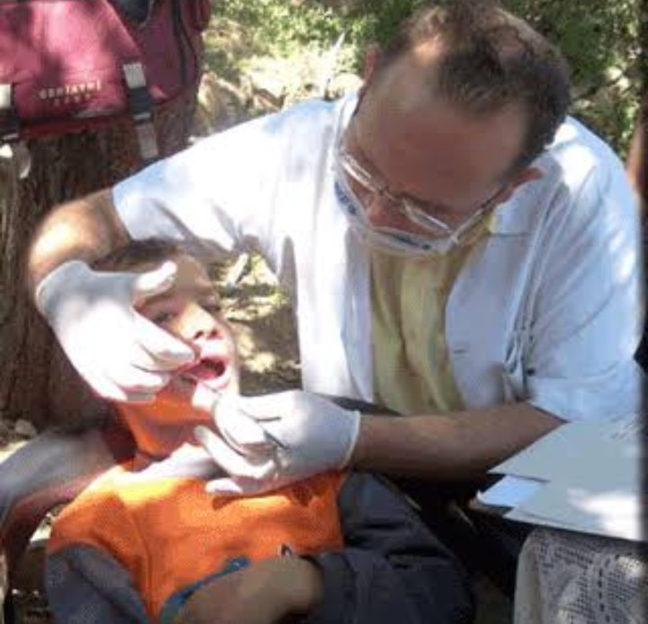
INTRODUCTION
The ART is based on modern knowledge about minimal intervention, minimal invasion and minimal cavity preparation for carious lesion
It is a procedure based on removing carious tooth tissues using hand instruments alone and restoring cavity with an adhesive restorative material

Slide 3
CONTENTS
DEFINITION
PRINCIPLES
INDICATIONS
CONTRAINDICATIONS
ADVANTAGES
PROCEDURE
- Arrange a good environment
-Hygiene &control of cross infection
-Restoring the cavity
FAILED OR DEFECTIVE RESTORATION
CONCLUSION

Slide 4
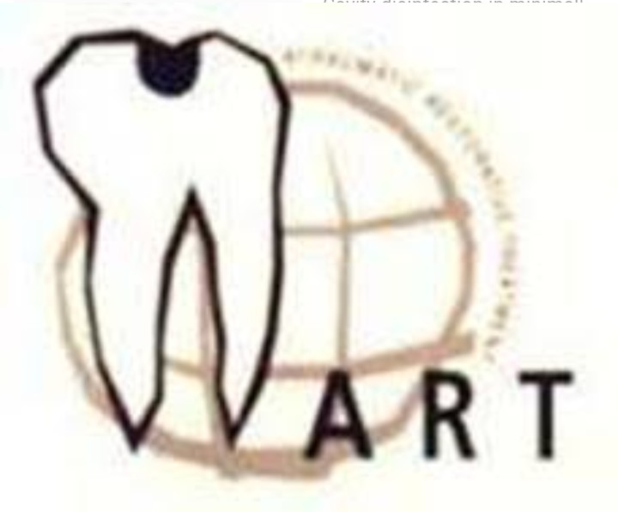
DEFINITION
ART is defined as a minimally invasive care approach in preventing dental caries and stopping it’s further progression (Jo E. Frencken, 2012)

Slide 5
PRINCIPLES
The two main principles of ART are:
1.Removing carious tooth tissues using hand instruments only
2. Restoring the cavity with a restorative material that sticks to the tooth

Slide 6
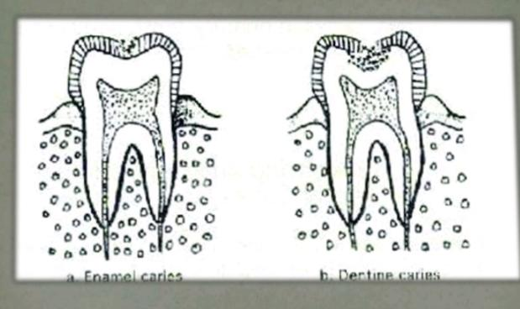
INDICATIONS
Only in small cavities ( involving dentin)
In those cavities that are accessible to hand instruments
Public health programs

Slide 7
CONTRAINDICATIONS
There is presence of swelling (abscess) or fistula (opening from abscess to the oral cavity) near the carious tooth
Pulp of the tooth is exposed
Teeth have been painful for a long time and there may be chronic inflammation of the pulp
There is obvious carious cavity, but opening is inaccessible to hand instruments
There are clear signs of cavity , for example in a proximal surface, but the cavity cannot be entered from the proximal or occlusal direction

Slide 8
ADVANTAGE
ART is a biological approach that requires minimal cavity preparation that conserves sound tooth tissues and causes less trauma to teeth
As ART is painless the need for local anesthetic are reduced and so is the psychological trauma to patients.
Simplifies infection control as hand instruments can easily be cleaned and sterilized

Slide 9
No electrically driven and expensive dental equipment needed which enables ART to be practiced in remote areas and in the field
Technique is simple enough to train non dental personnel or primary health care workers
ART approach is very cost effective
It makes restorative care more accessible for all Population groups

Slide 10
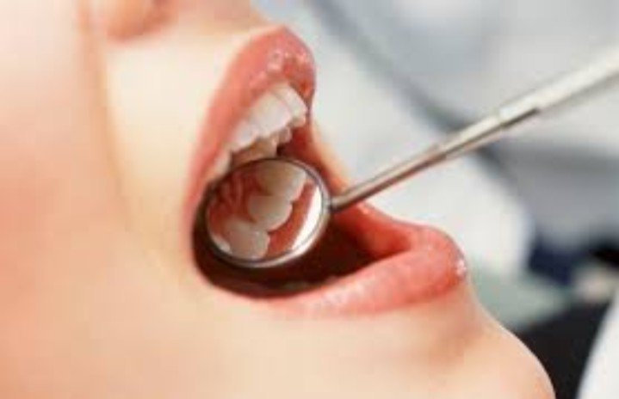
PROCEDURE
Arrange a good working environment
Hygiene and control of cross infection
Restoring the cavity

Slide 11
1.Arranging a good working environment
OUTSIDE THE MOUTH
Operator’s work posture and position
Operator sits firmly on stool, with straight back, thighs parallel to the floor and both feet flat on the floor
Distance from the operator’s eye to the patient’s tooth is usually between 30 and 35 cm
Head and neck should be still, lines between eyes horizontal and head bent slightly forward

Slide 12
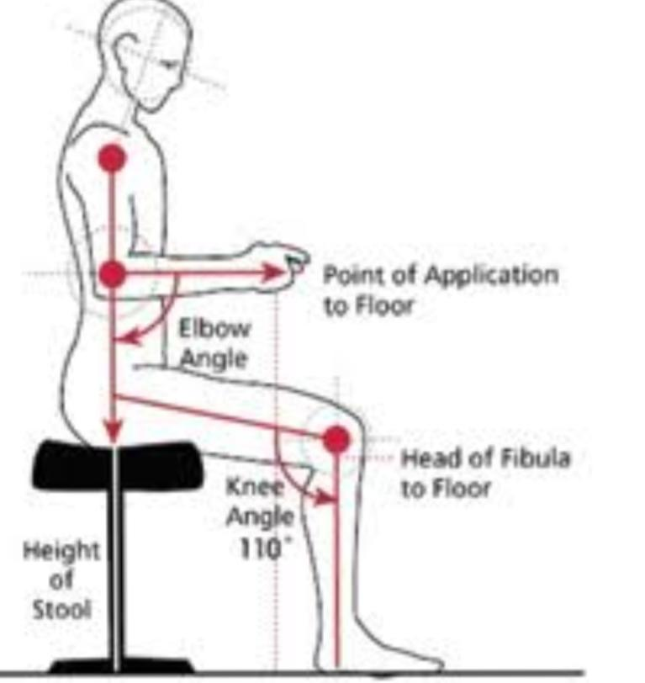
Range of positions from which operator can perform all tasks lies on an arc from 10 to 1 on the clock
Direct rear position - 12 o’clock
Right rear position - 10 o’clock
are most commonly used position

Slide 13
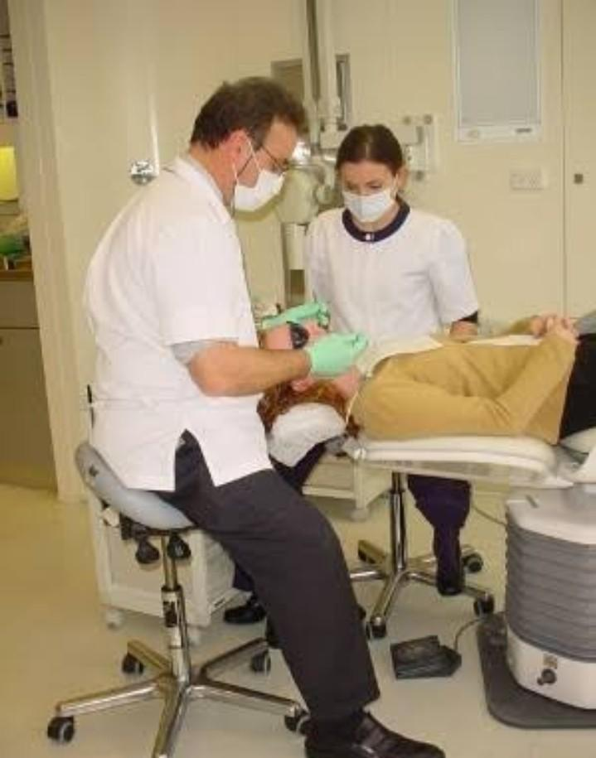
ASSISTANCE
This allows operator to concentrate on the cavity and maintain effective saliva control
Assistant works at left side of a right handed operator and does not change the position
Assistant should sit as close to patient as possible, facing patient’s mouth
Assistant’s head should be 10-15cm higher than operator to see operating field
Assistant need a flat stable surface for holding instruments

Slide 14
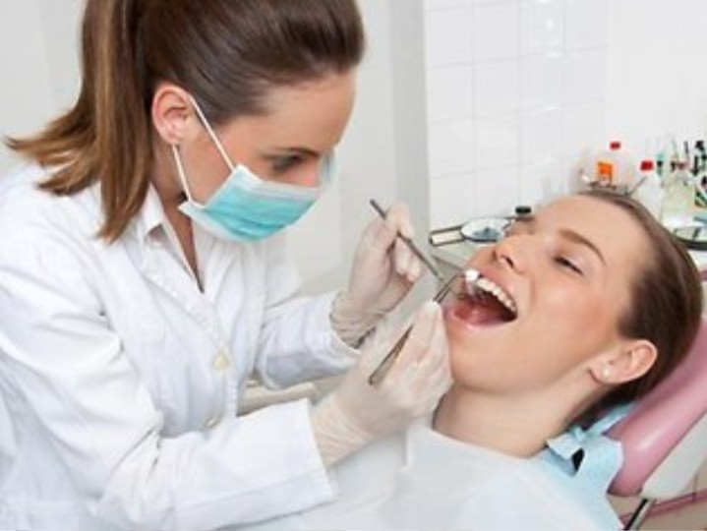
WORKING ALONE
Assistant may not be always available
A small table for holding instruments and materials is either placed at head end of the patient or on the right hand side of the operator close to the patient’s body

Slide 15
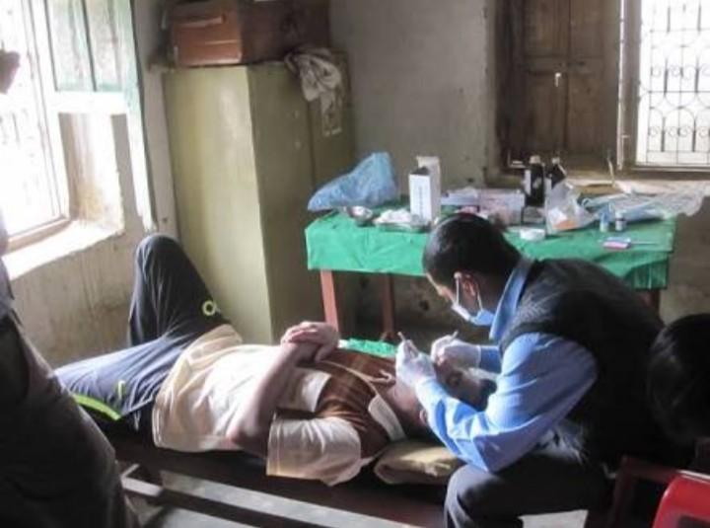
PATIENT’S POSITION
Patient lying on the back on a flat surface
A head rest made of firm foam or a rubber ring with a cover stabilize patient’s head

Slide 16
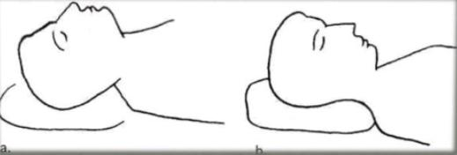
PATIENT’S HEAD POSITION
Tilting the head
Backward tilt lifting the chin for access to upper teeth
Forward tilt dropping the chin for access to lower teeth
Turning the head
a. Central position
b. Left turn
C. Right turn
Mouth opening
a. Fully open
b. Partly closed, to relax cheek muscles for better access to buccal surfaces

Slide 17
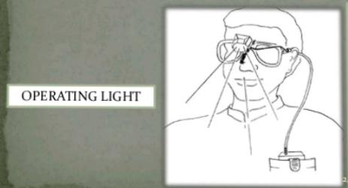
OPERATING LIGHT
Artificial light is more reliable
In a field setting, a portable light source is recommended
Eg: headlamp, glasses with a light source attached, light source attached to mouth mirror

Slide 18
INSIDE THE MOUTH
Control of saliva around the tooth
Cotton wool rolls are quiet effective at absorbing saliva and can provide short time protection from moisture or saliva

Slide 19
2.Hygiene and control of cross infection
Place all instruments in water immediately after use
Remove all debris from instruments by scrubbing with brush in soapy water
Put the clean instruments in a pressure cooker and add water to a depth of 2-3cm from the bottom and heat for 15 minute
Take instruments out of pressure cooker with a instrument forceps and dry them with a clean towel. Store them in a covered metal box

Slide 20
3.RESTORING THE CAVITY
STEPS ARE:
-Caries removal
-conditioning the prepared cavity
-mixing
-restoring the cavity

Slide 21
ESSENTIAL INSTRUMENT OF ART

Slide 24
A.CARIOUS REMOVAL
If cavity is small, place the corner of blade of dental hatchet into the cavity and turn the instrument forward and backward
Carious dentin can be removed with excavator. Soft caries is removed by making circular scooping movements around the long axis of the instrument
Remove all the soft caries from enamel-dentin junction before removing caries near the pulp
Overhanging of enamel must be removed. Blade of dental hatchet placed at the edge of enamel and fracture off small pieces

Slide 26
Particular care needed when removing carious dentin from 2 places-
1.The enamel-dentin junction – It is the part where restoration must stick very well to the tooth. If caries is not completely removed, bacteria will be able to penetrate between the gap between restoration and cavity wall. Caries will develop further.
2. The floor in deep cavities – When removing carious dentin near the pulp there is risk of damaging the pulp. It is important to remove no more dentin than is really essential.

Slide 27
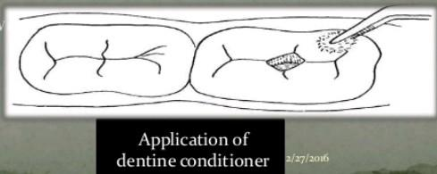
B.CONDITIONING THE CAVITY
Cavity walls must be clean to improve chemical bonding
2 possibilies :-
1. Dentin conditioner( 10% solution of polyacrylic acid)- Dip a cotton wool pellet in one drop of conditioner .Then clean the entire cavity and adjacent fissures for 10-15 sec
Glass ionomer liquid- Dip the moistened cotton wool pellet in glass ionomer liquid and clean cavity for 10-15 sec

Slide 28
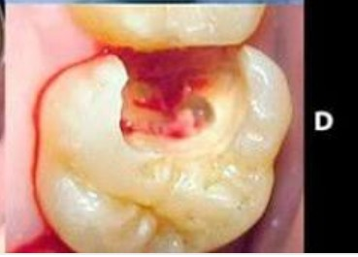
If cavity contaminated with blood
-stop bleeding by pressing with a cotton wool pellet on wound
-wash the blood away with water
-dry the cavity with cotton wool pellet
-place the dry cotton wool pellet on both sides of tooth to prevent recontamination
-apply the conditioner in the cavity

Slide 29
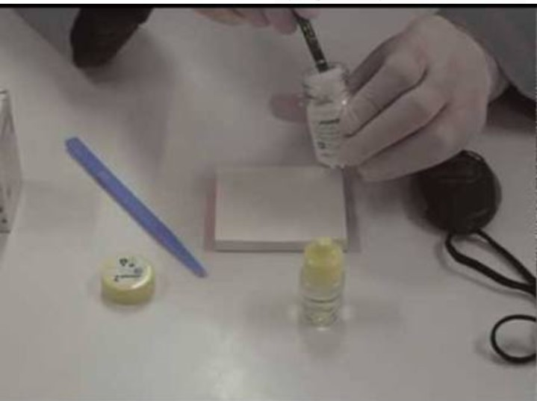
C.MIXING
Place a spoonful of powder on the glass slab or mixing pad
Use spatula to divide powder into two equal portions
Dispense 2 drops of liquid next to the powder
Spread the liquid with a spatula over surface of about 1.5-2cm
Start mixing by adding one half of powder into the liquid. Roll the powder into the liquid gently wetting the particle.
Second portion is folded into the mix. Mix firmly while keeping mass together
Mixing time- 20-30 sec
Final mixture should look smooth like chewing gum

Slide 30
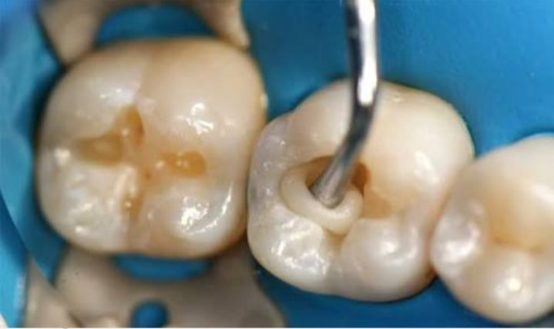
D.RESTORING THE CAVITY
The mixture inserted into cavity in small amounts using blunt end of applier/carver instruments
Push mixture into place with round surface of medium excavator.
Rub small amount of petroleum jelly on the gloved index finger and press the restorative material firmly into cavity. This is called ‘the press-finger technique’
Remove finger sideways after a few seconds

Slide 31
Excess glass ionomer material will be displaced by press finger technique towards the slopes of cusps and between the cusp
Quickly remove excess material with a medium or large excavator
Do not disturb restoration during hardening time
Keep tooth moisture free
After about 1-2 mint check the bite using articulation paper
Ask the patient to not to eat for one hour

Slide 33
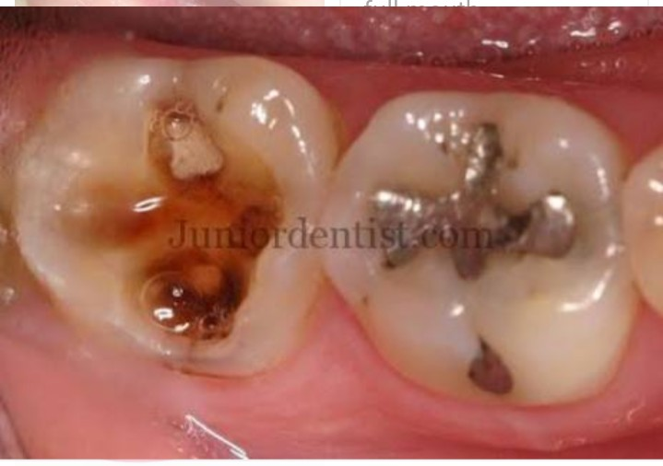
FAILED OR DEFECTIVE RESTORATION
1.Restoration is completely missing
Reasons:
-contamination with saliva or blood during restorative procedure
-Mix of material was too wet or too dry
-Not all the soft caries had been removed
-Thin undermined enamel had been left behind, later break off
Whatever the reason, clean the cavity , apply conditioner and refill the cavity

Slide 34
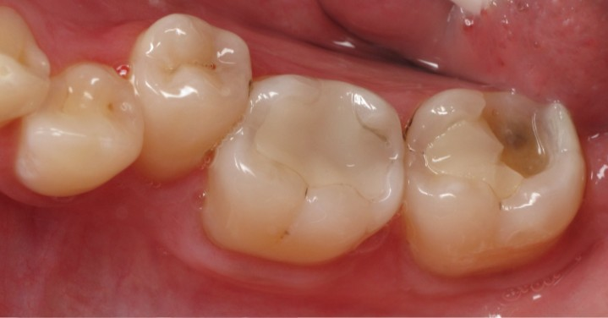
2.PART OF RESTORATION HAS BROKEN AWAY
Reasons:
-The restoration was too high
-Air bubble was trapped in material during placement
Whatever the reason,
-Clean the tooth surface and the remaining restorative material with an explorer and wet cotton wool pellet
-Condition the entire surface
-Fill the gap with a new mixture of glass ionomer

Slide 35
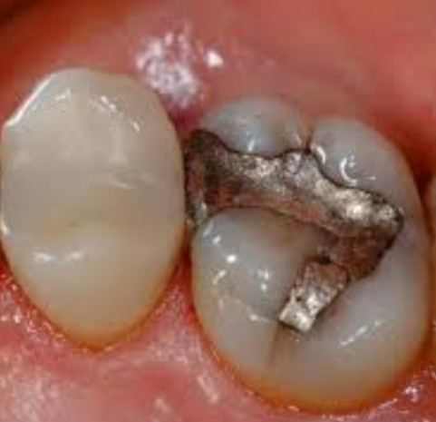
3.RESTORATION HAS FRACTURED
Commonly happens in multiple surface restoration which is too high
If the fractured part is loose and can be removed, repair the gap similar to broken away restoration.
If fractured part cannot be removed, repair through ART not possible.

Slide 36
4.RESTORATION HAS WORN AWAY
Possible reason:
-Patient eats very hard food frequently
-patient clenches his tooth frequently
-Mixture had been too wet/dry
Clean all the surfaces of tooth and remaining restoration.
Apply dentin conditioner over glass ionomer and cavity wall.
Place a new layer of glass ionomer on top of old one.

Slide 37
5.Caries Has Developed In The Adjacent Surfaces
Remove the soft caries
Clean and fill the new cavity adjacent to restoration according to standard procedure

Slide 38
CONCLUSION
ART procedure has been developed to focus on groups of people who are unable to obtain restorative dental care.
Administrated along with health promoting messages about a prudent diet ,good oral hygiene, use of fluoride toothpaste and sealant application
ART is not a compromise but perfect alternative treatment approach for developing countries

