Slide 1
PERIAPICAL PATHOLOGY
PRESENTED BY:
DR. ALLU BABY

Slide 2
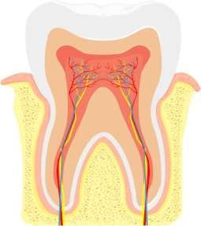
INTRODUCTION
The dental pulp is the part in the center of a tooth made up of living connective tissue and cells called odontoblasts.
The pulp contains the blood vessels the nerves and connective tissue inside a tooth and provides the tooth’s blood and nutrients.
Pulpitis is inflammation of dental pulp tissue

Slide 3
CAUSE OF PULP DISEASE
According to Grossman,
PHYSICAL
  Mechanical
    Trauma- a) Accidental
b) Iatrogenic dental procedures
    Pathologic wear
    Crack through the body of the tooth
    Barometric changes

Slide 4
B) Thermal
Heat during cavity preparation
Exothermic heat during setting of cement
Conduction of heat and cold through deep restoration with out a protective base
Frictional heat during the polishing of restoration
c) Electrical
- Galvanic shock

Slide 5
II) CHEMICAL
Phosphoric acid, acrylic monomer
Erosion
III) BACTERIAL
Toxins associated with caries
Direct invasion of pulp from caries or trauma
Anachoresis

Slide 6
CLASSIFICATION OF PULP DISEASE
According to Grossman.
- Based on clinical features.
Pulpitides (Inflammation)
  Reversal
    Symptomatic (acute)
    Asymptomatic (chronic)
B) Irreversible
Acute
  Abnormally responsive to cold
  Abnormally responsive to heat

Slide 7
2) Chronic
Asymptomatic with pulp exposure
Hyperplastic pulpitis
Internal resorption
Pulp Degeneration
  Calcific
  Others
111) Necrosis

Slide 8
FACTORS AFFECTING RESPONSE OF PULP
Severity and duration of irritant.
Nature of irritant.
Health condition of the pulp or pre-existing state of the pulp
Apical blood flow
Local anatomy of the pulp chamber
Host defence

Slide 9
FACTORS AFFECTING RESPONSE OF PULP
Severity and duration of irritant.
Nature of irritant.
Health condition of the pulp or pre-existing state of the pulp
Apical blood flow
Local anatomy of the pulp chamber
Host defence

Slide 10
PATHWAYS OF BACTERIAL INVASION OF THE PULP
Most common cause of pulp injury- irreparable
Opening in dental hard tissue wall caries
clinical procedures trauma induced fractures microcracks
Bacteria from the gingival sulcus/ pocket
Endodontic reinfection
Extension of a periapical infection from adjacent infected teeth.

Slide 11
ANACHORESIS
Transportation of microbes through the blood or lymph to an area of inflammation such as tooth with pulpitis

Slide 12
AERODONTALGIA
Toothache occuring at low atmospheric pressure experienced either during flight or during a test run in a decompression chamber
Observed in higher altitudes over 5000 feet
Tooth with chronic pulpitis can be symptomless at ground level, but it may cause pain at high altitudes because of reduced pressure
Treatment:
Lining the cavity with a varnish or a base of zinc phosphate
cement with a subbase of ZOE cement in deep cavities

Slide 13
Reversible Pulpitis (Pulp Hyperemia)
Mild to moderate inflammatory condition of the pulp caused by noxious stimuli in which the pulp is capable of returning to the uninflammed state following removal of the stimuli.
Etiology:
Trauma
Thermal shock
Excessive dehydration of the cavity
Galvanism
Bacteria from caries

Slide 14
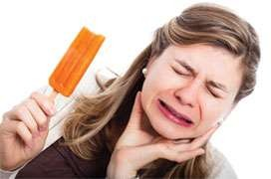
CLINICAL FEATURES:
Tooth is sensitive to thermal changes, especially cold.
Pain - short duration, disappears on withdrawal of thermal
irritant.
Affected tooth responds to stimulation of electric pulp tester at lower level of current indicating low pain threshold.
Teeth usually show deep caries, metallic restoration with defective margins.

Slide 15
HISTOLOGICAL FEATURES:
Dilation of pulp blood vessels.
Edema fluid collection due to damage of vessel wall & allowing extravasations of RBC or diapedesis of WBC.
Slowing of blood flow & hemoconcentration due to
transudation can cause thrombosis.
Reparative or reactionary dentin in adjacent dentinal wall.

Slide 16
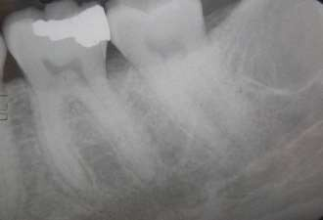
DIAGNOSIS:
Based on symptoms
Clinical test- cold test
TREATMENT:
Prevention of dental caries
Early insertion of filling
Desensitization of neck of teeth where gingival recession
occurs
Cavity varnish or base application before insertion of filling
Care in cavity preparation and polishing
If primary cause is not corrected, extensive pulpitis may result in death of pulp.

Slide 17
Acute Pulpitis
Extensive acute inflammation of the dental pulp is a frequent immediate sequela of focal reversible pulpitis, although it may occur as an acute exacerbation of a chronic inflammatory process
Etiology:
Bacterial invasion through the dental caries- most common
Chemical, thermal or mechanical causes
Reversible pulpitis may deteriorate into irreversible pulpitis

Slide 18
CLINICAL FEATURES:
Early stages- involves only a portion of the pulp, usually the area just beneath the carious lesions.
Teeth extremely sensitive to Hot or cold stimuli and cause increase in pain intensity & persists even after the thermal stimulus has been removed.
Pain - poorly localized since pulp of individual tooth is not represented in sensory cortex.
Intrapulpal abscess formation cause severe pain
lancinating or throbbing type. (10 – 15mins)
Intensity of pain can increase when patient lies down.

Slide 19
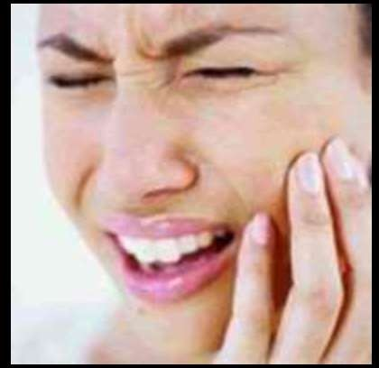


cold
hot
Thermal stimulation

Slide 20
Pulp vitality test indicates increased sensitivity at low level of current.
Pulpal pain is due to:
  pressure built up due to lack of exudate escape.
  pain producing substances from inflammation.
Pain subsides when drainage is established or when pulp
undergoes complete necrosis.
The tooth is not tendered to percussion unless the pulpal inflammation has spread beyond the root apex into the periapical region.

Slide 21
HISTOLOGIC FEATURES:
Edema in pulp with vasodilation.
Infiltration of polymorphonuclear leukocytes along vascular channels & migrate through endothelium lined structures.
Destruction of odontoblasts at pulp dentin border.
Abscess consists pus, leukocytes & bacteria.
Acute suppurative pulpitis- Numerous abscess formation cause pulp liquefaction & necrosis.

Slide 22
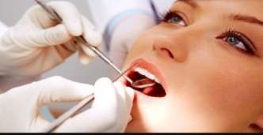
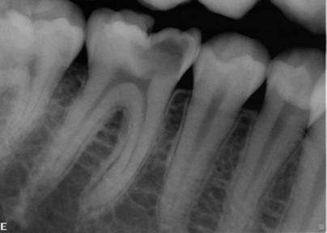
DIAGNOSIS
1) Inspection:
Discloses a deep cavity
Pulp exposure
2) Radiography:
Exposure of the pulp
Caries under a filling
3) Thermal test

Slide 23
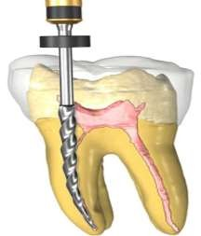
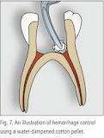
TREATMENT:
Drainage of exudate from pulp chamber.
Pulpotomy & placing calcium hydroxide over entrance of
root canal.
Root canal treatment.
Extraction of tooth.

Slide 24
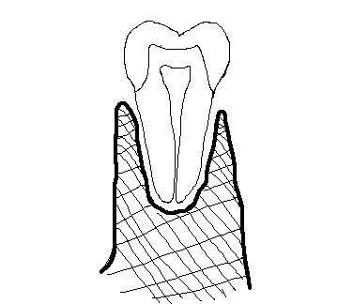
Chronic Pulpitis
Persistent inflammatory reaction in pulp with little or non constitutional symptoms.
CLINICAL FEATURES:
Pain is not prominent, mild, dull ache which is intermittent.
Reaction to thermal changes is reduced because of degeneration
of nerves.
Response to pulp vitality tester is reduced.
Wide open carious lesion & with exposure of pulp cause relatively little pain.
Manipulation with small instruments often elicits bleeding but
with little pain.

Slide 25


HISTOLOGIC FEATURES:
Infiltration of mononuclear cells, lymphocytes & plasma cells, with vigorous connective tissue reaction.
Capillaries are prominent; fibroblastic activity & collagen fibers in bundles.
When granulation tissue formation occurs in wide open exposed pulp surface – ulcerative pulpitis. (with bacterial stains & micro org. in carious lesion)
If pulpal reaction vacillates between an acute & chronic phase causes pulp abscess formation, which is surrounded by fibrous CT wall, which is called Pyogenic Memberane

Slide 26

TREATMENT :
Root canal therapy
Extraction of tooth.

Slide 27
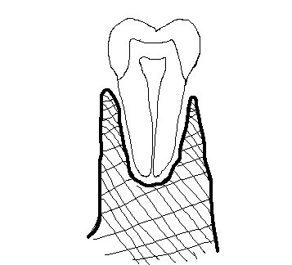

Chronic Hyperplastic Pulpitis (pulp polyp)
Overgrowth of pulp tissue outside the boundary of pulp chamber as protruding mass.
Characterized by the development of granulation tissue, covered at times with epithelium and resulting from long standing low grade irritation
ETIOLOGY:
Slow progressive carious exposure of the pulp
A large open cavity, a young resistant pulp and a chronic low grade stimulus are necessary

Slide 28
CLINICAL FEATURES:
Children & young adults with high degree of tissue resistance & reactivity & responds to proliferative lesions.
Teeth with large , open carious lesions.
Pulp - pinkish red globule of tissue protruding from chamber & extend beyond caries.
Most commonly affected are deciduous molar & Ist permanent molars.
Pulp is relatively insensitive

Slide 29
Lesion bleeds profusely upon provocation.
Due to excellent blood supply high, tissue resistance & reactivity in young persons leads to unusual proliferative property of pulp.
Some cases, gingival tissue adjacent, may proliferate into carious lesion & superficially resemble hyperplastic pulpitis. So careful examination is made to determine whether connection is with pulp or gingiva.

Slide 30
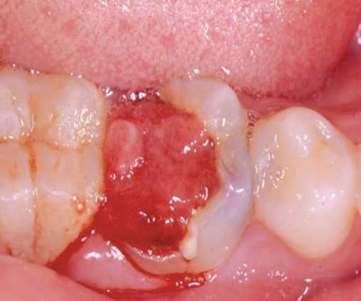

Slide 31
HISTOLOGIC FEATURES:
Hyperplastic tissue is basically granulation tissue, consisting delicate CT fibers & young blood capillaries.
Inflammatory infiltrates – lymphocytes, plasma cells & PMNLs.
Fibroblast and endothelial cell proliferation prominent.
Stratified squamous type epithelial lining resembles oral mucosa with well formed rete pegs.
Grafted epithelial cells are believed to be desquamated epithelial
Cells, which carried by saliva.
Origin of these cells is unknown. They are degenerated superficial squames, which have lost dividing capacity.

Slide 32
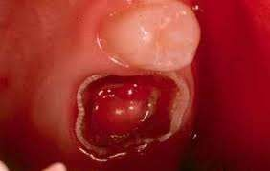
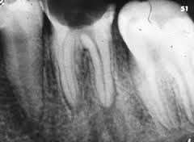
DIAGNOSIS
Clinical Examination:
Seen in children and young adults
A freshly, reddish pulpal mass fills most of the pulp chamber or cavity or even extends beyond the confices of the tooth.
Radiography:
Large open cavity with direct access to the pulp chamber

Slide 33
TREATMENT:
Extraction of tooth
Pulp extripation.

Slide 34
Gangrenous Necrosis of Pulp
Untreated pulpitis → results complete necrosis of pulp.
As this is associated with bacterial infection – pulp gangrene.
It is associated with foul odor when pulp is opened for endodontic treatment.
In sickle cell anemia, blockage of pulp vessels seen
Dry gangrene- pulp dies for unexplained reasons.
This may be due to trauma or infarct.

Slide 35
REVERSIBLE PULPITIS
IRREVERSIBLE PULPITIS
Nature of pain is mild & diffuse.
Brief duration & can be produce cold stimuli that elicits the pain mostly, although hot, sweet or sour food may also initiate the pain.
Once stimulus is removed, pain is usually subsides.
Tooth responds to electric pulp tester at lower currents.
Reversible pulpitis if allowed to progress can led to irreversible pulpitis.
Sharp, severe, radiating pain of long duration & varying intensity.
Pain continues even after the
stimulus is removed.
Pain may exacerbate with bending over or lying down..
Increased by stimulus, like heat & at times relieved by cold although the cold may intensify the pain.
When infection extends into PDL - apical periodontitis.

Slide 36
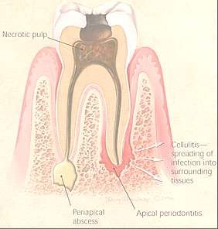
Diseases Of Periapical Tissues

Slide 37
Once infection has established in the dental pulp, spread of the process can be in one direction- through the root canals and into the periapical region.
Number of different tissue reaction may occur, depending upon a variety of circumstances.
Subtle transformation from one type of lesion into another type in most cases.

Slide 38
Interrelationships of
periapical infections
Pulpitis
Acute chronic
Apical periodontitis
Acute chronic
Periapical abscess
Acute chronic
Periapical granuloma
Periodontal cyst
Osteomyelitis
Acute
Focal
chronic
Diffuse
Periosteitis
Cellulitis
Abscess

Slide 39
DIAGNOSIS
CHIEF COMPLAINT: Pain on biting, pain with swelling, pus discharge etc.
DENTAL HISTORY : Recurring episodes of pain, swelling with discharge, swelling which reduces on its own.
OBJECTIVE EXAMINATION
Extraoral examination- general appearance, skin tone, facial asymmetry, swelling, extraoral sinus, sinus tract, tender or enlarged cervical lymph nodes.
• Intraoral examination- examination of soft tissues and teeth to look for discolouration, abrasion, caries, restoration etc.

Slide 40
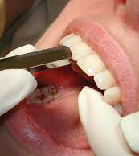
TESTS
CLINICAL PERIAPICAL TESTS
1. PERCUSSION- indicates inflammation of the peridontium.
2. PALPATION- determines how far the inflammatory process has extended periapically.

Slide 41
VITALITY TESTS
3. PULP VITALITY-
• Thermal tests- includes heat and cold testing
• Anesthetic testing • Test Cavity
• Electrical pulp testing
4. PERIODONTAL EXAMINATION-
• Probing- determines the level of connective tissue attachment.
• Mobility- determines the status of pdl.

Slide 42
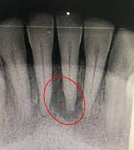
RADIOGRAPHY
5. RADIOGRAPHIC EXAMINATION-
Loss of lamina dura apically
Radiolucency at apex regardless of cone angle nd usually resembles a hanging drop.
Cause of pulp necrosis is usually evident.

Slide 43
CLASSIFICATION
GROSSMAN’S CLASSIFICATION
➢ Acute Periradicular disease
(a) Acute alveolar abscess
(b) Acute apical periodontitis(symptomatic periodontitis) - Vital - Non Vital
(c) Acute exacerbation of chronic apical periodontitis(phoenix abscess)
➢ Chronic periradicular diseases
(a) Chronic apical periodontitis - chronic alveolar abscess - cystic apical periodontitis
(b) Persistent apical periodontitis
➢ Condensing osteitis
➢ External root resorption
➢ Diseases of the periradicular tissues of non-endodontic origin

Slide 44
Apical Periodontitis
Inflammation of PDL around apical portion of root.
Types: 1.Acute Apical Periodontitis
2.Chronic Apical Periodontitis Etiology:
spread of infection following pulp necrosis,
occlusal trauma,
Bitting suddenly on high objects
Inadvertent endodontic procedures
Pushing the infected material into apical portion
Chemical irritation from root canal medicaments

Slide 45
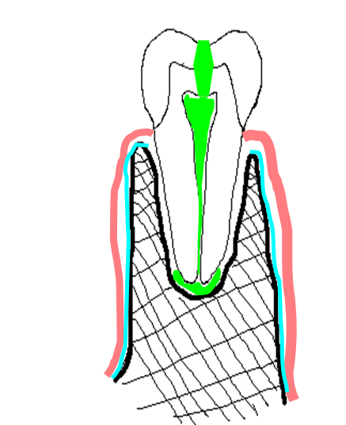
Acute Apical Periodontitis
Painful inflammation of the peridontium as a result of trauma, irritation, or infection through the root canal, regardless of whether the pulp is vital or nonvital.
Also referred to as symptomatic apical
periodontitis.
Tooth is tender on percussion & pain can be
severe making closure of the teeth difficult.

Slide 46
Etiology
VITAL TOOTH | NON VITAL TOOTH
Occlusal trauma | Sequelae of pulpitis
Wedging of foreign body between teeth | During root canal therapy Forcing of irrigating irrigants or medicaments through the apical foramen
Blow on teeth | Extension of obturating material through the apical foramen , Perforation of the root, Overinstrumentation
Orthodontic pressure

Slide 47
CLINICAL FEATURES:
Thermal changes does not induce pain.
Slight extrusion of tooth from socket.
Cause tenderness on mastication due to inflammatory edema collected in PDL.
Due to external pressure, forcing of edema fluid against already sensitized nerve endings results in severe pain.

Slide 48
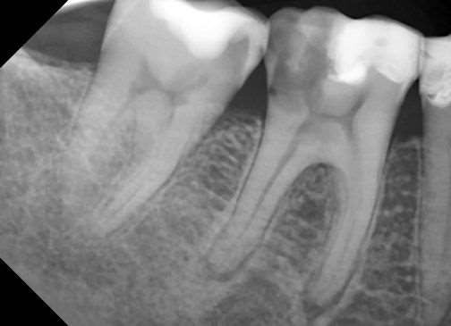
DIAGNOSIS:
CLINICAL DIAGNOSIS:
Tender to percussion
RADIOGRAPHIC FEATURES:
widening of PDL space

Slide 49





HISTOLOGIC FEATURES:
PDL shows signs of inflammation -vascular dilation
-infiltration of PMNs
Inflammation is transient, if caused by acute trauma.
If irritant not removed, progress into surrounding bone
resorption.
Abscess formation may occur if it is associated with bacterial
infection Acute periapical abscess / Alveolar abscess

Slide 50
TREATMENT:
Selective grinding if inflammation due to occlusal
trauma.
Extraction & endodontic treatment be done to drain exudate.

Slide 51
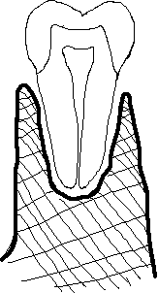
Chronic Apical Periodontitis (Periapical Granuloma)
A growth of granulomatous tissue continuous with the Periodontal ligament resulting from the death of the pulp and the diffusion of bacterial toxins from the root canals into surrounding periradicular tissue through the apical and lateral canals
Low- grade infection
Most common sequelae of pulpitis or apical periodontitis.
If acute (exudative) left untreated → chronic (proliferative).

Slide 52
Term is not accurate since it doesn’t shows true
granulomatous inflammation microscopically.
Presence of lateral or accessory root canals opening on
the lateral surface
granuloma
ETIOLOGY
Death of the pulp
of the root give rise to lateral
Irritation of the periapical tissue that stimulates a productive cellular response

Slide 53
CLINICAL FEATURES:
Tooth involved is non vital / slightly tender on percussion.
Percussion may produce dull sound instead metallic due to
granulation tissue at apex.
Mild pain on chewing on solid food.
Tooth may be slightly elongated in socket.
Sensitivity is due to hyperemia, edema & inflammation of PDL.
In many cases, asymptomatic.
Fully developed granuloma seldom presents more severe clinical symptoms.
No perforation of bone & oral mucosa forming fistulous tract unless undergoes acute exacerbation.

Slide 54
RADIOGRAPHIC FEATURES:
Thickening of PDL at root apex.
As concomitent bone resorption & proliferation of granulation tissue appears to be radiolucent area.
Thin radiopaque line or zone of sclerotic bone sometimes seen outlining lesion.
Long standing lesion may show varying degrees of root
resorption.

Slide 55
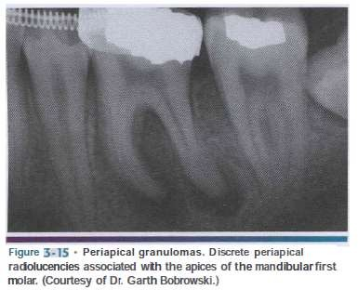
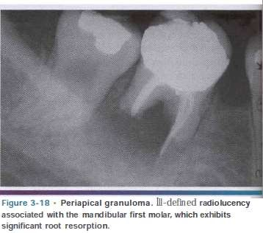

Slide 56
HISTOLOGIC FEATURES:
Hyperemia and edema of the PDL ligament with infiltration of chronic inflammatory cells.
Inflammatory and locally increased vascularity of the tissue are associated with resorption of the surrounding bone adjacent to this area.
Granulation tissue mass consists proliferating fibroblasts, endothelial cells & numerous immature blood capillaries with bone resorption.
Capillaries lined with swollen endothelial cells.
Its is relatively homogenous lesion composed of
macrophages, lymphocytes & plasma cells.

Slide 57
TREATMENT
Extraction & RCT with / without apicoetomy.
If untreated → apical periodontal cyst formation.

Slide 58


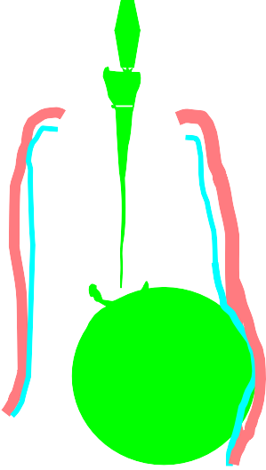
Periapical Abscess
(Dento-Alveolar abscess, Alveolar Abscess)
Periapical abscess is an acute or chronic suppurative process of the dental periapical region.
Developed from acute periodontitis / periapical
granuloma.
Acute exacerbation of chronic lesion → Phoenix Abscess ETIOLOGY:
traumatic injury
pulp necrosis,
irritation of periapical tissues

Slide 59
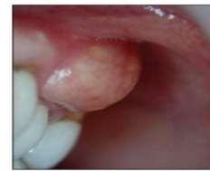
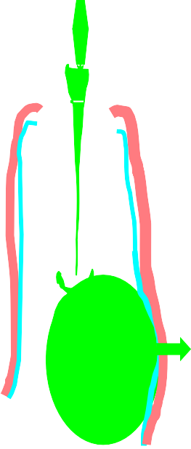
CLINICAL FEATURES:
Common findings of inflammation- heat, redness,
swelling and pain.
Tenderness of tooth, which relives after pressure application.
Extreme painful tooth extrude from socket.
Systemic manifestations like lymphadenitis & fever may present when confined to periapical region.
Rapid extension to adjacent bone marrow spaces produces acute osteomyelitis or dentoalveolar abscess.

Slide 60
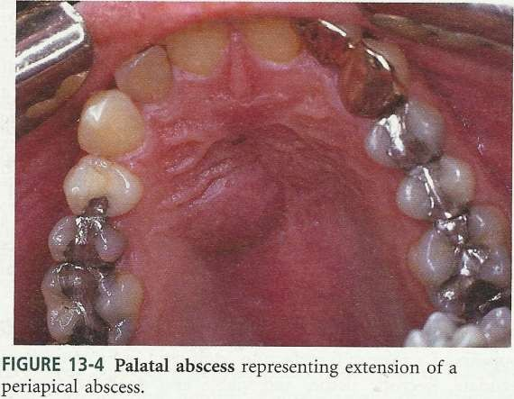

Slide 61
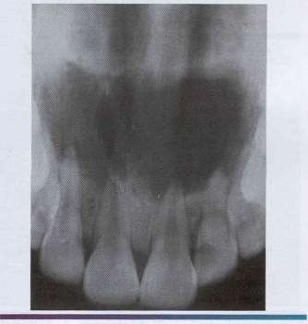
RADIOGRAPHIC FEATURES:
Slight thickening of PDL space.
Radiolucent area at apex of root.

Slide 62
HISTOLOGIC FEATURES:
Area of suppuration composed of PMN leukocytes, lymphocytes, cellular debris, necrotic materials & bacterial colonies.
Dilation of blood vessels in PDL & bone marrow space.
Marrow space show inflammatory infiltrates.
Tissue around area show suppuration containing serous exudate.

Slide 63
TREATMENT:
Drainage of abscess
extraction.
Root canal treatment.
by opening pulp chamber or
If untreated, causes osteomyelitis, cellulites & bacteremia & formation of fistulous tract opening to oral mucosa.

Slide 64
ACUTE EXACERBATION OF A CHRONIC LESION/ PHOENIX ABSCESS
An acute inflammatory reaction superimposed on an existing chronic lesion such as a cyst or granuloma
ETIOLOGY:
Periradicular disease
Bacteria released
from root canals during
instrumentation may trigger acute response

Slide 65
Symptoms:
At onset, tooth is tender to touch
As inflammation progresses tooth may be elevated in its socket and may become sensitive.
Mucosa over the radicular area appears red and swollen
Histopathologically, shows areas of liquefaction necrosis with disintegrated polymorphonuclear leukocytes & cellular debris surrounded by macrophages, lymphocytes, plasma cells in periradicular tissues.

Slide 66
DIAGNOSIS:
Common findings of inflammation- heat, redness, swelling and pain.
Most commonly associated with the initiation of RCT
History of trauma
Radiographically, well defined periradicular lesion may be present.
TREATMENT:
Drainage and debriment
Root Canal Treatment

Slide 67
RADICULAR CYST
INTRODUCTION
Radicular cysts are the most common inflammatory cysts and arise from the epithelial residues in the periodontal ligament as a result of periapical periodontitis following death and necrosis of the pulp.
Most common odontogenic cyst.
Other names: Periapical cyst, apical periodontal cyst,
root end cyst or dental cyst

Slide 68
Periapical Cyst: These are the radicular cysts which are present at root apex.
Lateral Radicular Cyst: These are the radicular cysts which are present at the opening of lateral accessory root canals of offending tooth.
Residual Cyst: These are the radicular cysts which remains even after extraction of offending tooth

Slide 69
ETIOLOGY: Infected tooth, leading to necrosis of tooth
Inflammation stimulates the epithelial rests of melassez found in apical periodontal ligament
Periapical granuloma infected/sterile
Epithelium undegoes necrosis caused by lack of blood
supply
Cyst

Slide 70
BAY CYST: Island of squamous epithelium which have developed from the odontogenic rests of Malassez can also be found in a periapical granuloma without cystic transformation.

Slide 71
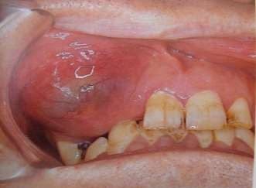
CLINICAL FEATURES: -
Age incidence: peak in 3rd, 4th and 5th decade
Sex incidence: Slightly more males.
Frequency: Commonest cystic lesion of jaws.
Primarily symptom less.
Discovered accidentally during routine dental X ray exam.
Diagnostic criteria – associated teeth are non vital
Rare in deciduous teeth.

Slide 72
Clinical presentation
Symptomless
At first the enlargement is bony hard but as the cyst increases in size, the covering bone becomes very thin despite subperiosteal bone deposition and the swelling then exhibits ‘egg shell crackling’.
Occasionally, a sinus may lead from the cyst cavity to the
oral mucosa.

Slide 73
RADIOLOGICAL FEATURES:
Classically presents as round / ovoid radiolucency with sclerotic borders and associated with pulpally affected tooth.
Rarely induce resorption of affected teeth

Slide 74
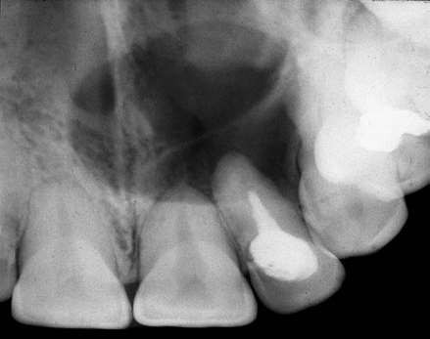
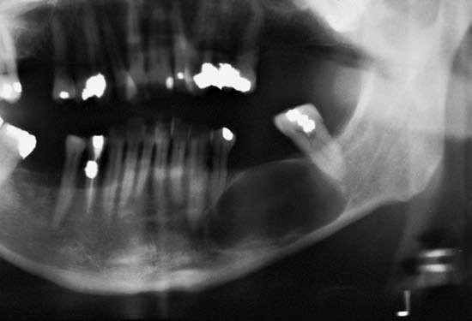
The lesion is a well defined radiolucency associated with the apex of a non-vital root filled tooth.
The lesion is at the site of a previously extracted tooth

Slide 75
HISTOLOGICAL FEATURES
Almost all radicular cysts are lined wholly or in part by
stratified squamous epithelium.
These linings may be discontinuous in part and range in thickness from 1 to 50 cell layers. The majority are 6–20 cell layers thick.
In early cysts- the epithelial lining may be proliferative and show arcading with an intense associated inflammatory process .
As cyst enlarges- the lining becomes quiescent and fairly regular with a certain degree of differentiation to resemble a simple stratified squamous epithelium

Slide 76
TREATMENT:
Extraction of the involved tooth + Curettage of the periapical tissue.
Root canal treatment + Apicocectomy.

Slide 77
CELLULITIS/ PHLEGMON
Cellulitis is a diffuse inflammation of soft tissues which is not circumscribed or confined to one area, but which, in contrary to the abscess, tends to spread through tissue spaces and along fascial spaces.
If an abscess is not able to establish drainage through the surface of the skin or into the oral cavity it may spread diffusely through fascial planes of the soft tissue.

Slide 78
ETIOLOGY
It occurs as a result of infection by microorganisms that produce significant amount of streptokinase, hyaluronidase and fibrinolysins which acts to breakdown or dissolve hyaluronic acid , the universal intracellular cement substance, and fibrin.
MICROORGANISMS- Streptococci, Prevotella
Porphyromonas
Dental infection
Sequela of periapical abscess or osteomyelitis
Pericoronitis
Tooth extraction or injection with a infected needle
&

Slide 79
PATHOLOGY
Streptococci → potent producers of hyaluronidase In their growth phase consume local oxygen
Metabolize nutrients to produce → acidic environment Conductive to the subsequent growth of anaerobic microbes Prevotella, Porphyromonas destroy collagen

Slide 80
CLINICAL FEATURES
Systemic general appetite.
features →increased body temperature ,
of
fatigue, chills, sweatings, headache, loss
Swelling is because of inflammatory edema.
If superficial tissue space involved- skin is inflammed, has an orange peel appearance and is even purplish
If spread of infection in deeper planes- overlying skin is normal
Regional lymphadenitis present

Slide 81
In maxilla-
Perforates the outer cortical layer of bone above the buccinator attachment → swelling in the upper half of the face.
Extension towards eye→ cavernous sinus thrombosis
In mandible-
Perforates the outer cortical plate below the buccinator
attachment → swelling in the lower half of the face.
Spread to cervical tissue cause respiratory discomfort
Facial abscess and Fistulous tract may occur

Slide 82
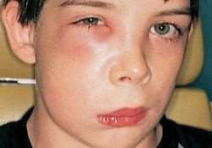
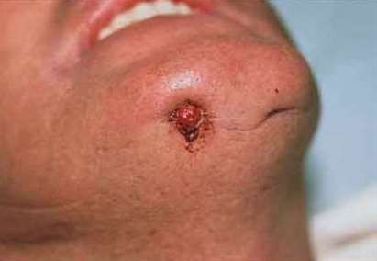

Slide 83
HISTOLOGICAL FEATURE
A microscopic section through an area of cellulitis shows a diffuse exudation of polymorphoneuclear leukocyte and lymphocyte.
Considerable serous fluid and fibrins causing separation
of connective tissue and muscle fibres.

Slide 84
COMPLICATION
Cavernous sinus thrombosis
Ludwigs Angina
Facial abscess

Slide 85
TREATMENT
Antibiotics
Antianaerobics
Removal of the cause of the infection
To avoid massaging the affected area to avoid spread

Slide 86
CONCLUSION
Establishment of proper diagnosis is of utmost importance to carry out the effective clinical procedure for the benefit of patient .
Review after the treatment is also to be given importance
It is essential that we understand the progressive nature of the periapical disease process as well as how and why the various stages occur so they can be diagnosed and managed appropriately.

Slide 87
References
R Rajendran, B Sivapathasundaram. Shafers textbook of oral pathology 6th ed
Neville ,Damm, Allen, Bouquot. oral and maxillofacial pathology 2nd ed
Shear M, Cysts of the Oral and maxillofacial Regions, 4th Edition.
Stephane Schwartz, Garre’s osteomyelitis: a case report, The American Academy of Pedodontics/Vol. 3, No. 3
Marc M. Baltensperger, Osteomyelitis of the Jaws.

Slide 88
THANK YOU

