Slide 1
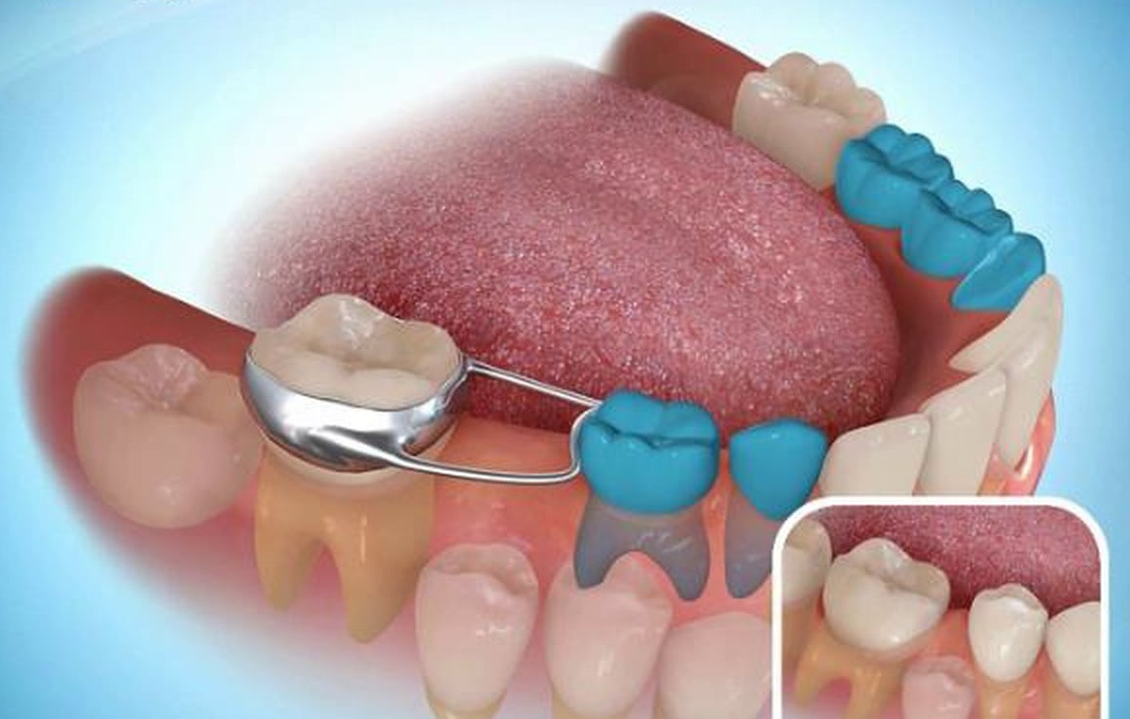
SPACE MANAGEMENT
Dr. Eldho Babu

Slide 2
Definitions
Space Maintenance : (JC Brauer)
The process of maintaining a space in a given arch previously occupied by a tooth or a group of teeth
Space Maintainer : (Boucher)
fixed or removable appliance designed to preserve the space created by premature loss of a primary tooth or a group of teeth

Slide 4
Indications
If the space shows signs of closing.
If the use of space maintainer will make the future orthodontic less complicated.
If the need for treatment of malocclusion at a later date is not indicated.
When the space should be maintained for two year or more.
To avoid supra eruption of opposing tooth.
To improve the masticatory system and restore dental health.

Slide 5
Contraindications
If the radiograph shows that the succedaneum tooth will erupt soon.
If the radiograph shows one third of the root of is already calcified.
When the space left is greater than the needed for the permanent as indicated from radiographically.
If the space shows no signs of closing.
When the succedenous tooth is absent.

Slide 8
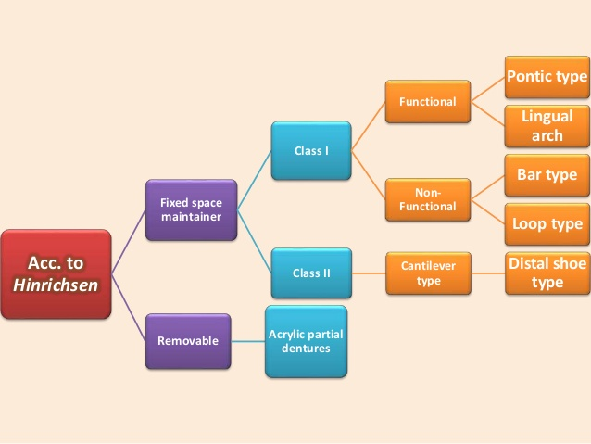

Slide 9
BAND & LOOP
CROWN & LOOP
LINGUAL ARCH HOLDING DEVICE
NANCE’S PALATAL HOLDING DEVICE
TRANS PALATAL
DISTAL SHOE
REMOVABLE SPACE MAINTAINER

Slide 10
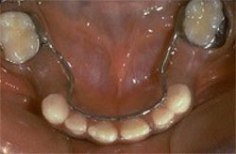
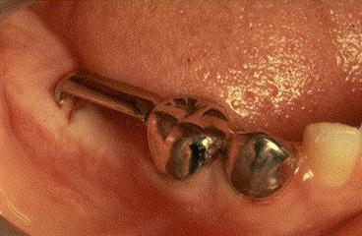
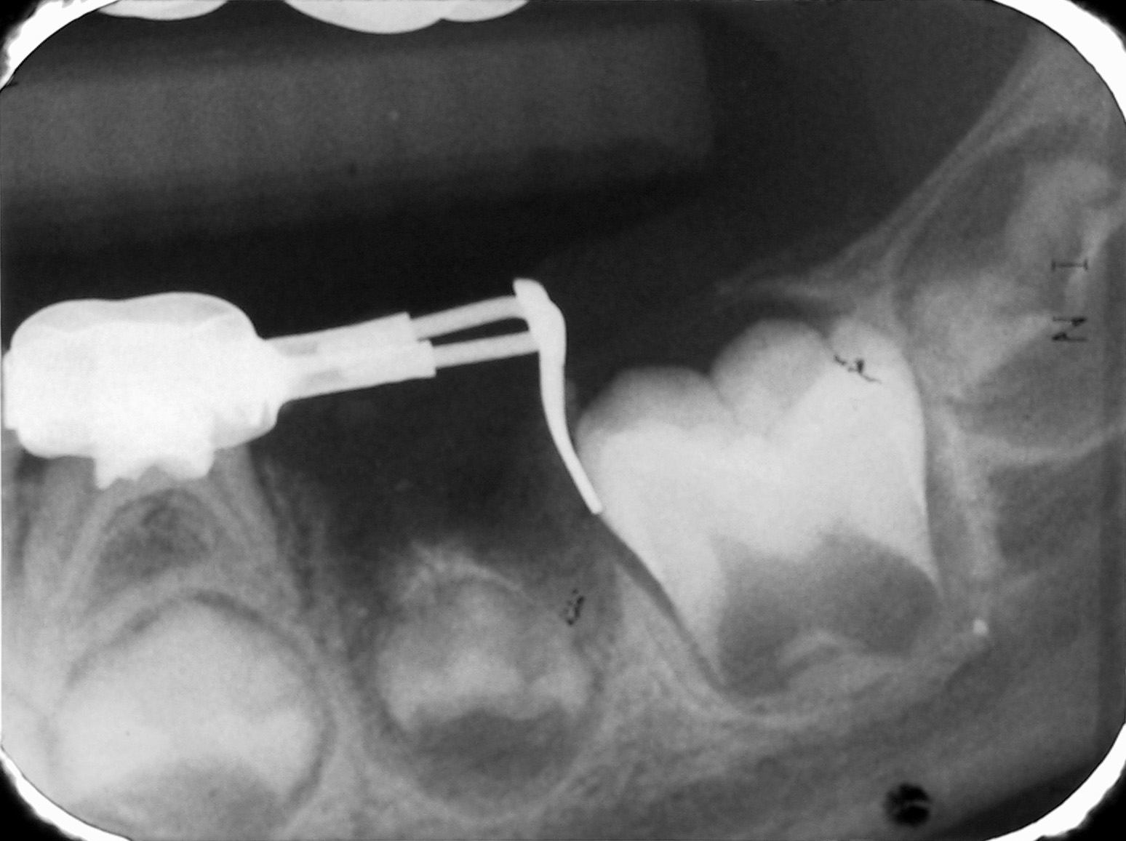
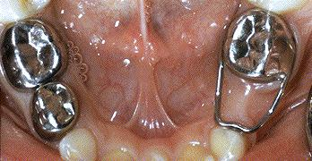
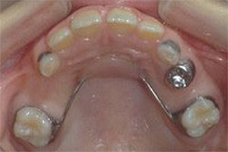
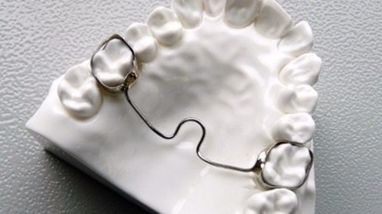

Slide 11
SPACE REGAINERS

Slide 12
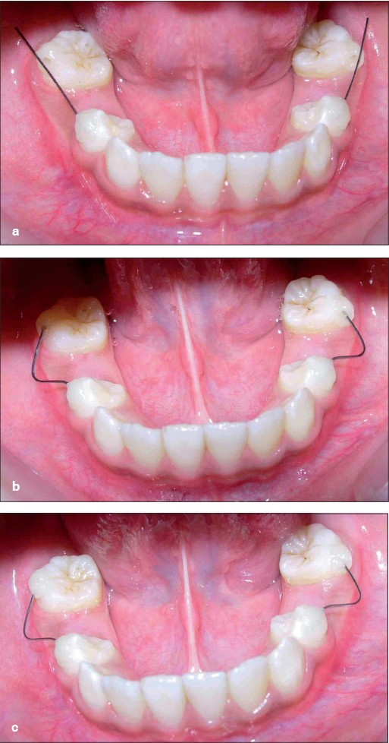
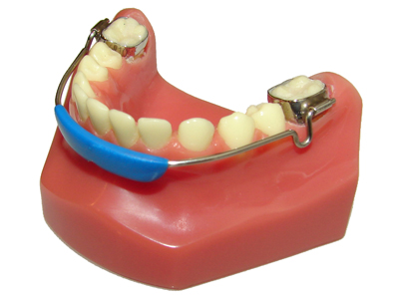
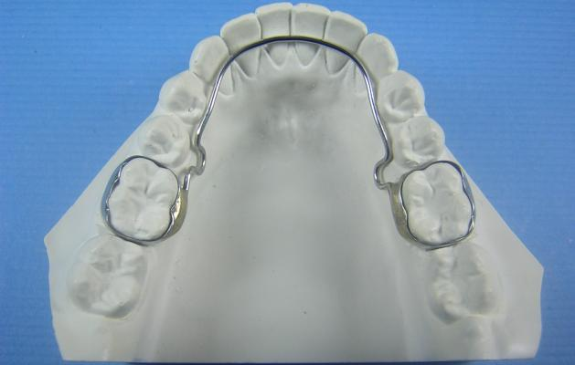
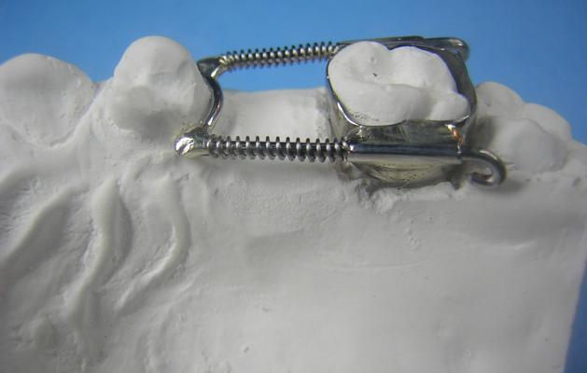
Fixed
Hotz lingual arch
Gerber space regainer
Lip bumper
Niti

Slide 13
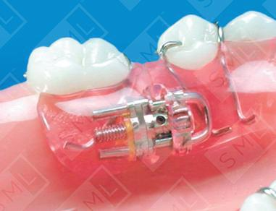
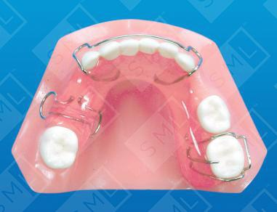
Removable
Split saddle/ Dumbbell space regainer
Sling shot space regainer
Jack screw

