Slide 1
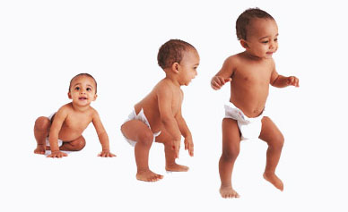
Growth and development- general principles
Dr Deaby Miriam
Reader
Department of Orthodontics

Slide 2
INTRODUCTION
Practice of Orthodontics have two basic requirements:
Possess an intimate knowledge of the anatomy and growth of head
Master the techniques for regulating tooth position
Sound knowledge of growth and development is essential for successful ortho treatment

Slide 3

DEFINITIONS
GROWTH
Self multiplication of living substance- Huxley
Increase in size, change in proportion and progressive complexity- Krogman
DEVELOPMENT
Progress towards maturity- Todd
All the naturally occurring unidirectional changes in the life of an individual from its existence as a single cell to its elaboration as a multifunctional unit terminating in death

Slide 4
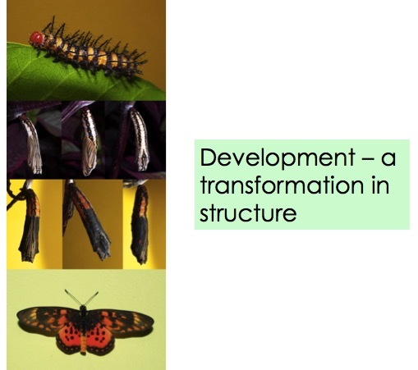
DIFFERENTIATION
Change from a generalized cell or tissue to one that is more specialized

Slide 5
Factors affecting physical growth
Heredity
Major role in overall growth
Sum total of traits potentially present in the fertilized ovum
Gender
Nutrition
Adequate supply of nutrients are essential
Effects of malnutrition are reversible to a certain extend
Catch up growth- if the adverse effects are not too severe, the growth process accelerates when proper nutrition is provided

Slide 6
Illness
Usual minor childhood diseases do not have much effect
Prolonged and debilitating illness- marked effect
Race
Has a role
Eg- American blacks- calcification and eruption of teeth occur almost a year earlier than white counterparts
Socioeconomic factors
Children brought up in affluent and favourable socioeconomic conditions show earlier onset of growth events
They grow to a larger size than others
Reason- better nutrition, better facilities,regular meals,sleep, exercise

Slide 7
Family size and birth order
Big families with limited income – growth affected
Studies have shown first born babies tend to weigh less at birth and have small stature but higher IQ
The smaller the family size,the better would be nutrition conditions
Secular trends
Changes in size and maturation ina a large population can be shown to occur with time
Reasons- changes in socioeconomic condition,lifestyle and food habits

Slide 8
Climatic and seasonal effects
Seasonal variations affect adipose tissue content and weight of newborn babies
Psychological disturbances
Children experiencing stressful conditions display inhibition of growth hormone secretion
Prologed psychological disturbances markedly retard growth
Exercise
Regular strenuous exercise stunted growth in kids
Development of motor skills and increase in muscle mass is influenced by exercise

Slide 9
Hormones
Growth supporting substance
Regulate growth and development
Thyriod, growth hormone

Slide 10
Concepts of growth
CONCEPT OF NORMALITY
Ideal denotes the central tendency of the group
Normality changes with age- what is normal for an age group may not be necessarily normal for a different age group
RHYTHM OF GROWTH
First wave of growth- birth to 5-6 year
Most intense and rapid in first two years
After 2 years- slow increase terminating in boys about 10-12 years and girls 10 years
Another wave of growth- corresponds to adolescent spurt
Completed in girls between 14-16 years
Extended in boys through 16-18 years
Final period of slow growth-girls-ends between 18-20
In boys- till 25 th year

Slide 11
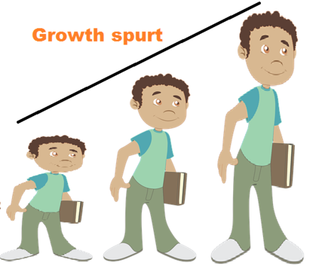
Growth spurts
Sudden increase in growth
1)Just before birth
2)Infantile spurt- upto 3 years of age
3)Mixed dentition spurt(juvenile growth spurt):
Boys:8-11 years
Girls:7-9 years
4)Prepubertal growth spurt/adolescent spurt
Boys:14-16 years
Girls:11-13 years

Slide 12
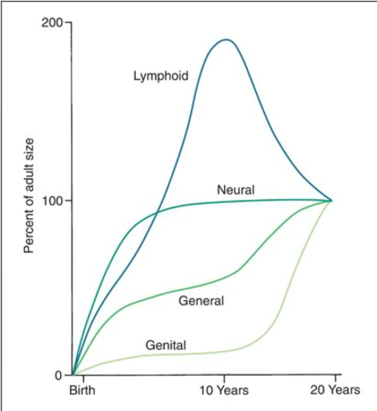
Differential growth
Scammon’s growth curve(curve of systemic growth)
Richard Scammons
General
Represents growth of body as a whole
Represents stature, weight,height
Pattern is S or sigmoid shaped-
4 phases- rapid growth- infancy and early childhood
Steady growth-middle childhood
Rapid growth-in adolescence
Slow increase and eventual cessation after adolescence

Slide 13
Scammon’s growth curve(curve of systemic growth)
Neural curve
Includes growth of brain,nervous system and associated structures like eye and parts of skull
Rapid growth in early postnatal period
Reach 95% growth by 7 years
Steady gain after 7 years
Lymphoid curve
Growth of lymphoid gland, tonsil, thymus
Rapid growth in infancy and childhood –reach 200%of adult size by 11-13 years
Decline during 20s

Slide 14
Scammon’s growth curve(curve of systemic growth)
Genital curve
Growth of primary and secondary sexual characteristics
Show slight growth in infancy followed by latent period most of childhood
Rapid growth and maturation during adolescent growth spurt

Slide 15
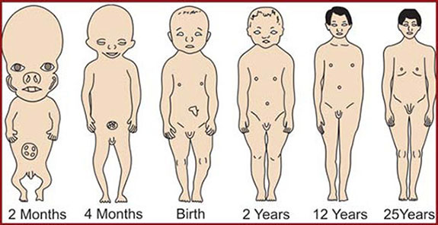
Cephalocaudal Gradient of Growth
-Scammon
There is an axis of increased growth extending from head (cephalic) towards the feet (caudal region).
It can be seen that postnatal growth of regions of the body that are away from the hypophysis grow more rapidly and at a faster rate than the structures that are nearer to it.

Slide 16
Within the face, the cephalocaudal gradient of growth is reflected postnatally with mandible growing at a faster rate compared to maxilla, as it is situated relatively farther away from sella turcica compared to maxilla.

Slide 17
GROWTH SITE AND GROWTH CENTRE
GROWTH CENTRE
Area of bone that controls the overall growth of the bone that controls overall growth of the bone
Areas of primary cartilaginous bone growth which act as skeletal growth centers
More genetically controlled
Little or no influence of epigenetic factors
Has tissue separating capabilities
Can grow and expand even in the presence of epigenetic mechanical factors which normally restict growth
E.g. cranial base synchondroses

Slide 18
GROWTH SITE
Areas where significant growth of that bone occurs
Marked response to external influences
Growth site is an area of growth which occurs secondarily
E.g. periosteal bone growth associated with muscle function
Sutural bone growth
Growth sites can occur at growth centers but all growth sites are not growth centres

Slide 19
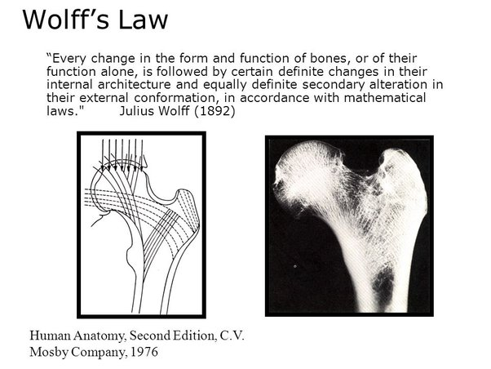

Slide 20
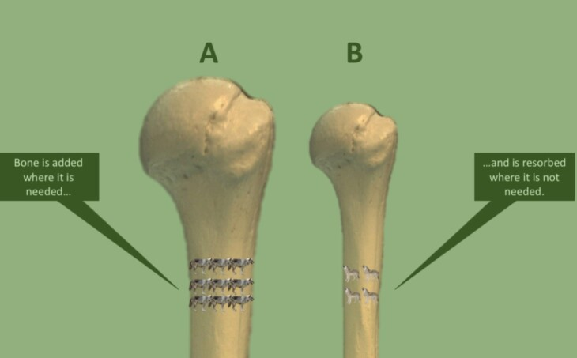
Wolff's Law
Wolff's Law is the idea that natural healthy bones will adapt and change to adapt to the stress that it is subjected to.
If the bones are subjected to heavier and heavier loads, they will naturally reconstruct themselves to accommodate that weight. This is how bones typically respond to stress

Slide 21
Theories of growth
REMODELLING THEORY OF CRANIOFACIAL GROWTH
By BRASH
Bone only grows appositionally at surfaces and growth of jaws is characterized by deposition of bone at posterior surface of maxilla and mandible
Suggests that all skeletal growth occurs by bone remodelling

Slide 22
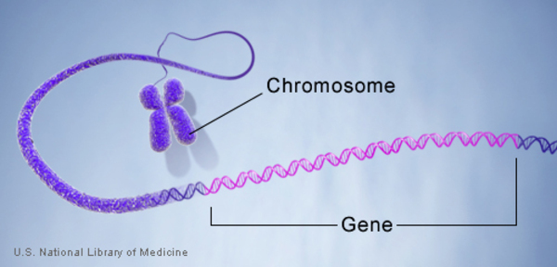
Genetic theory
Allan Brodie
Earliest theories
All growth is preplanned and is controlled by genetic influence

Slide 23
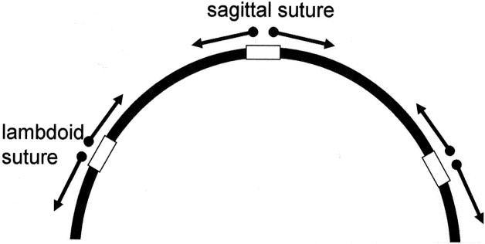
SUTURAL THEORY
Sicher
Connective tissue and cartilagenous joints of the craniofacial skeleton are the primary sites where growth takes place
Points raised against this theory:
When a suture is transplanted to another location, tissue does not continue to grow- lack of innate growth potential
Growth takes place in untreated case of cleft palate even in absence of sutures
Microcephaly and hydrocephaly raised doubts

Slide 24
CARTILAGENOUS THEORY
James Scott
According to this, intrinsic growth controlling factors are present in cartilage
Growth of maxilla is attributed to nasal septal cartilage-pacemaker for entire nasomaxillary complex growth
Points in favour of this theory:
In many bones, cartilage growth occurs and bone merely replaces it
If part of epiphyseal plate is transplanted to different location,it will continue to grow in new location

Slide 25
Nasal septal cartilage shows innate growth potential on being transplanted to another site
Experiments on rabbits involving removal of nasal septal cartilage shows retarded midface development

Slide 26
Functional matrix concept
Melvin Moss
Origin,form, position,growth and maintenance of all skeletal tissues and organs are always secondary, compensatory and necessary responses to chronologically and morphologically prior events or processes that occur in specifically related non skeletal tissues
Functional cranial component is divided into:
Functional matrix
Skeletal unit

Slide 27
Skeletal unit
All skeletal tissues associated with single function
Bone, cartilage,tendons
When bone is comprised of several contiguous skeletal units-microskeletal units
Eg:mandible has alveolar, angular, condylar, gonial,mental,coronoid and basal microskeletal units
When adjoining portions of a number of neighboring bones are united to function as a single cranial component- macroskeletal unit
Eg;entire endocranial surface of the calvarium

Slide 28
Functional matrix
Divided into:
Periosteal matrices
Capsular matrices
Periosteal matrix
Acts directly and actively upon their related skeletal units
Alteration in their functional demands produce a secondary compensatory transformation of the size and/shape of their skeletal units

Slide 29
Such transformations are brought by interrelated processes of bone deposition and resorption
Periosteal matrices include muscles,blood vessels,nerves,glands etc
Capsular matrix
Acts indirectly and passively on their related skeletal units-produces secondary compensatory translation in space
Skeletal units are passively and secondarily moved in space as enveloping capsule is expanded.
This growth is not brought about by deposition and resorption
Neurocranial capsule and oro-facial capsule are examples
These are envelopes which contain a series of functional cranial components which as a whole are sandwiched in between two covering layers

Slide 30
Neurocranial capsule surrounds and protects the neurocranial capsular functional matrix,ie. Brain,leptomeninges and CSF
Neurocranial capsule is made of skin, connective tissue,aponeurotic layer, loose connective layer,periosteum, base of skull and two layers of dura mater
Orofacial capsule surrounds an protects the oro-naso-pharyngeal spaces
Growth of skull is influenced by volume and patency of these spaces

Slide 31
VAN LIMBORGH’S THEORY
Combination of functional matrix theory,some aspects of Sicher’s theory and genetic theory
INTRINSIC GENETIC FACTORS:genetic control of skeletal units
LOCAL EPIGENETIC FACTORS:bone growth is dteremined by genetic control originating from adjacent structures like brain,eyes etc
GENERAL EPIGENETIC FACTORS: genetic factors determining growth from distant structures like sex hormones, growth hormone etc
LOCAL ENVIRONMENTAL FACTORS:non genetic factors from local external environment- habits, muscle force etc
GENETAL ENVIRONMENTAL FACTORS:general non genetic influences like nutrition,oxygen etc

Slide 32
SERVOSYSTEM THEORY
Alexandre Petrovic
Relies on components of cybernetrics to describe growth of craniofacial complex
The servo system theory is explained in a cybernetic language
Cybernetrics is based on communication of information
Any cybernetrically organized system operates through signals that transmit information ,processes such an input and produces output
Output is related to the input by a transfer function
In an openloop system,output does not affect the input
Organized living systems operate on closed loops system –there is communication between input and output

Slide 33
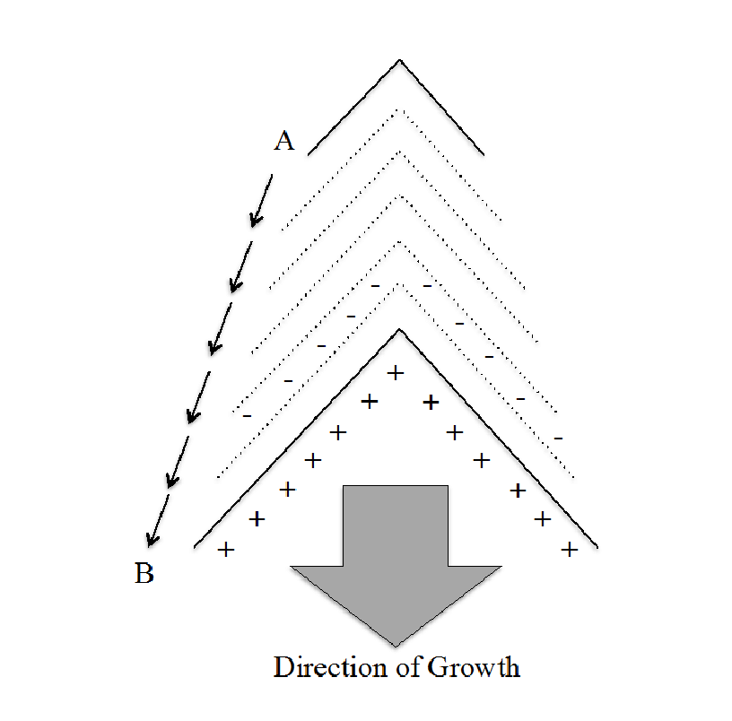
Enlow’s expanding V principle

Slide 34
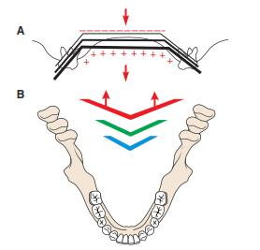

Slide 35
Enlows counterpart principle
Growth of any given facial or cranial part relates specifically to other structural and geometric counterparts in the face and cranium
There are regional relationships throughout the whole face and cranium.
If each regional part and its particular counterpart enlarges to same extend, balanced growth occurs
This 'counterpart principle' suggests that imbalances in the regional relationships are produced due to variation in:
a. Magnitude of growth between the counterparts.
b. Timing of growth between the counterparts.
c. Directions of growth between the counterparts.

Slide 36
There are number of counterparts, which are situated in the craniofacial region.
■ Nasomaxillary complex v/s anterior cranial fossa
■ Middle cranial fossa and breadth of ramus are counterparts
■ Maxillary arch v/s mandibular arch
■ Bony maxilla and corpus of mandible are mutual counterparts.
■ Maxillary tuberosity vs lingual tuberosity.

Slide 37
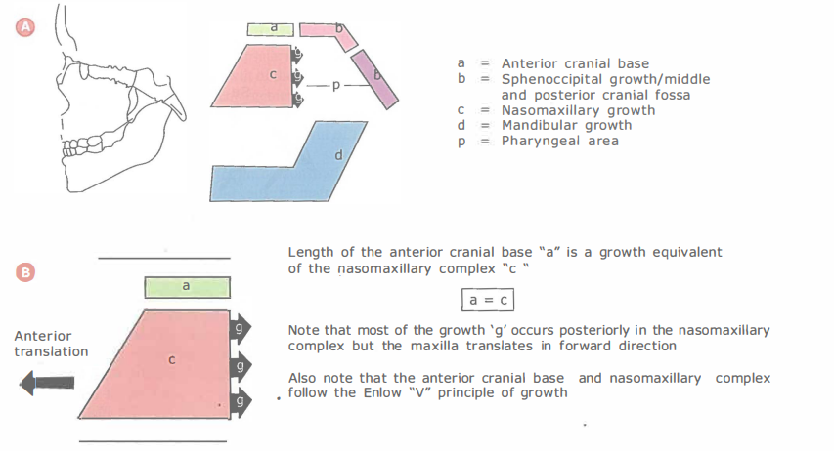

Slide 38
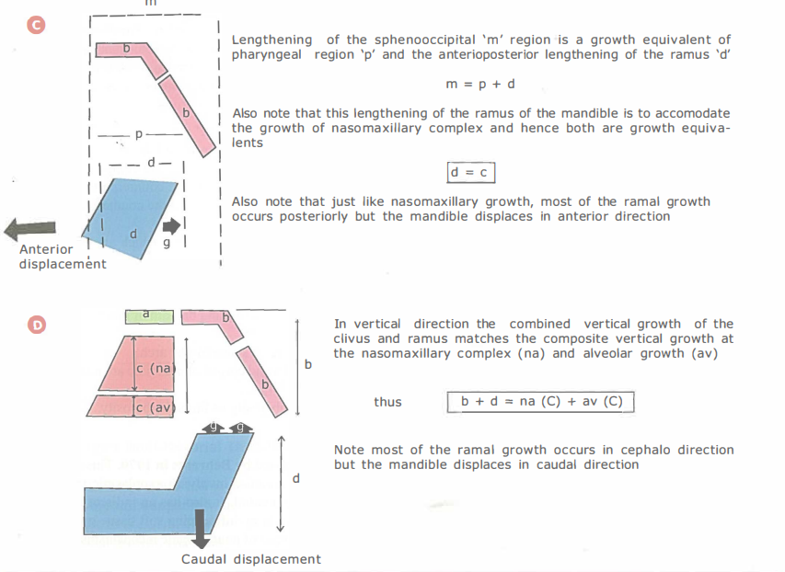

Slide 39
CONCLUSION
Growth and development from a new born to adult hood is characterized by a multiplicity of morphological, physiological and psychological changes.
Many characteristics of general body growth are also present in the growth of the craniofacial region.
The answer to our clinical problems lies in a complete understanding of craniofacial growth and its implication in the clinical situation for the appraisal of our treatment modalities that suit the patient better so as to achieve the best results in form of function, esthetics and structural balance.

