Slide 1
ACUTE GINGIVAL CONDITIONS
ANUG • PRIMARY HERPETIC GINGIVOSTOMATITIS • PERICORONITIS
Periodontology | Clinical features • diagnosis • treatment
Based on the uploaded teaching material

Slide 2
Acute gingival conditions
Three important clinical entities
ANUG
Necrosis, pseudomembrane, bleeding and characteristic pain
Primary herpetic gingivostomatitis
HSV-1 infection with generalized oral soreness and systemic symptoms
Pericoronitis
Inflammation around the crown of an incompletely erupted tooth
2

Slide 3
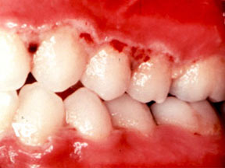
ANUG
ACUTE NECROTIZING ULCERATIVE GINGIVITIS
Definition
“A microbial disease of the gingiva in the context of an impaired host response.”
Characterized by death and sloughing of gingival tissue with characteristic signs and symptoms.
Other names
Plaut–Vincent disease • Trench mouth • Acute membranous gingivitis • Vincent’s gingivostomatitis • Fusospirillary gingivitis • Acute septic gingivitis
3

Slide 4
Etiology
Microbial profile described in the source material
Dominant / constant flora
Variable flora
Key concept
Spirochetes like [Treponema spp.]
Fusobacterium spp.
Prevotella intermedia
Selenomonas spp.
Anaerobic associated flora
Other organisms may vary
The condition is associated with fusiform and spirochetal bacteria in the setting of an impaired host response.
4

Slide 5
Predisposing factors
Local, systemic and behavioral influences
SYSTEMIC / HOST
LOCAL FACTORS
Poor oral hygiene
Overhanging restoration margins
Food impaction
Malpositioned teeth
Calculus
Systemic disease
Nutritional deficiency
Stress
Smoking
5

Slide 6
Host response & predisposing factors
Psychological stress
Smoking
Nutrition & disease
↑ Adrenocortical activity → corticosteroid effects → altered host immune responses → reduced ability to control indigenous bacteria.
Nicotine may reduce gingival papillary blood flow. Reduced blood flow may contribute to deficient host defense and papillary necrosis.
Malnutrition and vitamin deficiencies, particularly ascorbic acid deficiency, are described as predisposing factors. Systemic diseases include malignancy, SLE, drug-induced agranulocytosis and AIDS.
6

Slide 7
Clinical features of ANUG
Recognize the characteristic oral and systemic picture
ORAL SIGNS
EXTRAORAL / SYSTEMIC
Interdental papillae necrosis
Pseudo membrane covering the ulcer
Gingival tenderness
Spontaneous hemorrhage
Bad breath
Increased salivation
Metallic taste
Lymphadenopathy
Fever
Increased pulse rate
Loss of appetite
7

Slide 8
Horning & Cohen: 7 stages
Progression of necrosis
1
5
Necrosis of tip of interdental papilla
Necrosis extends into buccal/labial mucosa
2
6
Necrosis of entire papilla
Necrosis exposes alveolar bone
3
7
Necrosis extends to gingival margin
Necrosis perforates skin of cheek
4
Necrosis extends to attached gingiva
8

Slide 9
Microscopic features
Electron microscopic investigation: four zones
1 • Bacterial zone
2 • Neutrophil-rich zone
Large mass of bacteria
Underlying zone containing many leukocytes, particularly neutrophils
3 • Necrotic zone
4 • Spirochetal infiltration zone
Disintegrating cells with many spirochetes and fusiform-appearing bacteria
Tissue elements relatively preserved but infiltrated by large and intermediate spirochetes
9

Slide 10
Diagnosis
Clinical diagnosis is central
Clinical findings
Biopsy
Characteristic necrosis, pseudomembrane, spontaneous bleeding, tenderness and fetor support the diagnosis.
Listed in the source material as an additional diagnostic approach.
Differential context
The historical material highlights distinction from scurvy and chronic periodontitis.
10

Slide 11
ANUG treatment — first visit
Initial goal: control the acute phase gently
First-visit objectives
Avoid during acute phase
General examination
Removal of pseudomembranous slough
Remove only superficial calculus
Extensive procedures such as subgingival scaling, root planing and extraction are contraindicated in the acute stage.
Home care
3% H₂O₂ diluted with an equal amount of warm water
Chlorhexidine 0.125% rinse twice daily
Analgesic such as an NSAID
11

Slide 12
Supportive instructions & antibiotics
Patient instructions
When systemic signs are severe
Adequate rest
Avoid tobacco and alcohol
Limit toothbrushing initially to removal of surface debris
The source recommends an antibiotic regimen for severe necrosis, lymphadenopathy and other systemic signs/symptoms.
Regimens listed in the source
Amoxicillin 500 mg 6-hourly for 10 days
OR
Metronidazole 500 mg twice daily for 7 days
12

Slide 13
Follow-up & definitive periodontal care
SECOND VISIT
THIRD VISIT
MAINTENANCE
1–2 days after the first visit
Evaluate resolution of signs and symptoms
Gingival shrinkage may expose previously covered calculus → remove gently
Reinforce previous instructions
Approximately 5 days after the second visit
Evaluate resolution of symptoms
Formulate comprehensive periodontal treatment plan
Reinforce plaque-control procedures
Counsel regarding nutrition and smoking cessation
Address habits associated with recurrence
Discontinue H₂O₂
Chlorhexidine may continue for 2–3 weeks
Repeat scaling/root planing if necessary
13

Slide 14
Primary herpetic gingivostomatitis
HSV-1 infection of the oral cavity
Overview
Oral symptoms
Caused by herpes simplex virus type 1 (HSV-1).
Occurs most often in infants and children <6 years, but may occur in adolescents and adults.
Equal frequency in males and females.
Vesicle formaton
ruptured vesicles lead to ulcers
Generalized oral soreness
Difficulty eating and drinking
14

Slide 15
Primary herpetic gingivostomatitis
Extraoral/systemic features and treatment
Extraoral & systemic
Treatment listed in the source
Cervical adenitis
Elevated body temperature
Generalized malaise
Dehydration
Supportive treatment
Antiviral therapy
Mucosal ointment
15

Slide 16
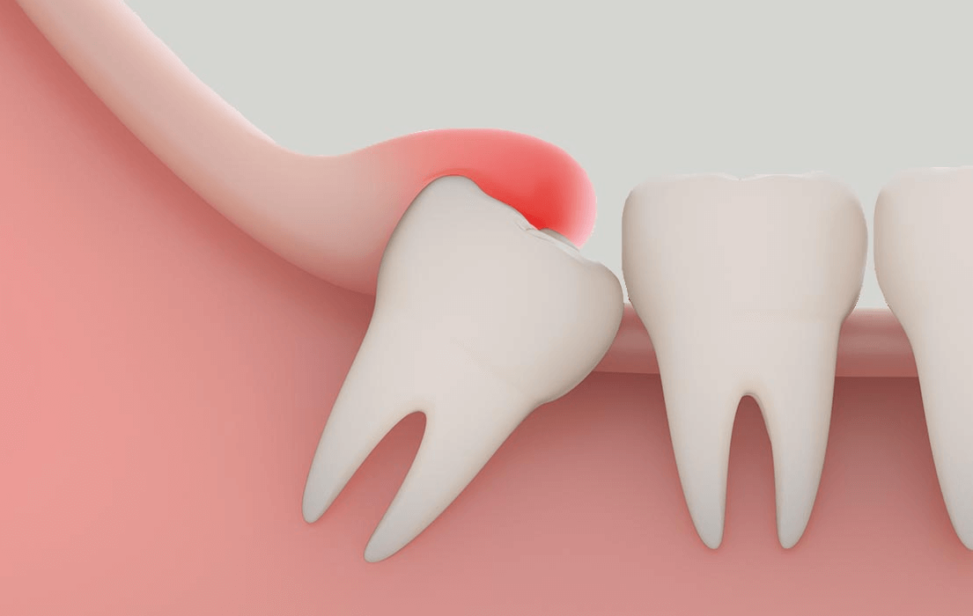
Pericoronitis
Inflammation around an incompletely erupted tooth
Definition
Clinical features
Inflammation of gingiva in relation to the crown of an incompletely erupted tooth.
Pain
Trismus
Bad taste
Neck swelling
Partially erupted tooth
Swollen, edematous gingiva
Pus discharge
Cervical lymphadenopathy
16

Slide 17
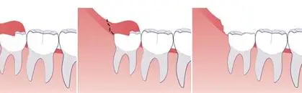
Pericoronitis — treatment
NON-SURGICAL
SURGICAL
Flush the area with hydrogen peroxide
Remove debris and gently elevate the flap while flushing with warm water
Analgesic / antibiotics
Operculectomy
Extraction
17

Slide 18
Quick comparison
Acute gingival conditions — exam-oriented summary
Condition
Primary cause / association
Key clinical clue
Core management
ANUG
Fusiform & spirochetal flora + impaired host response
Necrosis + pseudomembrane + spontaneous bleeding
Acute-phase local care → periodontal treatment
Primary herpetic gingivostomatitis
HSV-1
Generalized soreness + painful vesicles + systemic symptoms
Supportive care + antiviral therapy
Pericoronitis
Inflammation around incompletely erupted tooth
Pain, trismus, swollen operculum / pus
Local irrigation/debridement ± surgery
18

Slide 19
TAKE-HOME POINTS
ANUG is an acute necrotizing gingival disease associated with fusiform/spirochetal flora and an impaired host response.
Recognize the characteristic combination of interdental necrosis, pseudomembrane, spontaneous bleeding, tenderness and fetor.
Manage the acute phase gently first; definitive periodontal therapy follows resolution of acute symptoms.
Primary herpetic gingivostomatitis and pericoronitis have distinct clinical patterns and management approaches.
Thank you

