Slide 1
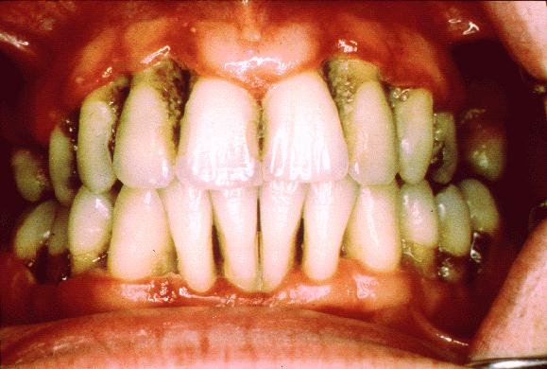
CHRONIC PERIODONTITIS

Slide 2
CONTENT
Definition
Major clinical and etiologic factor
Prevalence
Clinical features
Symptoms
Types
Disease severity
Disease progression
Clinical diagnosis
Radiographic features
Risk factors for disease
Treatment
Prognosis

Slide 3
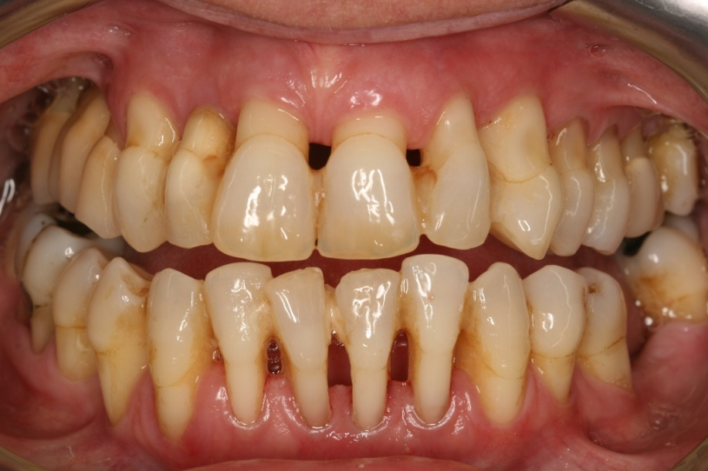
DEFINITION
Chronic periodontitis has been defined as “an infectious disease resulting in inflammation with in supporting tissues of the teeth, progressive attachment loss and bone loss”.

Slide 4
Major clinical and etiologic characteristics of the disease:
Microbial plaque formation.
Periodontal inflammation, and
Loss of attachment and alveolar bone.

Slide 5
PREVALENCE
Effects both sexes equally.
Increases with age.
Patients with systemic diseases

Slide 6
CLINICAL FEATURES
Most prevalent in adults but can occur in children and adolescents.(age‐35+yrs)
Supragingival and subgingival plaque accumulation (frequently associated with calculus)
Gingival inflammation
Pocket formation
Loss of periodontal attachment
Occasional suppuration
Poor oral hygiene – gingiva is typically may be slightly to moderately swollen

Slide 7
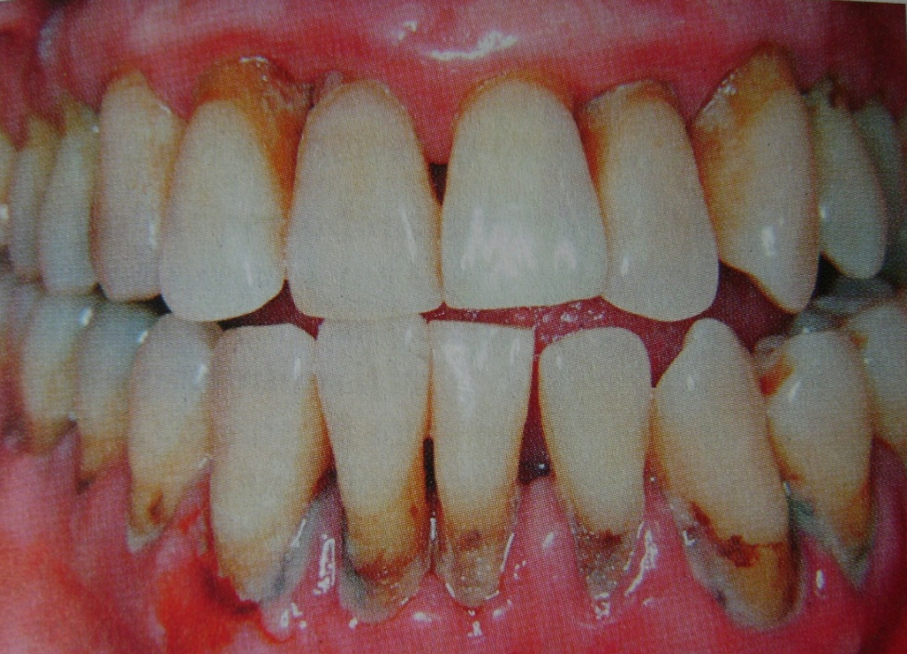
.
Color- pale red to magenta
Consistency – soft or firm
Surface topography – loss of stippling
Blunted or rolled gingival margin
Flattened or cratered papillae.
Tooth mobility.
Furcation involvement.
Spontaneous gingival bleeding.
Pocket depths are variable and both suprabony and intrabony pockets can be found.

Slide 8
SYMPTOMS
Bleeding gums during brushing or eating
Increasing spacing between teeth as a result of tooth movement
Loose teeth
Usually painless, but sometimes localized dull pain radiating deep into the jaw
Sensitivity to heat, cold, or both due to exposed roots
Food impaction
Halitosis
Gingival tenderness or itching

Slide 9
TYPES
DISEASE DISTRIBUTION
Chronic periodontitis is considered to be as “site specific disease”
Inflammation, pockets, attachment loss and bone loss are due to direct site-specific effects of sub-gingival plaque accumulation as a result of this local effect, attachment loss and pockets may occur.
It may occur on one surface of the tooth while the other surface remain normal.

Slide 10
In addition to being site specific, chronic periodontitis may be described as:
Localized:
  Periodontitis is considered localized when <30% of the sites assessed in oral cavity demonstrate attachment loss and bone loss.
Generalized:
  Periodontitis is considered generalized when >30% of the sites assessed demonstrate attachment loss and bone loss
  .
  The pattern of bone loss in chronic periodontitis can be vertical or horizontal.

Slide 11
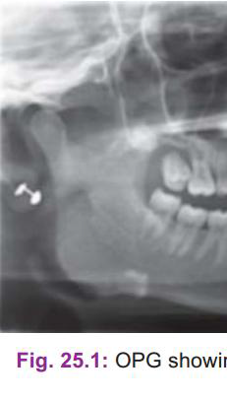
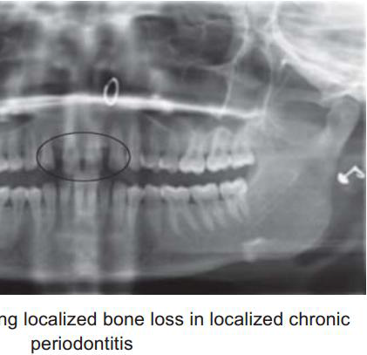
• Localized ≤ 30% of the sites are affected

Slide 12
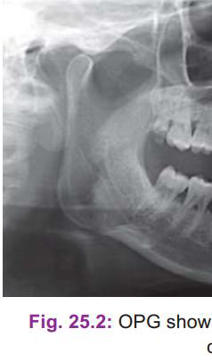
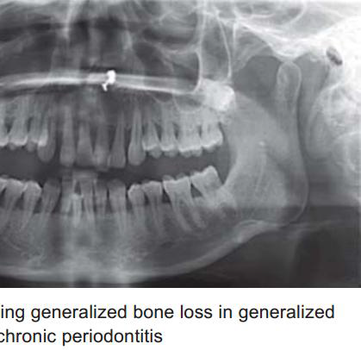
Generalized > 30% of the sites are affected

Slide 13
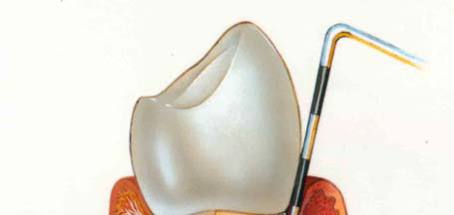
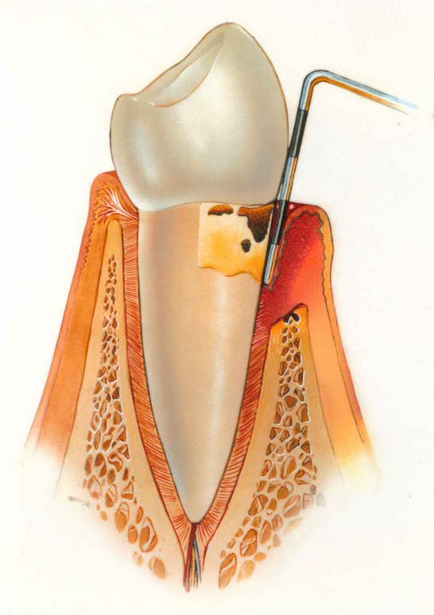
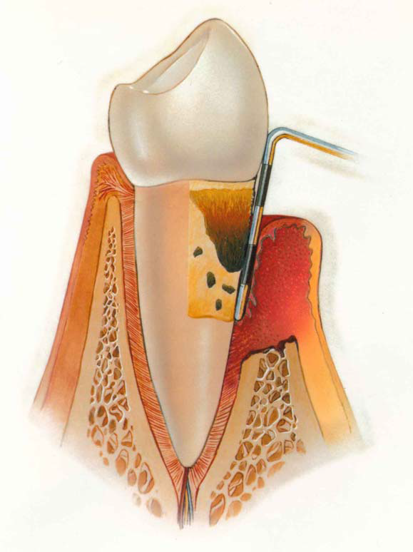
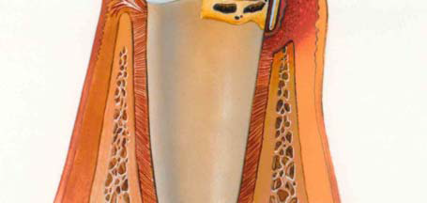
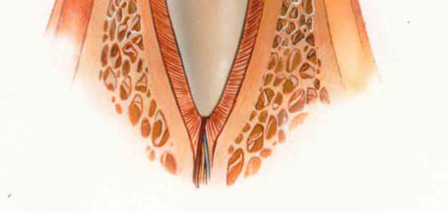
DISEASE SEVERITY
Severity can be categorized on the basis of the amount of Clinical attachment loss (CAL) as follows:
MILD PERIODONTITIS 1 to 2 mm CAL | MODERATE PERIODONTITIS 3 to 4 mm CAL | SEVERE PERIODONTITIS ≥ 5 mm CAL

Slide 14
DISEASE PROGRESSION
Continuous (Linear) Model
  Periodontal destruction occurs at a slow, steady rate over time.
  Attachment loss and bone loss progress continuously.
Random Burst (Episodic) Model
  Disease progresses in short periods ("bursts") of active tissue destruction.
  These active phases are followed by periods of remission or little to no progression.
  Bursts occur unpredictably at different sites.
Asynchronous Multiple Burst Model
  Different teeth or sites experience bursts of disease activity at different times.
  Not all sites are active simultaneously.
  This model is the most widely accepted for the progression of chronic periodontitis, as it best reflects the site-specific and episodic nature of the disease.
Model | Pattern of Progression
Continuous (Linear) | Slow, constant tissue destruction
Random Burst | Intermittent bursts with remission
Asynchronous Multiple Burst | Site-specific bursts occurring at different times (most accepted)

Slide 15
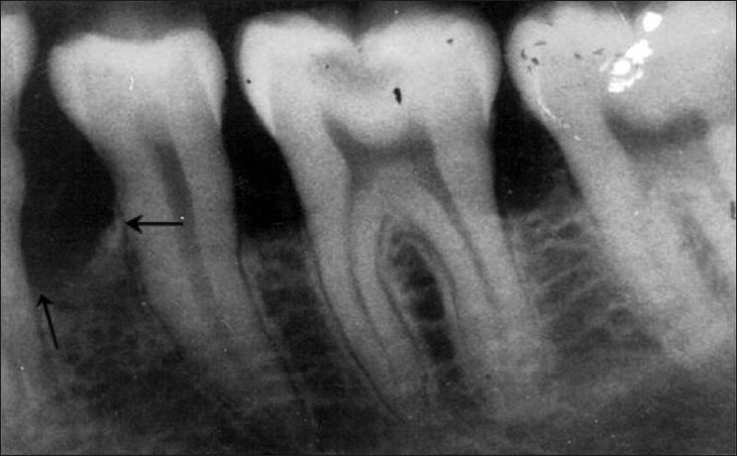
RADIOGRAPHIC FEATURES
Widening of PDL space
Loss of corticated interdental crestal margin
Localized or generalized loss of alveolar supporting bone.
Blunting of the alveolar crest due to beginning of bone resorption

Slide 16
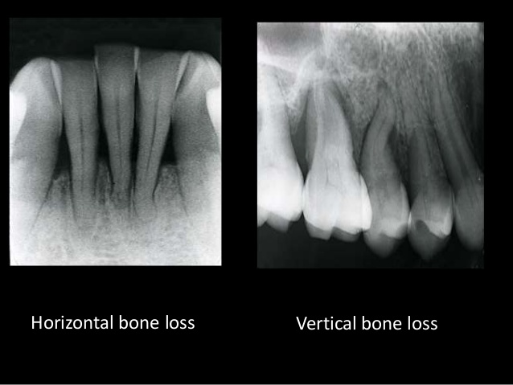
RADIOGRAPHIC FEATURES
Pattern of bone loss may be :
Vertical,
Horizontal,
Vertical bone loss is usually associated with intra bony pocket formation.
Horizontal bone loss is usually associated with supra bony pockets.

Slide 17
RISK FACTORS FOR DISEASE
Prior History of Periodontitis
Local Factors- furcation, Palatogingival groove
Systemic Factors- Diabetes
Stress
Smoking

Slide 18
TREATMENT
NON SURGICAL THERAPY
Initial therapy ( scaling and root planing)
Antimicrobial therapy – as an adjunct to routine periodontal therapy.
Improvement in oral hygiene.
Instruction, reinforcement, evaluation of plaque control records.
Removal of all the factors contributing to plaque accumulation, e.g. correction of ill-fitting appliances, overcontoured crowns, overhanging restorations, etc.

Slide 19
2. SURGICAL THERAPY
A variety of surgical treatment modalities may be appropriate in managing the patient.
1. Pocket elimination procedures.
2. Regenerative therapy:
A. Bone replacement grafts;
B. Guided tissue regeneration;
C. Combined regenerative techniques.
3. Resective therapy:
A. Flaps with or without osseous surgery;
B. Gingivectomy.

