Slide 1
DISCUSSION 1

Slide 2
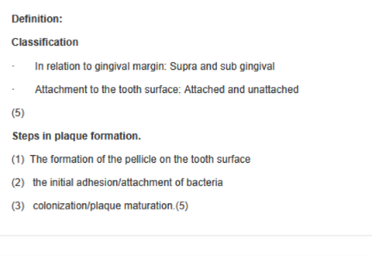
PLAQUE

Slide 3
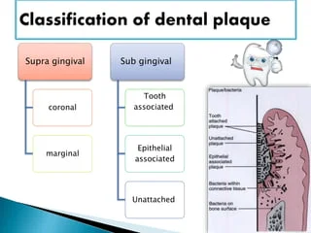

Slide 4
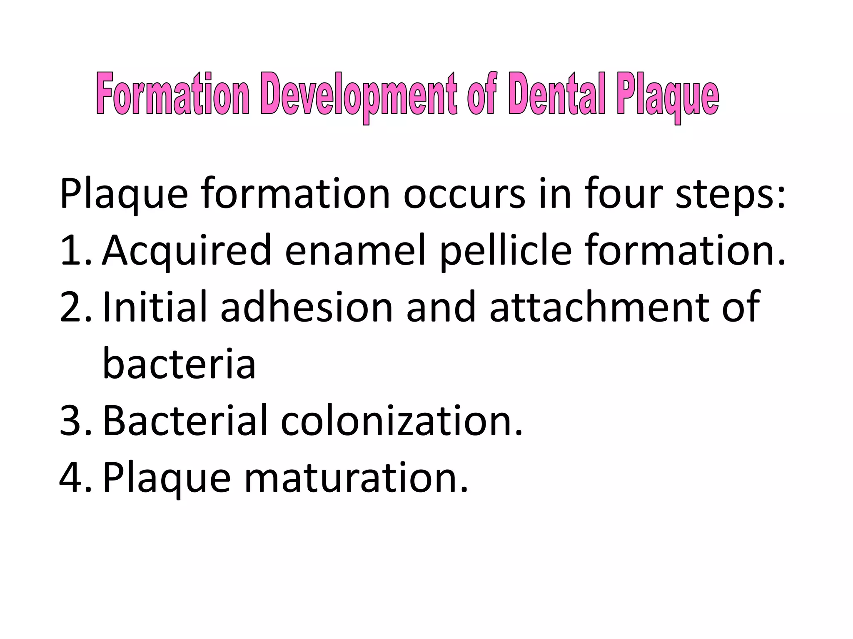
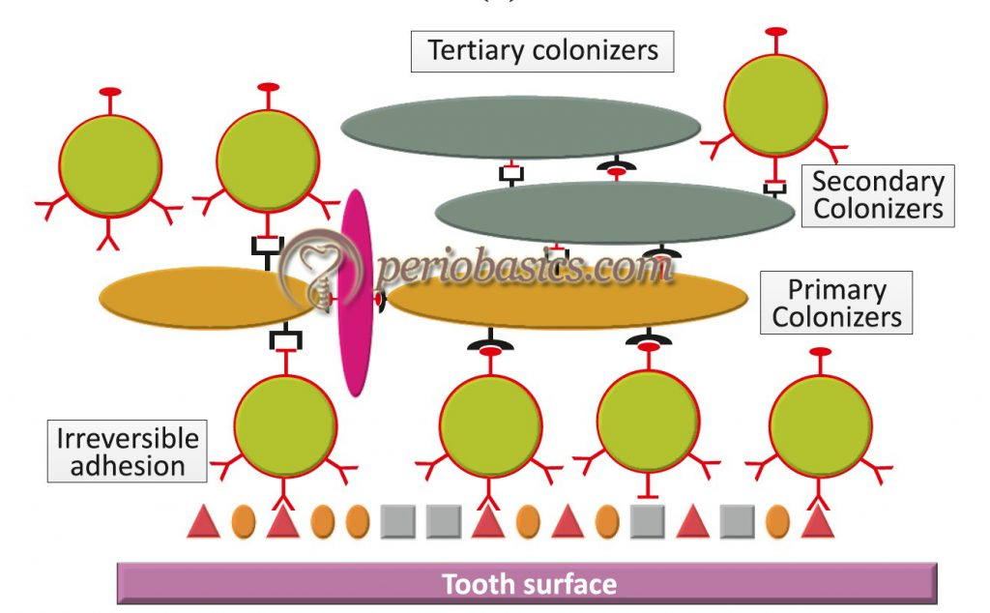
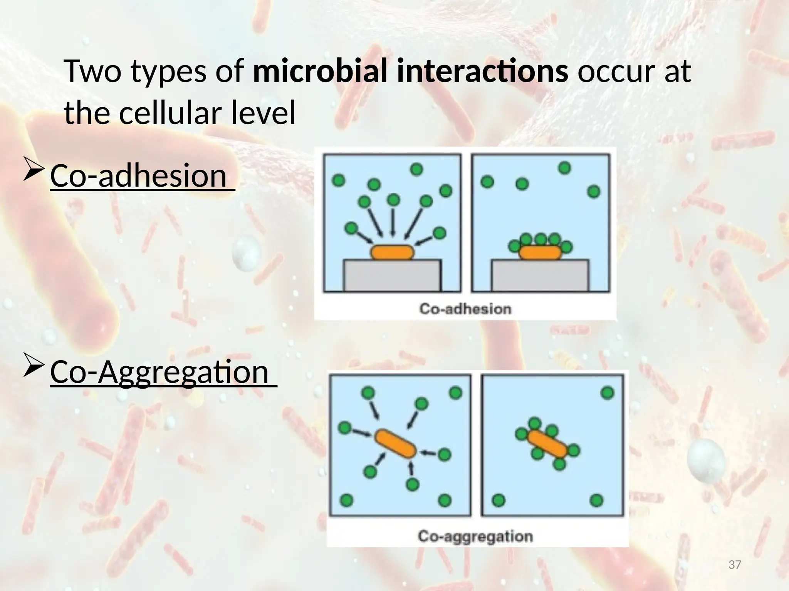

Slide 5
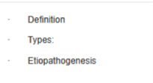
PATHOLOGIC MIGRATION

Slide 6
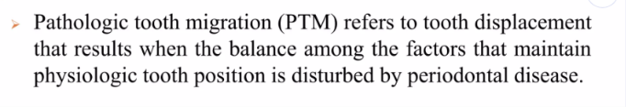
PATHOLOGIC TOOTH MIGRATION [3]

Slide 7
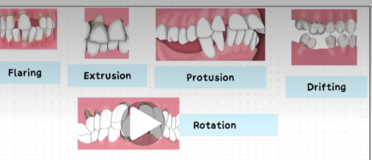
TYPE

Slide 8
ETIOPATHOGENESIS
TWO FACTORS THAT HELP TO MAINTAIN TOOTH IN POSITION
HEALTH AND NORMAL HEIGHT OF PERIODONTIUM
Eg : Aggressive periodontitis
FORCE EXCERTED ON TEETH
ANY IMBALANCE IN THE ABOVE TWO FACORS CAN CAUSE PATHOLOGIC MIGRATION
TOOTH MORPHOLOGY
MESIAL MIGRATIONTENDENCY
FULL COMPLEMENT OF TEETH
LOCATION OF CONTACT POINT
PROXIMAL INCISAL AND OCCLUSAL ATTRITION
AXIAL INCLINATION OF TEETH
FACTORS THAT ARE IMPORTANT
PARAFUNCTIONAL HABIT
Force from tongue [TONGUE THRUSTING]
Lip biting,thumb sucking
FORCE FROM CHEEKS
FORCE FROM GINGIVAL ENLAGEMENT/TUMOUR
FORCE FROM OCCLUSION

Slide 9
Failure of replacing Mandibular first molar
SECOND AND THIRD MOLAR TILT MESIALLY RESULTING IN DECREASE IN VERTICAL DIMENTION
PRMOLAR MOVE DISTALLY
INCISORS DRIFT LINGUALLY
ANTERIOR OVERBITE INCREASE AND THE MAXILLARY INCISORS HIT THE MANDIBULAR INCISORS
DIAESTIMA FORMATION

Slide 10

GINGIVAL FIBERS

Slide 11

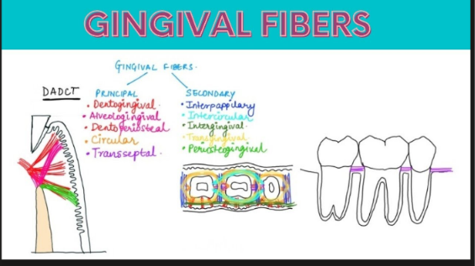
GINGIVAL FIBERS {3]

Slide 12
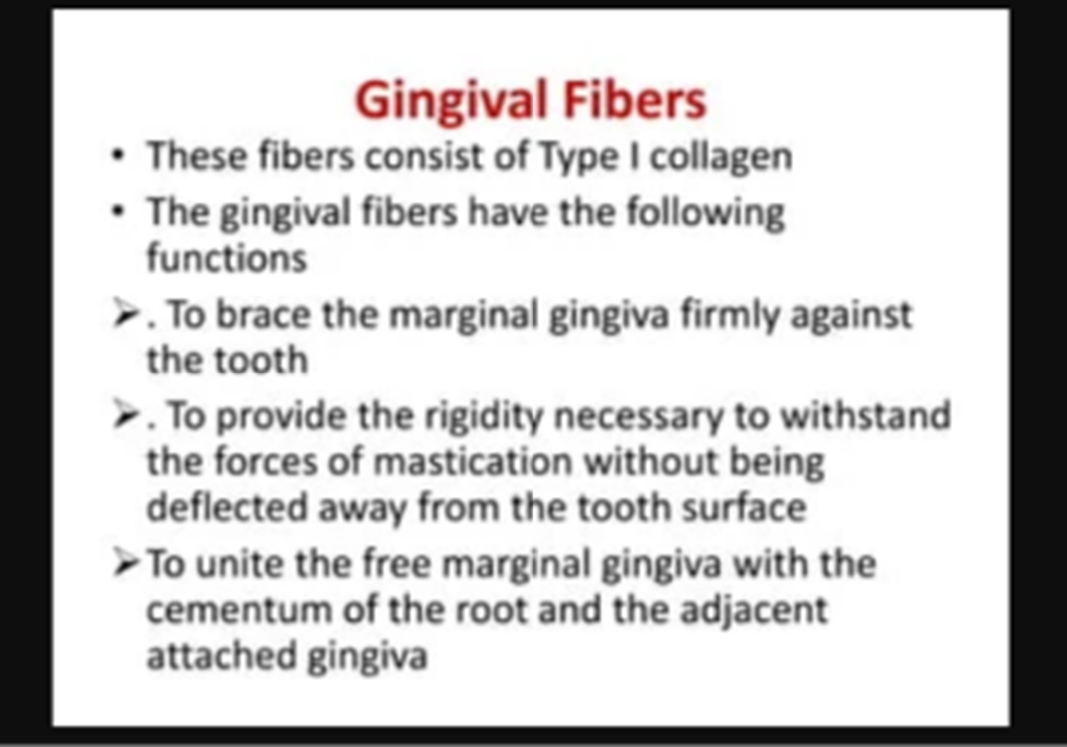

Slide 13
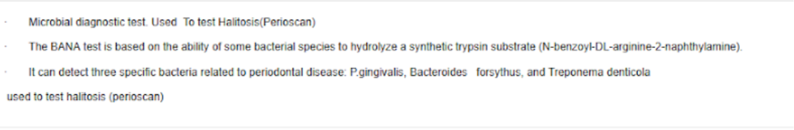
BANA[3]

Slide 14
