Slide 1
GINGIVAL CREVICULAR FLUID

Slide 2


Slide 3

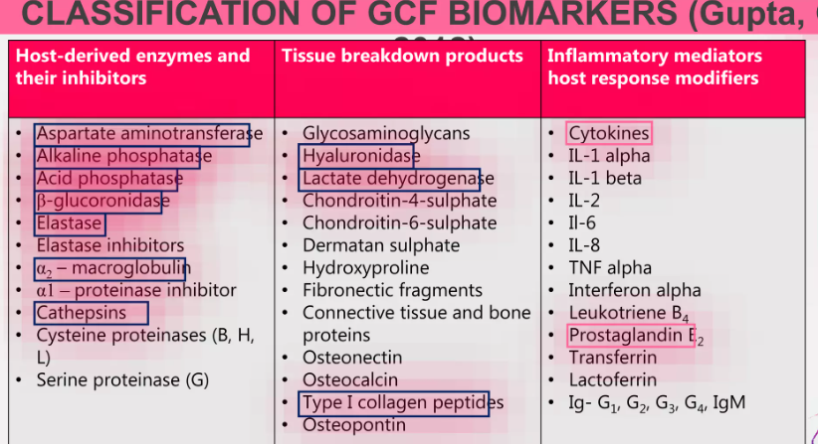
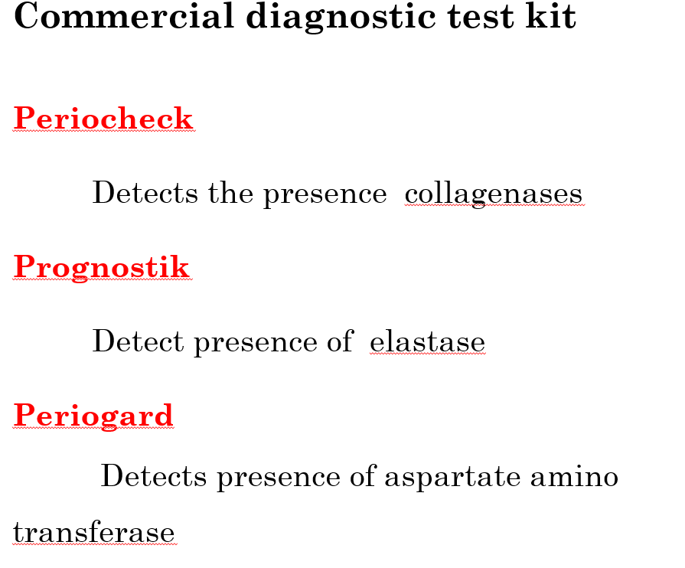

Slide 4
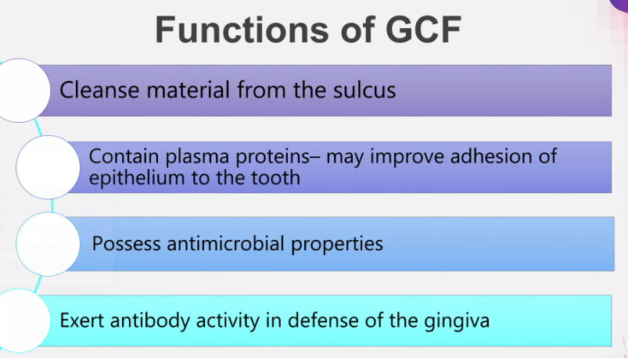

Slide 5
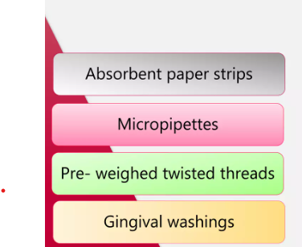
Methods of Collection

Slide 6
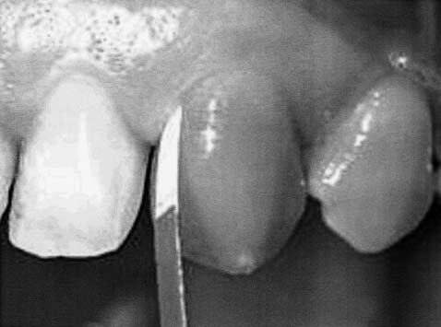
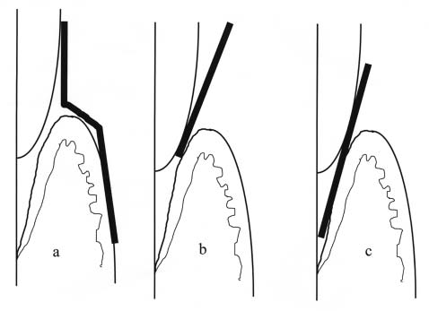

Slide 7
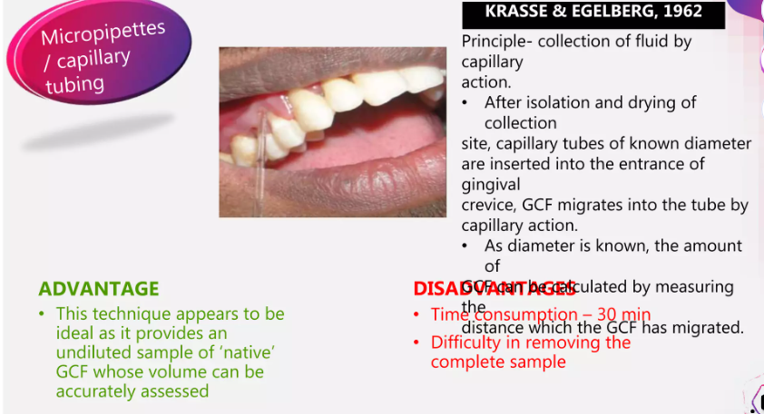

Slide 8
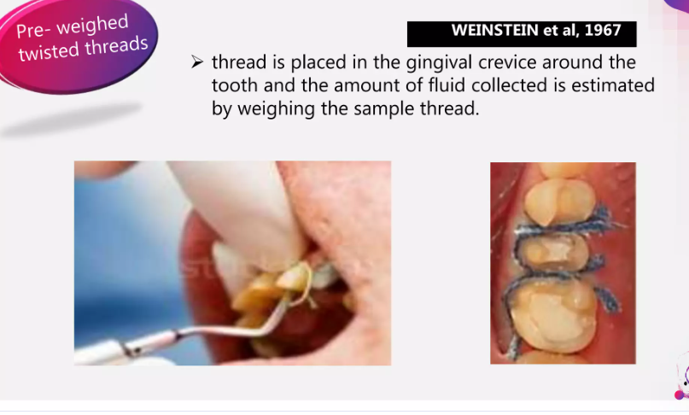

Slide 9
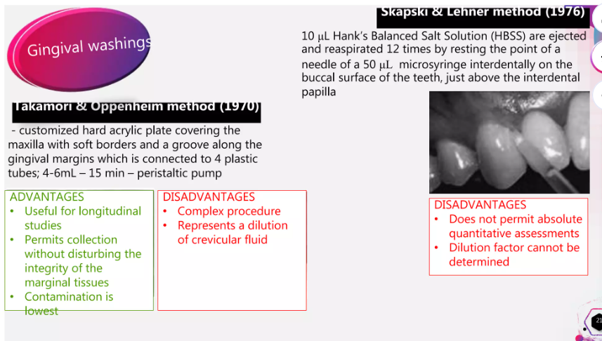

Slide 10
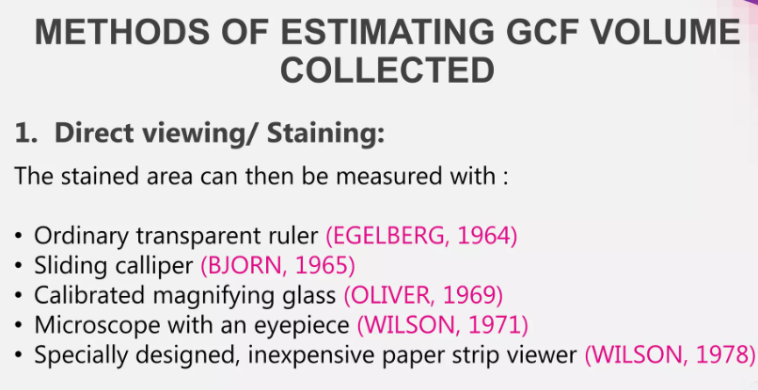
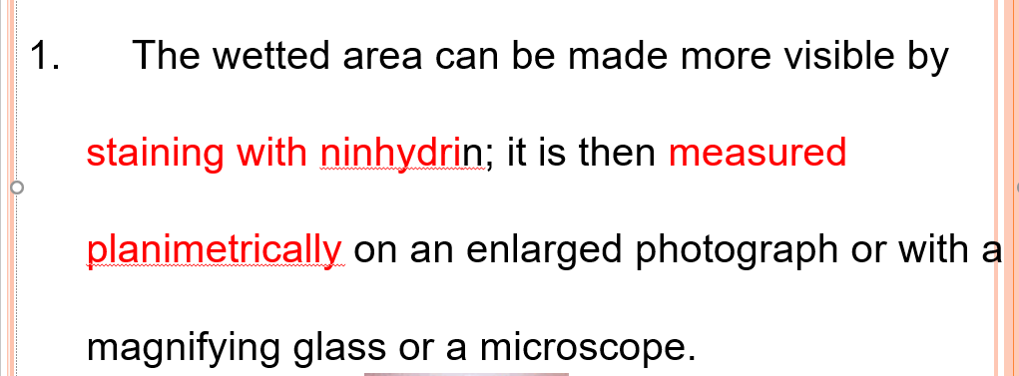

Slide 11
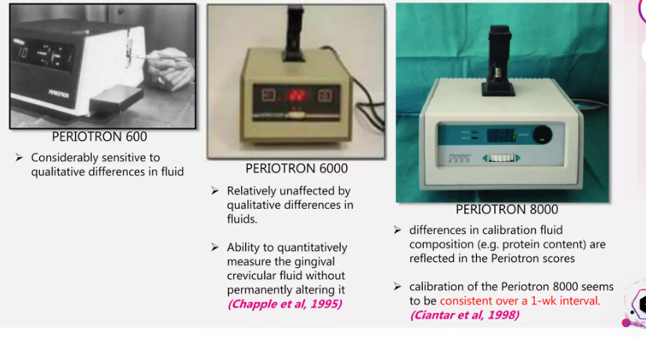
2

Slide 12
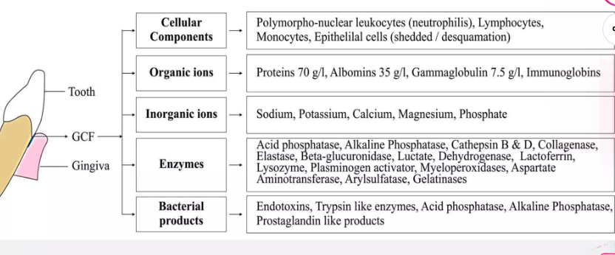
COMPOSITION OF GCF

Slide 13
Functions of GCF
The gingival fluid is believed to –
Cleanse material from the sulcus
Contain plasma proteins that may improve adhesion of the epithelium to the tooth
Possess antimicrobial properties
Excretion of drugs Tetracycline
Metronidazole

