Slide 1
PLAQUE AS A BIOFILM

Slide 2
Materia alba | Acquired pellicle | Plaque
Soft accumulations of bacteria and tissue cells that lack the organized structure and are easily displaced with a water spray. | The acquired pellicle is a thin protein film that forms on tooth surfaces, playing a crucial role in oral health by protecting teeth and facilitating the formation of dental plaque. | Dental plaque is defined clinically as a structured, resilient, yellow-grayish substance that adheres tenaciously to the intraoral hard surfaces, including removable and fixed restorations
mineralization of dental plaque
Calculus

Slide 3
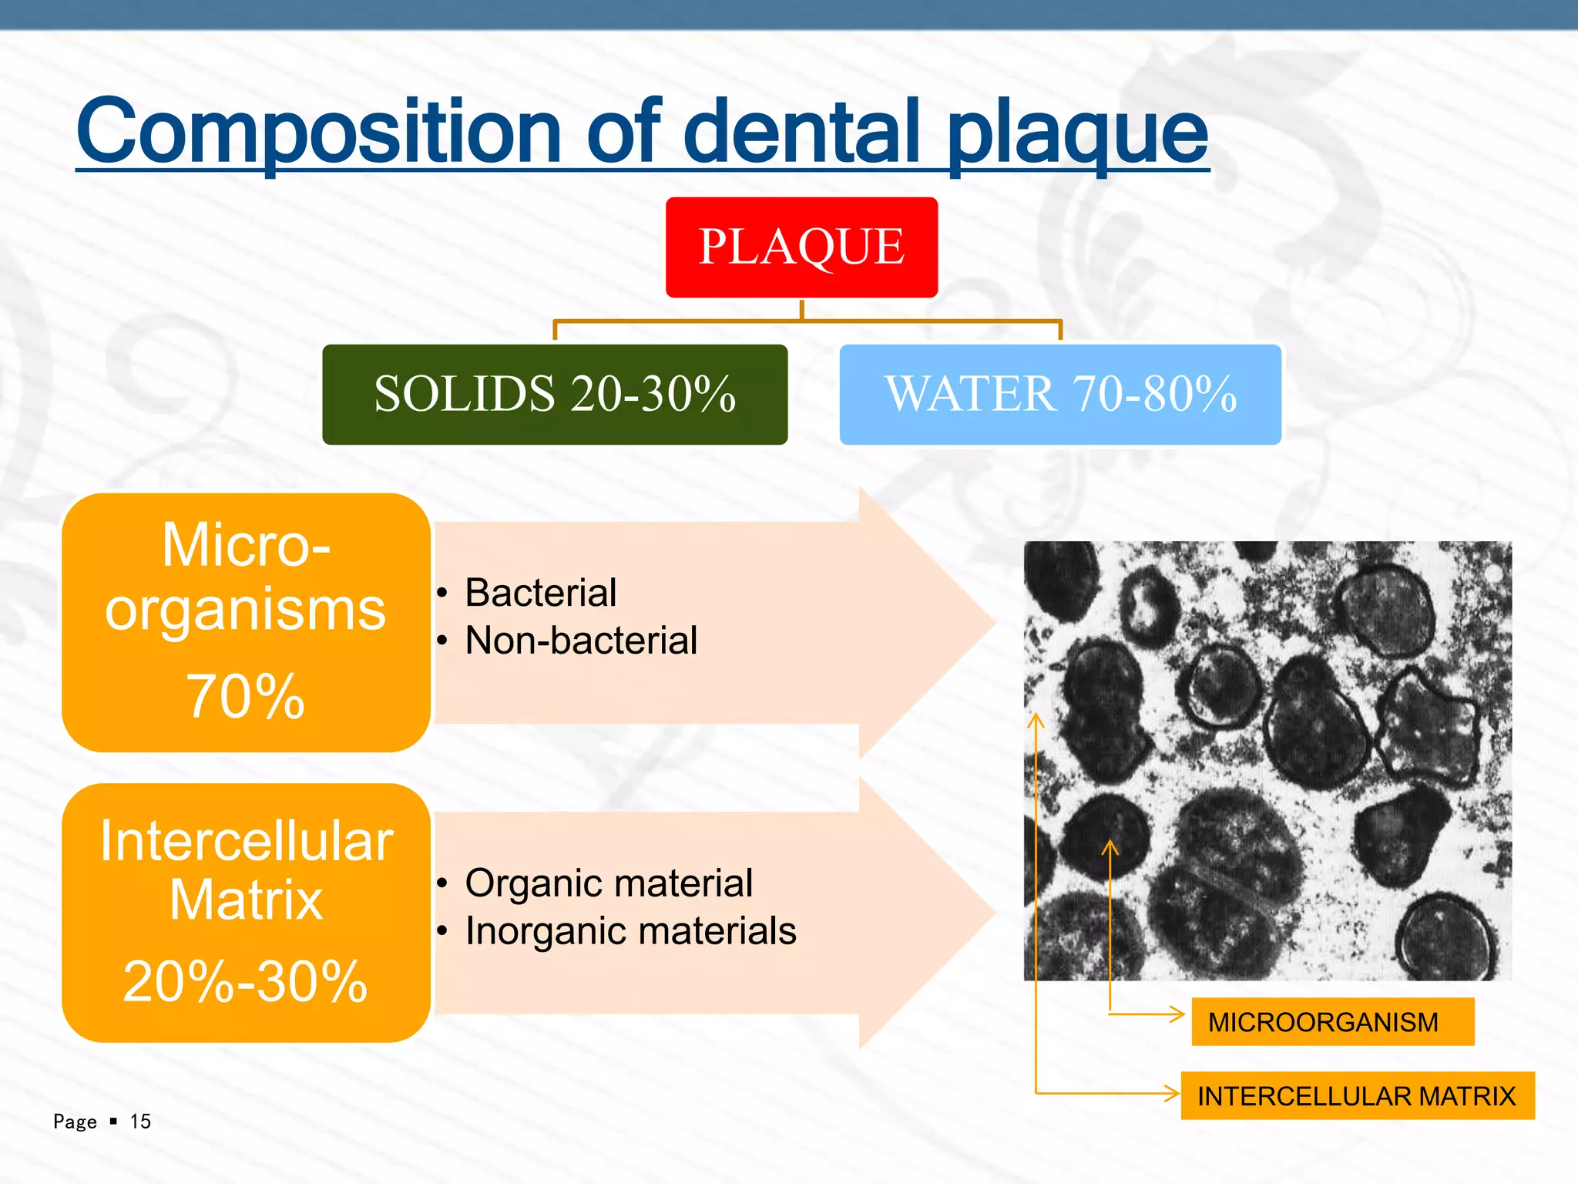

Slide 4
COMPOSITION OF DENTAL PLAQUE
ORGANIC MATERIAL
Glycoproteins
Polysaccharides.
Albumin,
Lipid material
INORGANIC MATERIALS
Calcium
Phosphorus
Sodium
Potassium
Fluoride

Slide 5
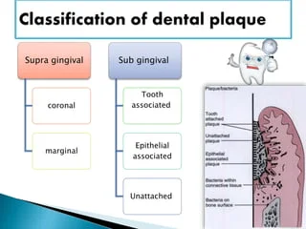
classification

Slide 6
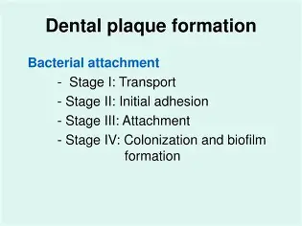
Formation of Dental Plaque
Formation of the pellicle coating on the tooth surface
2

Slide 7
Formation of the Dental Pellicle/Acquierd Pellicle
Acid precipitation
Microorganism produce acid
precipitation of salivary glycoprotein
Acquired pellicle

Slide 8
2)Initial Adhesion and Attachment of Bacteria
Phase 1: Transport to the surface.
Phase 2: Initial adhesion.
Phase 3: Attachment.

Slide 9
Phase 1: Transport to the surface.
Involves the initial transport of the bacterium to the tooth surface
Through
Brownian motion (average displacement of 40 (μm/hour)
Sedimentation of microorganisms
Liquid flow
Active bacterial movement (chemotactic activity).

Slide 10
Phase 2: Initial adhesion.
Reversible adhesion of the bacterium.
Initiated by the interaction between the bacterium and the surface, from a certain distance (50 nm)
Through long-range and short-range forces, including van der Waals attractive forces and electrostatic repulsive forces.

Slide 11
Phase 3: Attachment
After initial adhesion, a firm anchorage between bacterium and surface will be established by specific interactions (covalent, ionic, or hydrogen bonding).
This follows direct contact or bridging true extracellular filamentous appendages (with length up to 10 nm).(Fimbrea, fibrila)

Slide 12
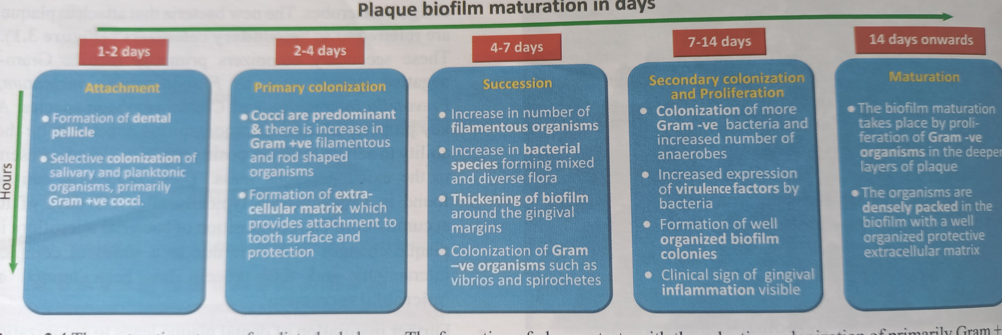

Slide 13
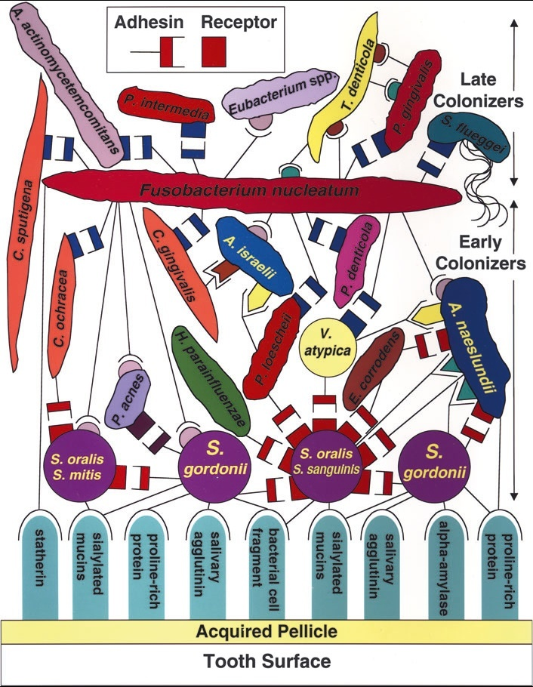

Slide 14
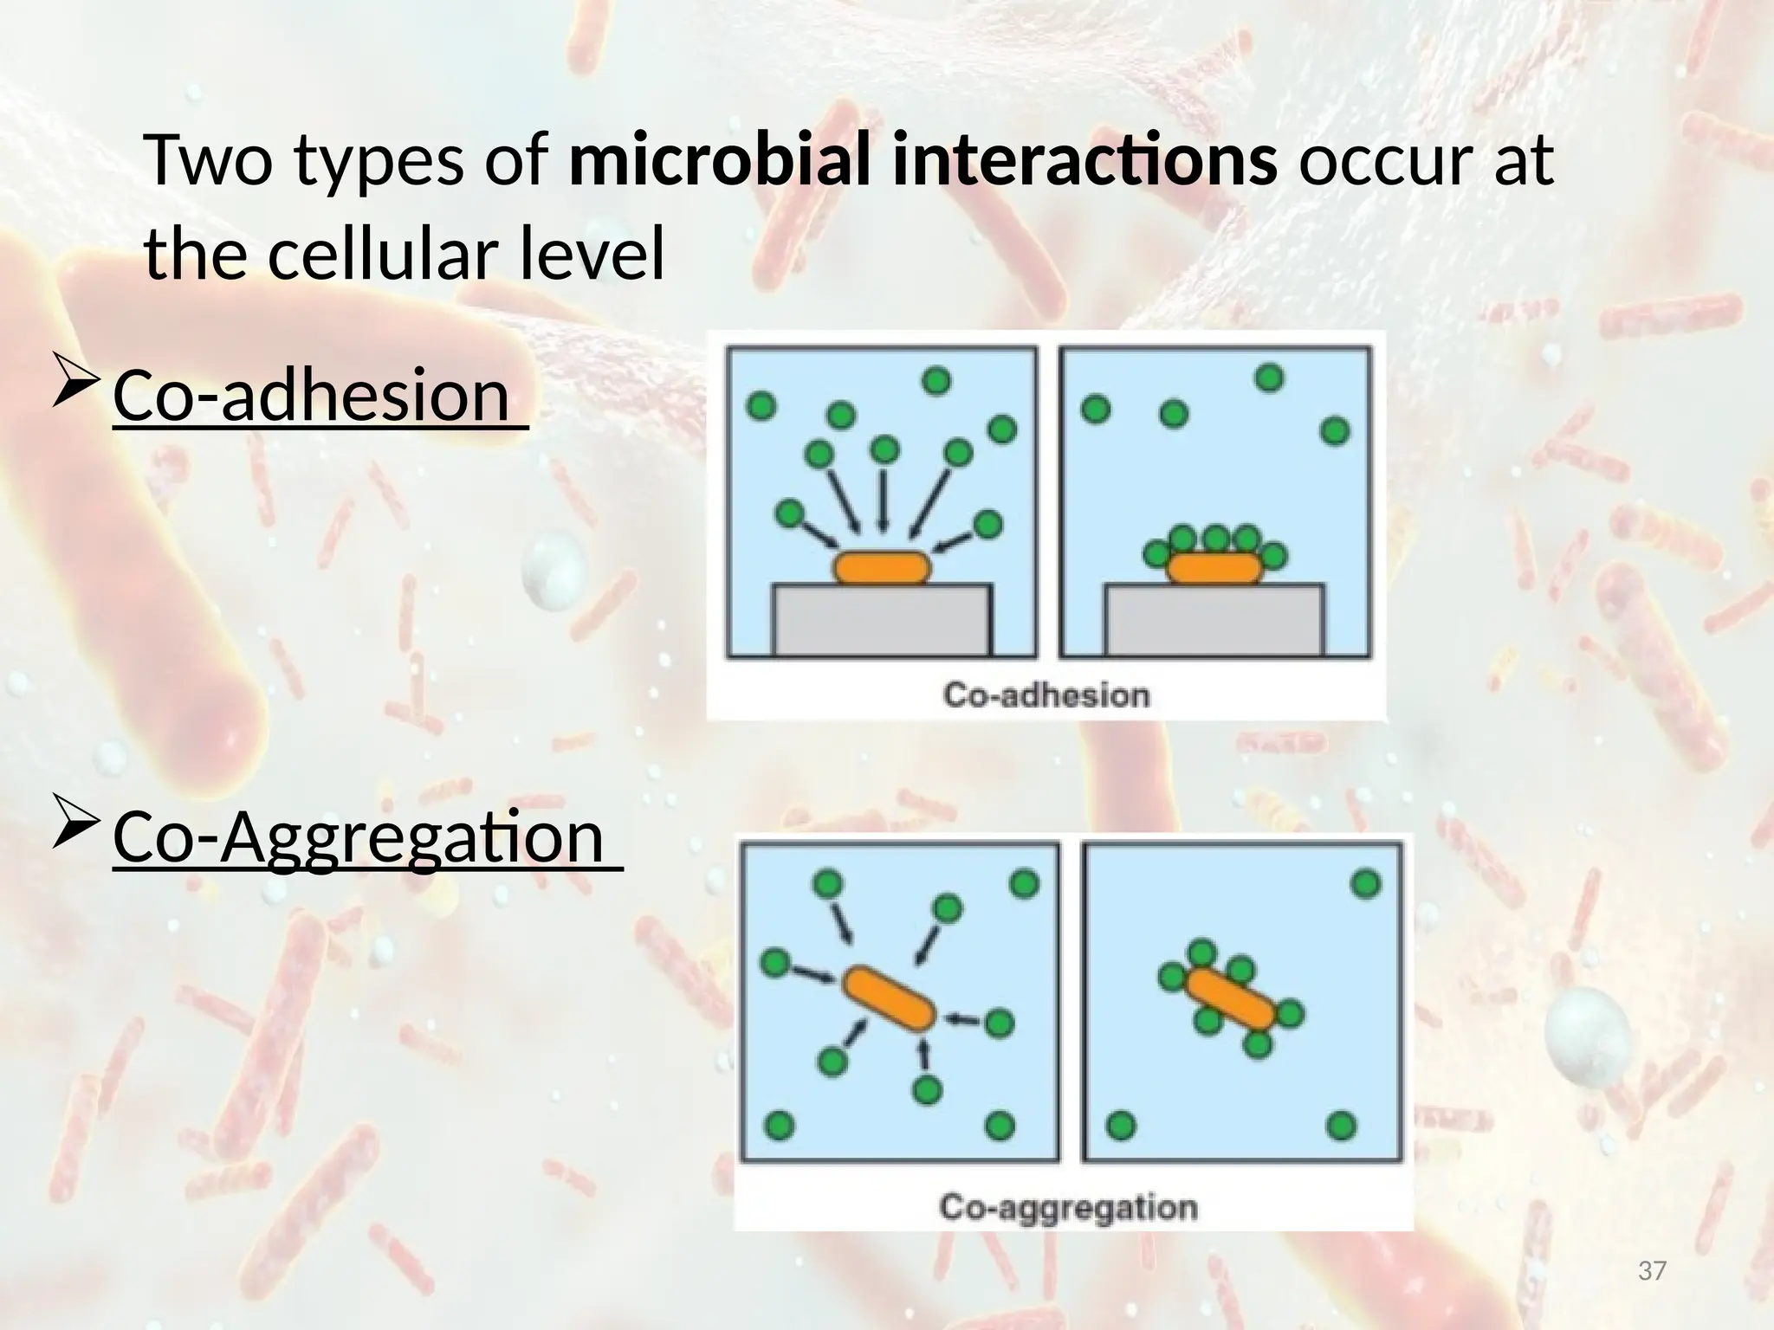

Slide 15
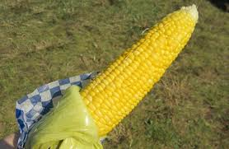
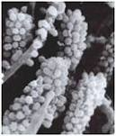

Slide 16
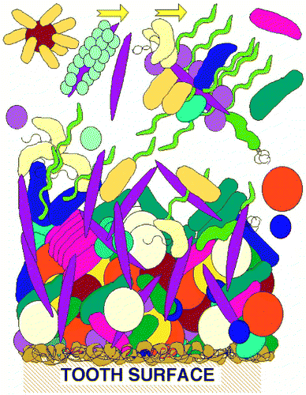

When one cell is relatively small and the partner is rod shaped and in 10-fold or greater excess, rosettes can be formed

Slide 17
Plaque Hypothesis
Non Specefic Plaque Hypothesis
Specific Plaque Hypothesis
Ecologic Plaque Hypothesis

Slide 18
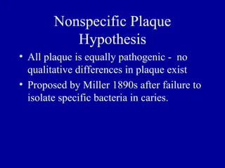
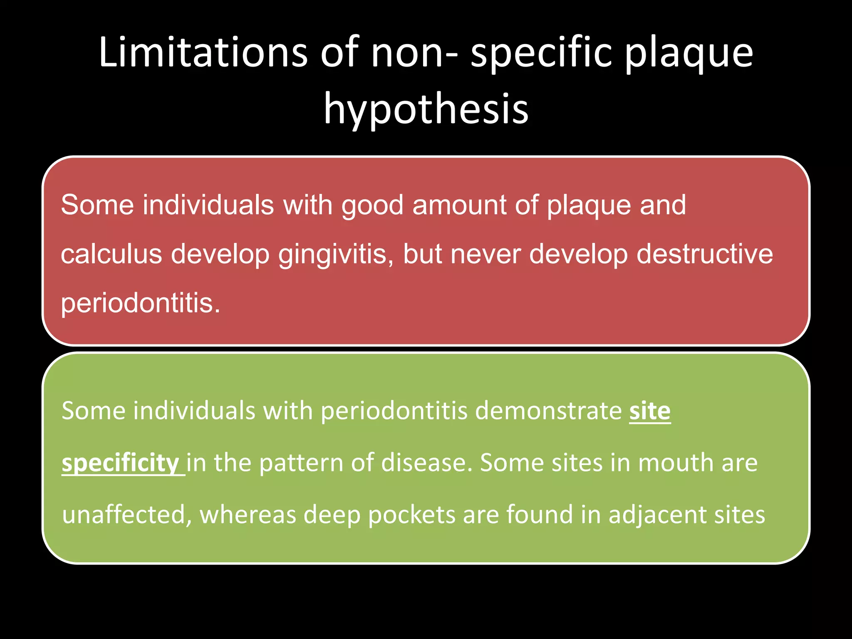

Slide 19
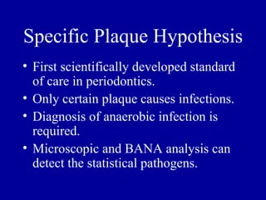
Specific Plaque Hypothesis

Slide 20
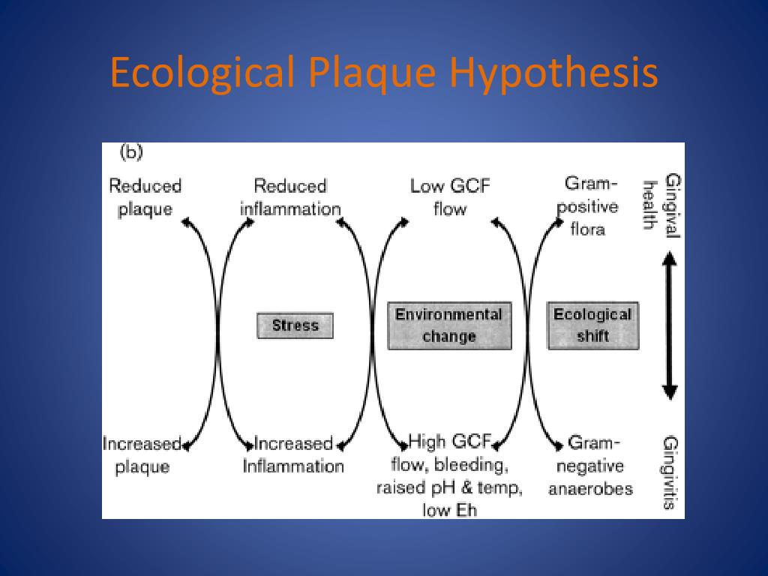

Slide 21
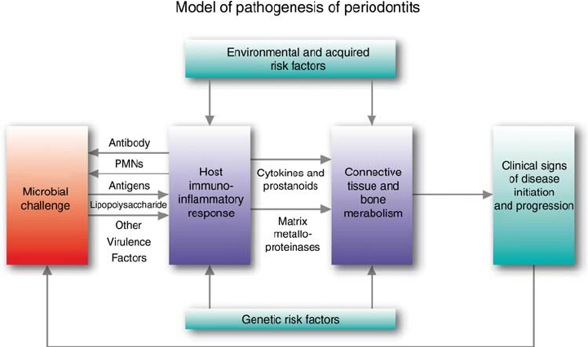

Slide 22
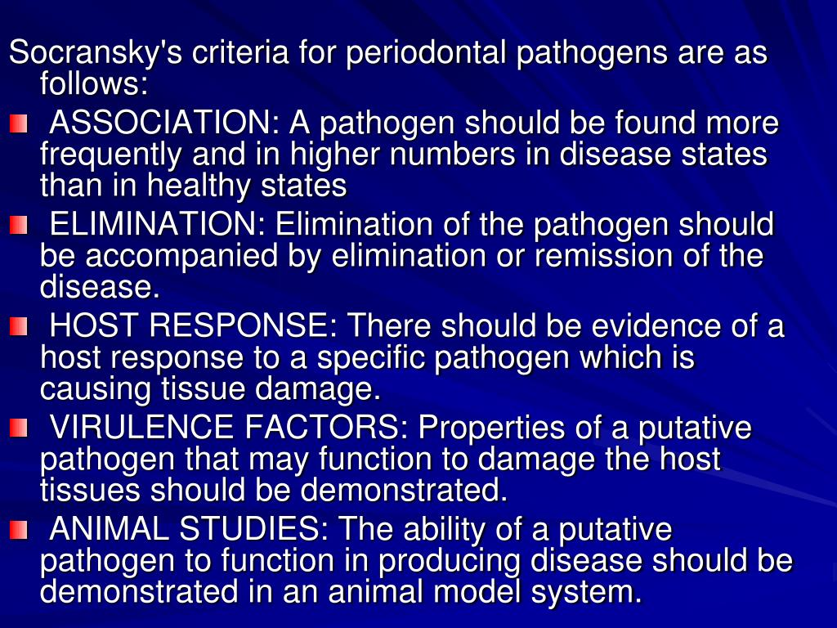

Slide 23
