Slide 1
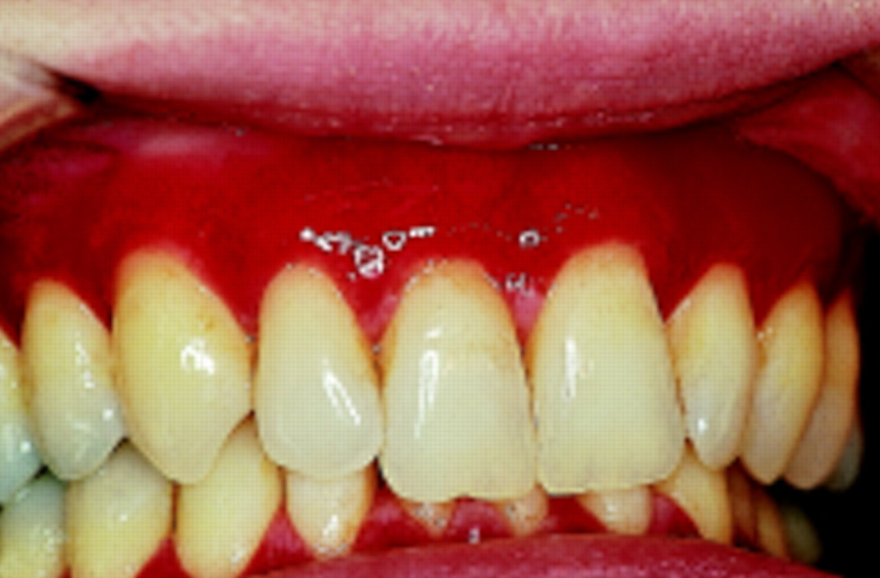
Gingival Inflammation and clinical features of gingivitis

Slide 2
FAQ
CLINICAL FEATURE OF GINGIVITIS
STAGES OF GINGIVITIS AND CLASSIFICATION
McCALLS FESTOONING
STILLMANCLEFT

Slide 3
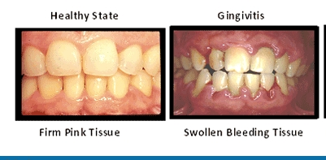
INTRODUCTION
Gingival inflammation is called as Gingivitis

Slide 4
Classification of gingivitis
Depending on distribution
Depending on the course and duration
Acute : sudden onset and short duration
Chronic : slow in onset, long duration
Recurrent : reappears after treatment
Localized gingivitis:
Confined to the gingiva of a single tooth or a group of teeth
Generalized gingivitis:
Involves the entire mouth
Papillary gingivitis
Marginal gingivitis
Diffuse gingivitis

Slide 5
CLINICAL FEATURES
COLOUR
NORMAL FEATURE
DISEASED STAGE
CORAL PINK/PINK
Colour depend on
PIGMENTATION--- Melanin
KERATINIZATION
VASCULARIZATION
Acute inflammation--- bright red
Chronic inflammation– deep red/blue
ANUG --- Shiny slate grey
Herpetic gingivostomatitis – Dull whitish grey
LEAD - BLUISH RED / DEEP BLUE
COLOUR CHANGE DUE TO INTOXICATION
BISMUTH/ MERCURY - BLACK LINE

Slide 6
CONSISTENCY
Normal
Diseased stage
Firm and resilient
Acute inflammation – soft and spongy
Chronic inflammation soggy puffiness ,pits on pressure
Fibrotic --- leathery consistency

Slide 7
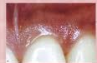
Surface texture
Normal
Stippled
Seen on maxillary anterior
Seen on attached gingiva and mid pappilary region
Marginal gingiva not stippled
Orange peel appearance
Connective tissue papillae into epithelial retepegs
Diseased stage
Acute inflammation - loss of stipiling
Chronic inflammation - hard and fibrotic with normal or deep stippling

Slide 8
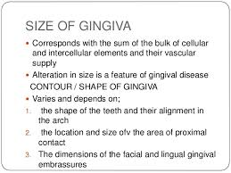
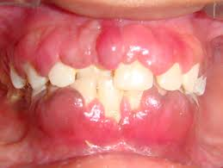
Size
Normal
Diseased state

Slide 9
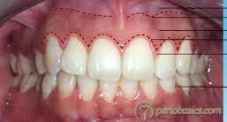
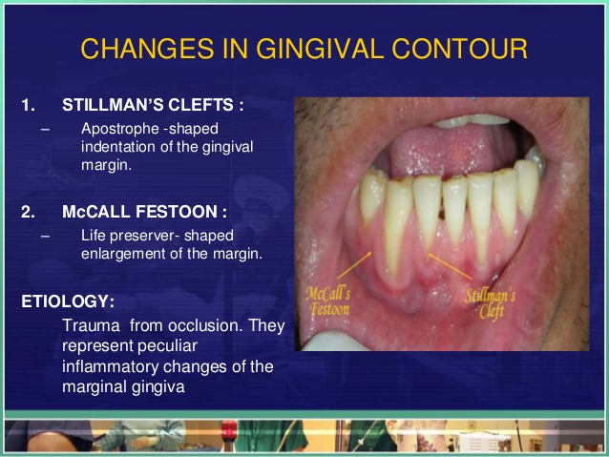


Contour
McCalls festooning
Stillman cleft

Slide 10
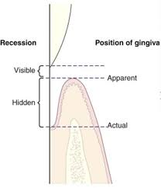

Position
Normal
2mm above CEJ
Diseased
Apically placed – recession
Coronally placed –enlargement

Slide 11
Bleeding on probing
Earliest visual sign of inflammation
Cause
Local cause --- trauma,inflammation
Systemic cause --- leukimia, vit C/K deficiency

Slide 12
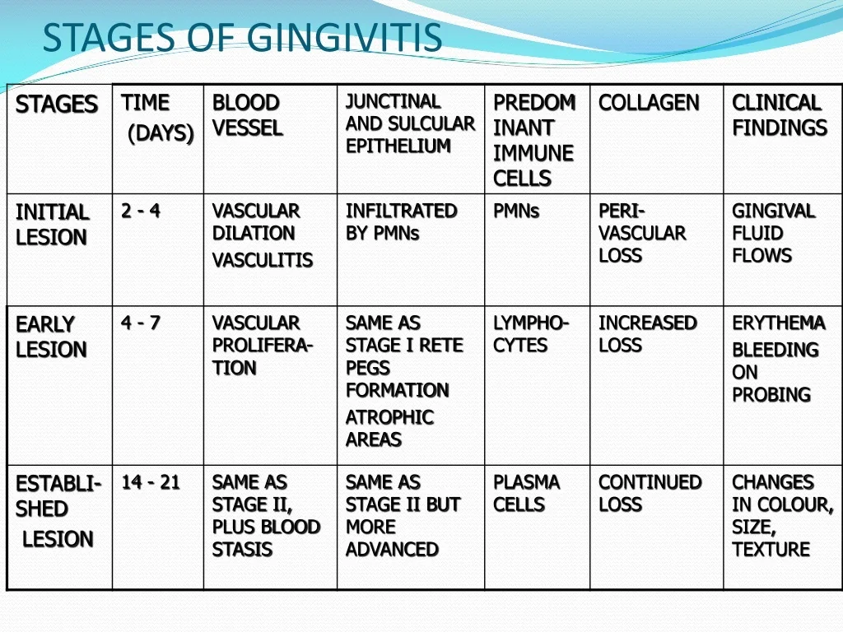

Slide 13
Acute / chronic
Classification
Localized -- marginal/ papillary /diffused
Generalized
colour
contour
Consistency
Bleeding on probing
Texture/ size
position
Clinical features
2 – 7 days/ Neutrophil/vascular dialatation/ increase gcf
Stages
initial
Early
established
4-7days/lymphocytes/vacular proliferation/BOP
14-21 days/plasma cell/stasis /change colour, texture
Advanced

