Slide 1
AUDITORY TUBE

Slide 2
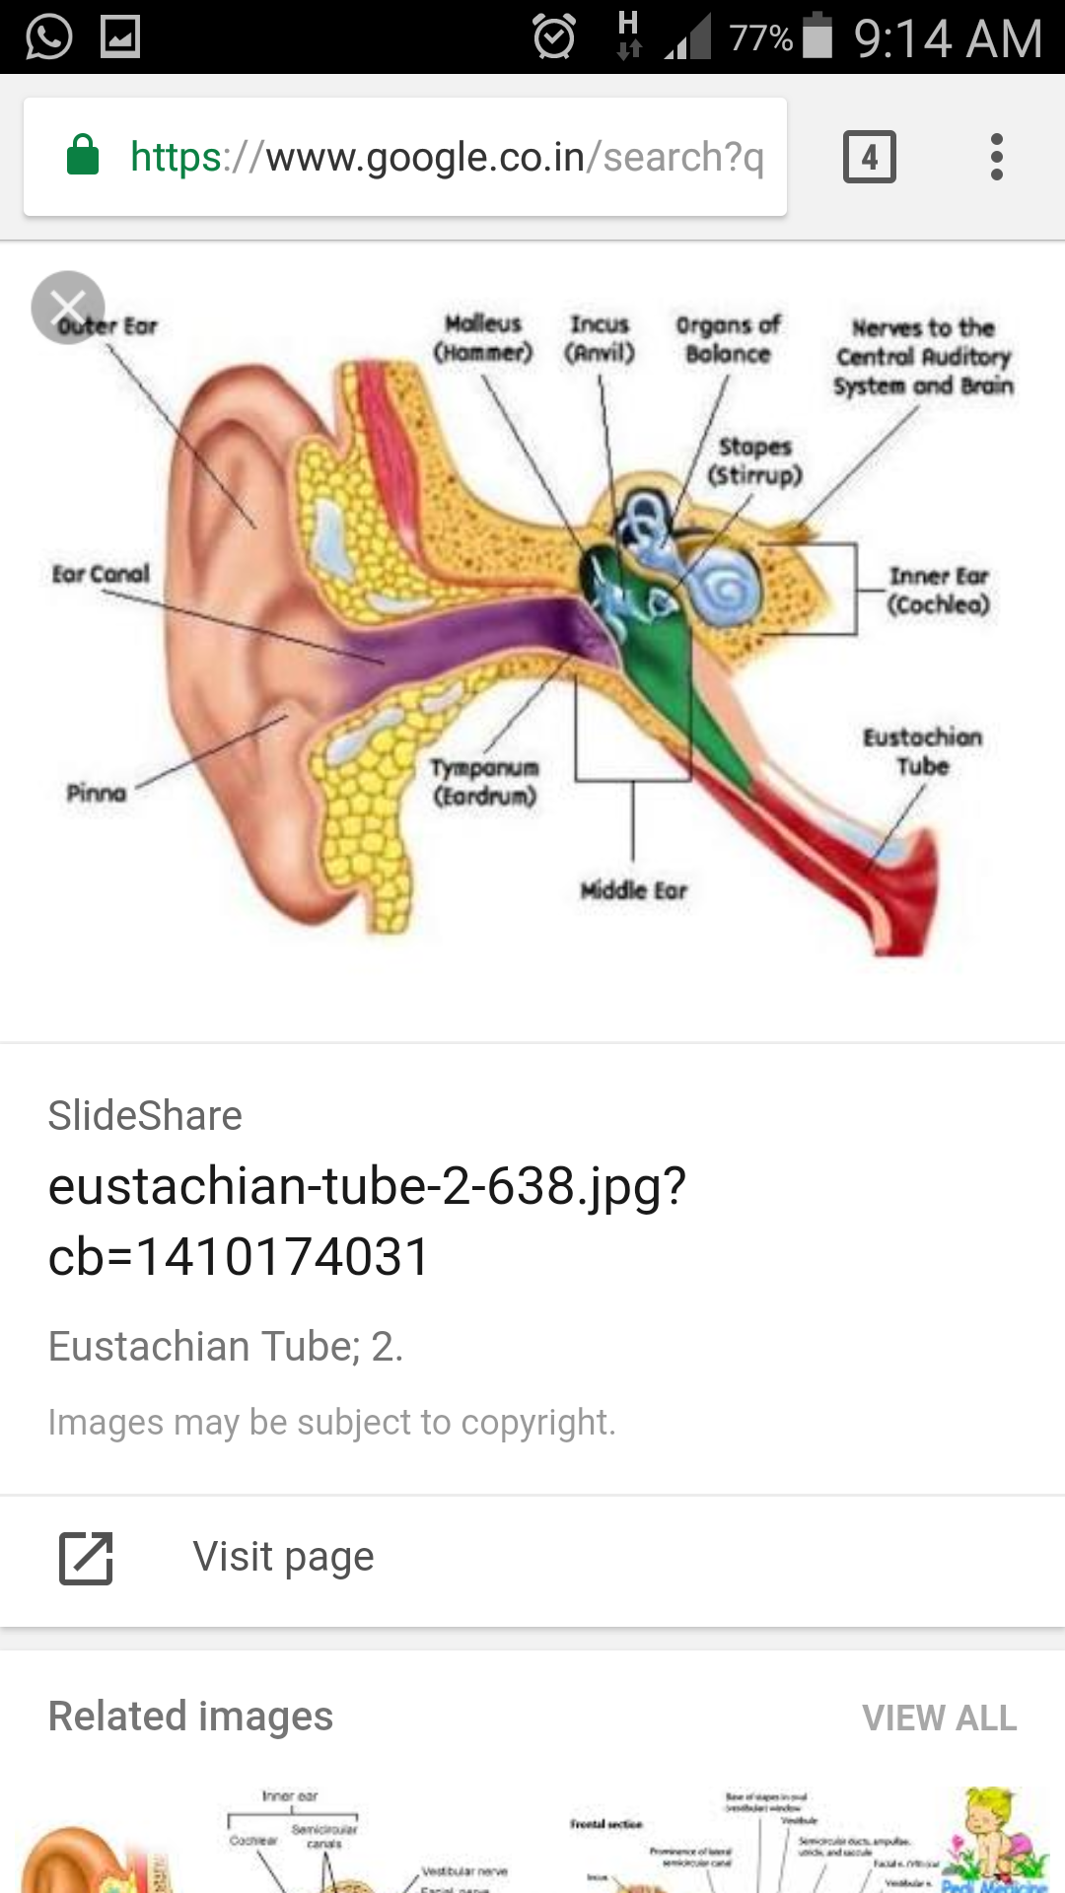

Slide 3
Also called pharyngotympanic tube or Eustachian tube
Is a mucous lined osseo-cartilaginous channel
It connects nasopharynx with tympanic cavity
It maintains an equilibrium of air pressure on either side of the tympanic membrane
Length :-
36 mm(4 cm) in an adult
Direction :-
Downwards, forewards and medially from the tympanic cavity to nasopharynx

Slide 4
Parts :-
2 parts; bony and cartilaginous
Bony part
Forms posterolateral 1/3 of tube
12 mm length
Lies between tympanic and petrous part of temporal
Opens into middle ear cavity
Medial end is narrow and attached to cartilaginous part
Relations:-
Superiorly - canal for tensor tympani
Medially – carotid canal
Laterally – chorda tympani, spine of sphenoid, auriculotemporal nerve, TMJ

Slide 5
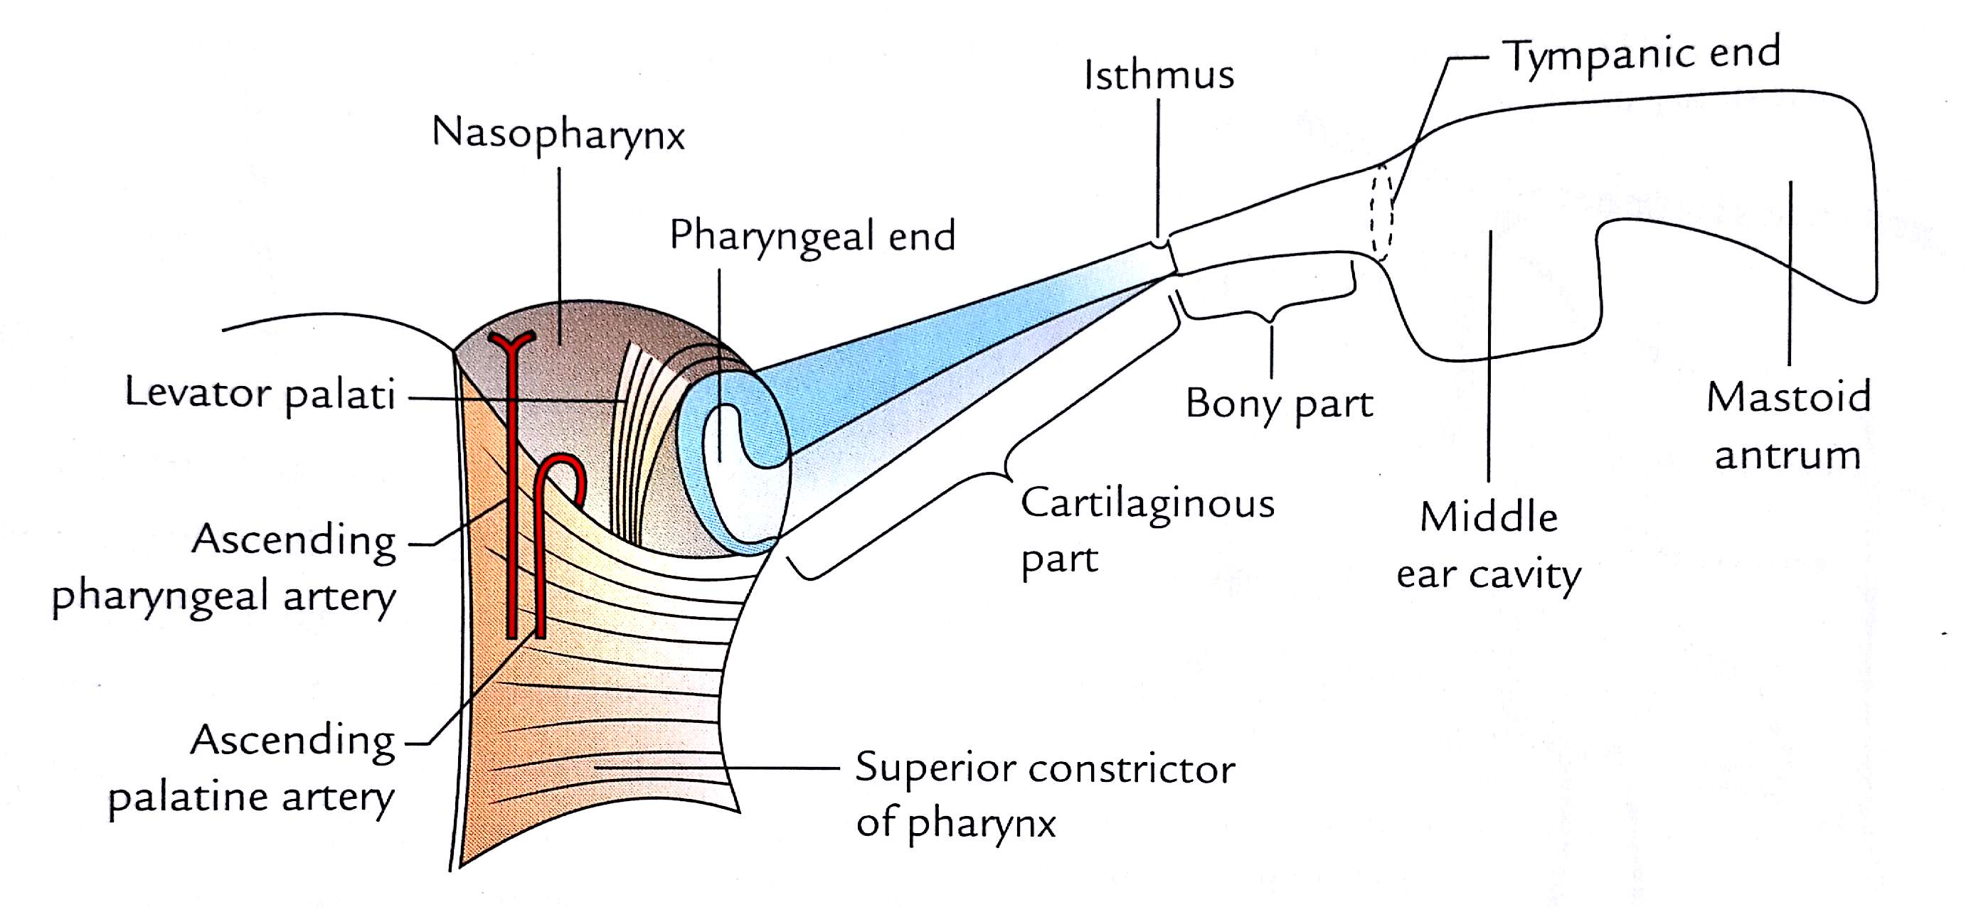

Slide 6
Cartilaginous part
Forms the anteromedial 2/3 of tube
24 mm length
Lies in the sulcus tubae
Made up of a triangular plate of elastic cartilage – folded itself and forms superior and medial walls
Lateral wall and floor are formed by fibrous membrane
Apex is attached to the bony part where it forms the narrowest part - isthumus
Base is free and forms the tubal elevation in the nasopharynx, pharyngeal opening is the widest part of the tube

Slide 8
Relations:-
Anterolaterally – tensor veli palatini, mandibular nerve and its branches, otic ganglion, chorda tympani nerve, middle meningeal artery
Posteromedially – apex of petrous temporal, levator veli palatini
Superiorly – sulcus tubae
Inferiorly – superior constrictor muscle, tensor veli palatini
Lining of the tube:-
Pseudostratified ciliated columnar epithelium with goblet cells

Slide 10
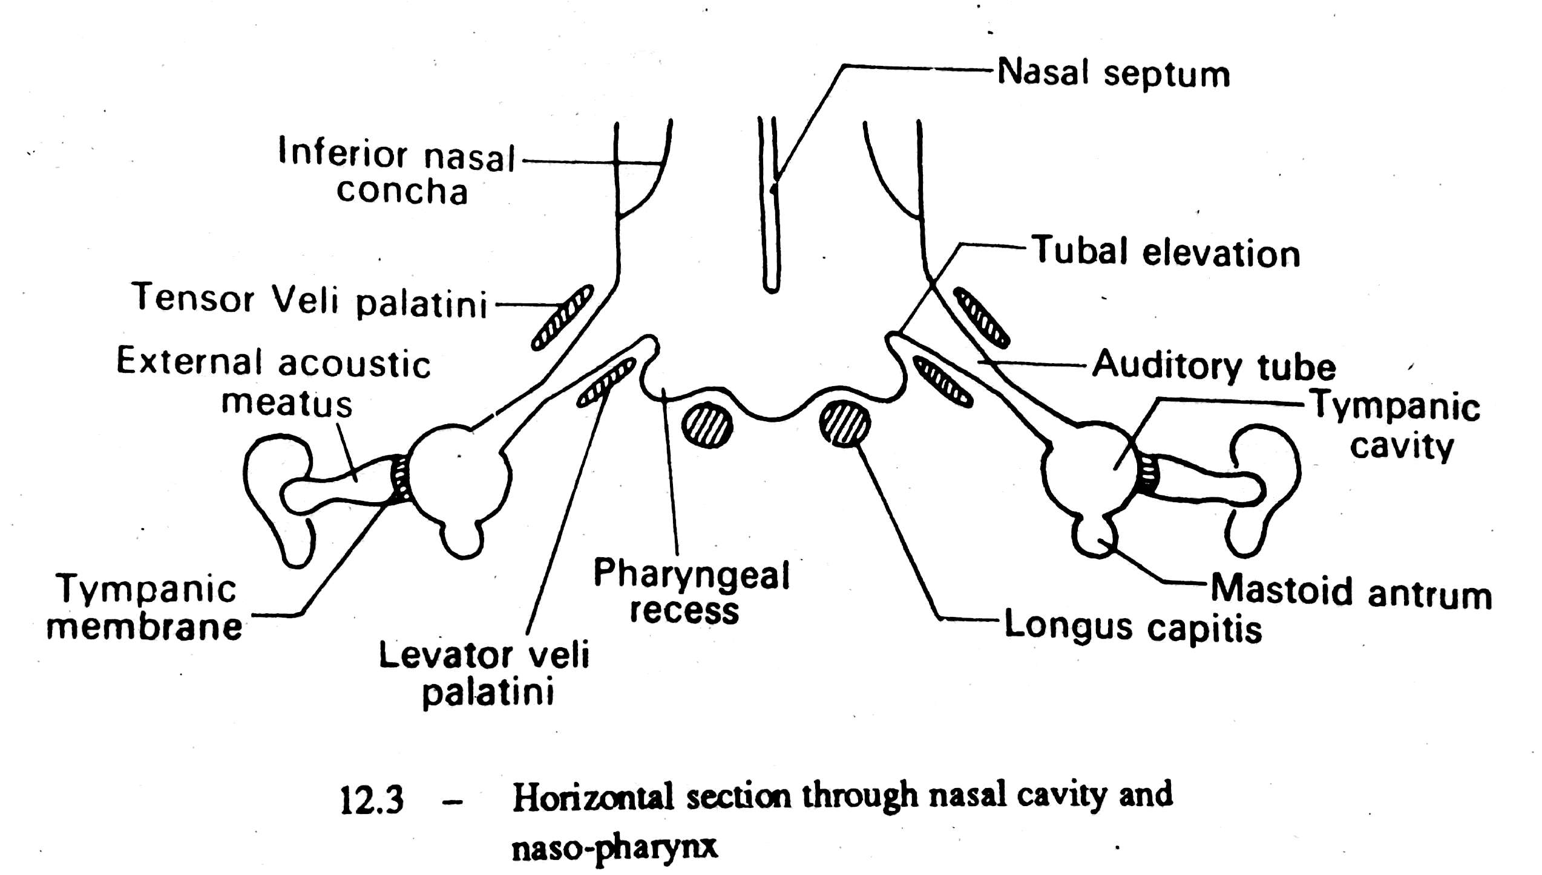

Slide 11
Differences
Infant
Adult
Length:- 18 mm
Direction:- More or less horizontal
Lumen:- Wider
Angulation of isthumus:- Absent
Tubal elevation:- Not Prominent
Length:- 36 mm
Direction:- Oblique; directed downwards, forwards and medially
Lumen:- Narrower
Angulation of isthumus:- Present
Tubal elevation:- Prominent

Slide 12
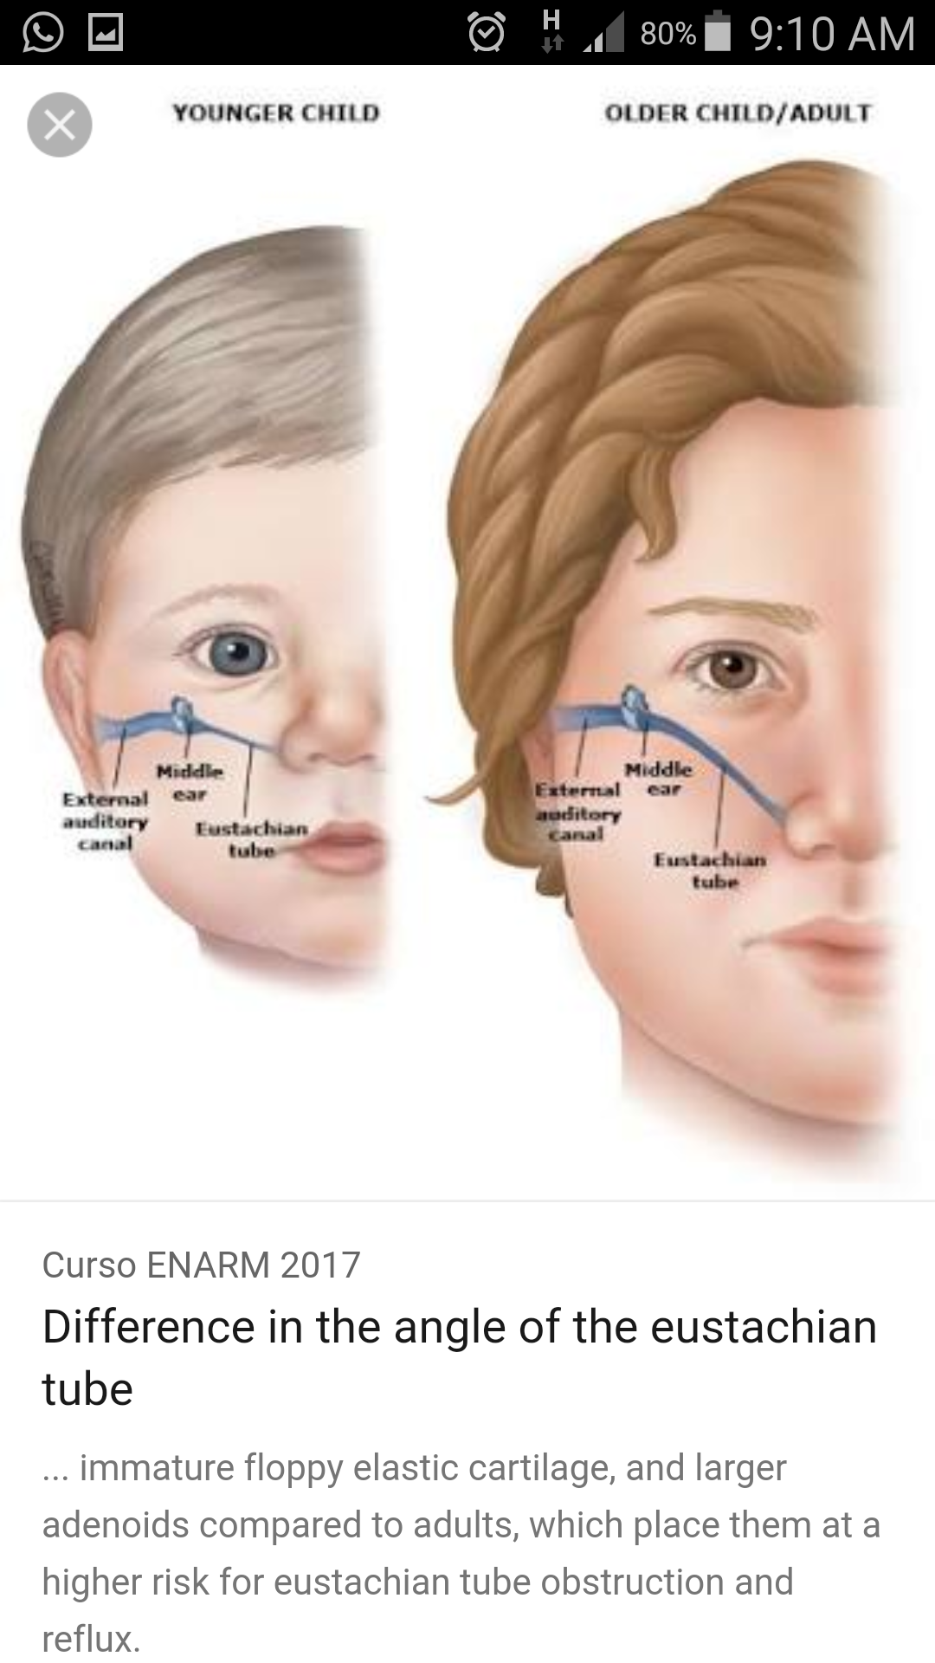

Slide 13
Arterial supply
Middle meningeal artery
Ascending pharyngeal artery
Artery of pterygoid canal

Slide 14
Venous drainage
Pharyngeal and Pterygoid venous plexus

Slide 15
Nerve supply
Pharyngeal opening – Pharyngeal branch of pterygopalatine ganglion
Cartilagenous part – Nervous spinosus branch of mandibular nerve
Osseous part – Glossopharyngeal nerve

Slide 16
Lymphatic drainage
Retropharyngeal nodes
Upper deep cervical nodes

Slide 17
Applied aspects
Tube acts as a channel of infection from nasopharynx to middle ear
Infections are common in infants
Tube is blocked due to inflammation of tubal tonsil

