Slide 1
SPECIAL IMPRESSION TECHNIQUES FOR REMOVABLE PARTIAL DENTURE PROSTHESIS

Slide 2
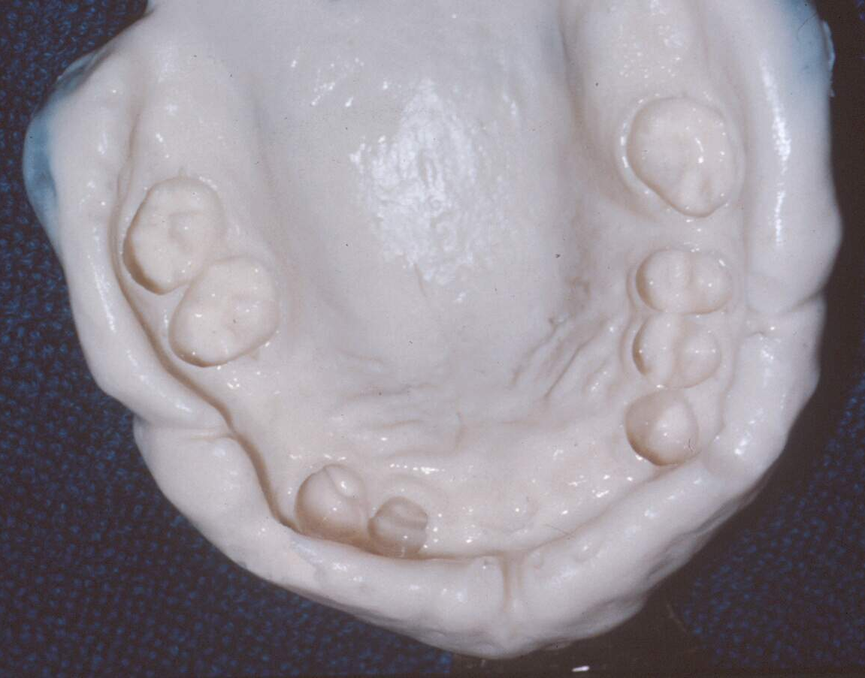
IMPRESSION
Definition:-
A negative likeness or copy in the reverse of the surface of an object , an imprint of the teeth and adjacent structures for the use in dentistry. ( G.P.T.-9)

Slide 3
Anatomic impressions
Anatomic form is the surface contour of the ridge when it is not supporting an occlusal load. These are indicated for tooth-supported partial dentures and most class IV.
Most maxillary distal extension bases can also be recorded with this technique.
A single impression with medium body/regular body/monophase elastomeric impression material using a custom tray is the preferred technique. Putty with light body wash in a stock tray can also be used. Irreversible hydrocolloid – alginates, may also be used. Addition silicones are preferred.

Slide 4
Functional impressions
Functional form is the form of the residual ridge recorded under some loading or compression.
This could be achieved by occlusal loading, finger loading, specially designed individual trays or consistency of recording medium.
It is indicated for distal extension bases (class I and class II), especially in the mandibular arch.

Slide 5
Maxillary distal extension ridges are covered by firm mucosa, stress is borne by crest and slopes of the ridge and hence a functional impression may not be needed. Another indication for this type of impression is a long span anterior edentulous ridge (class IV).
A dual impression technique is used along with a combination of impression materials – one that records the teeth in anatomic form and the other that records the residual ridge in functional form.

Slide 6
Factors influencing support of distal extension base
Quality of soft tissue covering edentulous ridge
A firm, tightly attached thick mucosa will offer the greatest support.
The more displaceable tissue is present over the edentulous ridge, less is the support.
Surgical removal of flabby tissue is indicated to increase the support.

Slide 7
Type of bony architecture of denture-bearing area
Cancellous bone has less ability to resist vertical forces compared to cortical bone. This is due to its irregular surface which acts as an irritant to overlying soft tissue when stress occurs.
This results in chronic inflammation of soft tissues which leads to resorption of the cancellous bone.
The crest of the maxillary and mandibular ridge is composed mainly of cancellous bone and hence should not be considered as a prime source of support

Slide 8
Design of partial denture
Rotational forces on the ridges in distal extension bases can be controlled by our design considerations
The most efficient method to control rotational stress is by using indirect retainers.

Slide 9
Amount of tissue coverage of denture base
The broad stress distribution design philosophy demands that the denture base must cover the maximum amount of surface area of the edentulous ridge to effectively distribute the functional stresses.
Overextension must be avoided, as it can cause soft tissue irritation, ulceration and even lifting or dislodgement of the base leading to leverage forces on the clasped abutment teeth

Slide 10
Amount of occlusal force
Greater the occlusal load on a denture base, greater should be its support. A denture base that is opposed by a full complement of natural teeth requires more support than that opposed by a complete denture.
Narrowing the food table of the artificial teeth will help reduce the load transmitted to the denture base. Supplemental grooves and sluiceways on artificial teeth increase the masticatory efficiency thereby reducing the load transmitted

Slide 11
Fit of denture base
To derive optimum support from stress-bearing areas, accurate fit of denture is mandatory.

Slide 12
Type of impression registration
Impression plaster and zinc oxide eugenol impression paste are best suited to record the ridges in the resting or anatomic state because of their low viscosity, though it can also be recorded by other materials like elastomeric materials and hydrocolloids.
This largely depends on the fit of the tray and the thickness of the spacer. Functional impressions to compress the tissues are better made with higher viscosity materials like waxes, impression pastes and elastomers

Slide 13
CLASSIFICATION
Functional impression procedures can be classified as follows:
1. Physiologic impressions: Those impressions which record the residual ridge under generalized compression.
i. Pick-up impressions
a. Mclean’s technique
b. Hindels’ technique
ii. Functional reline impressions
iii. Ridge correction technique using fluid wax

Slide 14
2. Selective pressure impressions:
Those which selectively compress the stress-bearing tissues

Slide 15
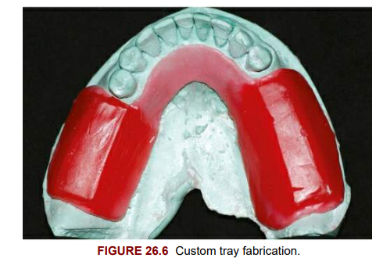
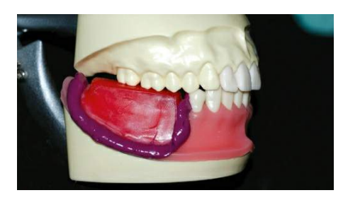
IMPRESSION PROCEDURES
PICK-UP IMPRESSIONS
1. MCLEAN’S TECHNIQUE
Custom tray is fabricated only for the distal extension base area with wax occlusal rims
• Functional impression is made of the residual ridges with zinc oxide eugenol impression paste or polyvinylsiloxane (PVS), by recording the impression with patient biting on the occlusal rims

Slide 16
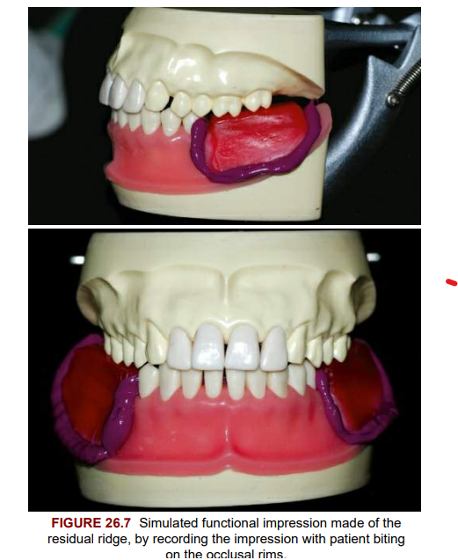
• After this impression has set, without removing the same, a second impression is made over the functional impression and the teeth, in a stock tray with alginate.
It is called as overimpression or
pick-up impression as the first impression
made with custom tray is contained in it.

Slide 17
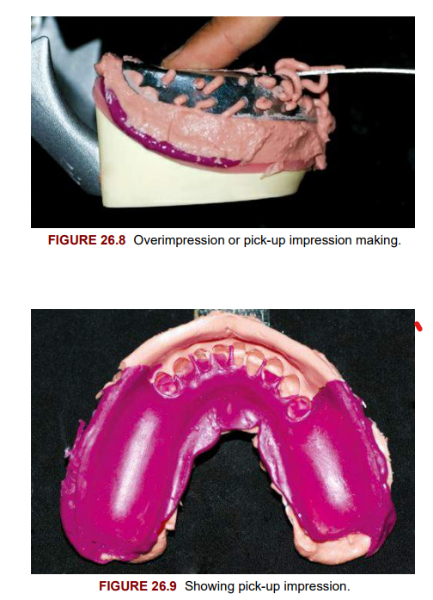
While making the overimpression, finger pressure is applied posteriorly to push the first impression down towards the ridge, to its functional biting position.
A master cast is poured after beading and boxing

Slide 18
Disadvantage:
Finger pressure on second impression will not produce the same amount of functional displacement of the tissue that biting forces produced in the first impression.
Hence compression of the tissues will not be the same and the functional impression will not be recorded as per the patient’s biting force.

Slide 19
2. HINDELS’ TECHNIQUE
Hindels and coworkers developed this technique to overcome the disadvantage of Mclean’s technique.
Hindels and coworkers developed stock trays with a large hole on either side posteriorly so that finger pressure could be directly applied to the first impression through the holes on the tray.

Slide 20
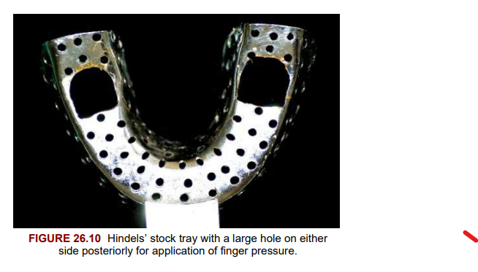
With the set anatomic impression in the mouth, the second overimpression was made in the specially designed stock tray with alginate, maintaining finger pressure till the material sets.
A master cast is poured after beading and boxing

Slide 21
Disadvantages of both Mclean’s and Hindels’ technique:
As tissues are recorded in compressed state, if clasp retention is good, even at rest position (when patient is not biting) the soft tissues are constantly displaced as the clasps will maintain the denture in this position. This will lead to interruption of blood supply to the ridges and bone resorption.
If clasp retention is not adequate, the denture will always remain slightly occlusal to the functionally recorded position. Hence the artificial teeth will first come into contact with the opposing teeth, when patient applies biting force. This will produces premature contacts which is uncomfortable to the patient.

Slide 22
FUNCTIONAL RELINE TECHNIQUE
This is done after fabrication of the metal framework and denture base. It consists of adding a new layer to the fitting or tissue surface of the denture base.
The procedure may be performed before the insertion of the partial denture, or it may be done at a later date to any cast partial denture, if because of bone resorption, the denture base no longer fits the ridge adequately and relining is necessary.

Slide 23
A cast partial denture is fabricated using an anatomic impression as described before.
To allow some space for the reline material, a layer of relief metal (ash metal), is added to the ridge area of the cast prior to packing the acrylic resin denture base material.
Space can also be provided by trimming the tissue surface of the denture base, but metal spacer provides a uniform thickness. After processing, the metal spacer is attached to the acrylic resin.

Slide 24
The partial denture is tried in the mouth and once the fit is confirmed, the metal spacer is removed and functional reline impression procedure carried out
Low-fusing green stick impression compound is flowed onto the tissue surface of denture base, tempered and placed in the patient’s mouth.
This procedure is performed several times along with border moulding so that an accurate impression of the ridge as compressed by the impression compound is obtained. The tissue surface of the low-fusing compound impression is trimmed uniformly by 1 mm and final impression is made with zinc oxide eugenol impression paste, fluid wax or medium body elastomeric impression materials

Slide 25
It is like making a primary impression with green stick compound and a final wash impression with the other materials. If fluid wax is used to produce a functional reline, green stick compound is eliminated and only wax is used for making the impressions.
The amount of soft tissue displacement can be controlled by the amount of relief given to the green stick compound before the final impression is made. The greater the relief, the less will be the tissue displacement

Slide 26
reline area is processed in heat cure denture base acrylic resin.
Disadvantages
Occlusion may be altered by reline procedure and needs adjustment.
A visible junction may be created between new acrylic and old denture base.
May be difficult to maintain correct position of framework on teeth during impression making

Slide 27
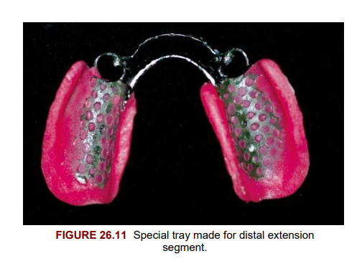
RIDGE CORRECTION TECHNIQUE USING FLUID WAX
This impression of the ridge is made after fabrication of the framework, but before denture base is processed.
Following fabrication of framework using an anatomic impression, special tray is made for the distal extension segment attached to the denture base major connector

Slide 28
Impression technique using fluid wax
Fluid wax: These are waxes that flow at mouth temperature and are firm at room temperature.
Frequently used are Iowa Wax – developed by Dr Smith and Korrecta Wax No. 4 – developed by Drs O.C. and S.G. Applegate.
Korrecta wax has more fluidity than Iowa wax. Tray extension is checked for any overextension by manipulating the border tissues. Wax in a container is placed in a water bath

Slide 29
The tray is placed in the mouth and border moulding is performed. At all times correct positioning of framework on teeth is ensured by finger pressure on the abutments. The wax is allowed to remain for 5 min with mouth half open.
Framework is removed and impression is dried and inspected. Areas in good functional contact with tissues will appear glossy, while insufficient contact will be dull.

Slide 30
Wrinkled areas indicate insufficient time for wax to flow, and areas of tray exposure need to be relieved. After all the corrections are made and impression shows complete tissue contact, the prosthesis is reinserted and left in the mouth for 12 min to ensure that wax has completely flowed and released any internal strains.

Slide 31
The final cast is poured using the altered cast technique.
The procedure can also be performed by using low-fusing green stick compound for border moulding and making final impression with zinc oxide eugenol impression pastes and medium body elastomeric impression materials. The amount of tissue compression depends on the thickness of spacer provided and viscosity of impression material

Slide 32
Selective pressure impressions
This technique directs forces to areas of ridge capable of withstanding stress and protects areas of ridge unable to absorb stress by relieving them.
As discussed earlier, only mandibular distal extension ridges require functional impressions. The buccal shelf area is the primary stress-bearing area, but the crest of the ridge is not a stress-bearing area and hence needs to be relieved

Slide 33
This procedure is similar to the ridge correction technique described previously, except for the spacer provided for the special tray. In this technique no spacer is provided and a close fitting special tray is fabricated on the distal extension ridge on the denture base minor connector.
The tissue surface of the tray is relieved in the ridge crest area by trimming the tray by 1 mm.

Slide 34
The buccal shelf area of special tray is trimmed very slightly so direct contact will be maintained and more pressure can be transferred here.
The lingual slope of ridge should be trimmed similar to buccal shelf as it may offer some support. If the soft tissue covering the ridge is very soft and displaceable, relief holes may be made in the special tray to dissipate the pressure even more

Slide 35
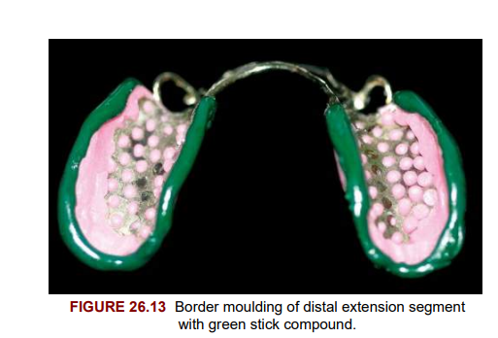
After border moulding with low-fusing green stick compound, final impression can be made with a free flowing impression material like zinc oxide eugenol impression paste. This is the material of choice when residual ridge is free from undercuts and when soft, flabby tissue is involved.

Slide 36
Altered cast technique
For the functional reline, ridge correction and selective pressure impressions, an altered cast technique is desirable.
This involves altering only the distal extension part of the master cast after a functional impression is made of the residual ridges.

Slide 37
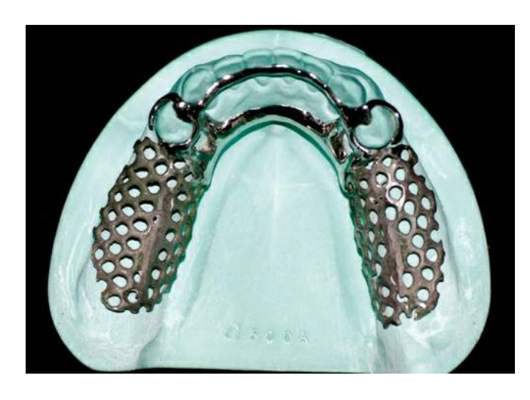
As discussed previously, the framework is fabricated on an anatomic impression in a refractory cast duplicated from the first master cast.
The framework fitted to the master cast is sent to the dentist by the laboratory

Slide 38
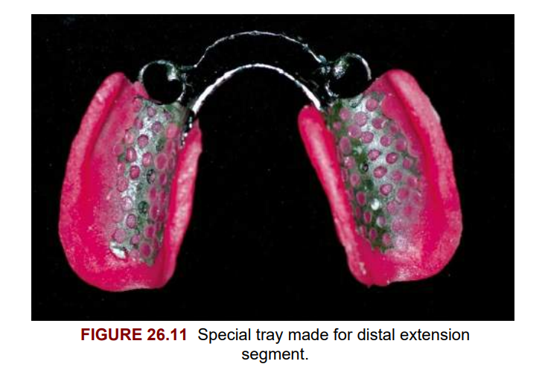
A special tray is made for the distal extension segment attached to the denture base major connector.
A functional impression is then made of the ridge area. The master cast is then altered to accommodate the functional impression as follows

Slide 39
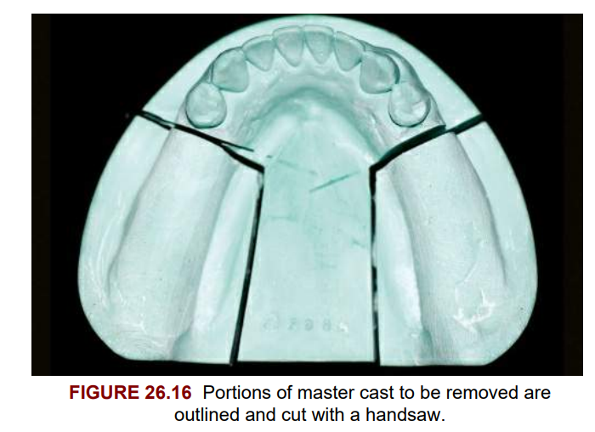
The area to be altered is outlined on the master cast. It consists of two lines one buccolingual and other anteroposterior along each distal extension ridge

Slide 40
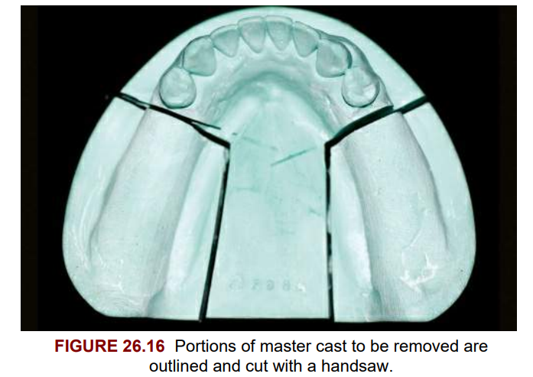
The buccolingual line is made 1 mm posterior to the distal abutment at right angles to the long axis of the ridge. The anteroposterior line is drawn at right angles to the first, just lingual and parallel to the lingual sulcus. The outlined area is cut and removed with a handsaw

Slide 41
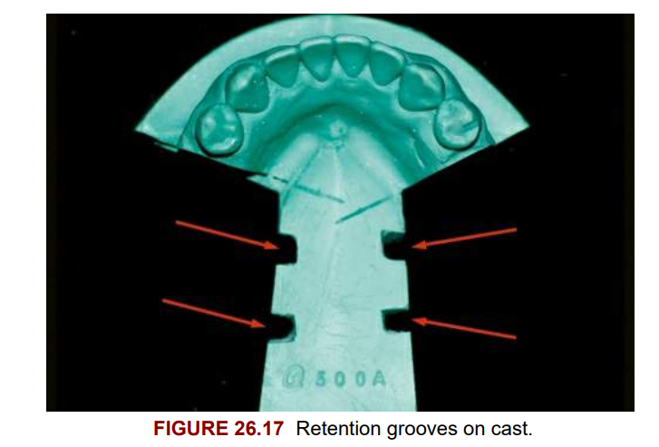
Longitudinal retention grooves are made on the cut surface of the cast to provide mechanical retention for the attachment of new stone to the old

Slide 42
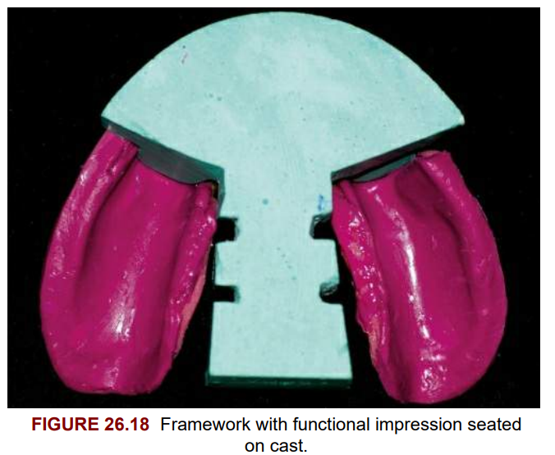
The framework with the functional impression is placed on sectioned master cast. Impression must not have any contact on the cast.

Slide 43
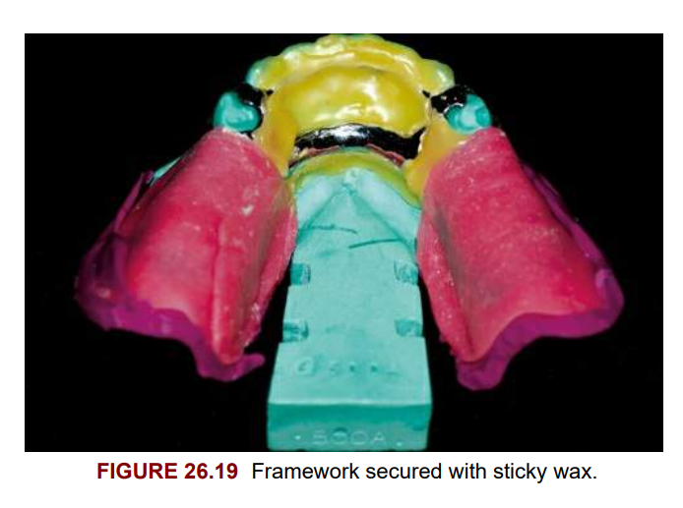
The framework is secured firmly to the cast with sticky wax after ensuring correct position of all components on the cast

Slide 44
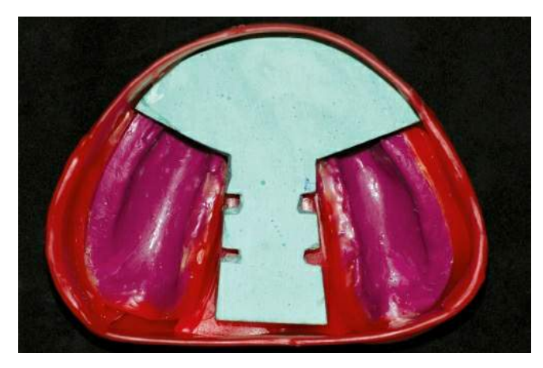
The impression area is beaded with utility wax and boxed with boxing wax. The cast is immersed in slurry water for 10 min to provide saturation of dry stone

Slide 45
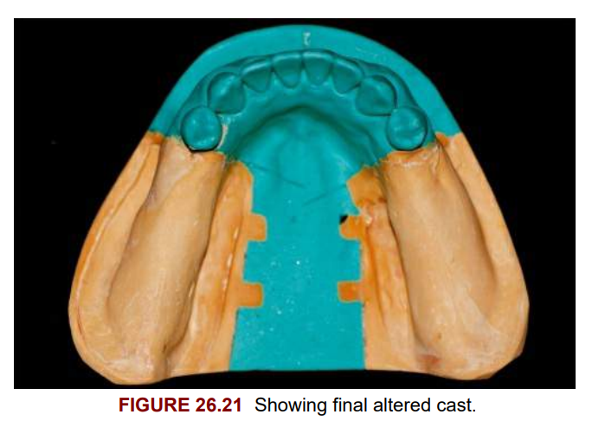
The functional impression is poured with low-expansion dental stone without much of vibration so that the framework is not disturbed. After final set, cast is trimmed and is ready for completion of the denture base part of the cast partial denture

