Slide 1
Gingival Enlargement

Slide 2
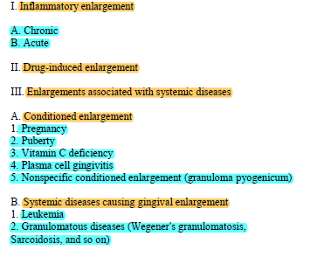
and conditions

Slide 3
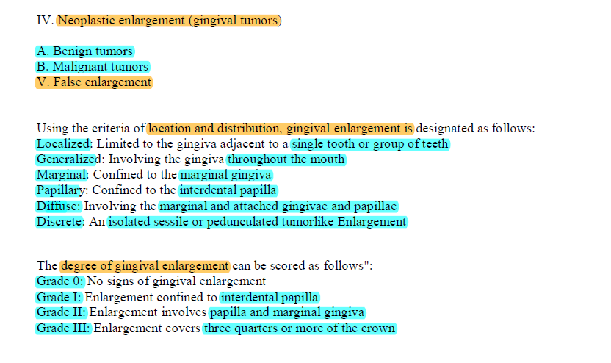

Slide 4
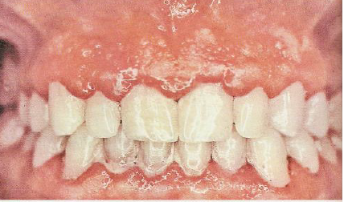
Chronic Inflammatory Enlargement
prolonged exposure to dental plaque
Slight ballooning of the interdental papilla and/or the marginal gingiva.
Enlargement may be localized or generalized and progresses slowly and painlessly, unless it is complicated by acute infection or trauma
Enlargement occurs as a discrete sessile or pedunculated mass
TREATMENT
Primarily self-administered plaque control.
Then Scaling and root planning.

Slide 5
Gingival Changes Associated with Mouth Breathing.
The gingiva appears red and edematous with a diffuse surface shininess of the exposed area.
The maxillary anterior region is the common site of such involvement.
Gingiva is clearly demarcated from the adjacent unexposed normal gingiva

Slide 6
Acute Inflammatory Enlargement Gingival Abscess.
localized, painful, rapidly expanding lesion sudden onset.
limited to the marginal gingiva or interdental papilla.
red swelling with a smooth, shiny surface. Within 24 to 48 hours, the lesion usually becomes fluctuant and pointed with a surface orifice from which a purulent exudate may be expressed.
The adjacent teeth are often sensitive to percussion. If permitted to progress, the lesion generally ruptures spontaneously.
when a foreign substance such as a toothbrush bristle, a piece of apple core, or a lobster shell fragment is forcefully embedded into the gingiva.
The lesion is confined to the gingiva and should not be confused with periodontal or lateral abscesses.
Periodontal (Lateral) Abscess. Periodontal abscesses generally produce enlargement of the gingiva, but they also involve the supporting periodontal tissues

Slide 7
Periodontal abscess:
Localized purulent inflammation in the periodontal tissue
Periodontal pocket present
It is also known as lateral and parietal abscess.

Slide 8
Treatment
under topical and anaesthesia , incision and drainage ofabscess
Area is cleansed with warm water and covered with a gauze pad
. After bleeding stops, the patient is dismissed for 24 hours and instructed to rinse every 2 hours with a glassful of warm water .
If the residual size of the lesion is too great , it is removed surgically.

Slide 9
Drug-induced gingival enlargement
Anticonvulsants,
Immunosuppressants
Calcium channel blockers
General Information Clinical Features
The growth starts as a
Painless
bead like enlargement of the interdental papilla and extends to the facial and lingual gingival margins .
When uncomplicated by inflammation, the lesion is mulberry shaped
firm
pale pink
and resilient, with a minutely lobulated surface
no tendency to bleed.

Slide 10
The enlargement is usually generalized throughout the mouth but is more severe in the maxillary and mandibular anterior regions.
It occurs in areas in which teeth are present, not in edentulous spaces, and the enlargement disappears in areas from which teeth are extracted.

Slide 11
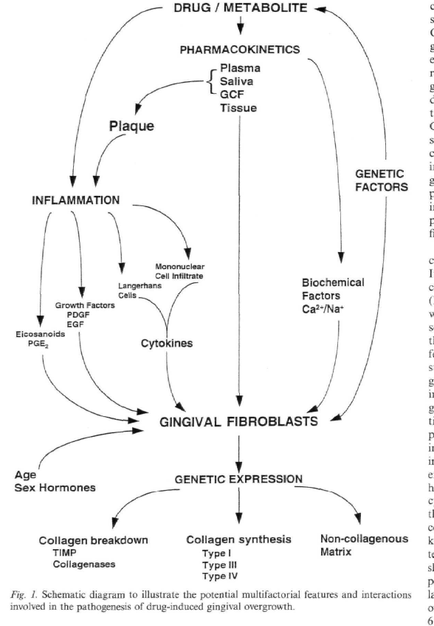

Slide 12
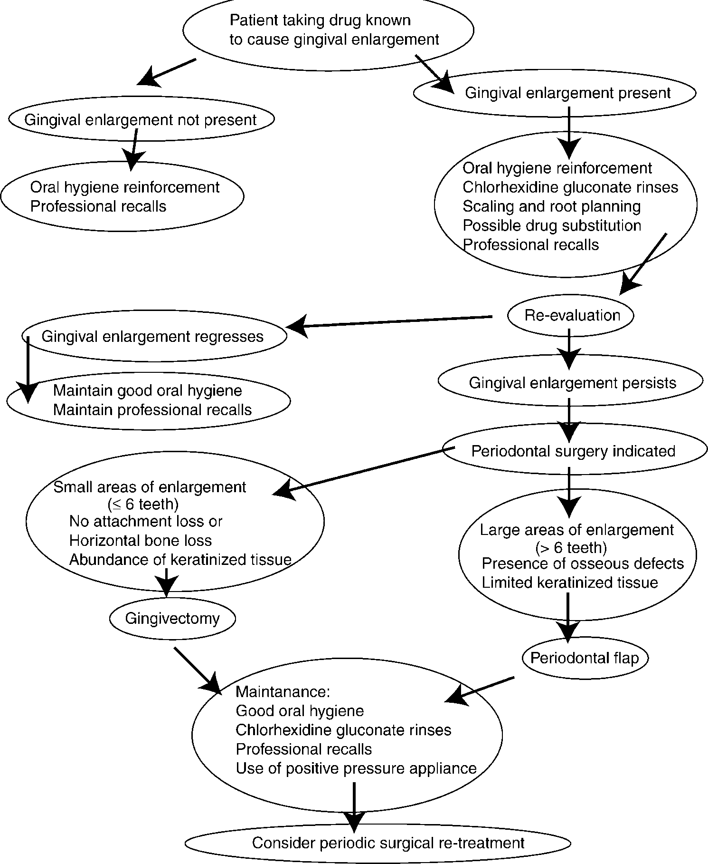

Slide 13
ENLARGEMENTS ASSOCIATED WITH SYSTEMIC DISEASES
LEUKEMIA
Diffuse or marginal
localized or generalized.
Bluish red and has a shiny surfacea
The consistency is moderately firm, but there is a tendency toward friability and hemorrhage
take a proper and detailed medical history
hematooncologist is consulted
Before chemotherapy laboratory investigation should be done , and administer antibiotic coverage before any periodontal treatment because infection is a major concern
WEGENER’S GRANULOMATOSIS
papillary enlargement
reddish purple
bleeds easily on stimulation

Slide 14
Enlargements associated with systemic conditions
PREGNANCY/PREGNANCY TUMOR
Is an inflammatory response to bacterial plaque
Modified by the patient's condition
Usually appears after the third month of pregnancy
Appears as a discrete, mushroom like, flattened spherical mass
Protrudes from the gingival margin or more commonly from the interproximal space
Sessile or pedunculated
Dusky red or magenta
Surface exhibits numerous deep red, pinpoint markings
Painless unless painful ulceration occurs

Slide 15
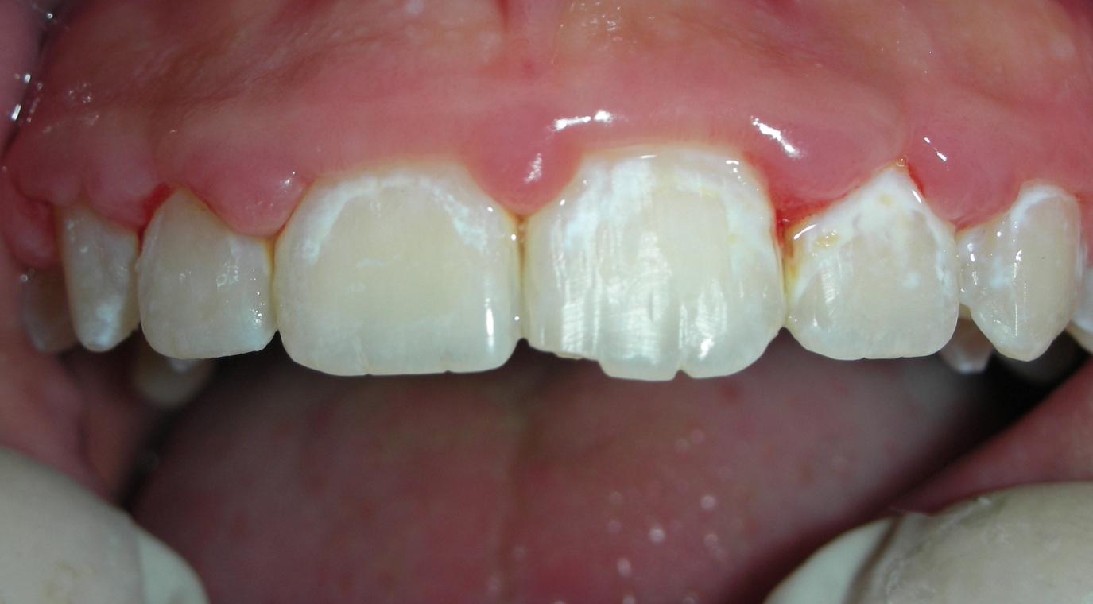
PUBERTY
Bulbous inter- proximal papillae
VIT C
  Gingiva is bluish red
Soft, and friable
Smooth, shiny surface
Hemorrhage, occurring either spontaneously or on slight provocation
Surface necrosis with pseudo membrane formation

Slide 16
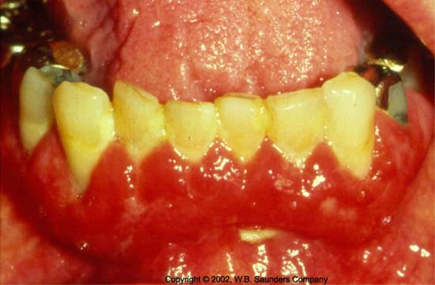
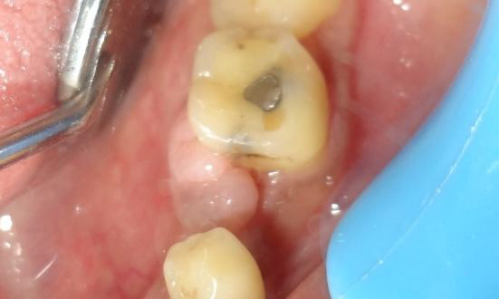
PYOGENIC GRANULOMA
PLASMA CELL GINGIVITIS
Discrete
spherical, tumorlike mass
If pedunculated it is attachment to a flattened, keloid like enlargement /with a broad base.
bright red or purple
friable or firm
Gingiva appears red, friable
granular and bleeds easily
Located in the oral aspect of the attached gingiva and therefore differs from plaque-induced gingivitis

Slide 17
Underlying Osseous Lesions
FALSE ENLARGEMENT
Underlying Dental Tissues
NEOPLASTIC ENLARGEMENT (GINGIVAL TUMORS)
Benign Tumors of the Gingiva
Malignant Tumors of the Gingiva
Fibroma.
Carcinoma
Peripheral Giant Cell Granuloma
Malignant Melanoma
Central Giant Cell Granuloma.
Sarcoma.
Leukoplakia.
Metastasis
Gingival Cyst

